Slide 1
Digital Twin Dual-Loop Control Framework
Physics-based weekly cooling optimization for data centers
EnergyPlus 9.5 digital twin · heuristic planner · expert-supervised deployment
3rd-draft progress report
June 2026

Slide 2
The problem & the goal
Why this project
• Cooling is one of the largest energy costs in a data center; operators run conservative, fixed setpoints to stay safe — which wastes energy.
• Goal: recommend, each week, the cooling setpoints that MINIMIZE energy…
– …while NEVER letting any server's inlet air exceed the 26 °C safety limit.
• Approach: a physics-based digital twin + a heuristic planner + an expert-supervised web app for deployment.
• Three design commitments:
– Physics-based (first-principles EnergyPlus model — not a black box / surrogate).
– Safe-by-construction (a hard temperature constraint, enforced three ways).
– Architected to connect to a real data center (a single, well-defined deployment seam).

Slide 3
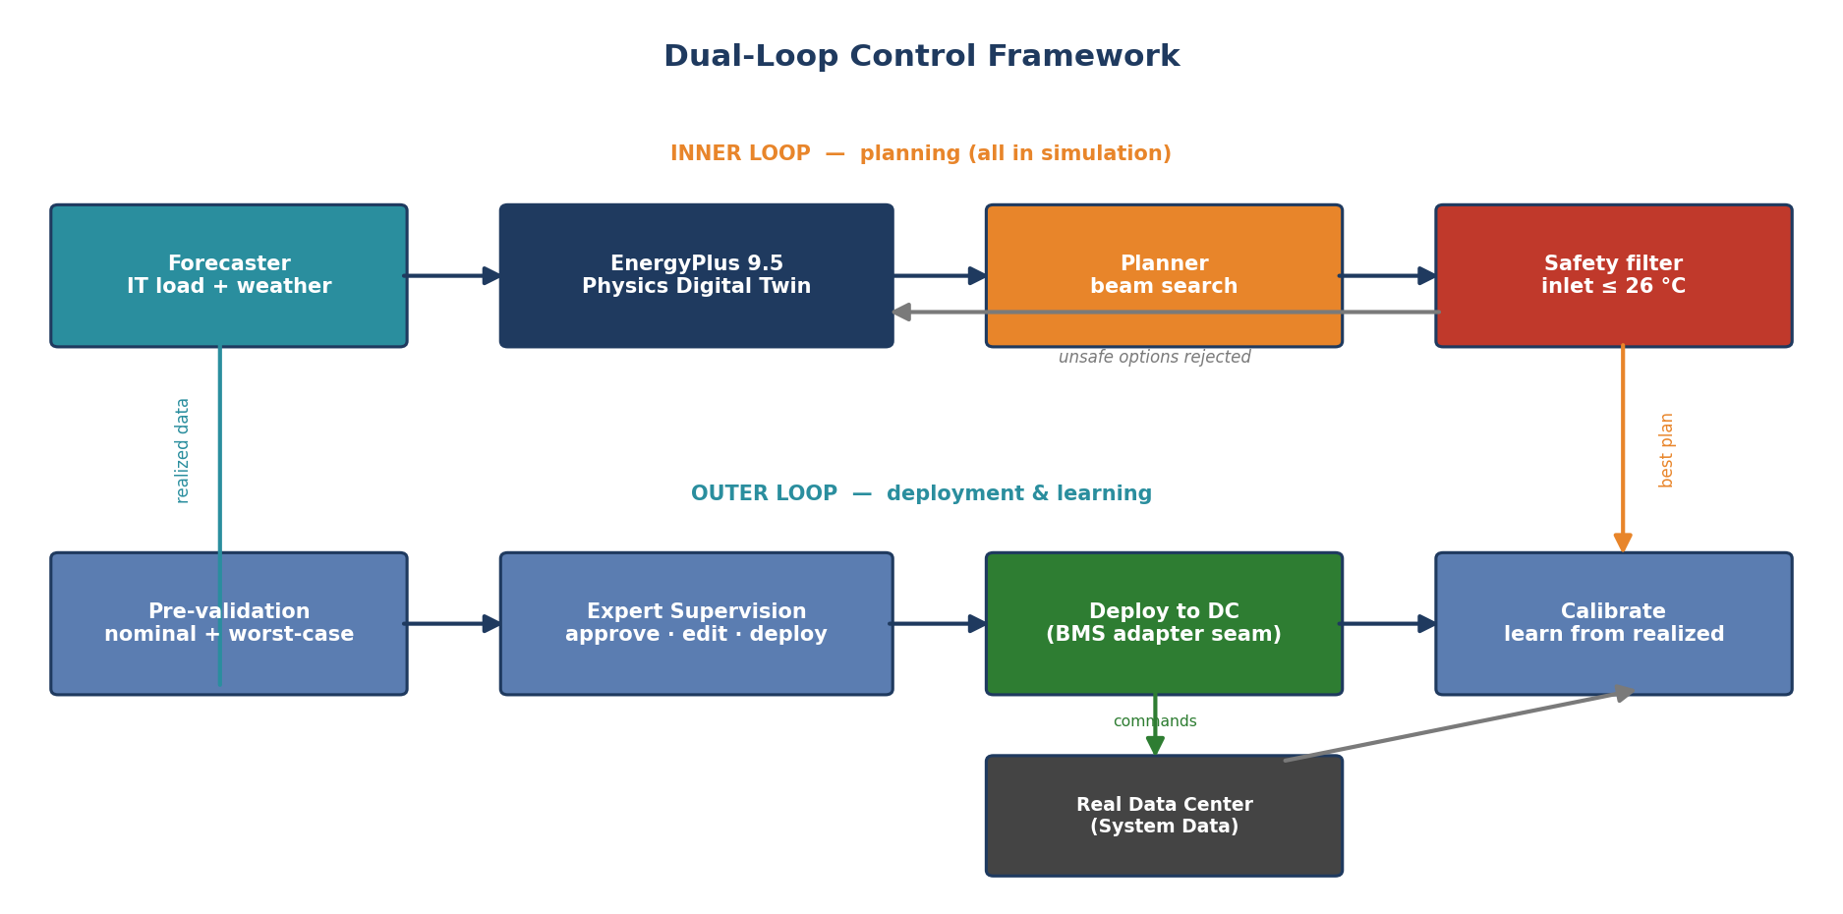
How it works: the dual loop
Architecture
Inner loop searches safe setpoints in simulation; outer loop validates, deploys (via the BMS seam), and learns from realized data.

Slide 4
A physics-based digital twin
Physical fidelity
• The twin is EnergyPlus 9.5 — the industry-standard building-physics engine — run live in Docker and coupled step-by-step to the planner (BCVTB).
• First-principles, not a black box:
– Real building geometry + HVAC: chilled-water plant, air handlers, airflow, heat transfer.
– Predicts per-rack inlet temperatures, zone temperatures, humidity, and power.
• Three global setpoints the planner controls:
– CRAH supply-air temperature (20–26 °C) · airflow (4.8–13.8 kg/s) · chilled-water temp (13–19 °C).
– Automatically broadcast to 45 individual actuators in the controlled hall.
• Every candidate plan is scored by a FULL-WEEK EnergyPlus simulation (parallelized across CPU processes).

Slide 5
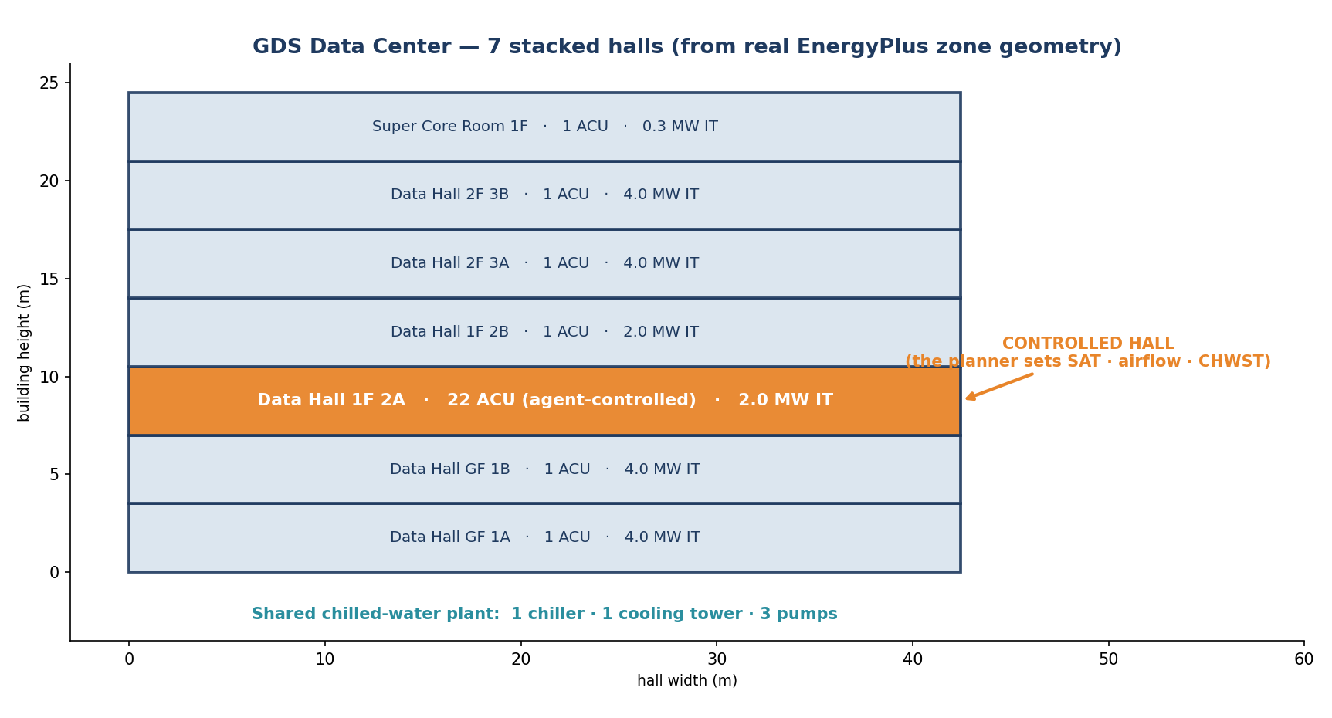
Data center topology — the building
Physical model
Reconstructed from the real EnergyPlus zone geometry: 7 stacked halls; the planner controls hall 1F 2A; all halls share one chilled-water plant.

Slide 6
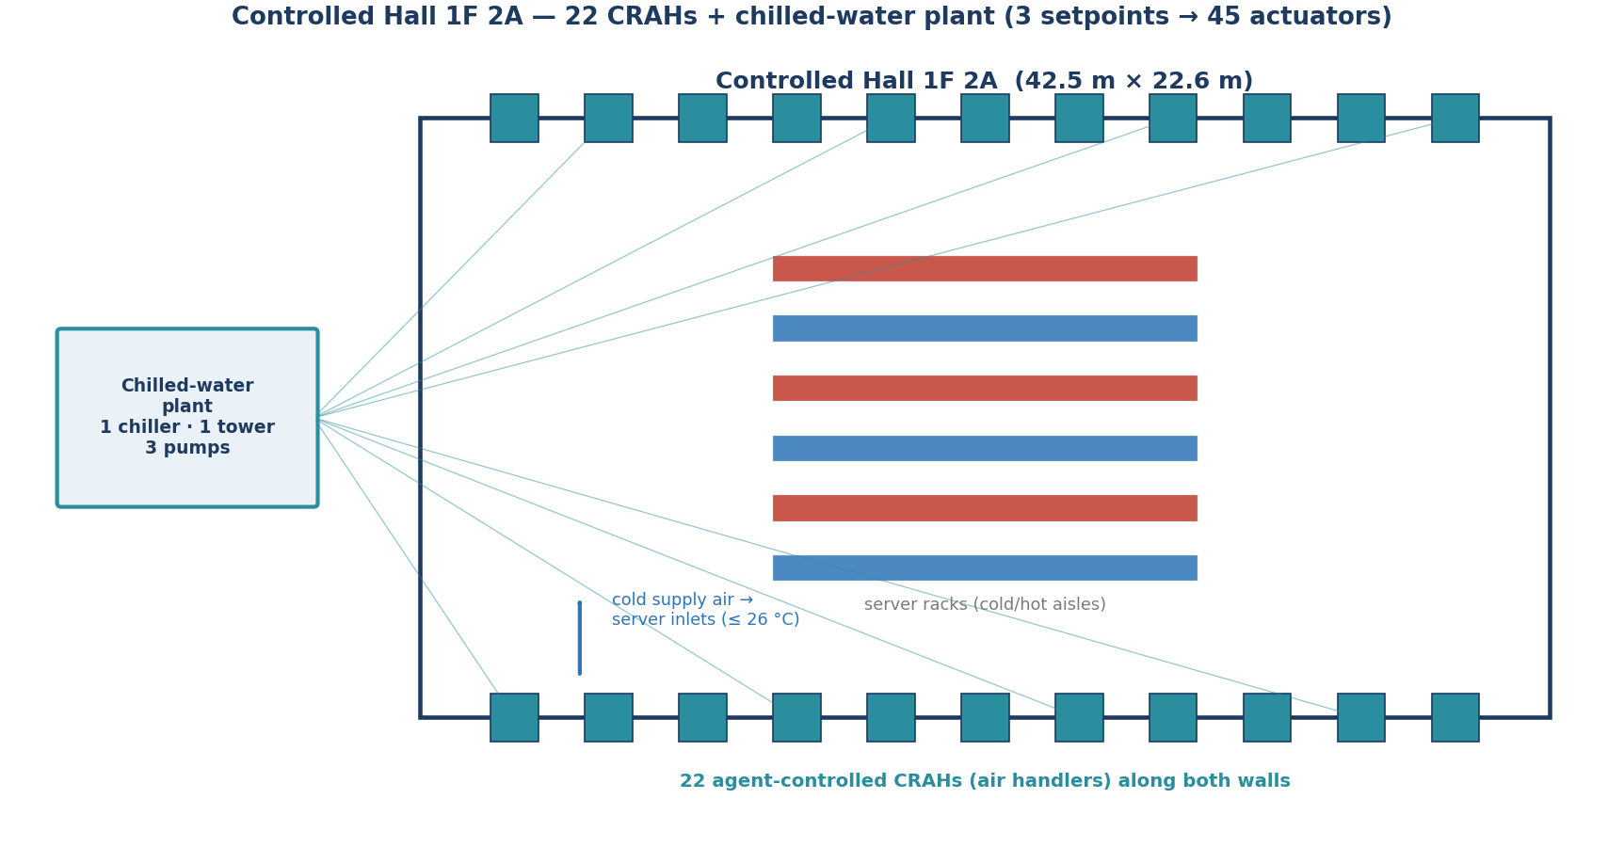
Data center topology — the controlled hall
Physical model
Hall 1F 2A: 22 agent-controlled CRAHs along the walls push cold air to the server inlets; the chilled-water plant feeds the coils. Inlet temp is the safety-critical signal.

Slide 7
The planner & safety nets
Optimization under a hard constraint
• Coarse-to-fine beam search over the 3 setpoints — lay a grid, keep the best few, zoom in, repeat.
• Objective = minimize cooling energy + small comfort penalties (temperature, humidity).
• Hard safety constraint: any week with a single step above 26 °C inlet is rejected outright.
• Three independent safety nets:
– Hard cap during search (feasibility gate).
– Robust re-check: re-simulate finalists on degraded 'weaker-than-expected plant' scenarios; keep only those safe in the worst case.
– Deploy backstop: a breach on the deployed week is flagged 'deploy-blocked', never 'deployed'.
• Optional day/night scheduling: different setpoints for day vs. night.

Slide 8
The operator's cockpit (web app)
Expert supervision
• Full-stack web app (FastAPI + React) — single sign-on with operator vs. expert roles.
• Six pages:
– New Plan — set the week + search settings, watch the search progress LIVE (streaming).
– Review — recommended setpoints, energy vs. an as-operated baseline, inlet-temperature safety trajectory.
– Digital Twin 3-D — interactive 3-D view of the hall with airflow.
– History / Dashboard — trends of predicted vs. realized energy across weeks.
• Expert workflow: approve · reject · edit setpoints · deploy — with the safety gate enforced (unsafe plans cannot be force-approved).

Slide 9
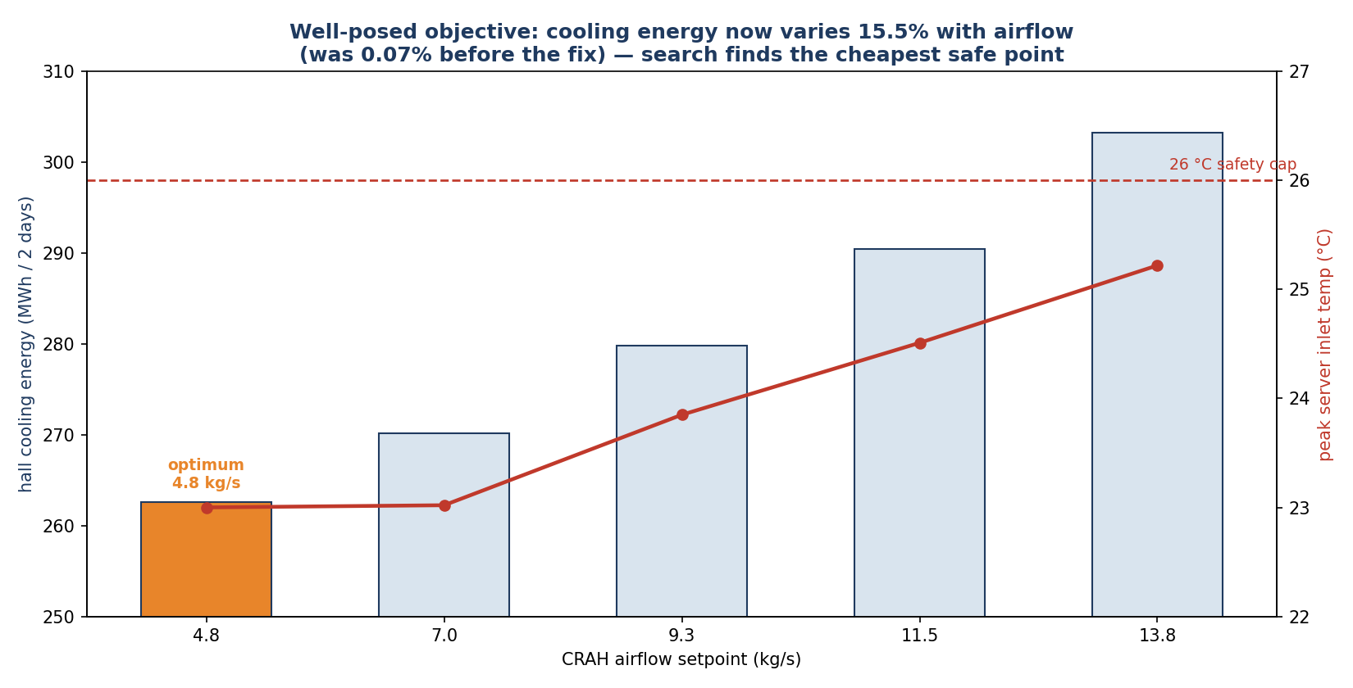
Result: the recommendations are physically well-posed
Validation
Verified with real EnergyPlus: cooling energy responds strongly + monotonically to airflow; the search picks the cheapest point that stays under the 26 °C cap.

Slide 10
Status after the 3rd draft
What is built
• BUILT & TESTED (✓): forecaster · EnergyPlus twin · beam-search planner · 3 safety nets · pre-validation · expert approve/edit/deploy workflow · 6-page web app.
– 287 Python unit tests + 78 frontend tests pass; 8 Docker integration tests exercise the real EnergyPlus loop end-to-end.
• PARTIAL (◐): weather uses a fixed historical file (not forecast) · live telemetry monitoring · active humidity control · physics re-calibration.
• NOT YET (○): the connection to a real data center — today 'deploy' runs against a perturbed simulation, by design for this stage.
• Honest fidelity caveats: deployment is simulation-to-simulation; the recirculation parameter is currently inert (safety margin is conservative/optimistic); numbers are directionally sound, not yet field-calibrated.

Slide 11
Ready to connect to a real data center
The path to closed-loop
• The deployment path is a single, well-defined seam: BmsAdapter.apply(setpoints, week).
• Everything downstream of that seam is already built and tested:
– expert approval gate · realized-KPI capture · automatic calibration ingest · deploy-blocked safety backstop.
• Connect-up work (well-scoped):
– 1) Implement the BMS adapter (BACnet / Modbus / vendor API) — start in shadow mode (recommend-only, no actuation).
– 2) Ingest live telemetry (inlet temps, power, humidity) into the calibration loop + a live monitoring dashboard.
– 3) Validate predicted vs. truly realized for several weeks, THEN enable closed-loop actuation.
• Design choices that make this clean: physics-based twin (transfers to the real site), strict separation of 'recommend' vs. 'actuate', and a calibration loop already built to absorb real data.

Slide 12
Roadmap
Next steps, in priority order
• Tier A — Close the loop to reality (highest impact):
– BMS adapter (shadow mode first) · real telemetry ingest · live monitoring + alerts dashboard.
• Tier B — Raise twin fidelity:
– Fix the recirculation physics, then calibrate to measured rack inlets · activate physics re-calibration · per-rack drill-down.
• Tier C — Smarter planning:
– Weather forecasting + uncertainty · carbon / time-of-use-tariff-aware objective.
• Tier D — Operator experience & assurance:
– Mid-week override UI · failure explainability · end-to-end tests · a recommend-only shadow pilot.

Slide 13
Summary
Where the 3rd draft stands
• A physics-based digital twin (EnergyPlus) + a heuristic planner + an expert-supervised web app — validated end-to-end in simulation.
• Safe-by-construction: a hard 26 °C inlet limit enforced by three independent nets.
• Recommendations are physically well-posed and directionally sound (e.g. +3.2% energy saving with zero violations); not yet field-calibrated.
• Architected and ready to connect to a real data center through one adapter seam — shadow mode first, then closed loop.
• Next: connect telemetry + BMS, raise fidelity (recirculation calibration), and run a shadow pilot.

