Slide 1
Chapter 4:
Networking and the Internet

Slide 2
Chapter 4: Networking and the Internet
4.1 Network Fundamentals
4.2 The Internet
4.3 The World Wide Web
4.4 Internet Protocols
4.5 Security
4-<number>

Slide 3
Network Classifications
Scope
  Personal area network (PAN)
  Local area network (LAN)
  Metropolitan area network(MAN)
  Wide area network (WAN)
Ownership
  Closed versus open
Topology (configuration)
  Bus (Ethernet)
  Star (Wireless networks with central Access Point)
4-<number>

Slide 4
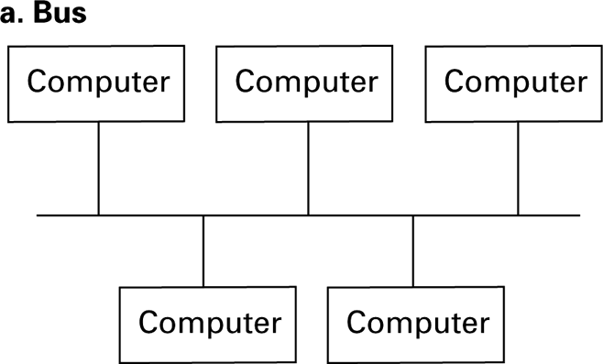
Figure 4.1 Network topologies
4-<number>

Slide 5
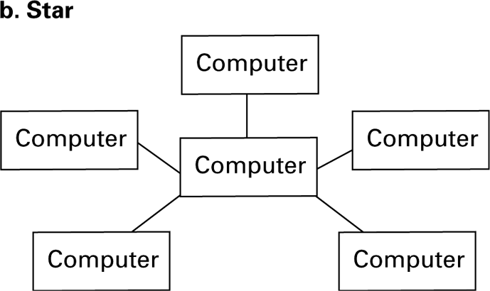
Figure 4.1 Network topologies (continued)
4-<number>

Slide 6
Protocols
CSMA/CD (Carrier-sense multiple access with collision detection)
  Used in Ethernet
  Silent bus provides right to introduce new message
CSMA/CA (Carrier-sense multiple access with collision avoidance)
  Used in WiFi
  Hidden terminal problem
4-<number>

Slide 7
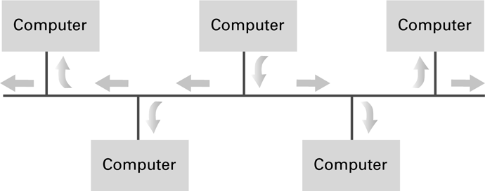
Figure 4.2 Communication over a bus network
4-<number>

Slide 8
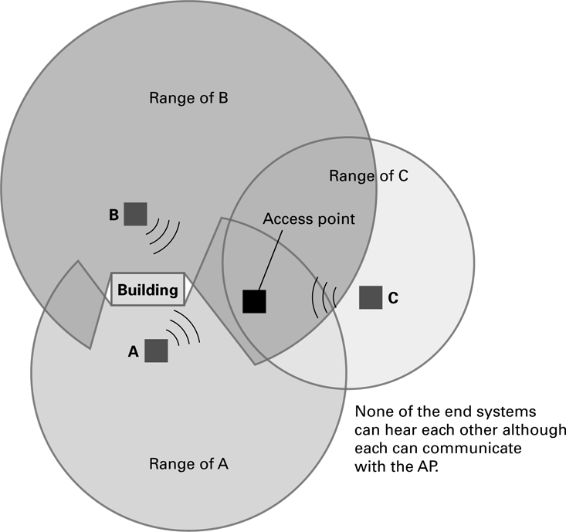
Figure 4.3 The hidden terminal problem
4-<number>

Slide 9
Connecting Networks
Repeater: Extends a network
Bridge: Connects two compatible networks
Switch: Connects several compatible networks
Router: Connects two incompatible networks
resulting in a network of networks called an
internet
4-<number>

Slide 10
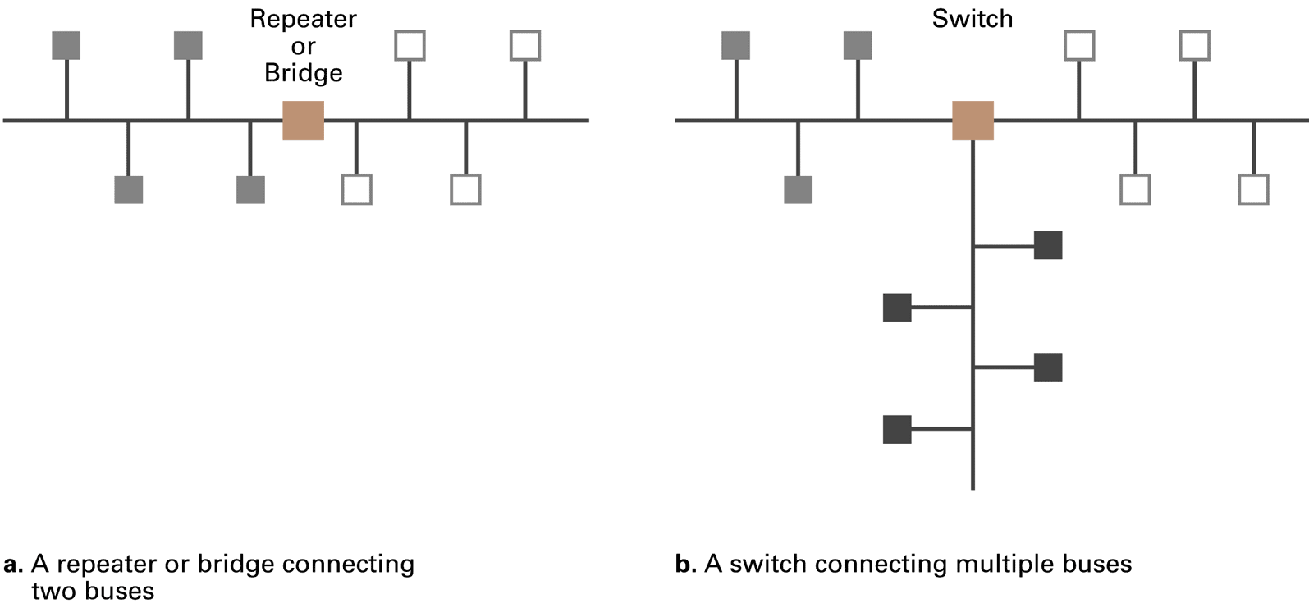
Figure 4.4 Building a large bus network from smaller ones
4-<number>

Slide 11
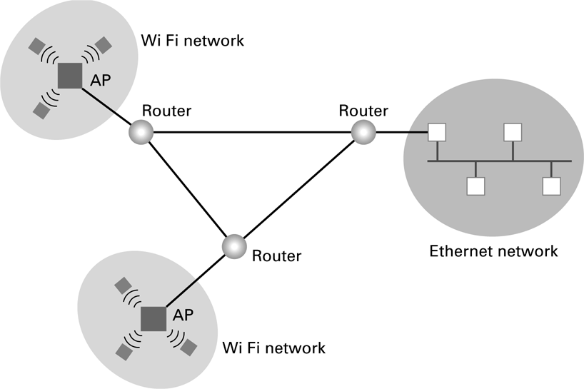
Figure 4.5 Routers connecting two WiFi networks and an Ethernet network to form an internet
4-<number>

Slide 12
Inter-process Communication
Client-server
  One server, many clients
  Server must execute continuously
  Client initiates communication
Peer-to-peer (P2P)
  Two processes communicating as equals
  Peer processes can be short-lived
4-<number>

Slide 13
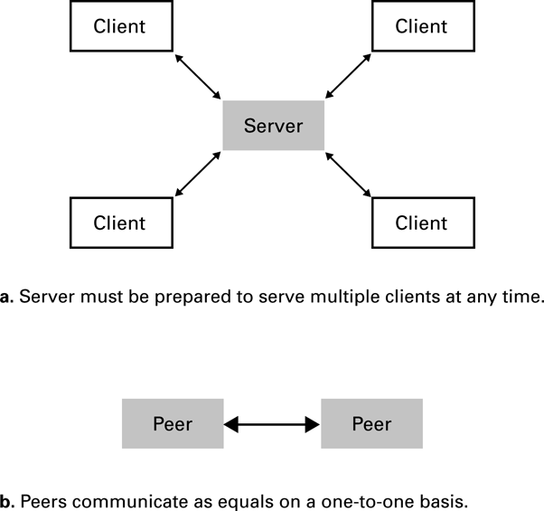
Figure 4.6 The client/server model compared to the peer-to-peer model
4-<number>

Slide 14
Distributed Systems
Systems with parts that run on different computers
  Cluster computing
  Grid computing
  Cloud computing
    Amazon’s Elastic Compute Cloud
    Google Drive
4-<number>

Slide 15
The Internet
The Internet: An internet that spans the world
  Original goal was to develop a means of connecting networks that would not be disrupted by local disasters
  Today a commercial undertaking that links a worldwide combination of PANs, LANs, MANs, and WANs involving millions of computers
4-<number>

Slide 16
Internet Architecture
Internet Service Provider (ISP)
  Tier-1: Reach every other network
  Tier-2: Peering with other networks
Access or tier-3 ISP: Provides connectivity to the Internet
  Hot spot (wireless)
  Telephone lines
  Cable/Satellite systems DSL
  Fiber optics
4-<number>

Slide 17
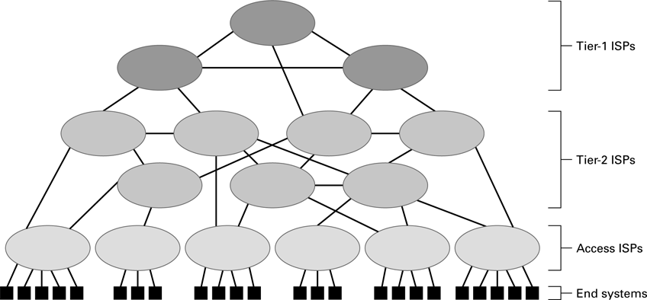
Figure 4.7 Internet Composition
4-<number>

Slide 18
Internet Addressing
IP address: pattern of 32 or 128 bits often represented in dotted decimal notation
Mnemonic address:
  Domain names
  Top-Level Domains
Domain name system (DNS)
  Name servers
  DNS lookup
4-<number>

Slide 19
Internet Corporation for Assigned Names & Numbers (ICANN)
Allocates IP addresses to ISPs who then assign those addresses within their regions.
Oversees the registration of domains and domain names.
4-<number>

Slide 20
Early Internet Applications
Network News Transfer Protocol (NNTP)
File Transfer Protocol (FTP)
Telnet and SSH (Secure Shell)
Hypertext Transfer Protocol (HTTP)
Electronic Mail (email)
  Domain mail server collects incoming mail and transmits outing mail
  Mail server delivers collected incoming mail to clients via POP3 or IMAP
4-<number>

Slide 21
SMTP Simple Mail Transfer Protocol
220 mail.tardis.edu SMTP Sendmail Gallifrey-1.0; Fri, 23 Aug 2413 14:34:10
HELO mail.skaro.gov
250 mail.tardis.edu Hello mail.skaro.gov, pleased to meet you
MAIL From: dalek@skaro.gov
250 2.1.0 dalek@skaro.gov... Sender ok
RCPT To: doctor@tardis.edu
250 2.1.5 doctor@tardis.edu... Recipient ok
DATA
354 Enter mail, end with "." on a line by itself
Subject: Extermination.
EXTERMINATE!
Regards, Dalek
.
250 2.0.0 r7NJYAEl028071 Message accepted for delivery
QUIT
221 2.0.0 mail.tardis.edu closing connection
4-<number>

Slide 22
More Recent Applications
Voice Over IP (VoIP)
Internet Multimedia Streaming
  N-unicast
  Multicast
  On-demand streaming
  Content delivery networks (CDNs)
4-<number>

Slide 23
World Wide Web
Hypertext combines internet technology with concept of linked-documents
  Embeds hyperlinks to other documents
Browsers present materials to the user
Webservers provide access to documents
Documents are identified by URLs and transferred using HTTP
4-<number>

Slide 24
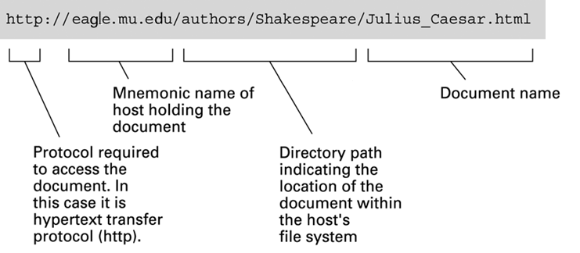
Figure 4.8 A typical URL
4-<number>

Slide 25
Hypertext Markup Language (HTML)
Encoded as text file
Contains tags to communicate with browser
  Appearance
    <h1> to start a level one heading
    <p> to start a new paragraph
  Links to other documents and content
    <a href = . . . >
  Insert images
    <img src = . . . >
4-<number>

Slide 26
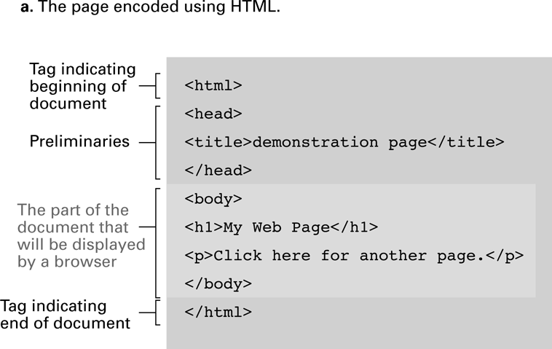
Figure 4.9 A simple webpage
4-<number>

Slide 27
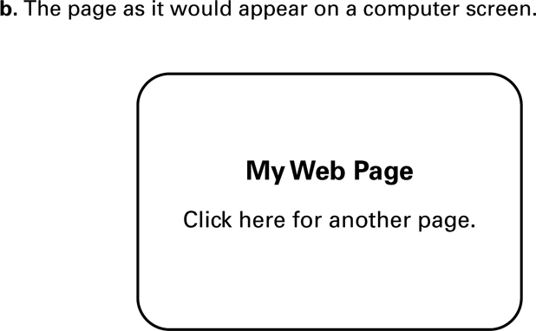
Figure 4.9 A simple webpage (continued)
4-<number>

Slide 28
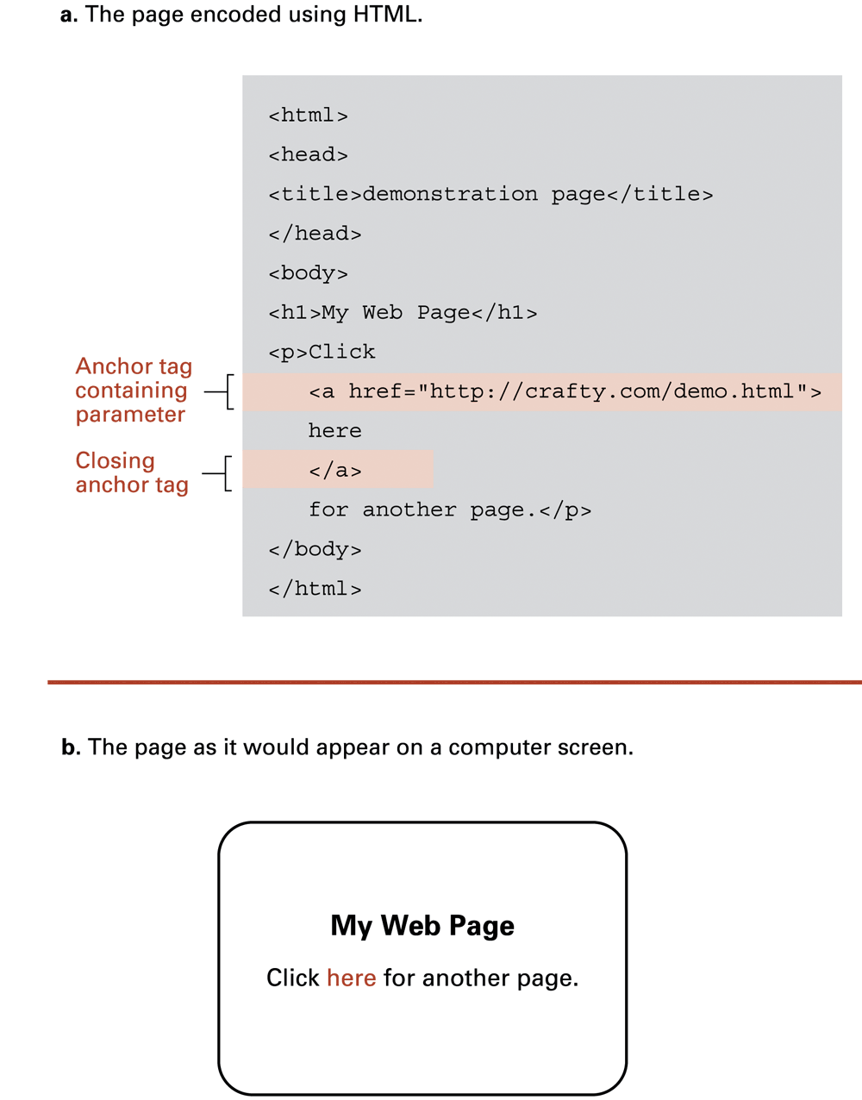
Figure 4.10 An enhanced simple webpage
4-<number>

Slide 29
Figure 4.10 An enhanced simple Web page (continued)
4-<number>

Slide 30
Extensible Markup Language (XML)
XML: A language for constructing markup languages similar to HTML
  A descendant of SGML (Standard Generalized Markup Language, for example HTML)
  Opens door to a World Wide Semantic Web
4-<number>

Slide 31
Using XML
<staff clef = “treble”> <key>C minor</key>
<time> 2/4 </time>
<measure> < rest> egth </rest> <notes> egth G, egth G, egth G </notes></measure>
<measure> <notes> hlf E </notes></measure>
</staff>
4-<number>

Slide 32
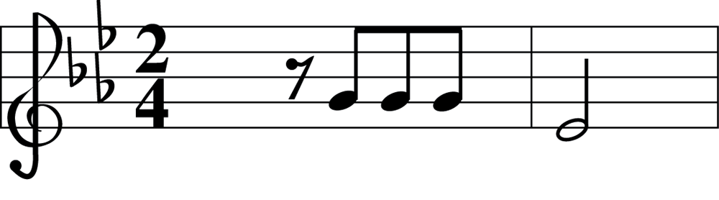
Figure 4.11 The first two bars of Beethoven’s Fifth Symphony
4-<number>

Slide 33
Client Side Versus Server Side
Client-side activities
  Javascript
  Macromedia Flash (Adobe Flash)
Server-side activities
  Common Gateway Interface (CGI)
  Servlets
  JavaServer Pages (JSP) / Active Server Pages (ASP)
  PHP
4-<number>

Slide 34
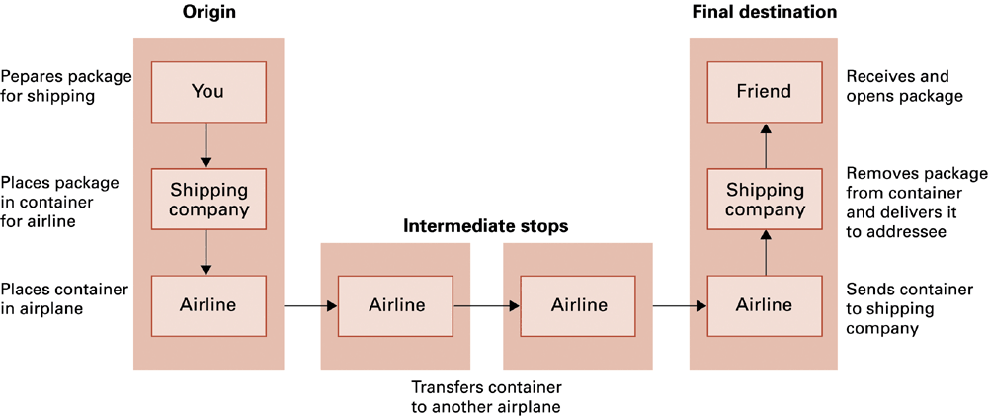
Figure 4.12 Package-shipping example
4-<number>

Slide 35
Internet Software Layers
Application: Constructs message with
address
Transport: Chops message into packets
Network: Handles routing through the
Internet
Link: Handles actual transmission of
packets
4-<number>

Slide 36
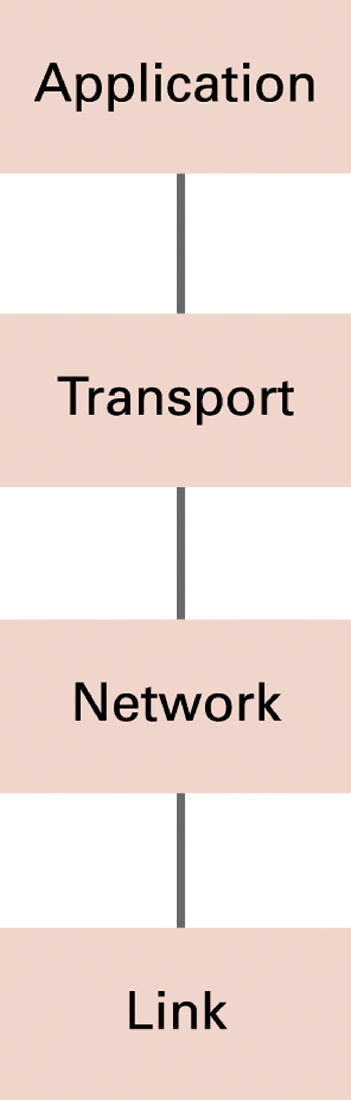
Figure 4.13 The Internet software layers
4-<number>

Slide 37
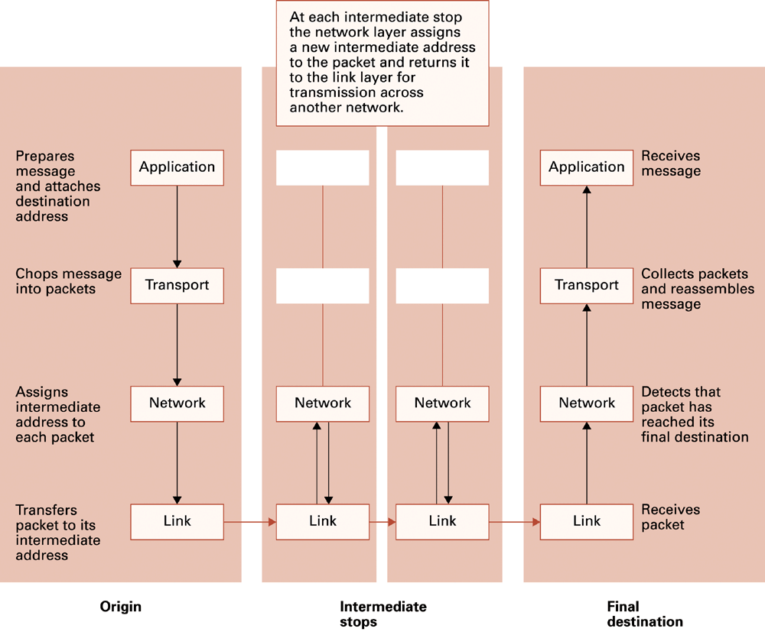
Figure 4.14 Following a message through the Internet
4-<number>

Slide 38
TCP/IP Protocol Suite
Transport Layer
  Transmission Control Protocol (TCP)
  User Datagram Protocol (UDP)
Network Layer
  Internet Protocol (IP)
    IPv4
    IPv6
4-<number>

Slide 39
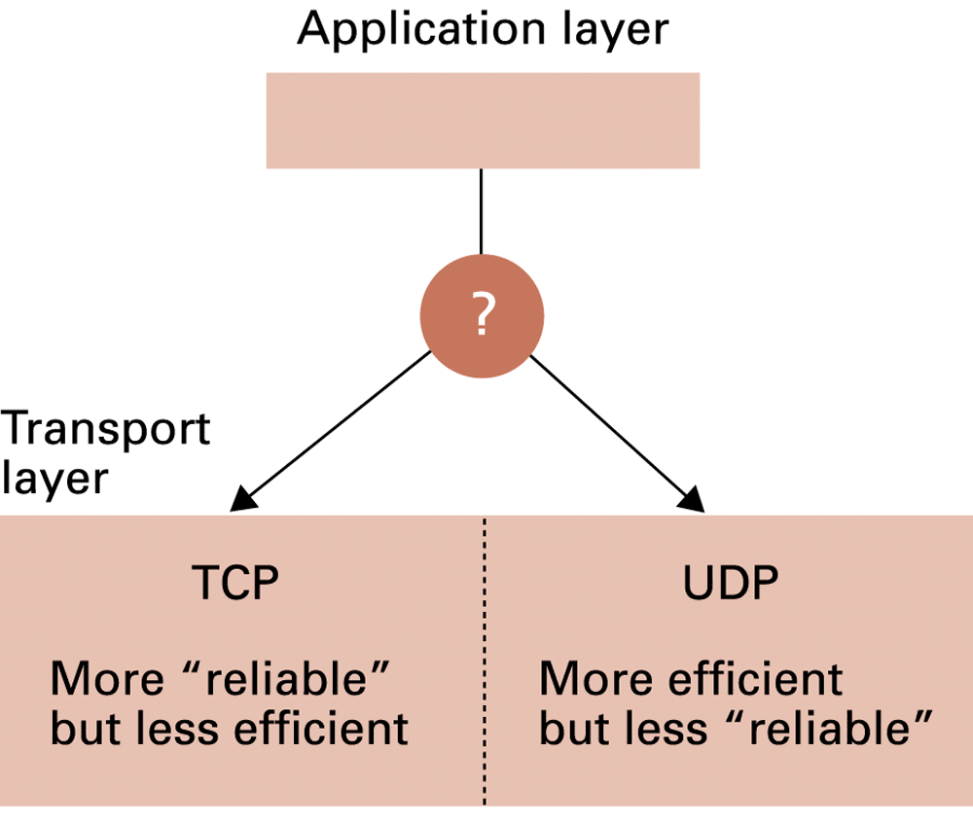
Figure 4.15 Choosing between TCP and UDP
4-<number>

Slide 40
Security
Attacks
  Malware (viruses, worms, Trojan horses, spyware, phishing software)
  Denial of service (DoS)
  Spam
Protection
  Firewalls
  Spam filters
  Proxy Servers
  Antivirus software
4-<number>

Slide 41
Encryption
HTTPS and SSL
Public-key Encryption
  Public key: Used to encrypt messages
  Private key: Used to decrypt messages
Certificates and Digital Signatures
  Certificate authorities
4-<number>

Slide 42
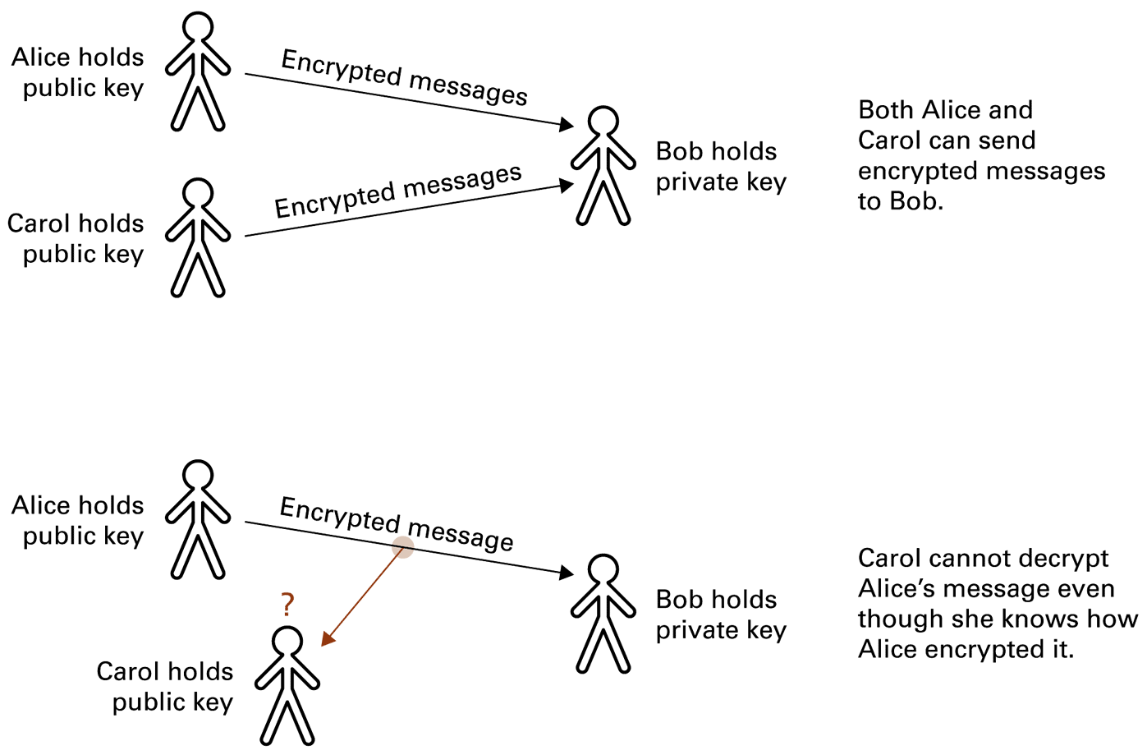
Figure 4.16 Public-key encryption
4-<number>

Slide 43
End
of
Chapter

