Slide 1
Scheduling algorithm
Presented: Nguyễn Huy Hiệu

Slide 2
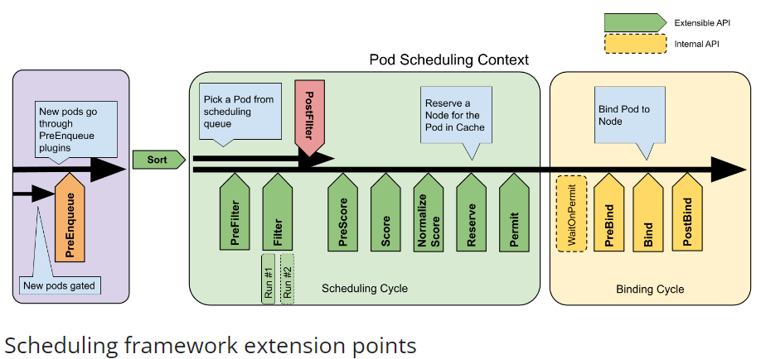
Scheduling Framework

Slide 3
Scheduling Framework
PreEnqueue
These plugins are called prior to adding Pods to the internal active queue, where Pods are marked as ready for scheduling.
Sort
These plugins are used to sort Pods in the scheduling queue. Only one queue sort plugin may be enabled at a time.
PreFilter
These plugins are used to pre-process info about the Pod, or to check certain conditions that the cluster or the Pod must meet.
Filter
These plugins are used to filter out nodes that cannot run the Pod.
PostFilter
These plugins are called after the Filter phase, but only when no feasible nodes were found for the pod.
PreScore
These plugins are used to perform "pre-scoring" work, which generates a sharable state for Score plugins to use.

Slide 4
Score
These plugins are used to rank nodes that have passed the filtering phase. The scheduler will call each scoring plugin for each node.
Normalized
Score
These plugins are used to modify scores before the scheduler computes a final ranking of Nodes.
Reserse
Include Reserve and Unreserve
Permit plugins are invoked at the end of the scheduling cycle for each Pod, to prevent or delay the binding to the candidate node. A permit plugin can do one of the three things: approve, deny, wait.
Permit
PreBind
If any PreBind plugin returns an error, the Pod is rejected and returned to the scheduling queue.
Bind
These plugins are used to bind a Pod to a Node. Bind plugins will not be called until all PreBind plugins have completed.
Post-bind plugins are called after a Pod is successfully bound. This is the end of a binding cycle, and can be used to clean up associated resources.
PostBind

Slide 5
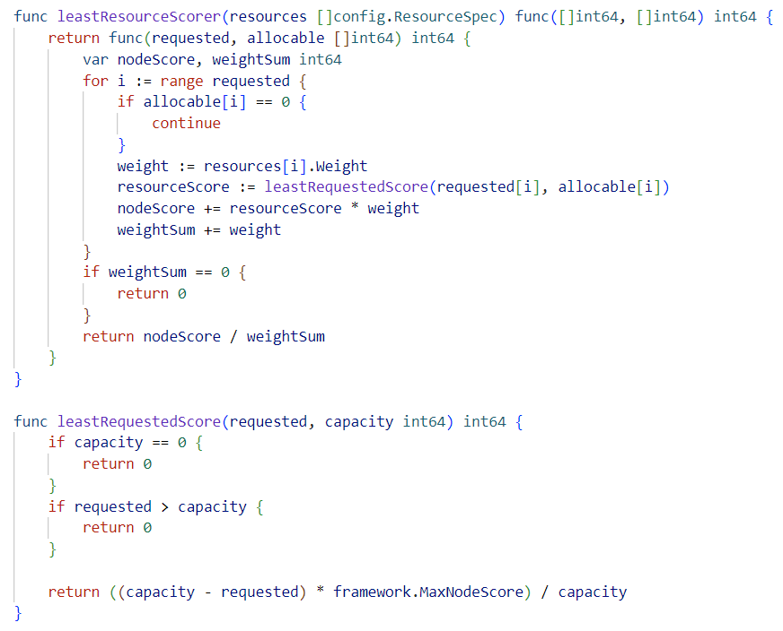
Least Requested

Slide 6
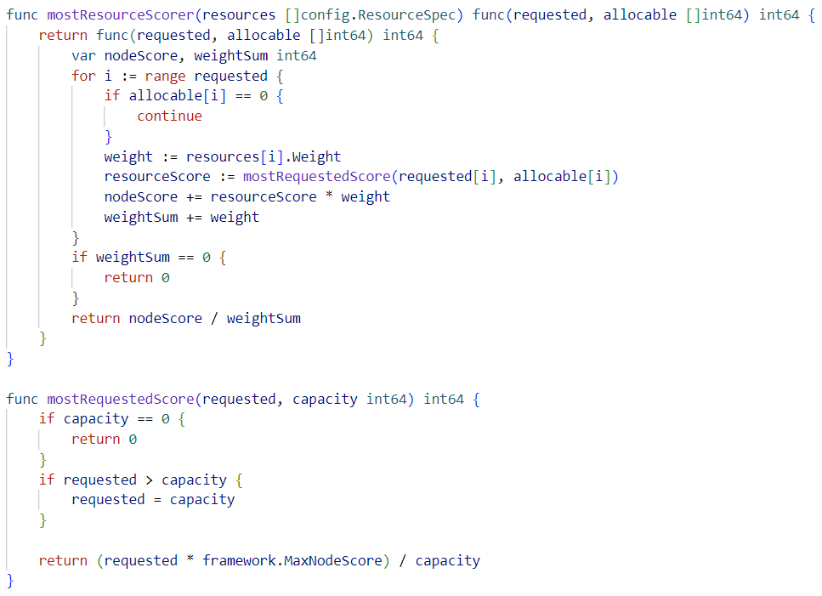
Most Requested

Slide 7
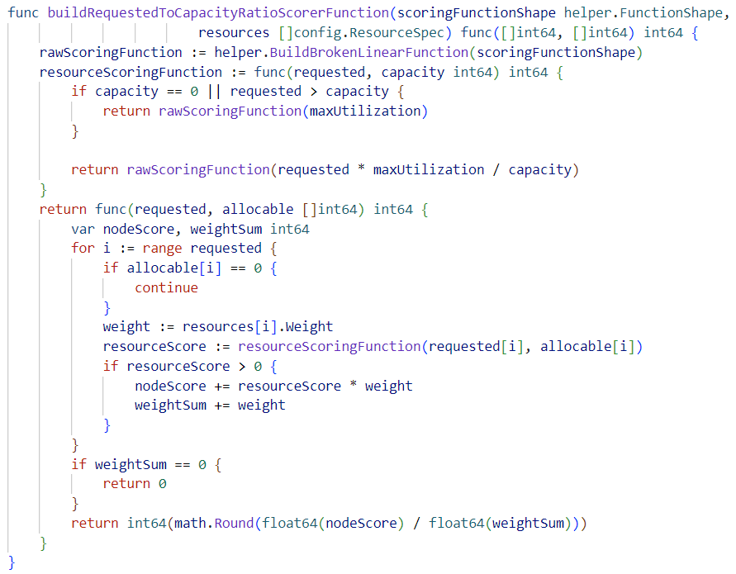
Requested To Capacity Ratio

Slide 8
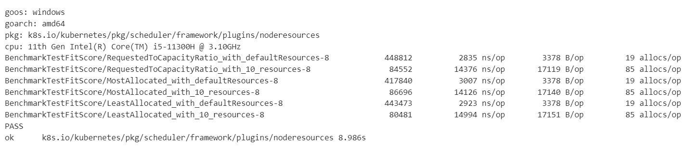
Advantages, Disadvantages and Testing
Least Requested: This algorithm aims to distribute the load evenly among all nodes in the cluster. However, it may not always result in optimal resource utilization, especially if some nodes have more resources than others.
Most Requested: While this algorithm can lead to better resource utilization, it can also create bottlenecks on popular nodes and lead to underutilization of other nodes.
Requested to Capacity Ratio: This algorithm can help balance load and optimize resources better. However, if pods have uneven resource requirements, it may not distribute resources optimally.

Slide 9
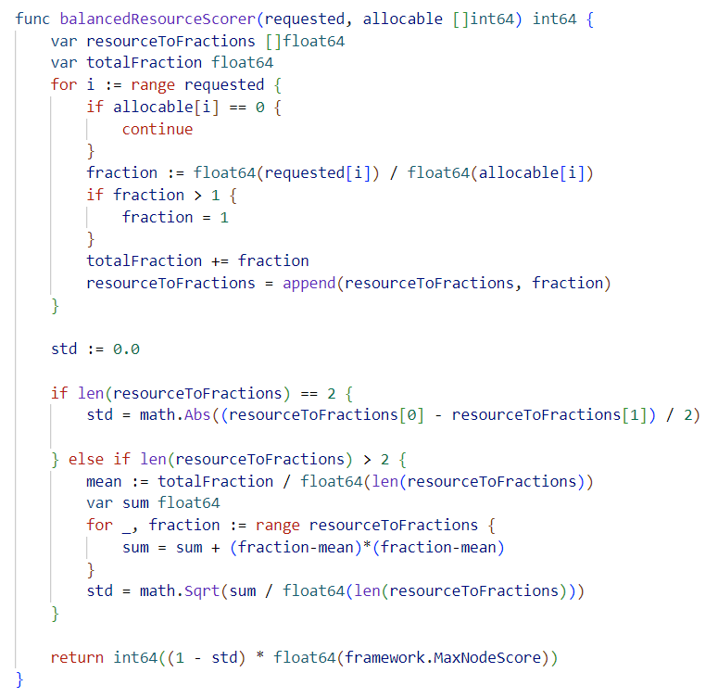
Balanced Resource Allocation

Slide 11
Thanks for watching

