Slide 1
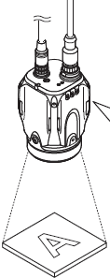
Operation Diagram
IV Sensor
Cravis
Inputs the imaging startup signal by synchronizing to the target position from a photoelectric switch or PLC Also, the trigger can be input at a regular interval with an internal trigger function.
Trigger input
Trigger input
Cravis received trigger signal input from PLC
IV Sensor
Light up the built-in light and image the target by using the CMOS image sensor
BUSY output function turns ON
Imaging
Imaging
Cravis take picture
Cravis camera
There are 4 step in this process:
Extract Color: Using to keep color which using for processing.
Particle Detect: Using to searching abnormal points
Binary : This function use to alter color picture become black & white.
Count pixel: Counting number pixel in area check.
A tool to calculate the matching rate in the area (number of pixels) of a target to be examined as the basic (100%) of the area (number of pixels) of a registered high quality target. This judges whether a target is a high or low-quality-target by setting the threshold to the matching rate.
Tool process
Image process
Status output
Output the status results.
When the total status results is OK, the total status output is ON
When the total status results is NG, the total status NG output is ON
Signal output
Output the status results.
Save image
Saves the image history memory in the sensor.
Signal output
Saves the image history memory in the Cravis.

Slide 2
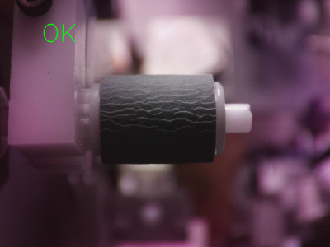
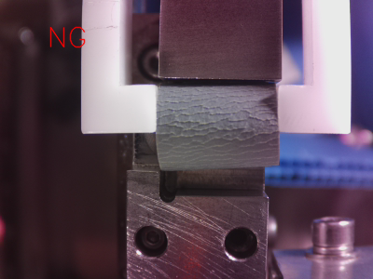
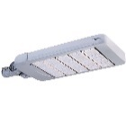

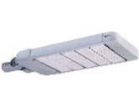

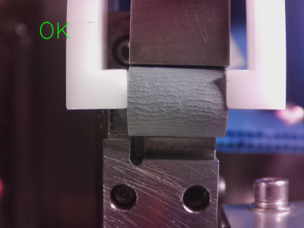
Difficult point
Detail | Expectation | Reality
Lighting
Position of the light and Cravis
Cravis
Cravis
Lighting
Rubber
Rubber
Area check | Stability | Unstable

Slide 3
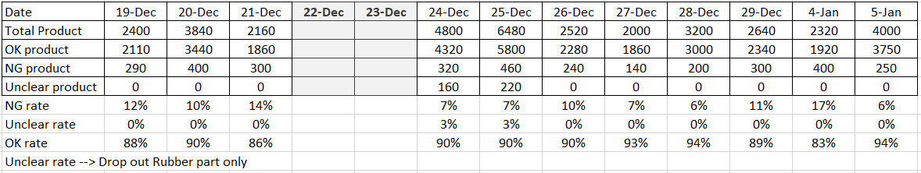
Daily rate
The position of the light and Cravis not like expectation
Cause
The area check abnomal, usually, rubber be transformed.
Algorithm not optimal

Slide 4
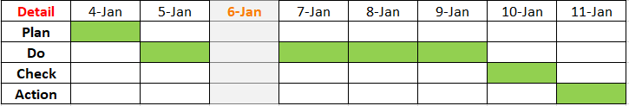
New method check and Plan to apply
Shading method
Operation Diagram
Trigger input
Imaging
Shading image
Image process
Signal output
Save image
Plan to apply new method

