Slide 1
ConvNeXt: A ConvNet for the 2020s
Zhuang Liu^{1,2} Hanzi Mao¹ Chao-Yuan Wu¹ Christoph Feichtenhofer¹ Trevor Darrell² Saining Xie¹
¹Facebook AI Research (FAIR) ²UC Berkeley
arXiv, 01/2022

Slide 2
Motivation
Performance difference between Transformers and ConvNets is usually attributed to the superior scaling behavior of Transformers.
ViT outperforms ResNet with larger model and dataset sizes.
Hierarchical Transformers (Swin and successors): try to incorporate existing behaviors of ConvNet with the cost of model or computational complexity.
Attention within local windows to replace ConvNet’s sliding window strategy.
→ ConvNeXt: an attempt to “modernize” a standard ResNet by adopting key components of a vision Transformer design.

Slide 3
ConvNeXt – Overview
ConvNet “modernization” process:
Training Techniques
ResNeXt-ify
Macro Design
Inverted Bottleneck
Large Kernel Sizes
Micro Design

Slide 4
ConvNeXt – Training Techniques
Close to DeiT’s and Swin Transformer’s.
300 epochs (extended from original 90).
AdamW optimizer.
Data augmentations: Mixup, Cutmix, RandAugment, Random Erasing.
Regularization schemes: Stochastic Depth, Label Smoothing.
ResNet-50 accuracy gained +2.7% (ImageNet-1K benchmark).
Notes:
Random Erasing randomly selects a rectangle region in an image and erases its pixels with random values.
Stochastic Depth aims to shrink the depth of a network during training, while keeping it unchanged during testing. This is achieved by randomly dropping entire ResBlocks during training and bypassing their transformations through skip connections.
Label Smoothing is a regularization technique that introduces noise for the labels. Assume for a small constant ϵ, the training set label y is correct with probability 1−ϵ and incorrect otherwise. Label Smoothing regularizes a model based on a softmax with k output values by replacing the hard 0 and 1 classification targets with targets of ϵ/k−1 and 1−ϵ respectively.

Slide 5
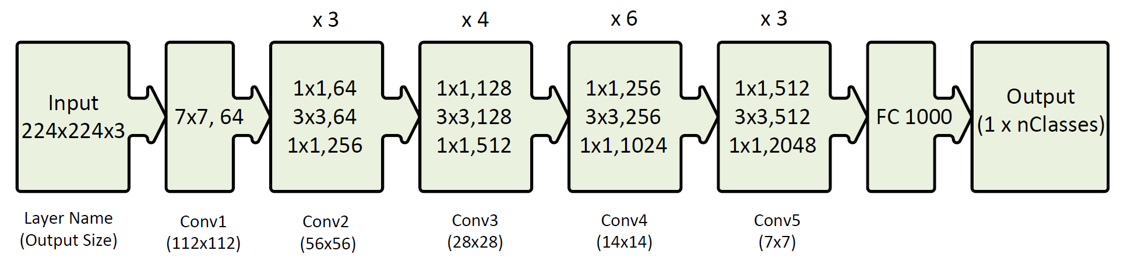
ConvNeXt – Macro Design
Following Swin Transformer’s.
Changing stage compute ratio to 1:1:3:1 (smallest model) or 1:1:9:1 (larger models).
Resnet-50’s (3, 4, 6, 3) to (3, 3, 9, 3)
Changing Conv1 stem to “patchify” 4x4 , stride 4 layer.
ResNet-50 accuracy gained resp. +0.6% and +0.1%.
Original ResNet-50

Slide 6
ConvNeXt – ResNeXt-ify
Adopt ResNeXt design but adapt to Transformer configuration.
Using depth-wise convolution for 3x3 conv layer in bottleneck block.
Similar to weighted sum operation in self-attention, which operates on a per-channel basis, i.e. only mixing information in the spatial dimension.
Increasing network width from 64 to 96 channels (same as Swin-T).
ResNet-50 accuracy gained +1%.

Slide 7
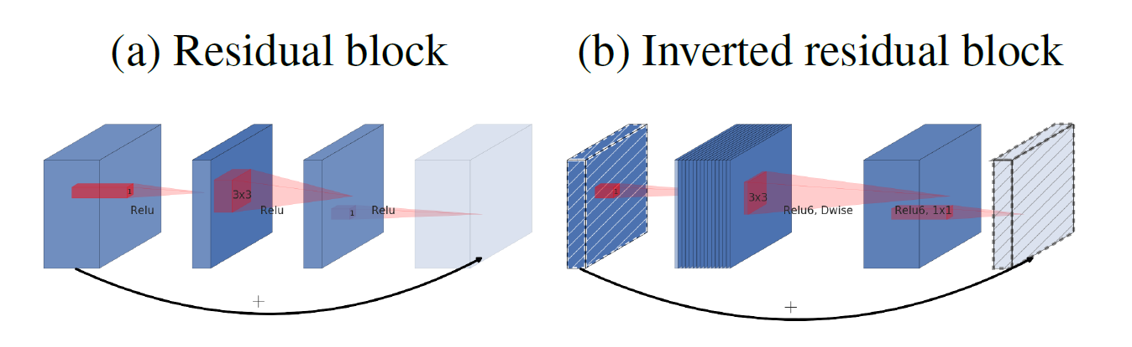
ConvNeXt – Inverted Bottleneck
In Transformer block, the hidden dimension of the MLP block is 4 times wider than the input dimension.
The idea was first proposed in MobileNetV2, the adopted in EfficientNet and others.
ResNet-50 accuracy gained +0.1%, while ResNet-200 accuracy gained +0.7%.
Notes:
Inverted Residual blocks are inverted BottleNeck layers. They expand features with the first conv instead of reducing them. Inspired by the intuition that the bottlenecks actually contain all the necessary information, while an expansion layer acts merely as an implementation detail that accompanies a non-linear transformation of the tensor, shortcuts are used directly between the bottlenecks. The inverted design is considerably more memory efficient, as well as works slightly better in the experiments.

Slide 8
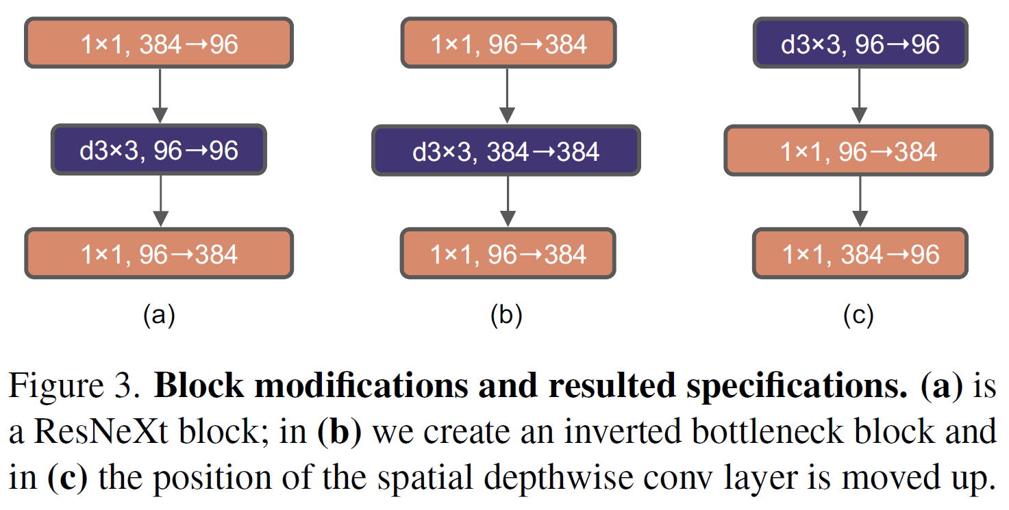
ConvNeXt – Large Kernel Sizes
Prerequisite: Moving up depth-wise conv layer.
The complex/inefficient modules (Swin’s Multi-head SA, large-kernel conv) will have fewer channels, while the efficient, dense 1×1 layers will do the heavy work.
Increasing the kernel size to 7x7.
Same as Swin Transformer.
Experimented with 3, 5, 7, 9, 11 but no further gain beyond 7x7 (ResNet-50) or 5x5 (ResNet-200).
ResNet-50 accuracy lost -0.7% and gained back +0.7%.

Slide 9
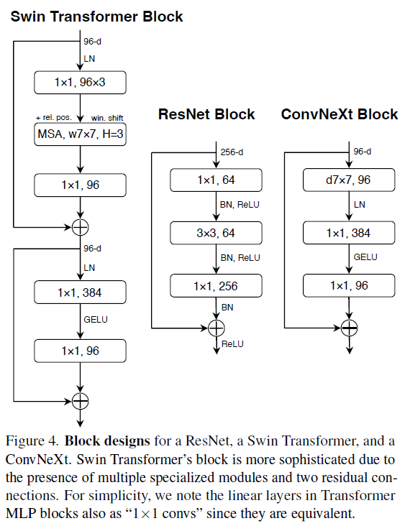
ConvNeXt – Micro Design
Replacing ReLU with smoother GELU.
(Gaussian Error Linear Unit)
Fewer activation functions.
Keep only one between the 2 1x1 layers.
Fewer normalization layers.
Keep only one before the 1x1 layers.
Substituting BN with LN.
Separate down-sampling layers.
Separate 2x2, stride 2 + LN layers instead of the 3x3, stride 2 conv at the start of each stage.
→ ResNet-50 accuracy gained resp. 0%, +0.7%, +0.1%, +0.1%, +0.5%.

Slide 10
ConvNeXt – Variants
With similar complexity to Swin Transformer:
ConvNeXt-T: C = (96; 192; 384; 768), B = (3; 3; 9; 3)
ConvNeXt-S: C = (96; 192; 384; 768), B = (3; 3; 27; 3)
ConvNeXt-B: C = (128; 256; 512; 1024), B = (3; 3; 27; 3)
ConvNeXt-L: C = (192; 384; 768; 1536), B = (3; 3; 27; 3)
ConvNeXt-XL: C = (256; 512; 1024; 2048), B = (3; 3; 27; 3)
(C is number of channels, B is number of blocks in each stage)
ConvNeXt-T/B is modernized version of Resnet-50/200, respectively.

Slide 11
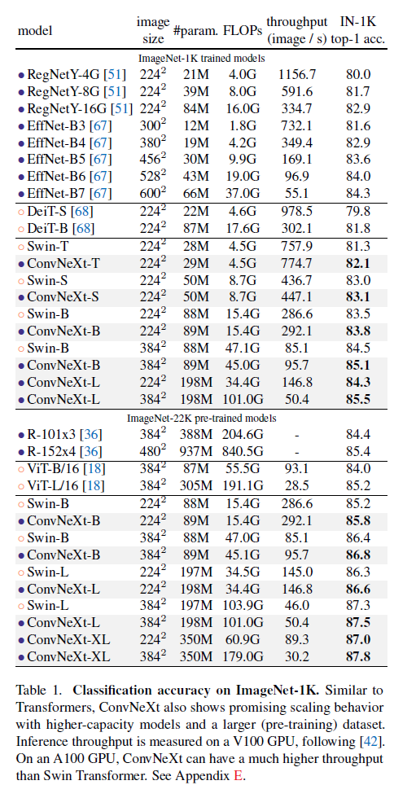
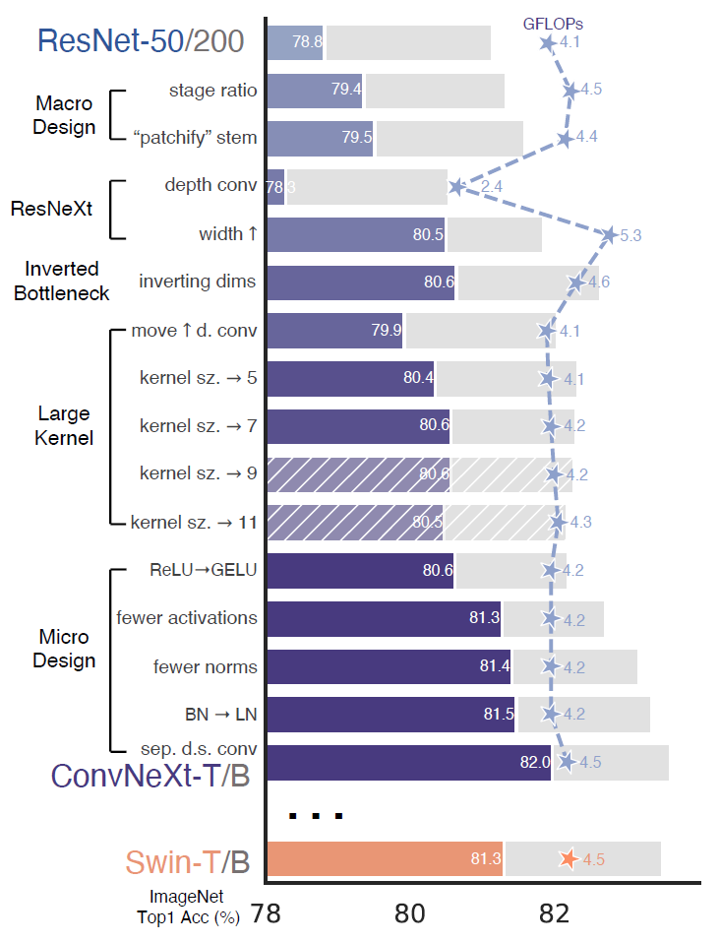
Experiment Results

Slide 12
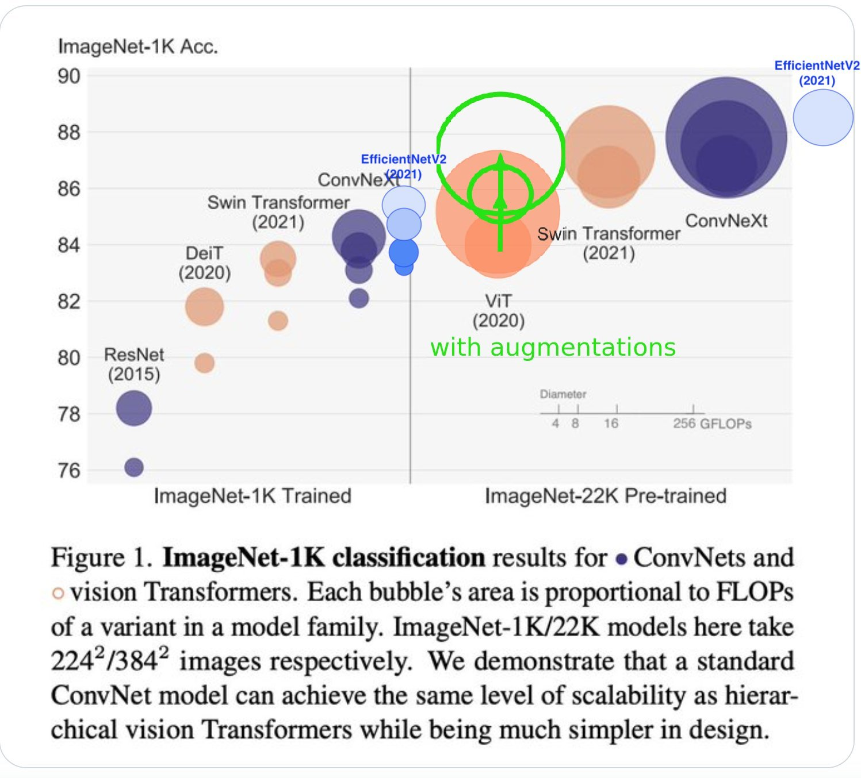
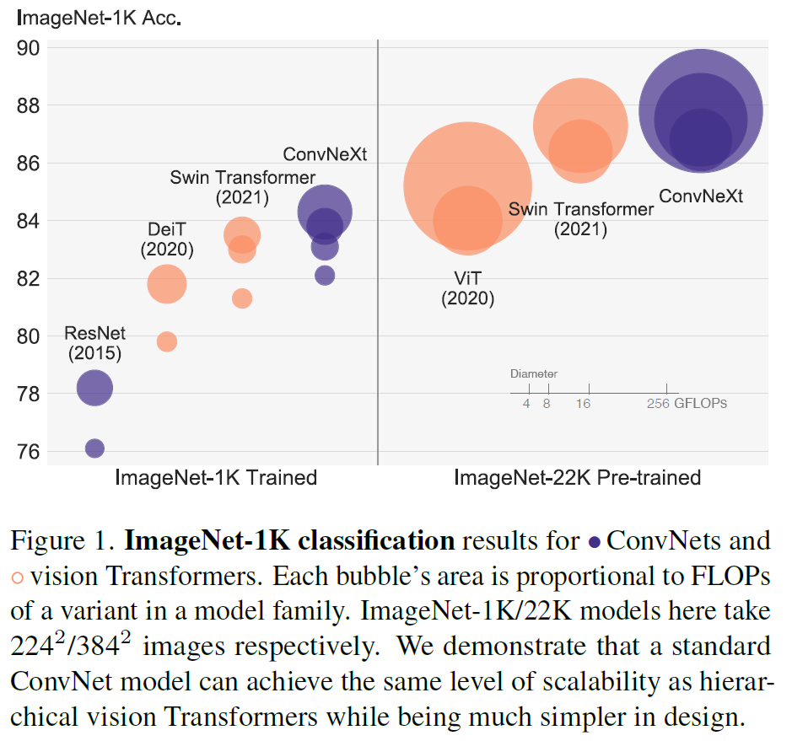
Experiment Results
Original results by ConvNeXt’s authors
Complemented by and EfficientNetv2’s authors

Slide 13
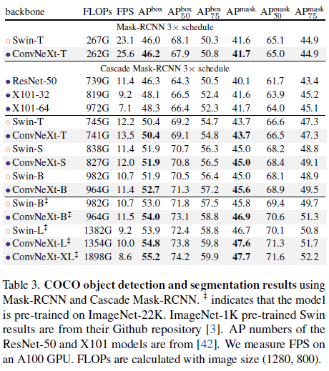
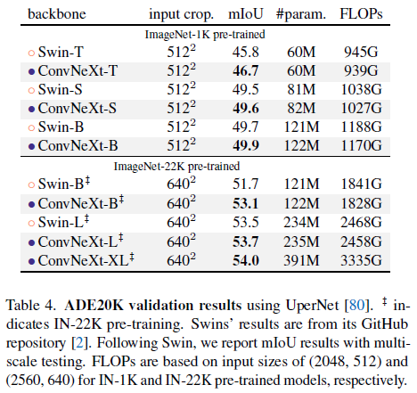
Experiment Results

Slide 14
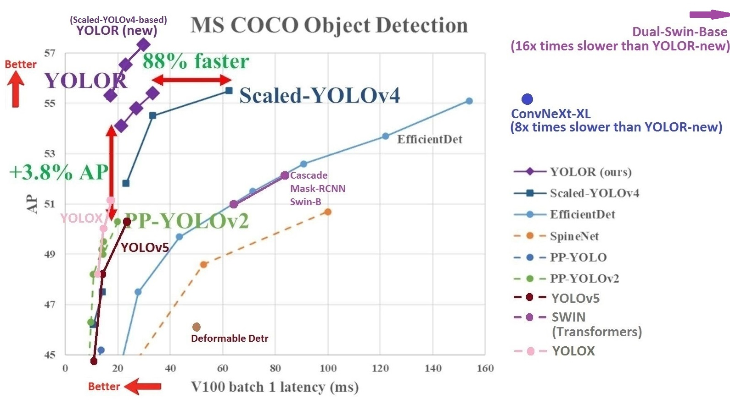
Experiment Results
Comparison with new YOLOR (Scaled-YOLOv4-based)* and others provided by Darknet framework and Scaled-YOLOv4’s author.
*: only weights provided, detailed improvements will be released in less than a month (probably).

Slide 15
Importance
Pure ConvNet model that can compete with SOTA hierarchical vision Transformers across multiple computer vision benchmarks.
The model has approximately the same FLOPS, #params., throughput and memory use as Swin Transformer, but does not require any specialized modules.

Slide 16
Thank you for listening

Slide 17
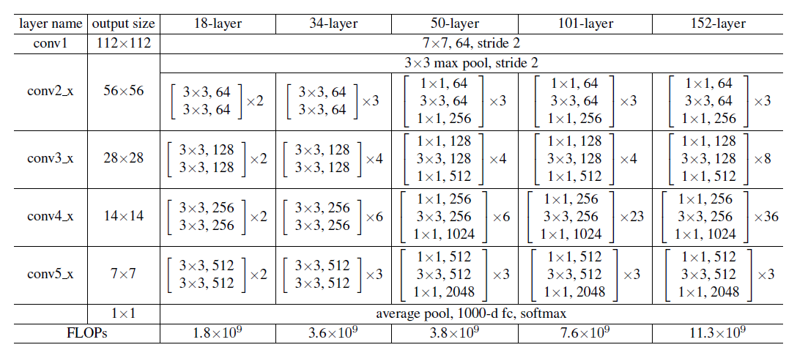
ResNet Original Architecture

