Slide 1
MLP-Mixer: An all-MLP Architecture for Vision
Google Research, Brain Team
NeurIPS 2021
Notes:
Conference on Neuron Information Processing Systems

Slide 2
Introduction
In recent years, CNNs and Self-Attention are the go-to mechanisms for achieving SOTA performance in image classification and computer vision in general.
The paper proposed the MLP-Mixer which is a competitive but conceptually and technically simple alternative, that does not use convolutions or self-attention, but based entirely on multi-layer perceptrons - MLPs.

Slide 3
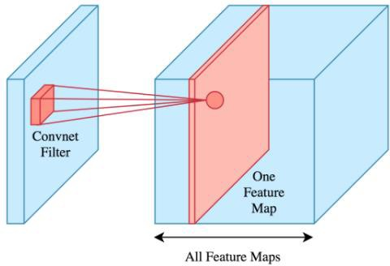
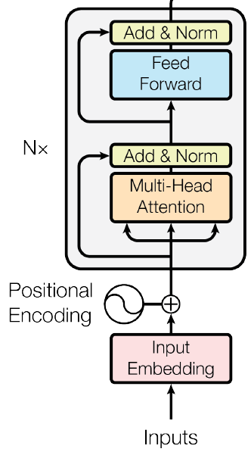
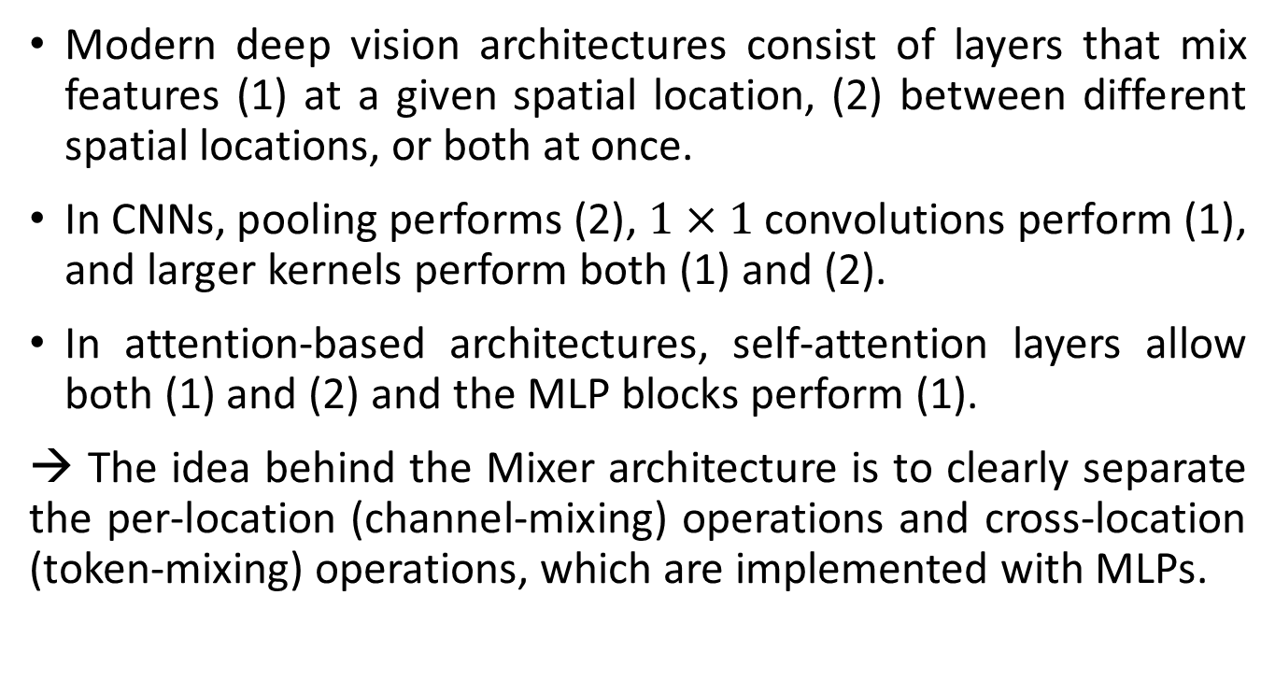
Introduction
Modern deep vision architectures consist of layers that mix features (1) at a given spatial location, (2) between different spatial locations, or both at once.
In CNNs, pooling performs (2), $1×1$ convolutions perform (1), and larger kernels perform both (1) and (2).
In attention-based architectures, self-attention layers allow both (1) and (2) and the MLP blocks perform (1).
→ The idea behind the Mixer architecture is to clearly separate the per-location (channel-mixing) operations and cross-location (token-mixing) operations, which are implemented with MLPs.
Convolution Layer
Self-Attention Layer
Notes:
1x1 conv = pointwise conv

Slide 4
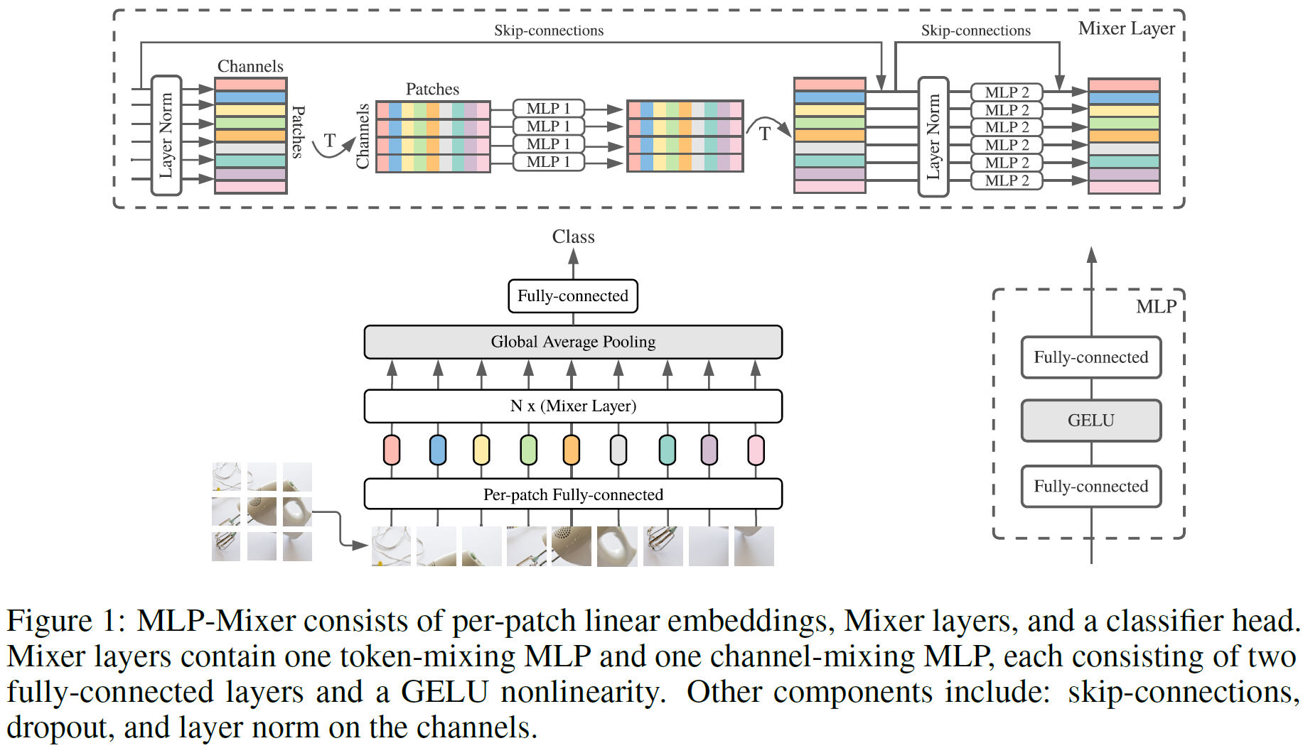
Mixer Architecture
Figure 1: MLP-Mixer consists of per-patch linear embeddings, Mixer layers, and a classifier head. Mixer layers contain one token-mixing MLP and one channel-mixing MLP, each consisting of two fully-connected layers and a GELU nonlinearity. Other components include: skip-connections, dropout, and layer norm on the channels.
Notes:
Generally, the Mixture architecture follows the structure of ViT.
Gaussian Error Linear Units is an activation function which weighs inputs using the standard Gaussian cumulative distribution function. In case of ReLU ( Rectified Linear Units ), the inputs are weighed using their sign.

Slide 5





Mixer Architecture
Per-patch Fully-connected layer:
Splits the input image into $S$ non-overlapping patches and projects them into embeddings with hidden dimension $C$ using a shared linear map. This results in a 2D input table $X∈ℝ^{S×C}$, which will stay unchanged across later mixer layers.
Is the same as a $P×P$convolution with stride $P$.
$$(C)$$
$$(P)$$
$$(H,W)$$
$$S={HW}/{P^{2}}$$

Slide 6
Mixer Architecture
Mixer layers:
Each layer consists of token-mixing and channel-mixing MLP blocks.
Tunable hidden widths in the MLPs are independent from the number of input patches. Therefore, the computational complexity of the network is linear in the number of input patches, unlike ViT whose complexity is quadratic.

Slide 7
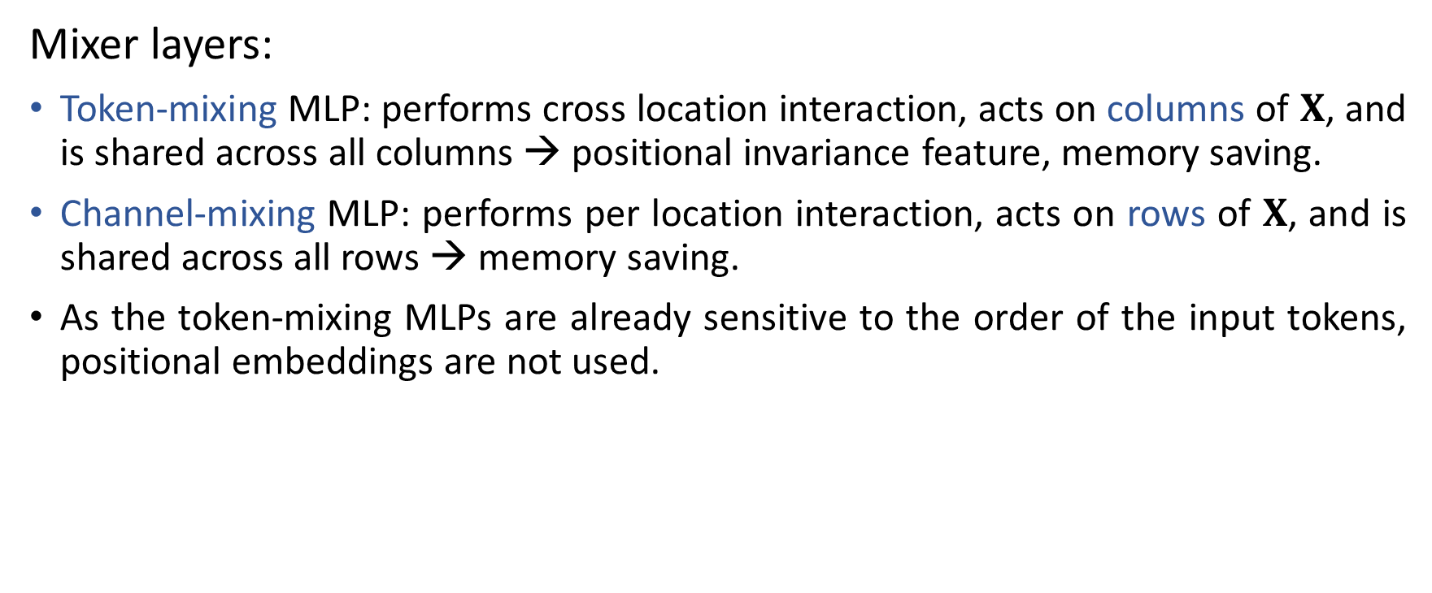
Mixer Architecture
Mixer layers:
Token-mixing MLP: performs cross location interaction, acts on columns of $X$, and is shared across all columns → positional invariance feature, memory saving.
Channel-mixing MLP: performs per location interaction, acts on rows of $X$, and is shared across all rows → memory saving.
As the token-mixing MLPs are already sensitive to the order of the input tokens, positional embeddings are not used.
Token-mixing
Channel-mixing

Slide 8
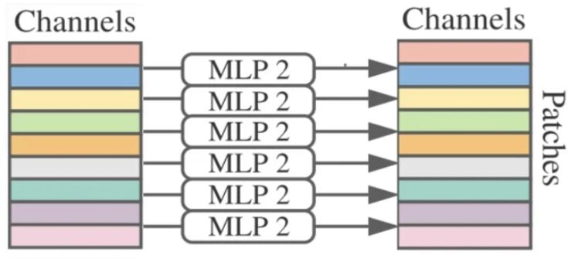
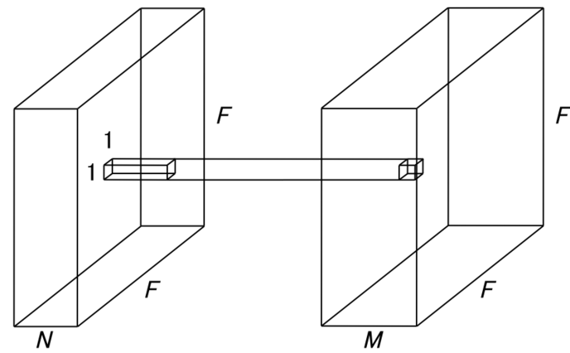
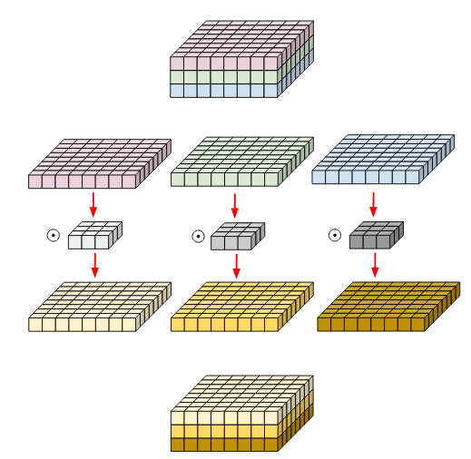
Mixer Architecture
Can be seen as a very special CNN:
Channel-mixing MLPs: point-wise convolutions
Token-mixing MLPs: weight-shared, single-channel depth-wise convolutions of full receptive field.
Notes:
1x1 conv = point-wise conv

Slide 9
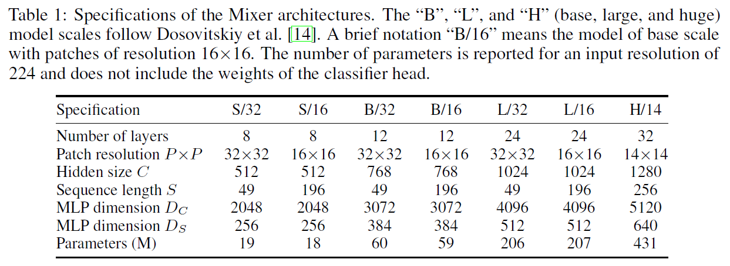
Mixer Architecture
Model configurations:

Slide 10
Experiments:
Pre-training:
on large scale JFT-300M dataset.
on smaller ImageNet or ImageNet-21k: requires extra regularization (to avoid overfit).
randaugment, dropout, mixup and stochastic depth were used.
Downstream tasks (fine-tuning):
ILSVCR2012 “Image Net” (original and cleaned-up ReaL labels).
“Avg. 5”: ImageNet, CIFAR-10, CIFAR-100, Pets, Flowers.
“VTAB-1k”: Visual Task Adaptation Benchmark, 19 diverse datasets with 1k training examples each.
Metrics:
Downstream accuracy.
Total pre-training time (core-days on TPUv3).
Test time throughput (images/sec/core on TPUv3).
Notes:
ImageNet-1k: 1000 classes; 1,281,167 training images; 50,000 validation images; 100,000 test images ImageNet-21k: 21,841 classes; 14,197,087 images
JFT-300M: 18k classes, 303M images

Slide 11
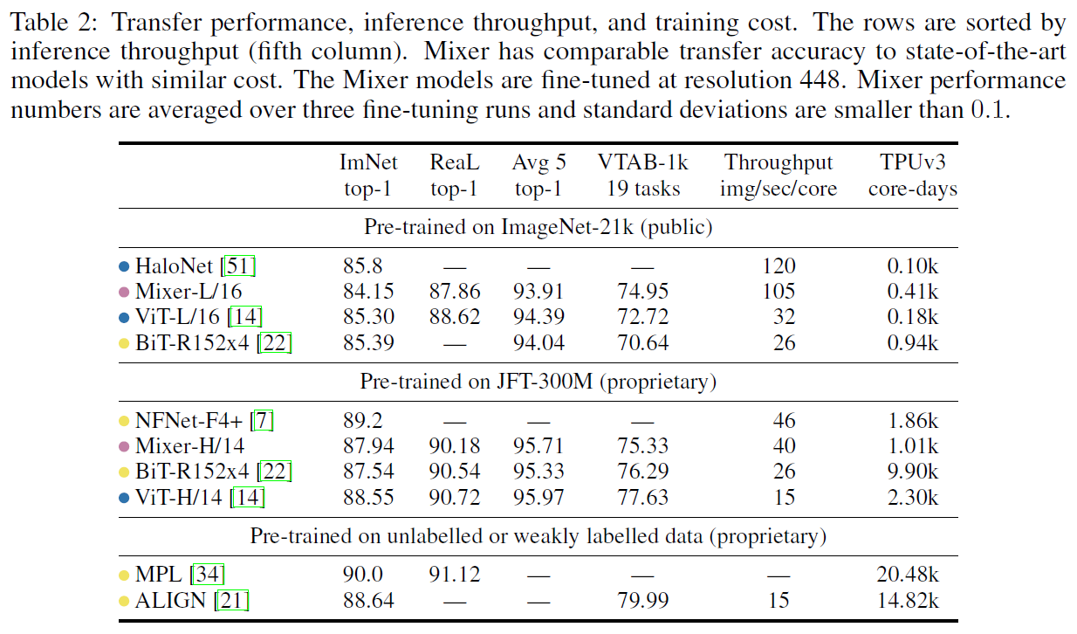
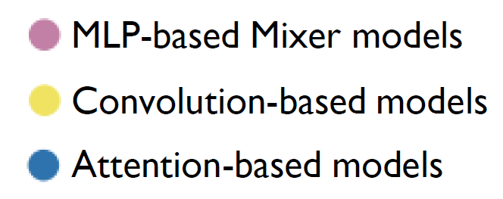
Experiments: Main Results
When pre-trained on ImageNet-21k with additional regularization, Mixer achieves an overall strong performance, although slightly inferior to other models. Similar to ViT, Mixer overfits without regularization.
When the size of the upstream dataset increases, Mixer’s performance improves significantly.

Slide 12
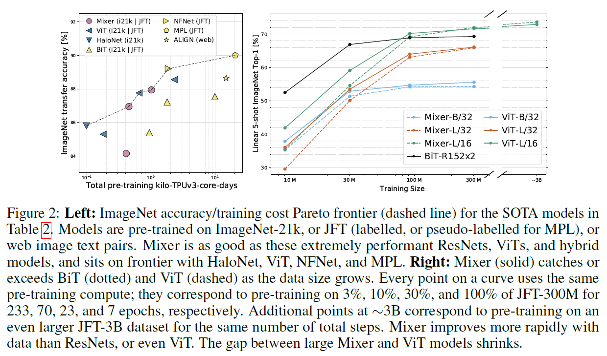
Experiments: Main Results
Accuracy with respect to total pre-training time and training size:
In terms of the accuracy-compute trade-off Mixer is competitive with more conventional neural network architectures.
It appears that Mixer benefits from the growing dataset size even more than ViT.

Slide 13
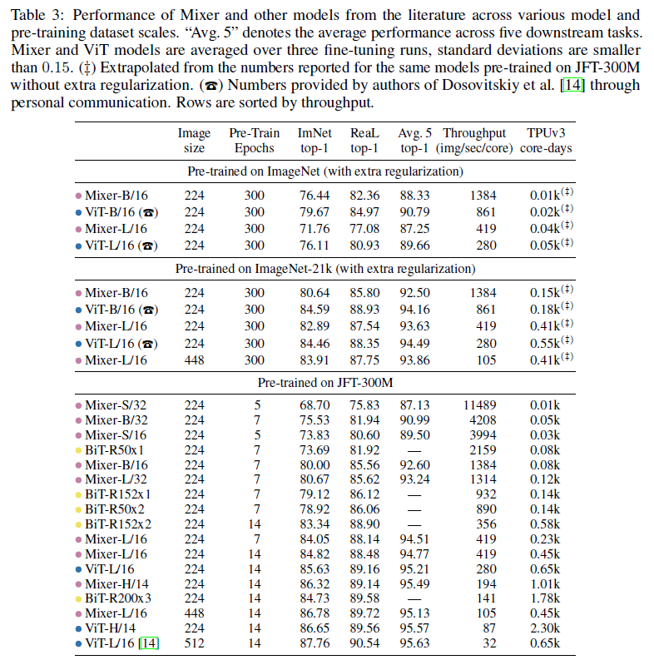
Experiments: Results at Various Scales
Mixer B/16 attains a reasonable score of 76.4% at resolution 224, but it tends to overfit when using random initialization.
The score is similar to a vanilla ResNet50, but behind SOTA CNNs/hybrids for the ImageNet “from scratch” setting (BotNet 84.7%, NFNet 86.5%).

Slide 14
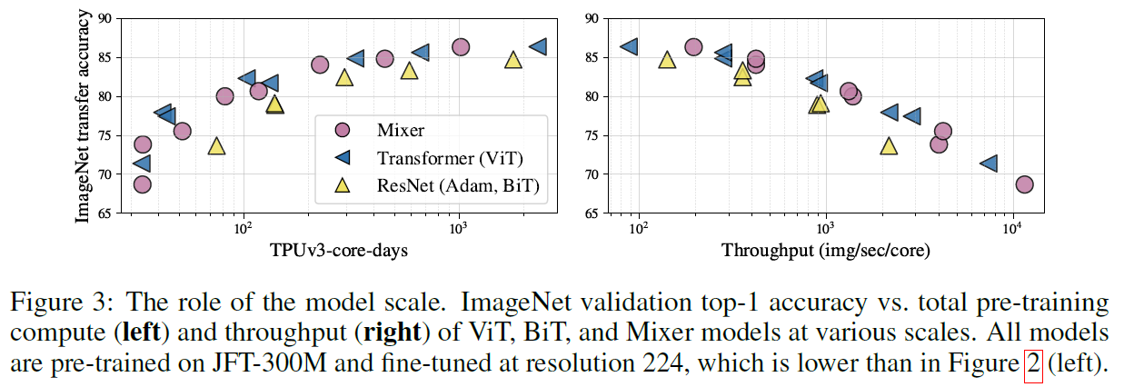
Experiments: Results at Various Scales
Accuracy with respect to total pre-training time and throughput at various scales:
As the pre-training dataset grows, Mixer’s performance steadily improves. Although Mixer is slightly below the frontier on the lower end of model scales, it sits confidently on the frontier at the high end.

Slide 15
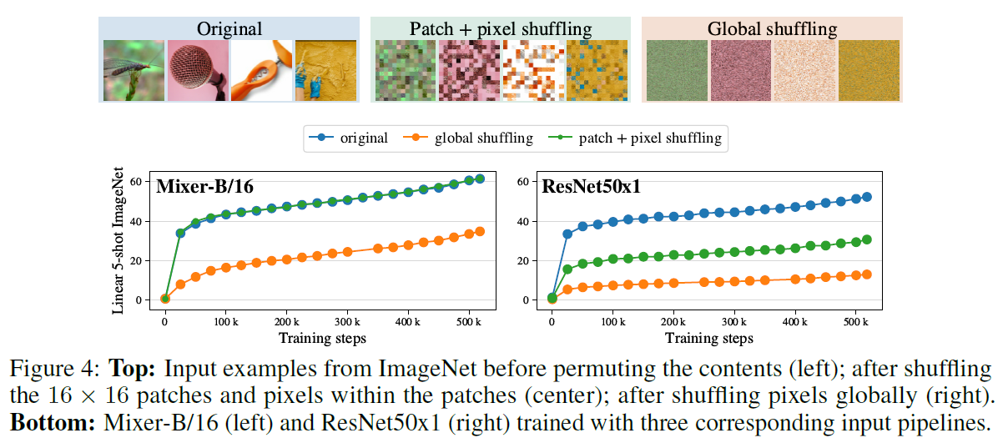
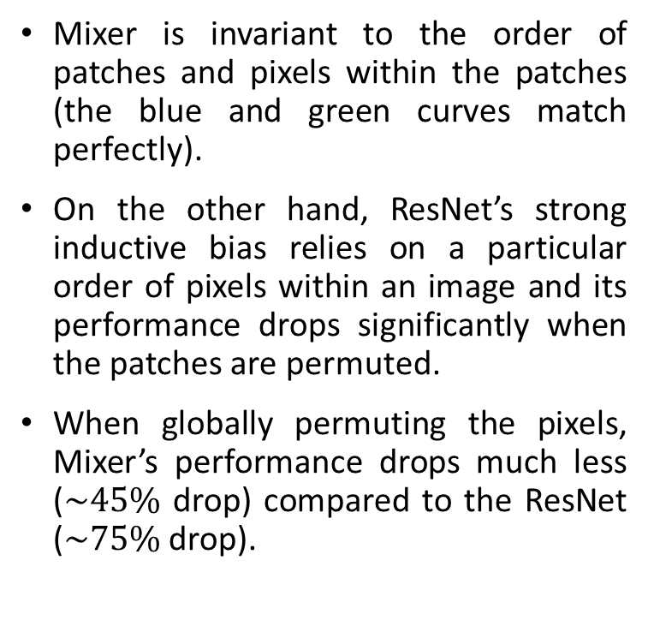
Experiments: Invariance to Input Permutation
Mixer is invariant to the order of patches and pixels within the patches (the blue and green curves match perfectly).
On the other hand, ResNet’s strong inductive bias relies on a particular order of pixels within an image and its performance drops significantly when the patches are permuted.
When globally permuting the pixels, Mixer’s performance drops much less ($\sim 45\%$ drop) compared to the ResNet ($\sim 75\%$ drop).

Slide 16
Conclusion
MLP-Mixer is simple and performs similarly to SOTA architectures for image classification in terms of trade-off between accuracy and computational cost.
Sparked a new trend of research.
Authors’ Questions:
The difference in features learned compared to CNNs and Transformers?
The inductive bias hidden in the features?
What about other tasks (segmentation, detection) and other domains (NLP, video)?

Slide 17
Thank you for your attention

