Slide 1
SeMask: Semantically Masked Transformers for Semantic Segmentation
Picsart AI Research | SHI Lab | IIT Roorkee
arXiv, 12/2021

Slide 2
Motivation
Traditional approaches in vision transformers:
Use an existing pretrained backbone as an encoder and transfer it to downstream tasks using pre-existing standard decoders such as, Semantic FPN¹ or UperNet².
Design a new encoder-decoder network where the encoder is pretrained on ImageNet for the semantic segmentation task.
Both involve finetuning the encoder backbone on the segmentation task.
Leaves out the semantic context that an image provides during the encoding stage, due to the relatively smaller size of the dataset and a change in the number and nature of semantic classes.

Slide 3
SeMask Framework
Incorporates semantic information into hierarchical vision transformer architectures and augments the global feature information captured by the transformers with the semantic context.
Instead of directly using the hierarchical transformers as a backbone, a Semantic Layer is added after the Transformer Layer.
2 decoders are used: a lightweight semantic decoder used only for training and a feature decoder.
→ Demonstrate with SeMask Swin Semantic FPN architecture.

Slide 4
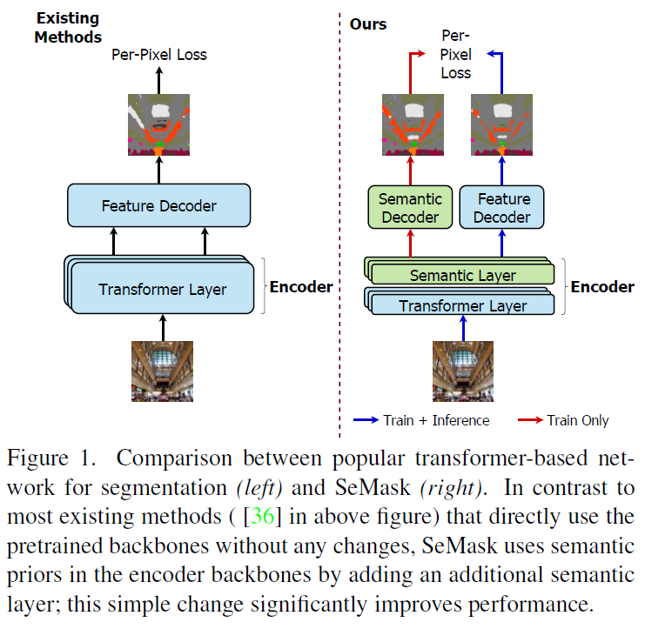
SeMask Framework

Slide 5
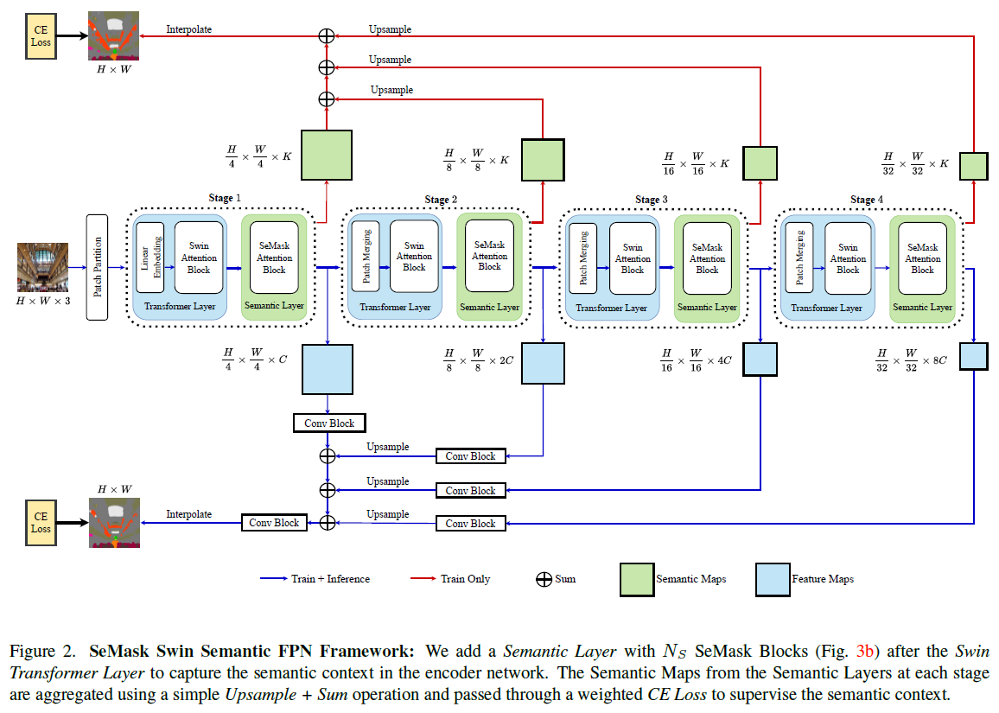
SeMask Swin Semantic FPN
Notes:
the Semantic Layer models the semantic context, which is used as a prior for calculating a segmentation score to update the feature maps based on guidance from the semantic nature present in the image.

Slide 6
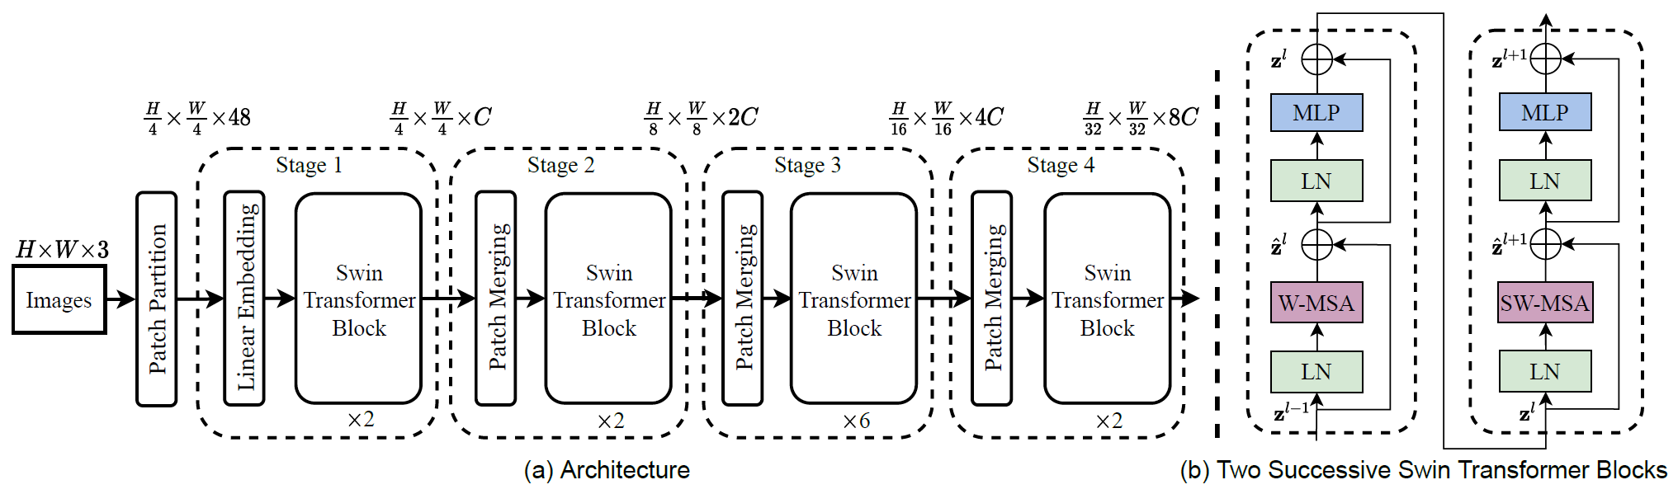
SeMask Swin Semantic FPN
Swin Transformer encoder (top) and SeMask Swin Transformer encoder (bottom)

Slide 7
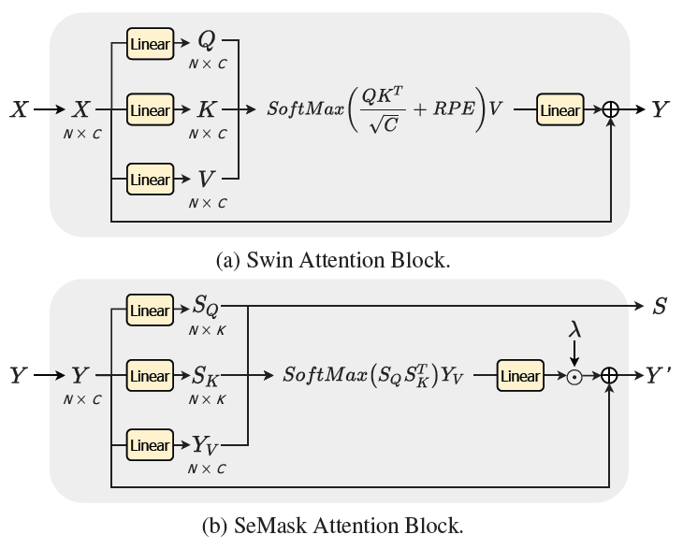
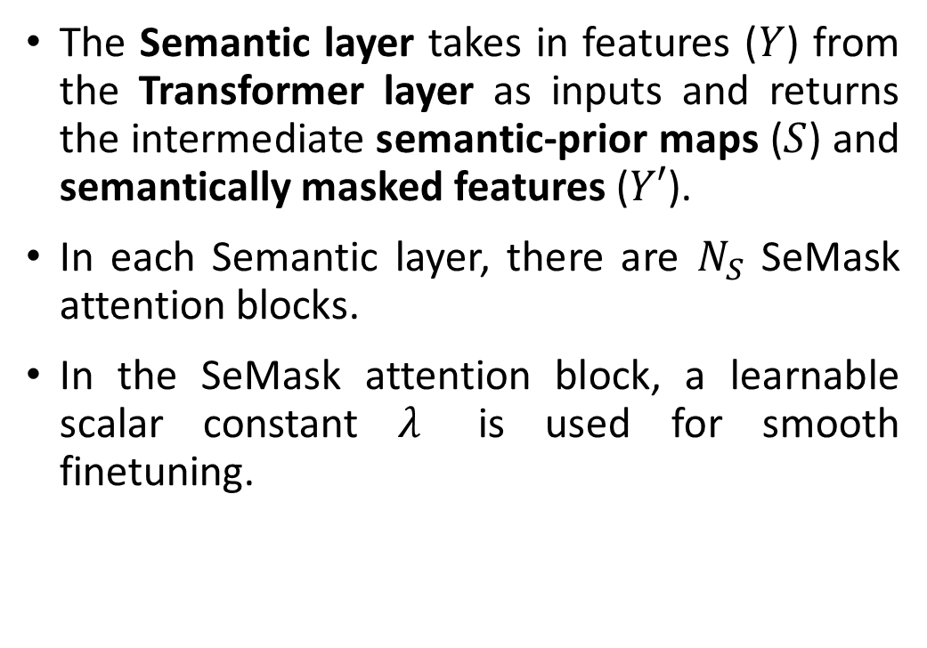
SeMask Encoder
The Semantic layer takes in features ($Y$) from the Transformer layer as inputs and returns the intermediate semantic-prior maps ($S$) and semantically masked features ($Y′$).
In each Semantic layer, there are $N_{S}$ SeMask attention blocks.
In the SeMask attention block, a learnable scalar constant $λ$ is used for smooth finetuning.
Notes:
Q, K, V: query, key and value
SQ, SK, FV: semantic query, semantic key, feature value
SQs are all later used to predict the semantic-prior map

Slide 8
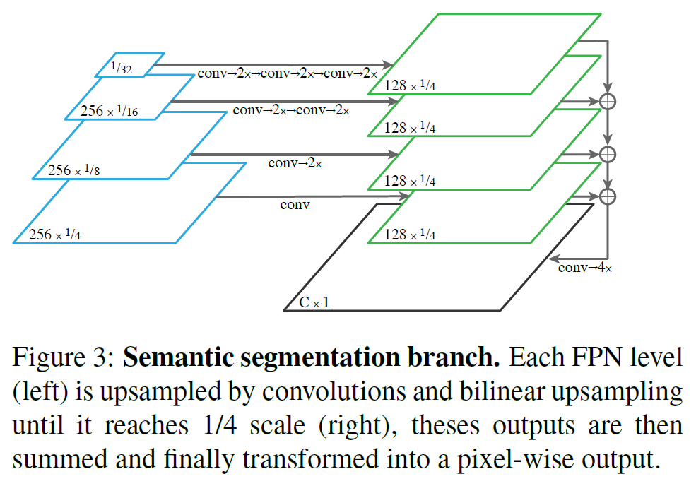
SeMask Decoders
The efficient and straightforward Semantic-FPN decoder aggregates the semantically masked features from each stage for producing the final dense-pixel prediction.
A lightweight semantic decoder based on upsample & sum operation aggregates the semantic-prior maps from all the stages to predict the semantic-prior for the network during training → greatly assists the feature extraction and eventually improve the performance on the semantic segmentation task.
Notes:
The Semantic-FPN fuses the features from different stages with a series of convolution, bilinear upsampling, and sum operations, making it efficient and straightforward as a segmentation decoder.

Slide 9
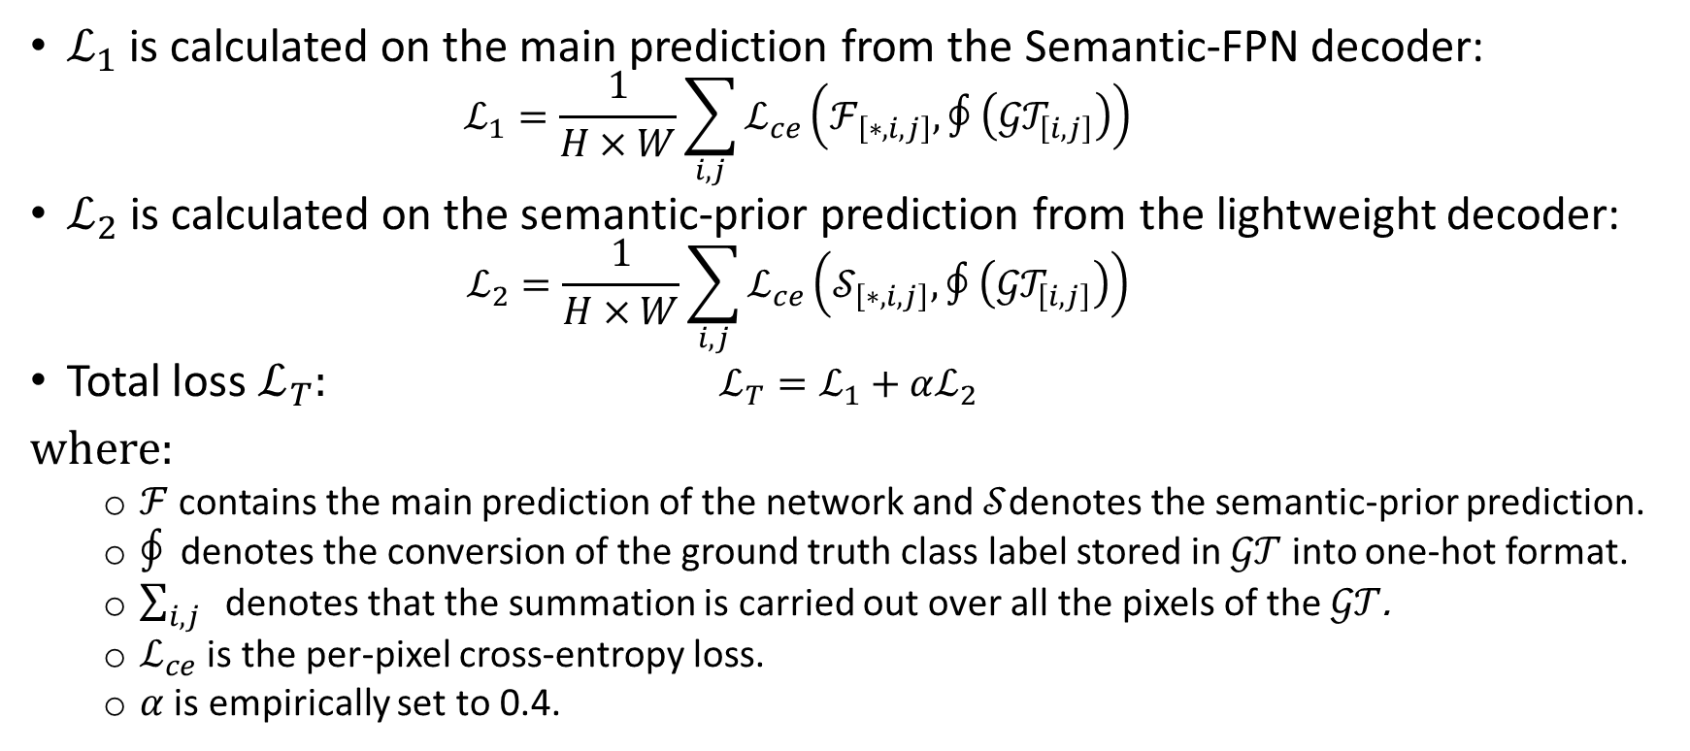
SeMask Loss Function
$ℒ_{1}$ is calculated on the main prediction from the Semantic-FPN decoder:
$$ℒ_{1}=\frac{1}{H×W}\sum_{i,j}{ℒ_{ce}\left(ℱ_{\left[∗,i,j\right]},∮\left({𝒢𝒯}_{\left[i,j\right]}\right)\right)}$$
$ℒ_{2}$ is calculated on the semantic-prior prediction from the lightweight decoder:
$$ℒ_{2}=\frac{1}{H×W}\sum_{i,j}{ℒ_{ce}\left(𝒮_{\left[∗,i,j\right]},∮\left({𝒢𝒯}_{\left[i,j\right]}\right)\right)}$$
Total loss $ℒ_{T}$: $ℒ_{T}=ℒ_{1}+αℒ_{2}$
where:
$ℱ$ contains the main prediction of the network and $𝒮$denotes the semantic-prior prediction.
$∮$ denotes the conversion of the ground truth class label stored in $𝒢𝒯$ into one-hot format.
$\sum_{i,j}{ }$denotes that the summation is carried out over all the pixels of the $𝒢𝒯$.
$ℒ_{ce}$ is the per-pixel cross-entropy loss.
$α$ is empirically set to 0.4.
Notes:
Contour integral function

Slide 10
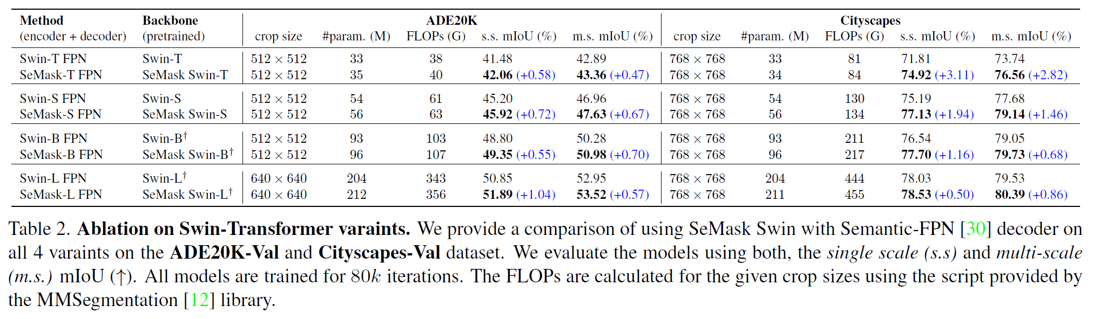
Experiments

Slide 11
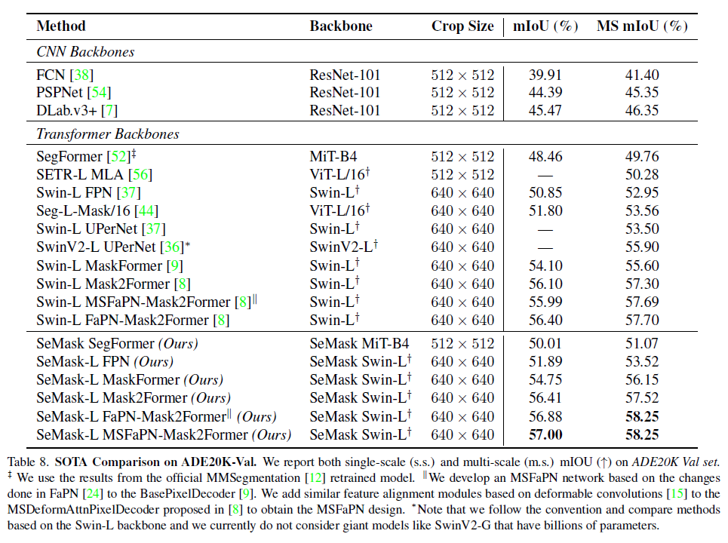
Experiments

Slide 12
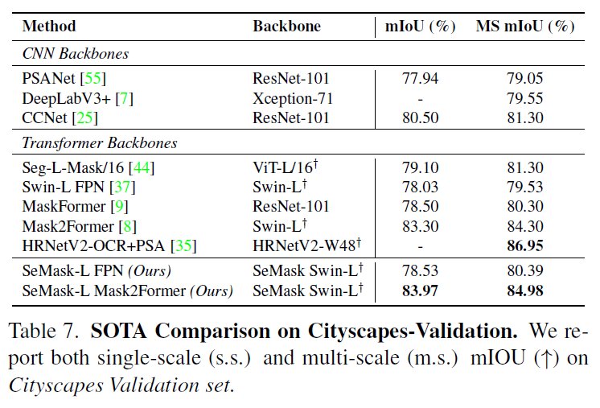
Experiments

Slide 13
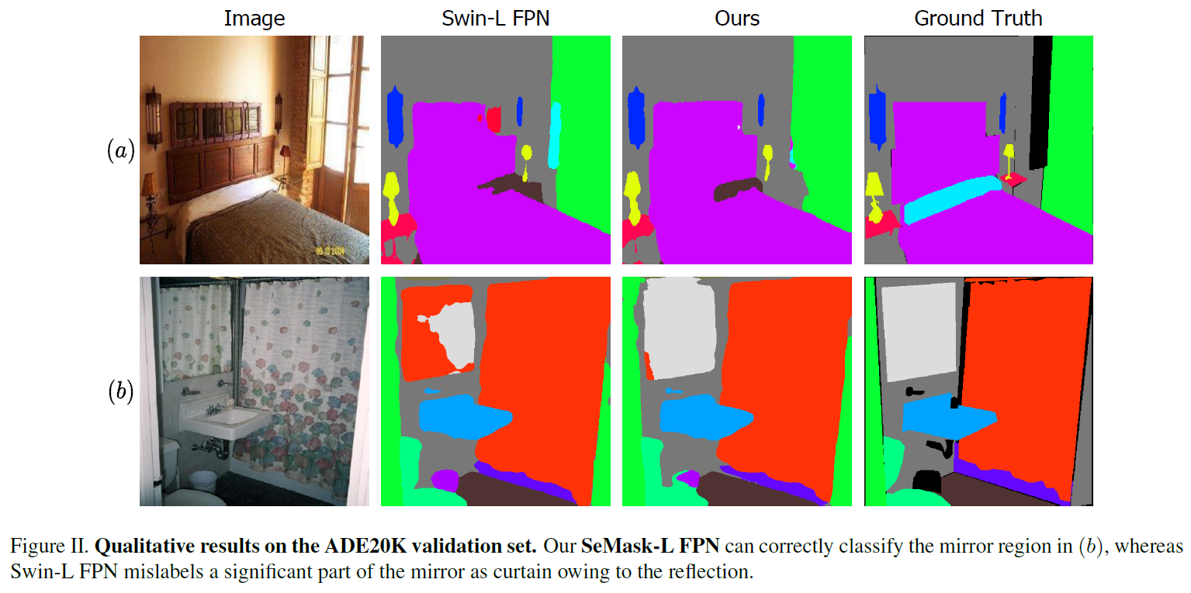
Experiments

Slide 14
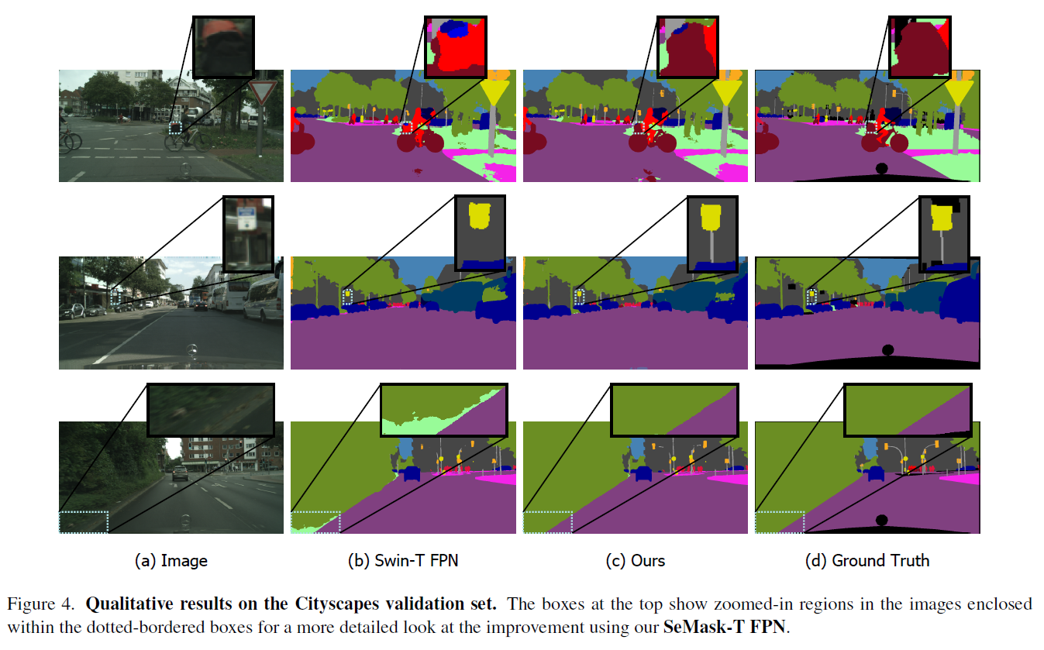
Experiments

Slide 15
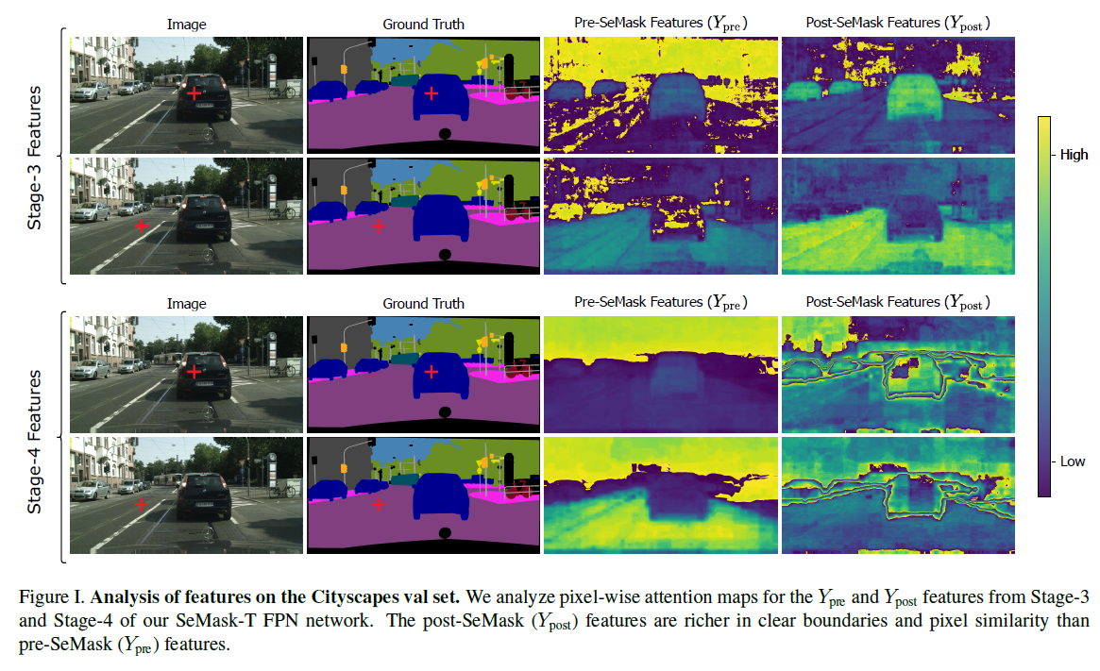
Experiments

Slide 16
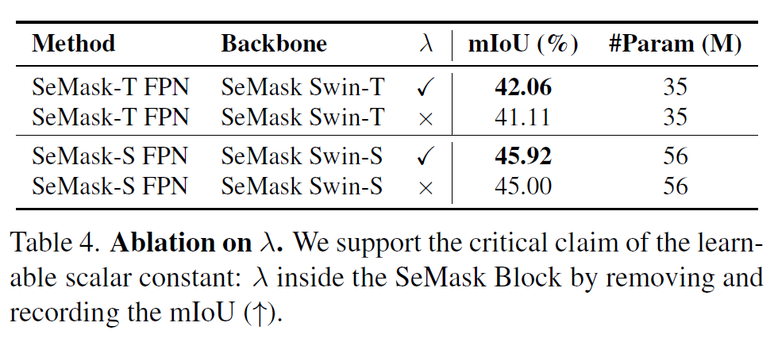
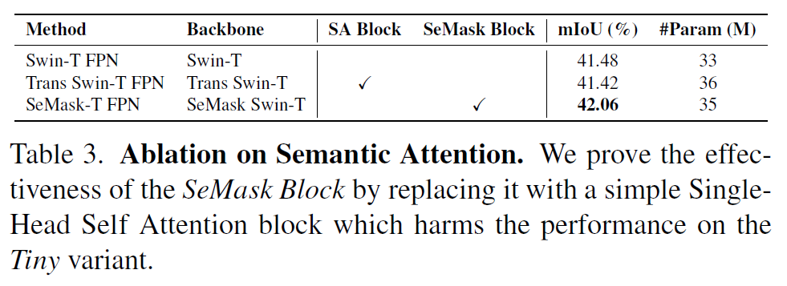
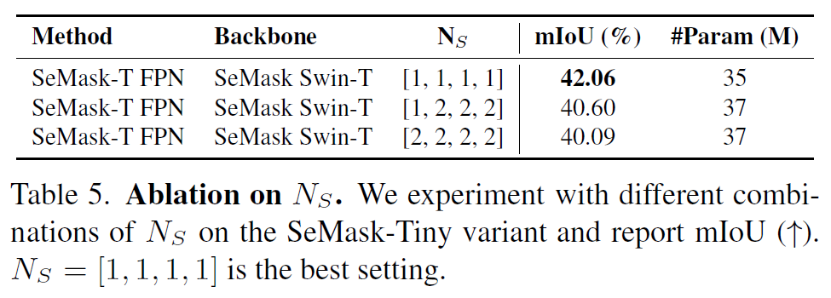
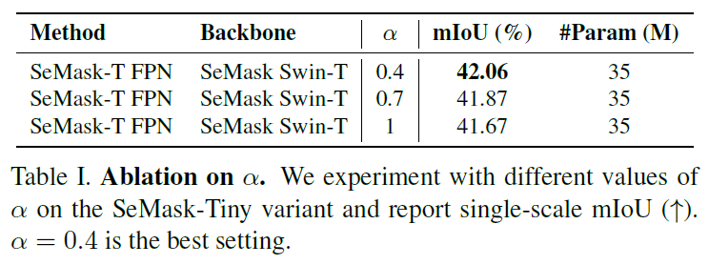
Ablations

Slide 17
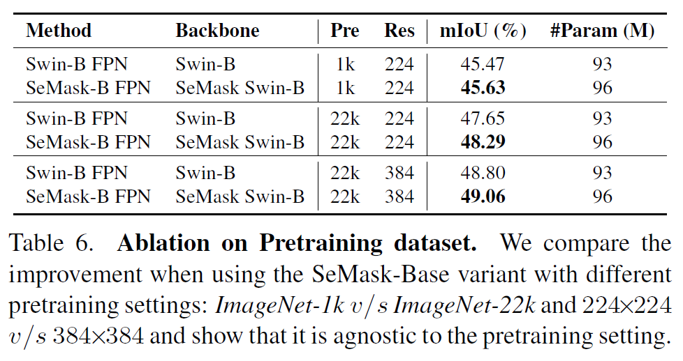
Ablations

Slide 18
Conclusion
Addressed the problem that directly finetuning of pretrained transformer backbone networks as encoders for semantic segmentation does not consider the semantic context in images.
Proposed the SeMask Block that can be plugged into any existing hierarchical vision transformer and uses semantic attention operation to capture the semantic context and augment the semantic representation of the feature maps.
Future research:
Observe the effect of adding similar priors for other vision downstream tasks like object detection and instance segmentation.
Find explanation for the experiments with CNNs resulting in worse performance.

Slide 19
Thank you for listening

