Slide 1
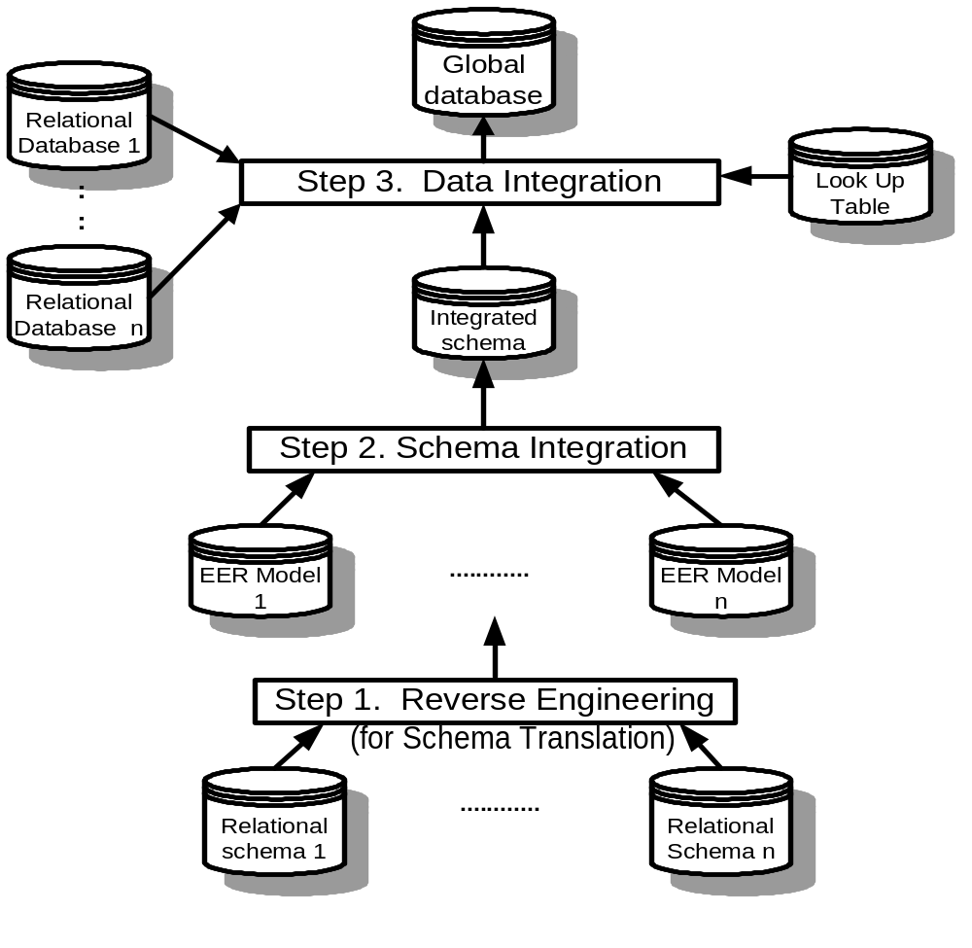
Architecture of multiple databases integration
115/11/08
1

Slide 2
Data Integration Concepts
Data semantics define the relationships between data for user’s data requirements.
Data semantics are presented in database conceptual schema such as EER model and DTD Graph.
Only relevant data can be integrated for an application.
Data relevance depends on user’s data requirements for an application.
Data consistency are the standard of data domain value and format. Inconsistent data must be transformed before data integration.
User supervision means users input for user’s data requirements, and which are for database design and schema integration
115/11/08

Slide 3
Schema integration of EER models
Begin For each existing database do
Begin If its conceptual schema does not exist
then reconstruct its EER model by reverse engineering;
For each pair of existing databases’ EER models schema A and schema B do
begin resolve semantic conflicts between EER model A and EER model B;/step1/
Merge classes between EER model A and EER model B; /*step2*/
Merge relationships between EER model A and EER model B; /*step3*/
end
end
115/11/08

Slide 4
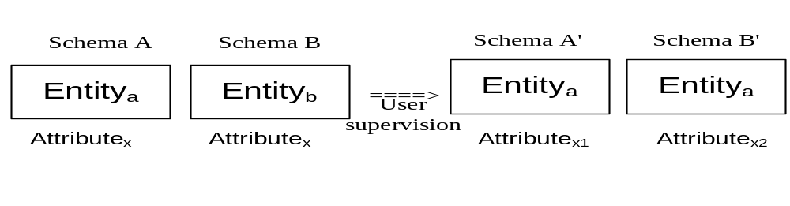
Step 1 Resolve conflicts among EER model
Resolve conflicts on synonyms and homonyms
(note: Class_{a} and Class_{b} are synonyms, Attribute_{x} are homonyms)
115/11/08

Slide 5
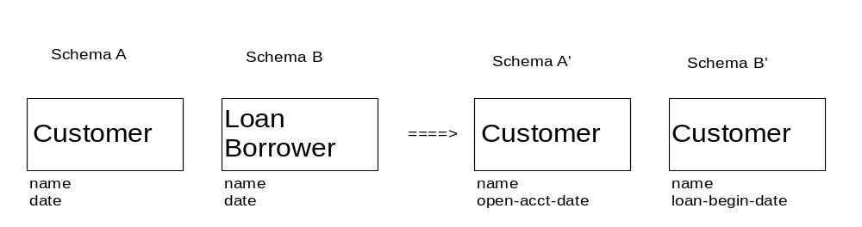
Example
115/11/08

Slide 6
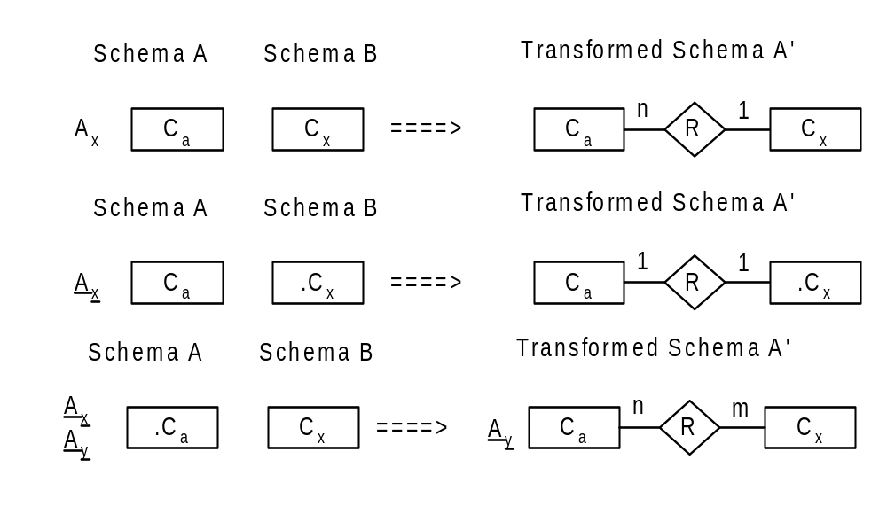
Resolve conflicts on data types
115/11/08

Slide 7
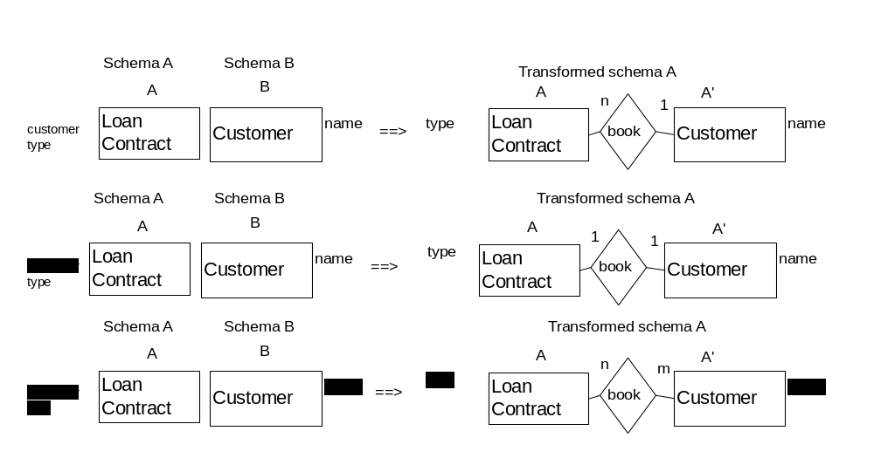
Example
115/11/08

Slide 8
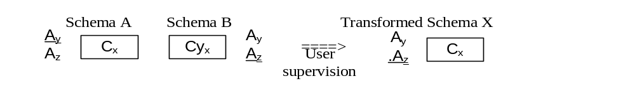
Resolve conflicts on key
115/11/08

Slide 9
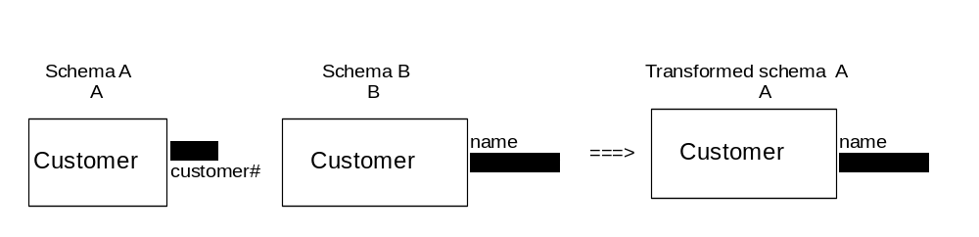
Example
115/11/08

Slide 10
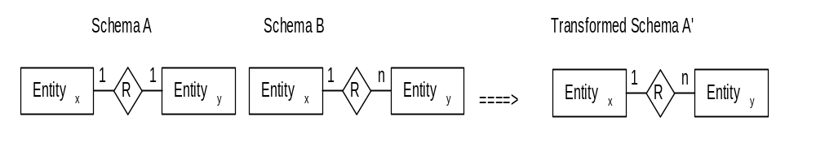
Resolve conflicts on cardinality
115/11/08

Slide 11
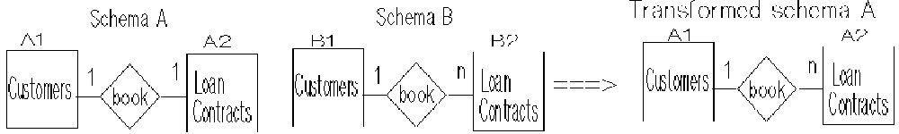
Example
115/11/08

Slide 12
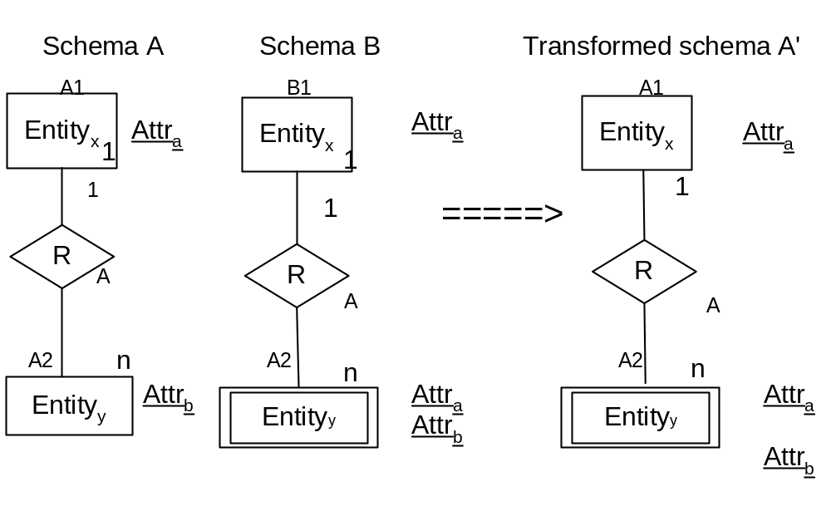
Resolve conflicts on weak entity
115/11/08

Slide 13
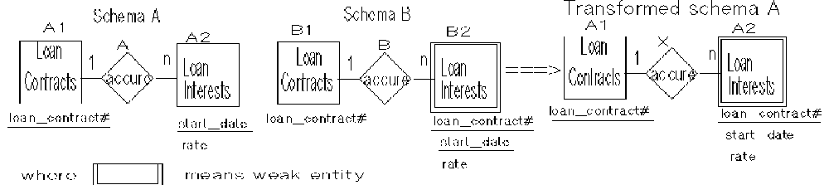
Example
115/11/08

Slide 14
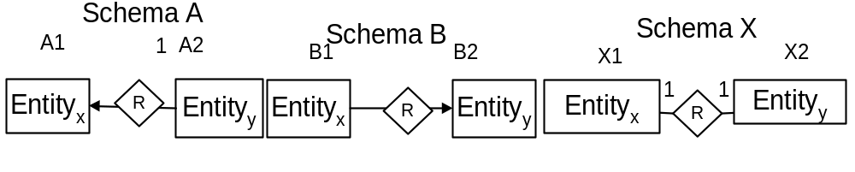
Resolve conflicts on subtype entity
115/11/08

Slide 15
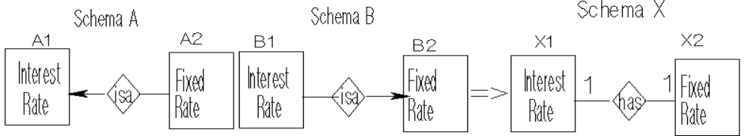
Example
115/11/08

Slide 16
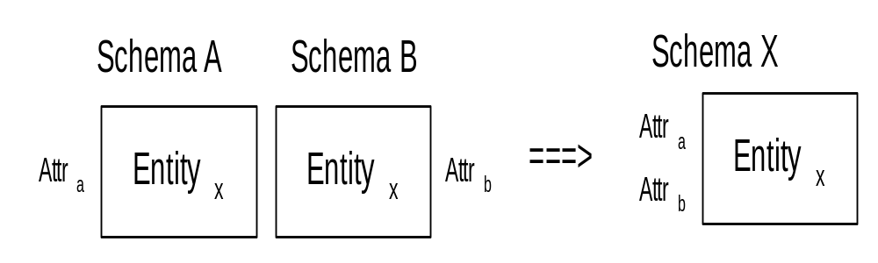
Step 2 Merge entities
Merge classes by Union
115/11/08

Slide 17
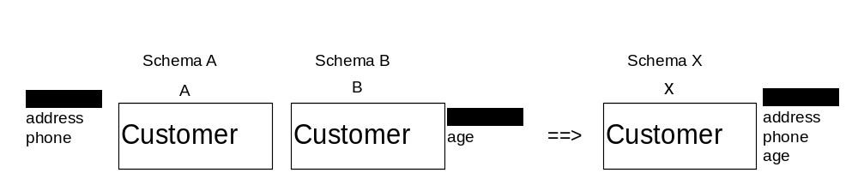
Example
115/11/08

Slide 18
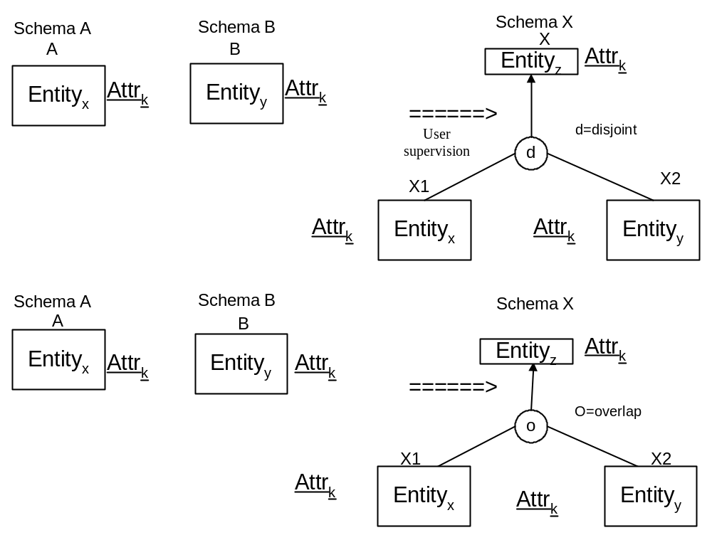
Merge EER models by Generalization
115/11/08

Slide 19
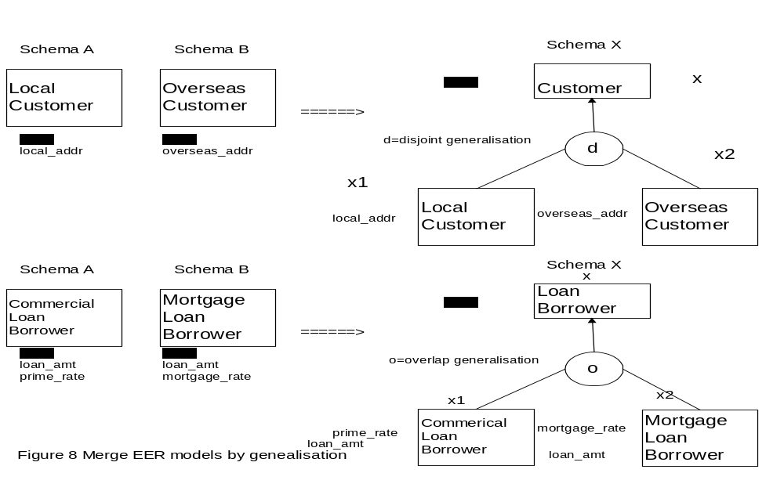
Example
115/11/08

Slide 20
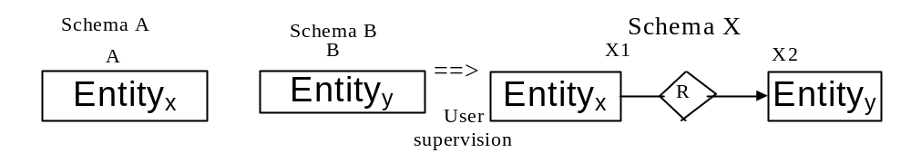
Merge EER models by Subtype Relationship
115/11/08

Slide 21
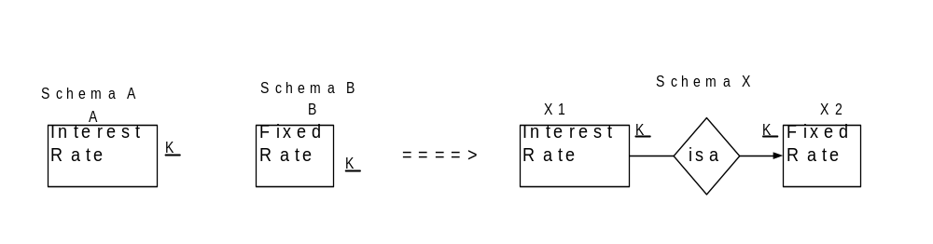
Example
115/11/08

Slide 22
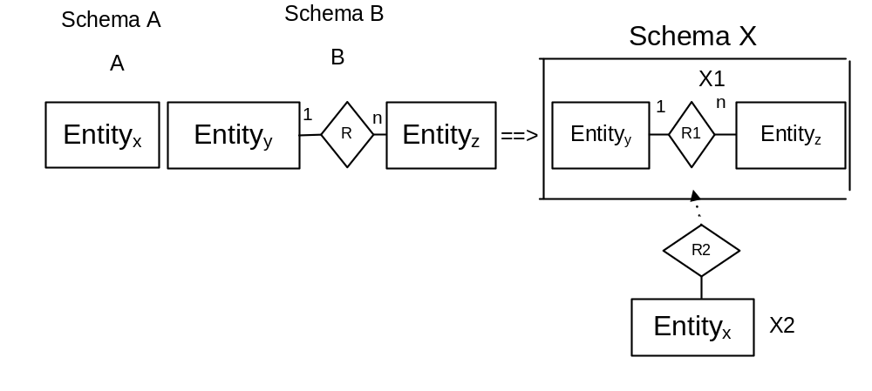
Merge entities by Aggregation
115/11/08

Slide 23
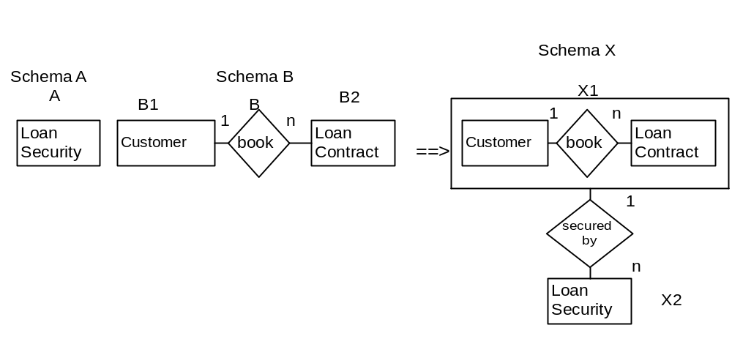
Example
115/11/08

Slide 24
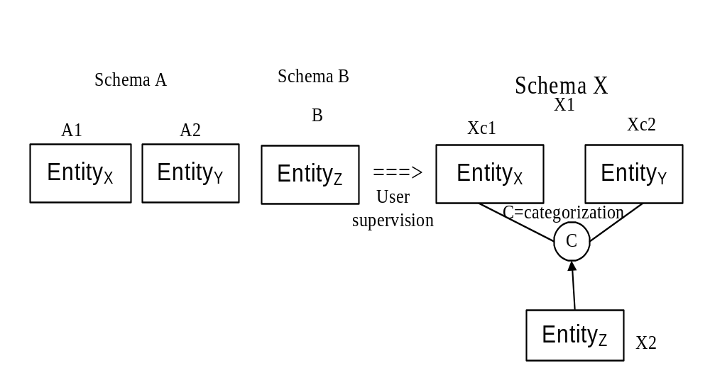
Merge entities by categorization
115/11/08

Slide 25
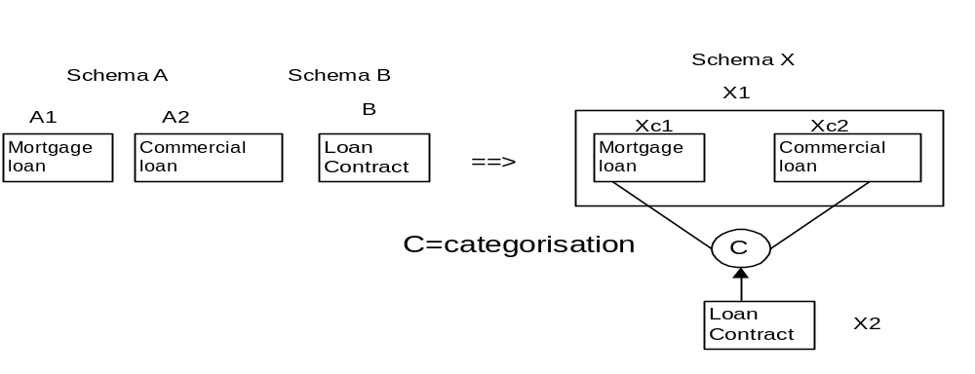
Example
115/11/08

Slide 26
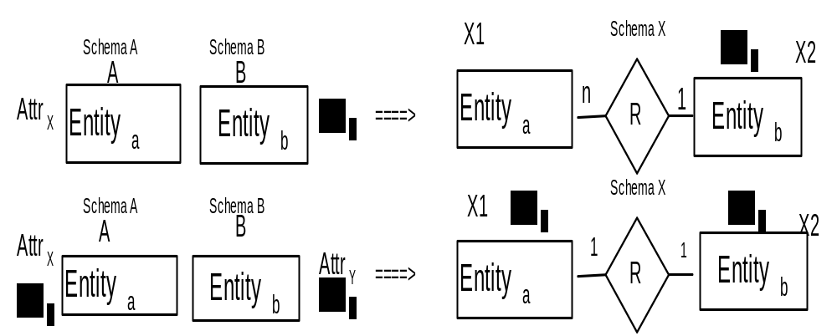
Merge entities by Implied Binary Relationship
115/11/08

Slide 27
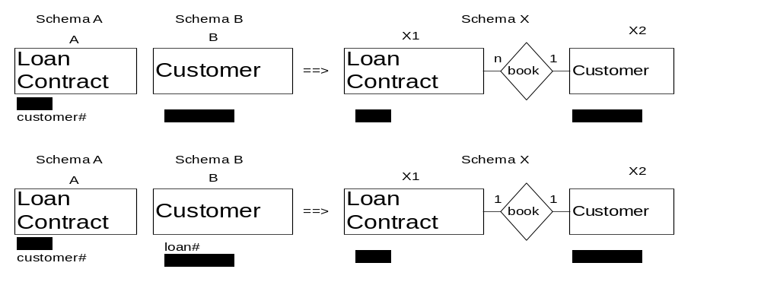
Example
115/11/08

Slide 28
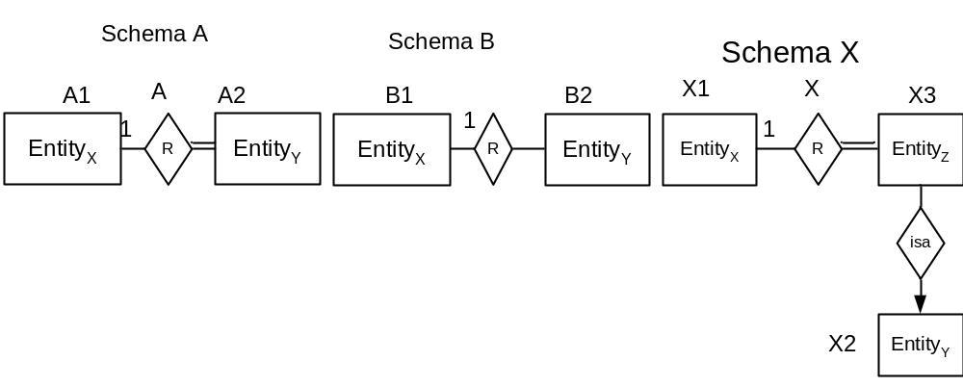
Step 3 Merge relationships
Merge relationships by subtype relationship
115/11/08

Slide 29
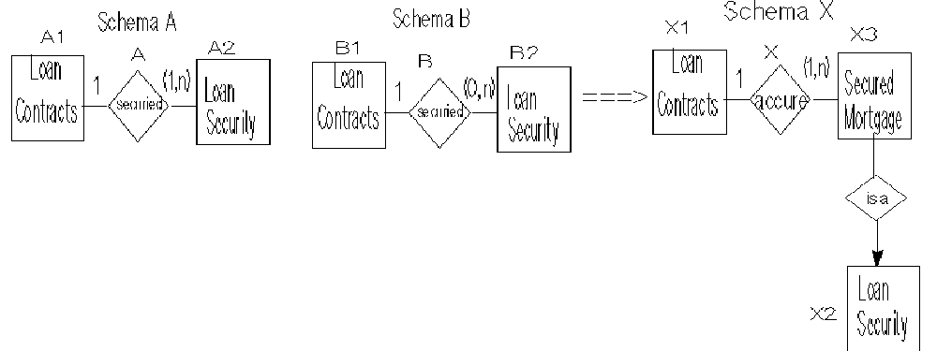
Example
115/11/08

Slide 30
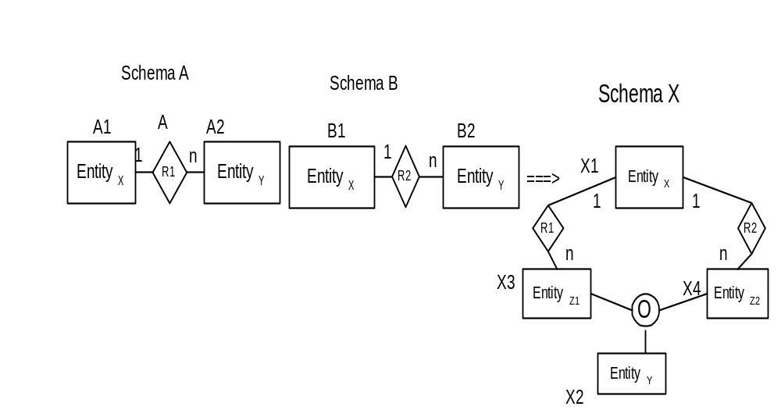
Merge relationships by overlap generalization
115/11/08

Slide 31
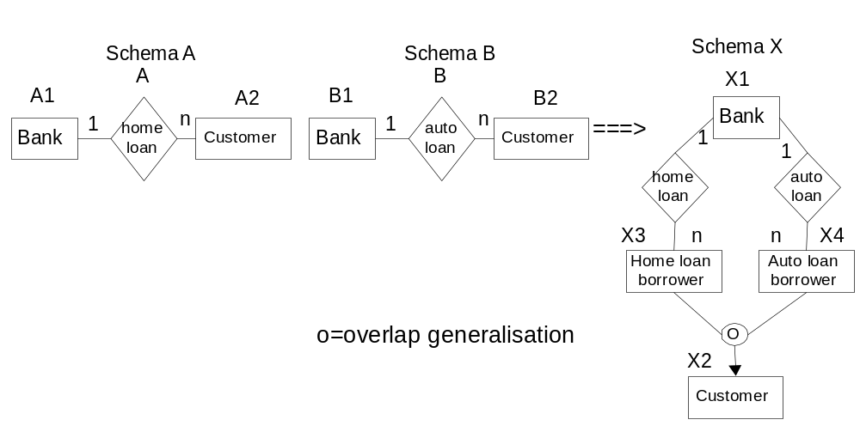
Example
115/11/08

Slide 32
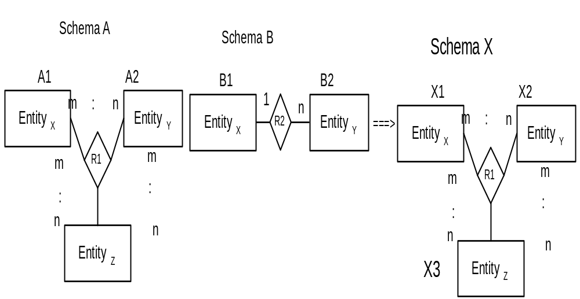
Absorbing Lower degree Relationship into a Higher degree Relationship
115/11/08

Slide 33
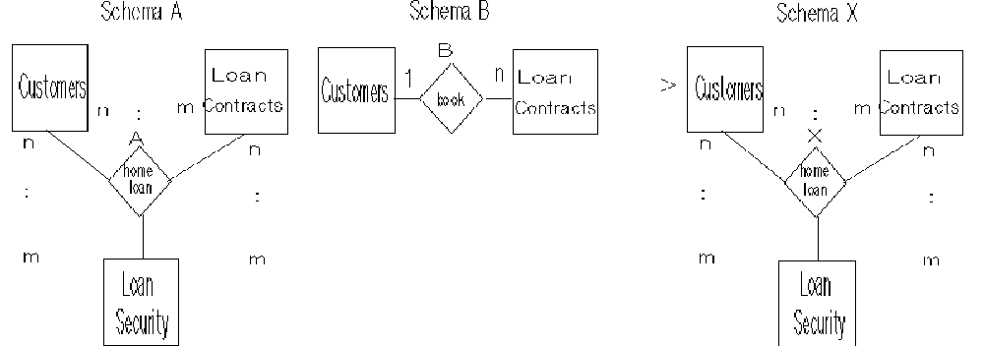
Example
115/11/08

Slide 34
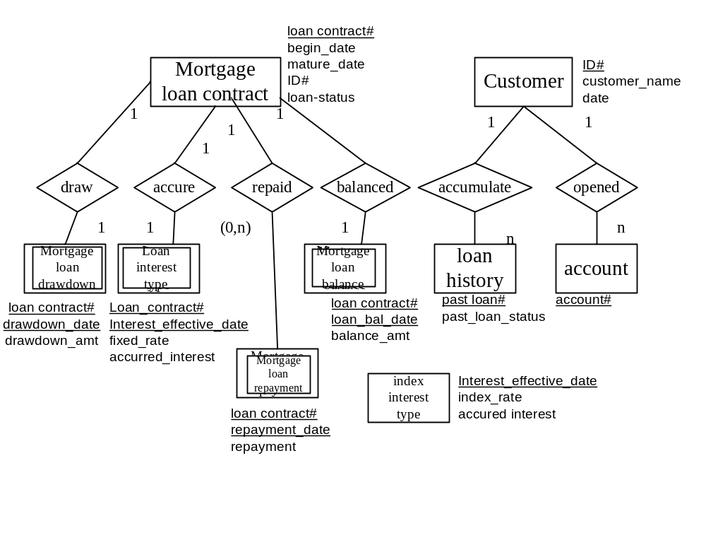
Case Study: In a bank, there are existing databases with different schemas: one for the customers, another for the mortgage loan contracts and a third for the index interest rate. However, there is a need to integrate them together for an international banking loan system.
115/11/08

Slide 35
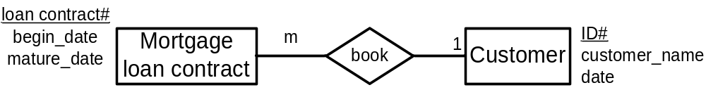
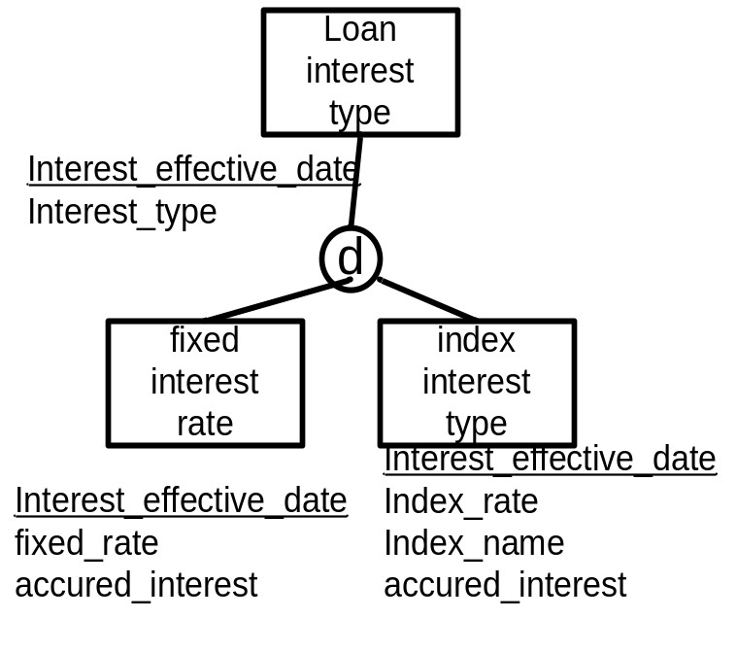
Step 2 Merge entities by Implied binary relationship and Generalization
Since data ID# appears in entity Mortgage Loan Contract and entity Customer, they are in one-to-many cardinality with foreign key on the “many” side.
Since Fixed and Index Interest Rate both have the same key, Interest_effective_date, they can be generalized disjointed as either fixed or index rate.
115/11/08

Slide 36
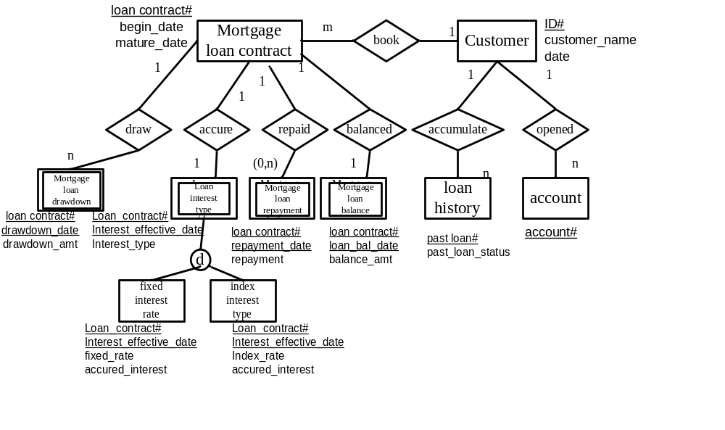
Thus, we can derive cardinality from the implied relationship between these entities, and integrate the two schemas into one EER model.
115/11/08

Slide 37
Reading assignment
“Information Systems Reengineering and Integration” by Joseph Fong, published by Springer Verlag, 2006, pp. 282-310.
115/11/08

Slide 38
Review question 3
Can two Relational Schemas be integrated into one Relational Schema? Explain your answer.
Which steps need user supervision for integrating two Extended Entity Relationship Models into one Extended Entity Relationship Model? Explain your answer.
115/11/08

Slide 39
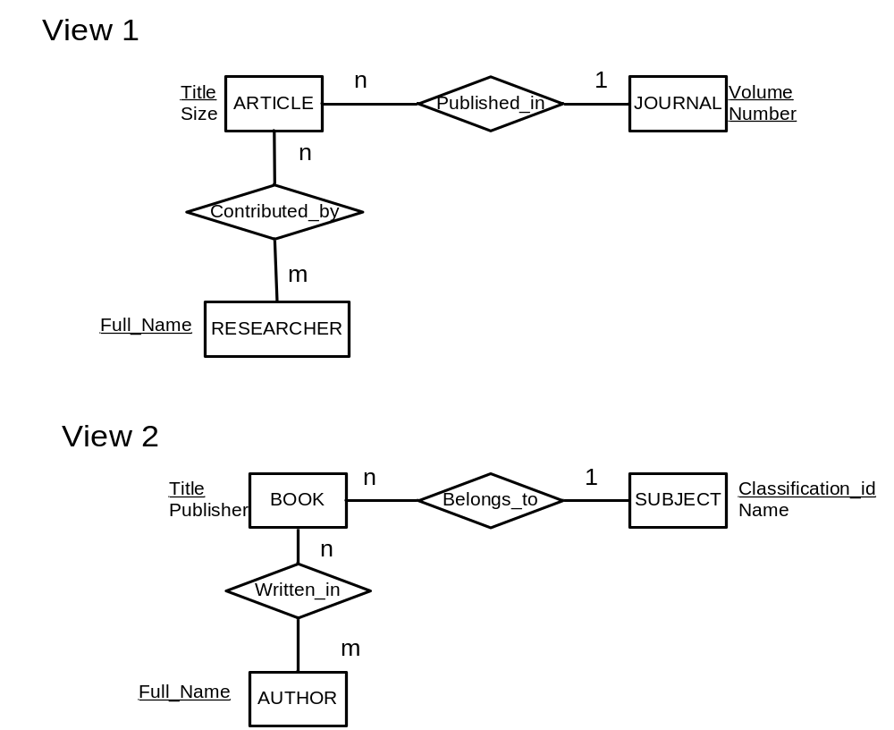
Tutorial question 3
Provide an integrated schema for the following two views which are merged to create a bibliographic database. During identification of correspondences between the two views, the users discover the followings:
RESEARCHER and AUTHOR are synonyms,
CONTRIBUTED_BY and WRITTEN_IN are synonyms,
ARTICLES belongs to a SUBJECT.
ARTICLES and BOOK can be generalized as PUBLICATION.
Hints: Given two subclass entities have same relationship(s). The two subclasses entities can be generalized into a superclass entity and the subclass relationship(s) can also be generalized into a superclass relationship..
115/11/08

