Slide 1
COLOR
Main
#007AFF
Text
#333
Explain
#666973
Other
#B0B3BF
BG
#F5F6F9
颜色由内容色和提示色两部分组成，分别撑起界面的基础信息和状态，主色为高纯度蓝色，更具有视觉冲击力和科技感。其他内容色向蓝色色相微微靠拢，使整个界面更加通透协调。提示色和蓝色也在同一纬度。
The color is composed of content color and prompt color, which respectively support the basic information and state of the interface. The main color is high-purity blue, which has more visual impact and sense of science and technology. Other content color is slightly closer to the blue color, making the whole interface more transparent and coordinated. Cue colors and blue are also at the same latitude.
Danger
#F94441
Warm
#FF8700
Normal
#2EAE00

Slide 2
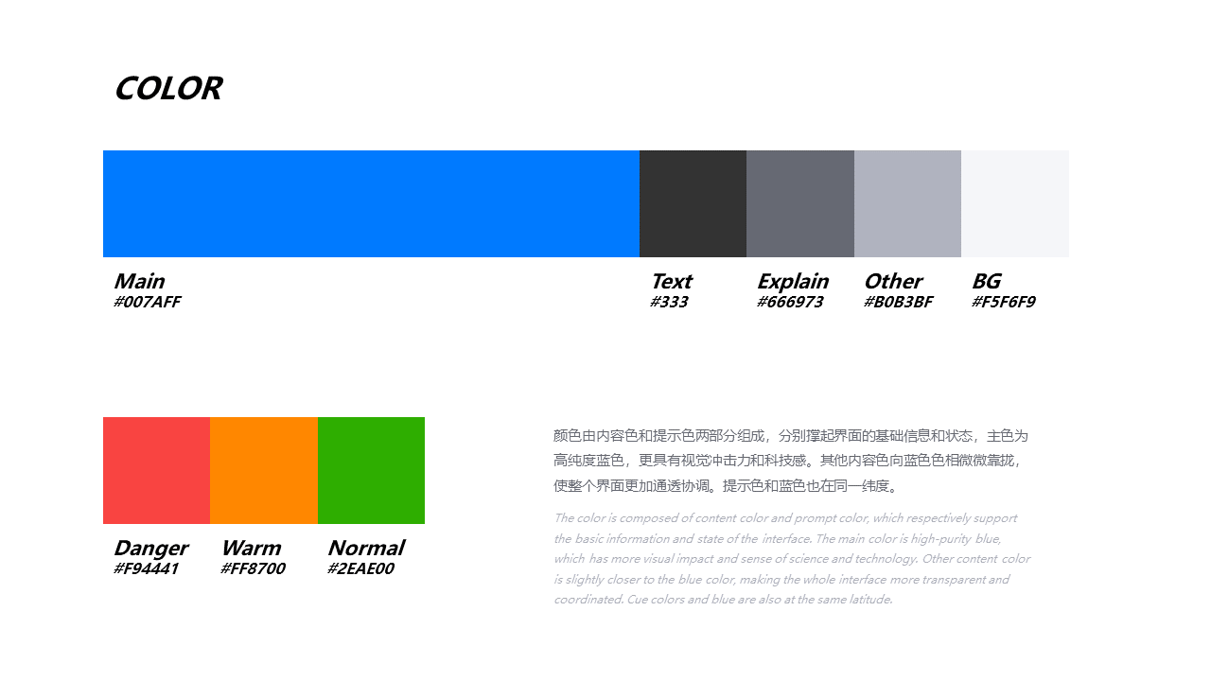
UI规范-色彩
UI SPECIFICATION-COLOR

