Slide 1

BITCOIN: EMERGENCE OF GLOBAL INVESTMENT ASSET
HUY NGUYEN
PACE UNIVERSITY - NEW YORK

Slide 2
Motivation: Flights To Safe Theory
During high market uncertainty, risk-averse investors will reallocate their portfolios away from risky assets and toward safer assets.
> Cross-market hedging to defense against strong market fluctuations.
> Relationship between assets are more significant as investors simultaneously move their capital between assets

Slide 3
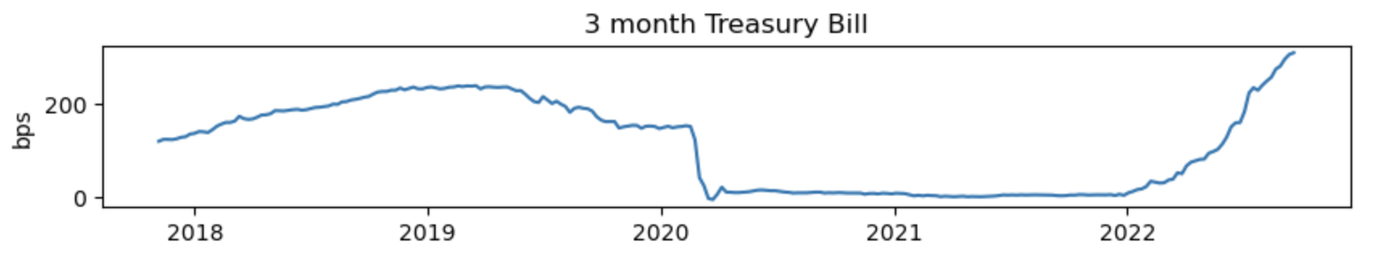
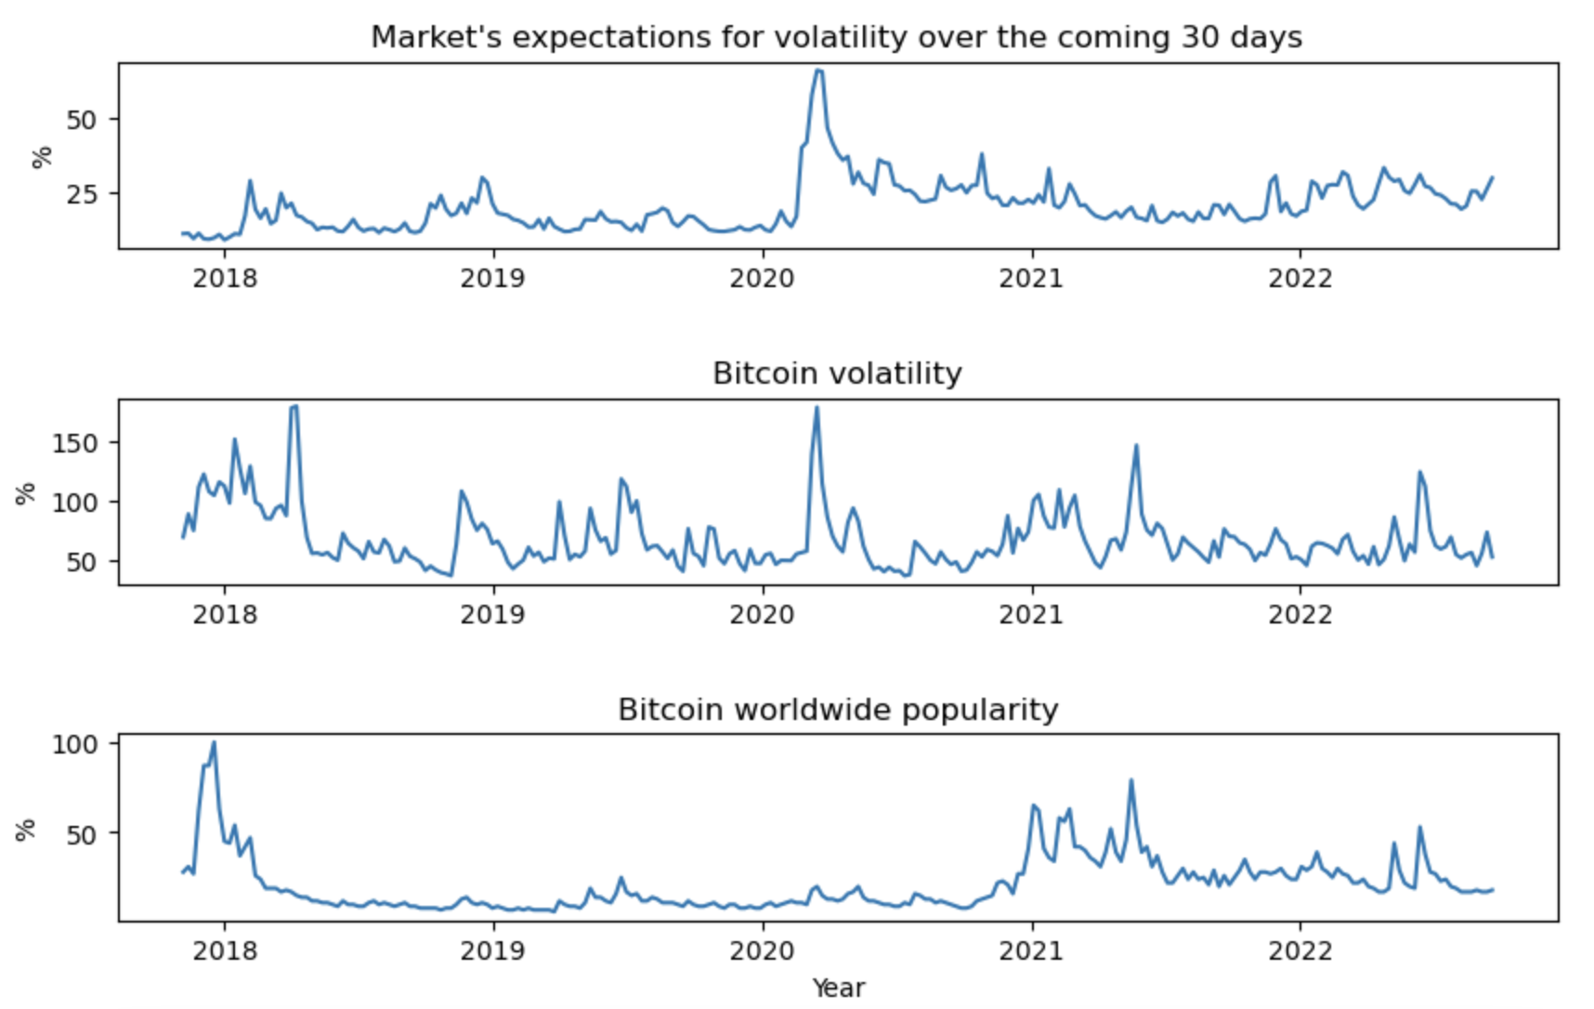

Slide 4
Research Questions
During market panic, do investors consider bitcoin a safe haven or a risky asset?
If bitcoin is a risky asset, how can we hedge against it during market downturn?

Slide 5
Variables
Dependent Variables:
Covariances of bitcoin and stocks, gold, US dollar
Calculate weekly covariance for most recent 12 weeks to observe the magnitude and direction of the interaction between 2 assets
Covariance = [ X - E(X)] * [Y - E(Y)] (% * %)
Independent Variables:
VIX: Chicago Board Options Exchange Volatility Index (%)
gg_trend_wrld: bitcoin popularity November 2017 - September 2022
btc_garch: bitcoin volatility measured by Garch(1,1) model
covid: time dummy variable, from January 2020 until end of August 2020
tbill: 3-month Treasury bill interest rate (basis point)
Data collected from Yahoo finance, NYU V-lab, Alpha Vantage, and google trends

Slide 6
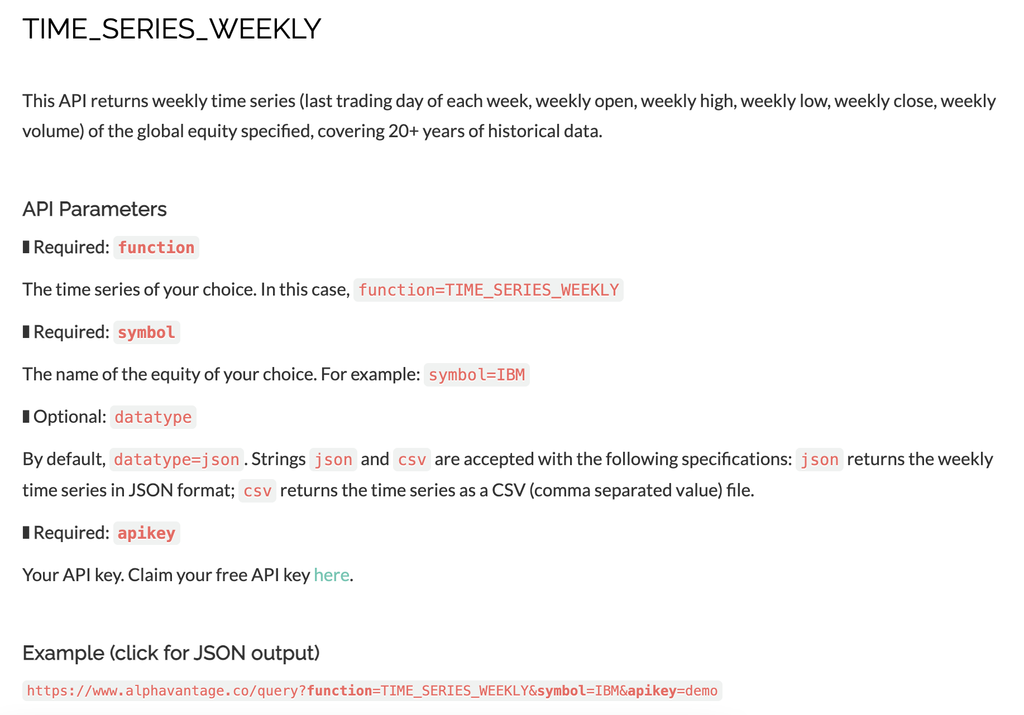
Dependent Variables

Slide 7
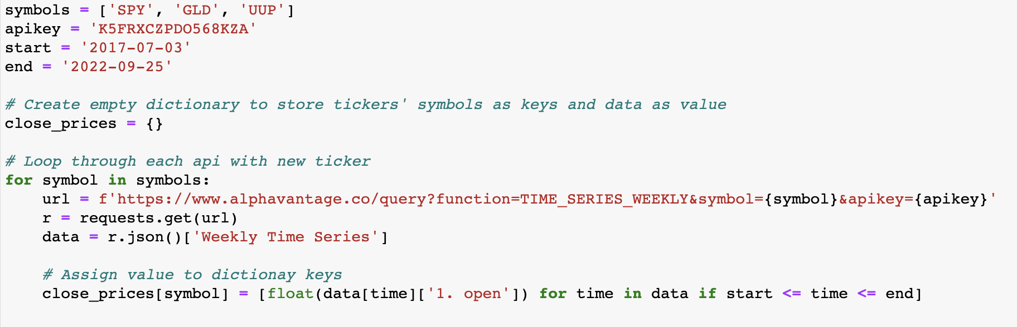
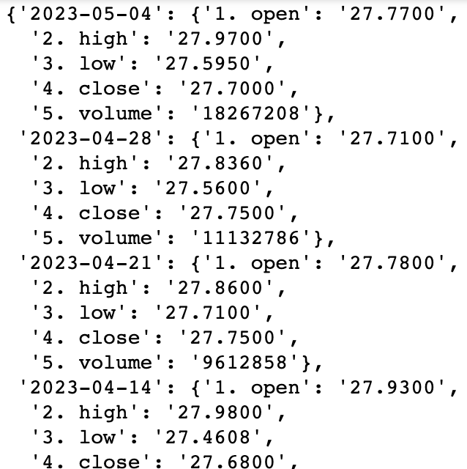

Slide 8
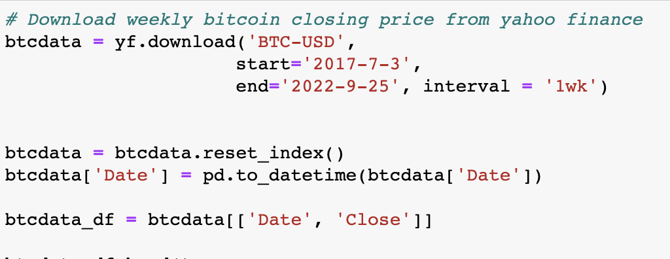
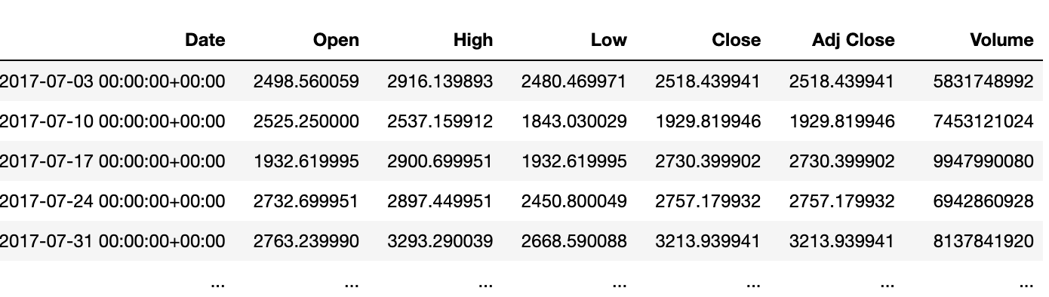

Slide 9
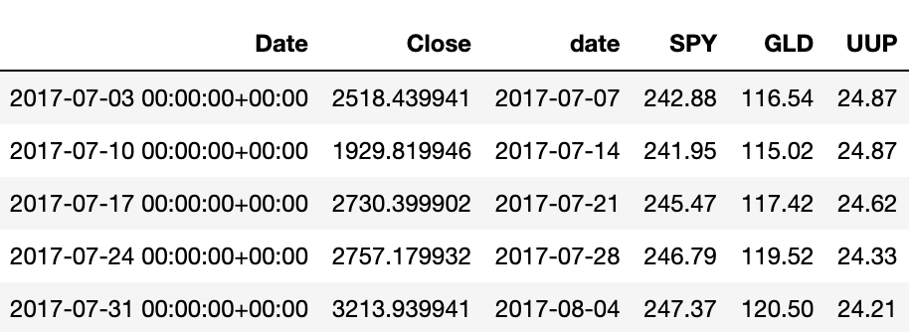
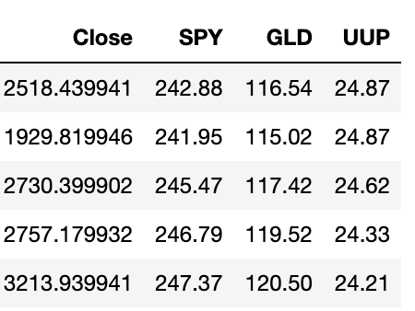
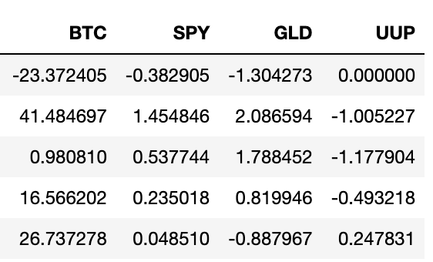
Monday open price
Monday close price
Only take value
Rename and calculate return (%)

Slide 10
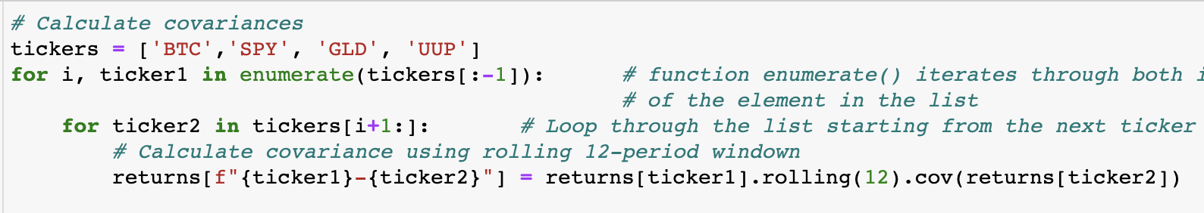
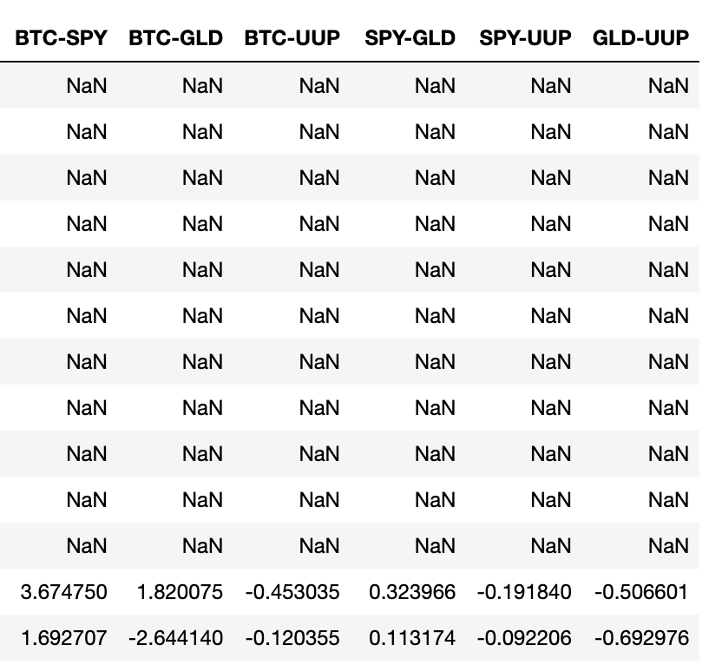
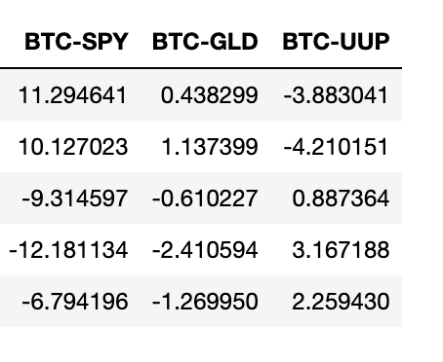
Head
Tail

Slide 11
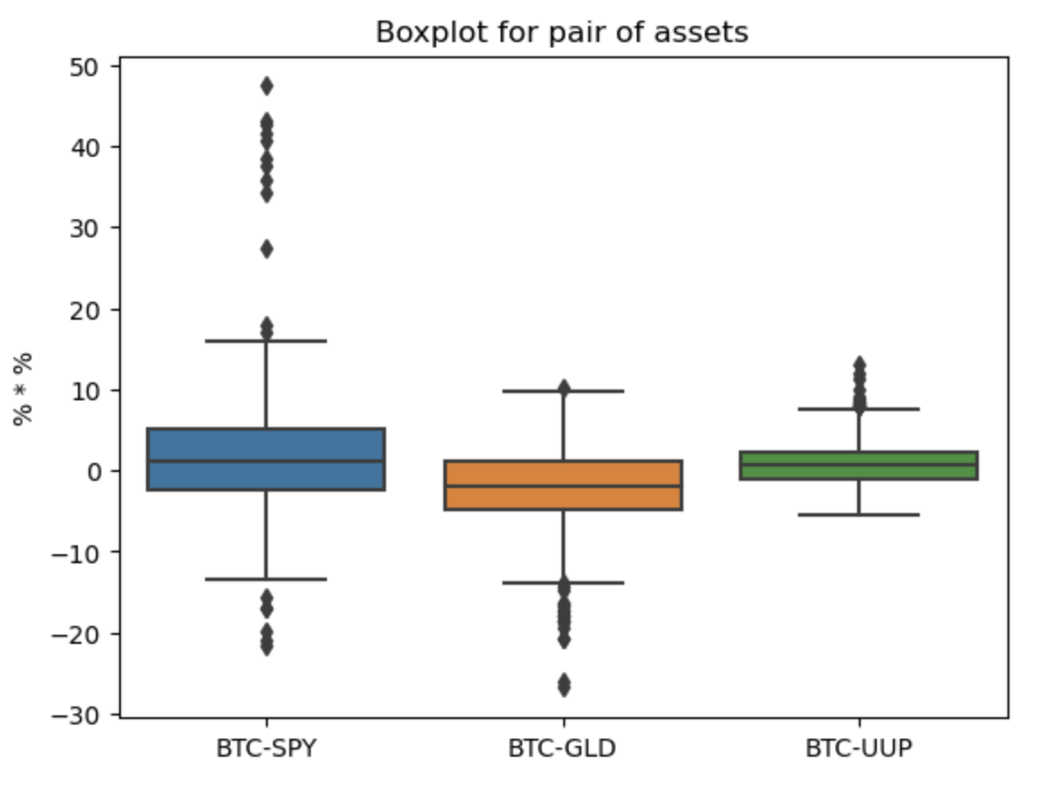

Slide 12
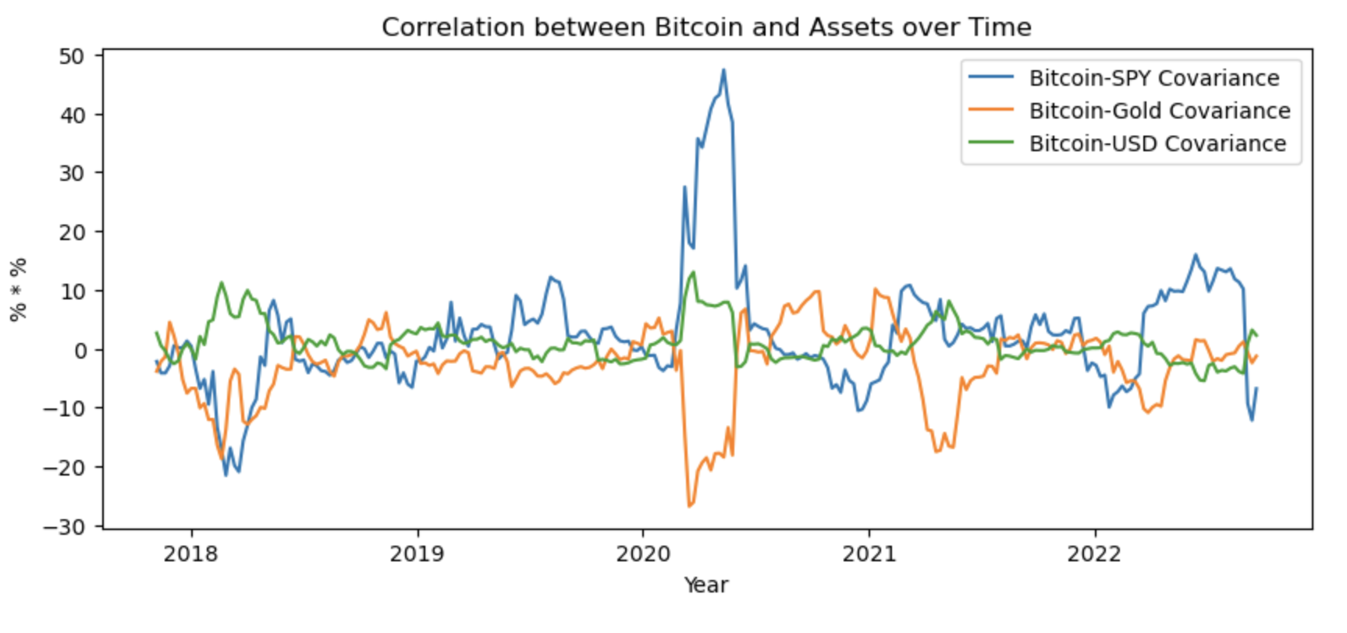
Graphs

Slide 13
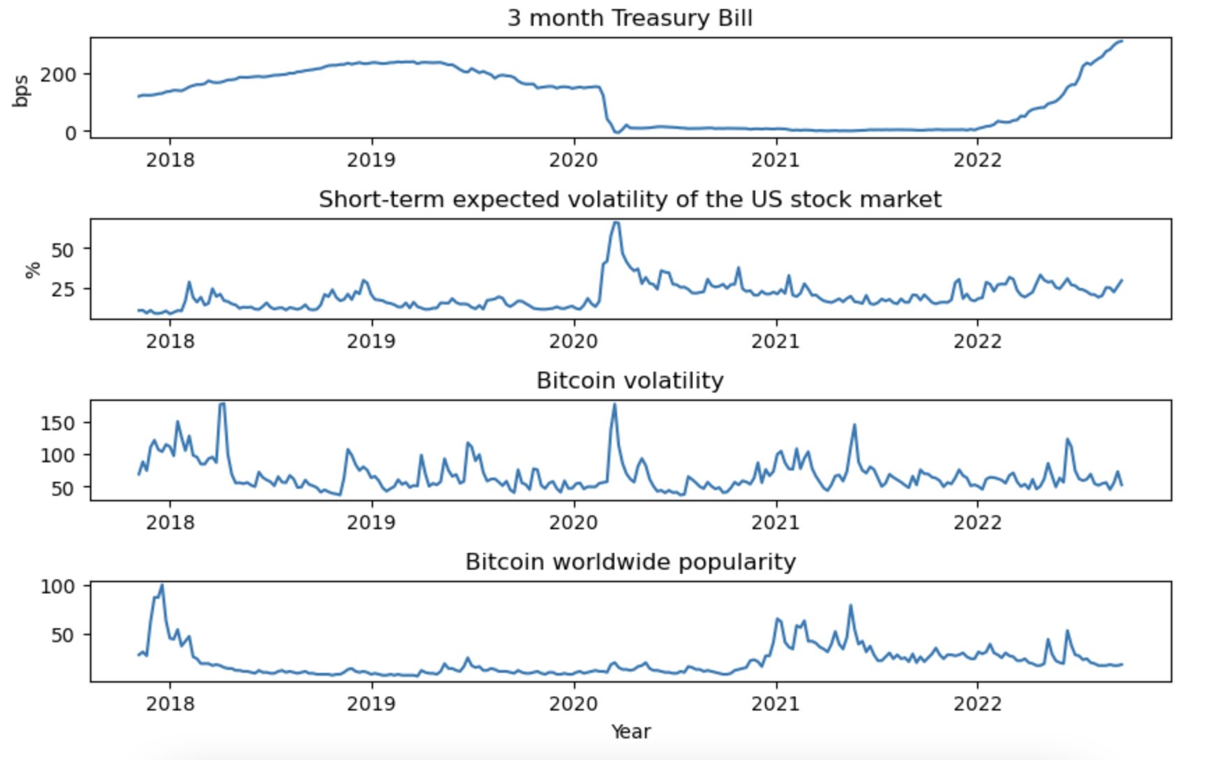

Slide 14
OLS Regressions
cov_bspyt = β0 + β1(VIX) + β2(VIX*covid) + β3(tbill) + β4(tbill*covid) + β5(gg_trend_wrld) + β6(btc_garch)+ u
cov_bgldt = β0 + β1(VIX) + β2(VIX*covid) + β3(tbill) + β4(tbill*covid) + β5(gg_trend_wrld) + β6(btc_garch)+ u
cov_busdt = β0 + β1(VIX) + β2(VIX*covid) + β3(tbill) + β4(tbill*covid) + β5(gg_trend_wrld) + β6(btc_garch)+ u
cov_bspy: covariance of bitcoin and SPDR S&P 500 ETF Trust
cov_bgld: covariance of bitcoin and SPDR gold share
cov_busd: covariance of bitcoin and U.S Dollar Index (DXY)

Slide 15
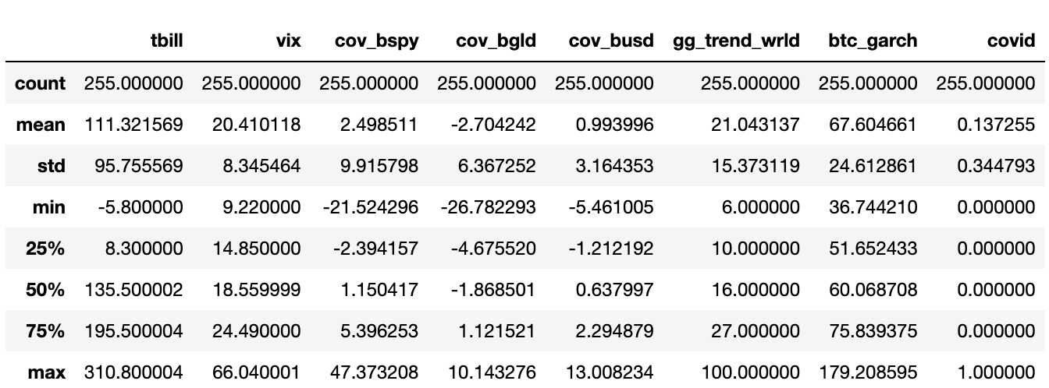
Data Summary

Slide 16
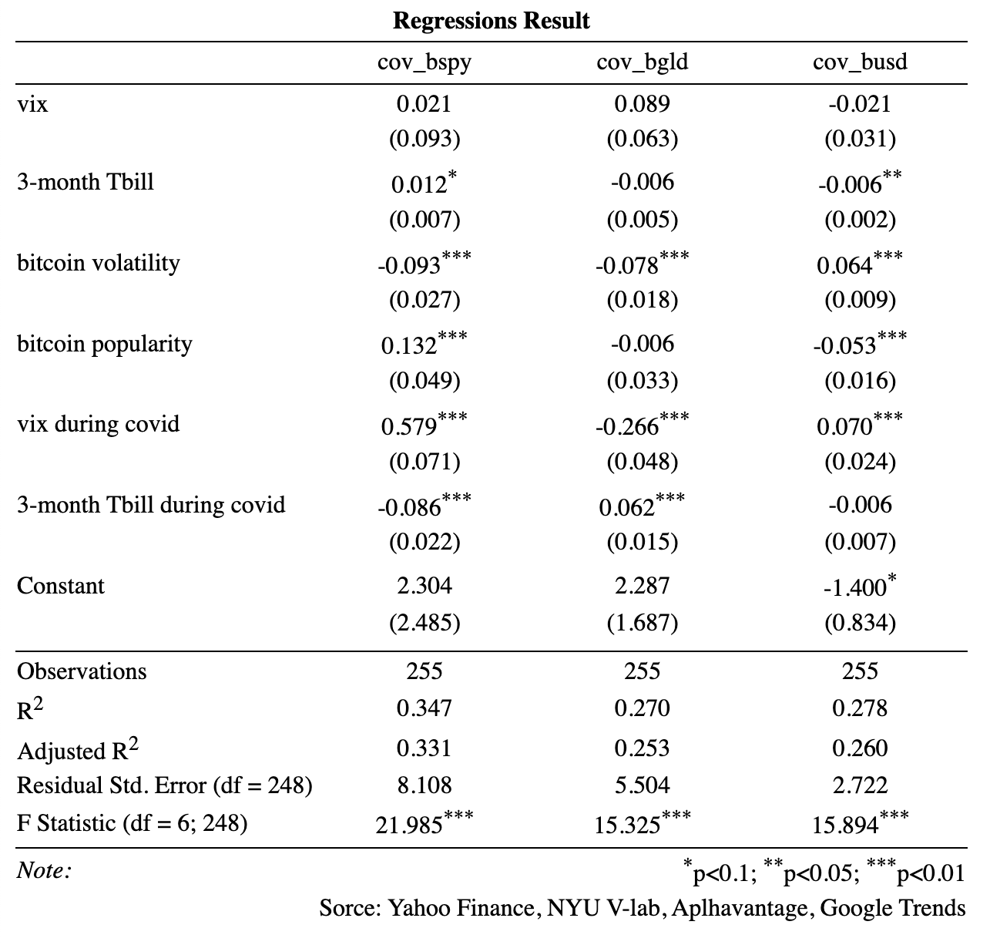
Results
On average:
vix’s affect on these relationships is not statically significant
3-month Treasury bill has statistically significant but weakly positive effect on the correlation of bitcoin with SPY and the dollar
During covid:
When vix increases by 1% point, the covariance between bitcoin and SPY increases by 0.579 (% * %)
When 3-month Treasury bill decreases by 1 basis point, the covariance between bitcoin and SPY increases by 0.086 (% * %)

Slide 17
Conclusions
Bitcoin is currently being treated as a speculative assets, rather than a hideout during market downturn
Gold and dollar-denominated assets (US dollar, US bonds) can be used to hedge against bitcoin under extreme market uncertainty

Slide 18
THANK YOU FOR LISTENING!

