Slide 1
Urban air quality system
Monitoring PM2.5 and forecasting the next 1–24 hours
Sources
Air quality + weather
Processing
Collect and analyze
Dashboard
Readings and forecasts
IT4043E Project
1
Notes:
The goal is a dashboard that shows recent air-quality measurements, historical trends and 1–24 hour PM2.5 concentration forecasts. PM2.5 refers to fine airborne particles. OpenAQ supplies pollution observations and Open-Meteo supplies modeled weather. This overview represents the complete target system, including planned components. AQI is a later extension.
Sources in IT4043E_Project:
docs/system-design.md
docs/architecture.md

Slide 2
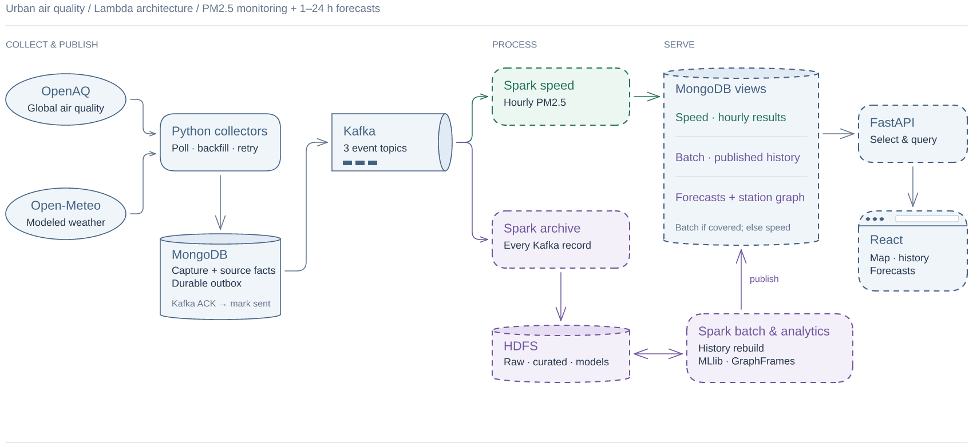
System architecture
Collectors fetch data. Spark prepares it for MongoDB.
Data sources
OpenAQ
Open-Meteo
Collectors
Poll providers
Kafka
Events
+ catalog
Spark
Validate and
store data
MongoDB
Processed data
MongoDB
Jobs + retries
FastAPI + React
Planned interface
Collectors track unfinished work. Spark stores validated readings.
2
Notes:
Collectors poll providers and retain captured responses, durable outbox entries, request budgets and leased jobs in a separate collector control database. They publish four topics, including source_catalog metadata. Spark Structured Streaming consumes Kafka and writes guarded source facts and catalog projections to the serving database. The two MongoDB databases have different names and responsibilities. Source latest snapshots remain separate from interval measurements. Hourly serving views and the API/dashboard are subsequent work.
Sources in IT4043E_Project:
docs/architecture.md
docs/streaming.md
docs/collectors.md

Slide 3
Speed and batch processing
Target design for hourly results and corrected historical analysis
Speed processing
Update recent hours
Serving views
MongoDB
Kafka
Incoming events
HDFS archive
Raw records
Batch jobs
Rebuild history
The API uses speed results until batch includes the latest changes.
3
Notes:
These dashed components represent planned hourly speed views, HDFS archival, batch reconstruction and derived serving views. The existing Spark source-fact projection pipeline on the previous slide is already implemented. The speed path recomputes affected hourly groups. The archive retains every Kafka record, including invalid input and broker coordinates. Batch jobs rebuild from a fixed committed archive cutoff and publish only after validation. MLlib forecasts and GraphFrames station analysis use historical datasets and publish results. FastAPI selects a batch result only when it covers that key’s latest processed input. Both paths must use equivalent revision and quality rules.
Sources in IT4043E_Project:
docs/system-design.md
docs/data-contracts.md
docs/streaming.md

Slide 4
Data architecture
Each reading belongs to a sensor and a reporting interval
Station
Location
Sensor
One parameter
Current measurement
One value per interval
select current
Weather location
Coordinates
Weather versions
Valid hour + fetch time
Measurement revisions
Earlier + corrected values
Corrections replace old values. Weather must be available by forecast time.
4
Notes:
A station can have many sensors, and a sensor produces observations for distinct reporting intervals. Distinct content revisions remain in measurement_revisions; measurements selects the current revision. A repeated delivery adds no extra observation. For the same station/hour, readings of 30 and 40 have mean 35. Correcting 30 to 50 changes the mean to 45, rather than treating 50 as an additional reading. station_weather maps eligible stationary station coordinates to reusable weather locations. Weather vintages keep valid time and actual fetch availability. Forecast features must use only vintages available at the forecast origin. The diagram omits locality and parameter catalogs, latest projections and source snapshots for a focused explanation.
Sources in IT4043E_Project:
docs/mongodb-schema.md
docs/data-contracts.md
docs/streaming.md

Slide 5
Deployment and next steps
Docker Compose supports development. Kubernetes is the target deployment.
Target: Kubernetes on one workstation
Current pipeline
Docker Compose
Collectors, Kafka and Spark
Processed data in MongoDB
Control plane
Scheduling
Worker 1
Services
Worker 2
Services
Next components
Kafka, MongoDB, HDFS and Spark workloads
HDFS and hourly views
Forecasting and analytics
FastAPI and React
A workstation failure affects every node.
5
Notes:
The current Compose pipeline runs collectors, Kafka, Spark and MongoDB, with Spark using local two-thread execution and a durable checkpoint volume. The target assessment deployment uses one kind control-plane node and two worker nodes on a workstation. Spark will run directly on Kubernetes. The node diagram is schematic and does not assign services to fixed nodes. The planned HDFS layout has one NameNode and three DataNodes with replication factor three. Sharing one physical workstation limits machine-level availability. Infrastructure sizing, HDFS, hourly views, batch publication, ML/graph analytics, FastAPI and React require subsequent implementation and verification.
Sources in IT4043E_Project:
docs/streaming.md
docs/system-design.md
docs/implementation-plan.md

