Slide 1

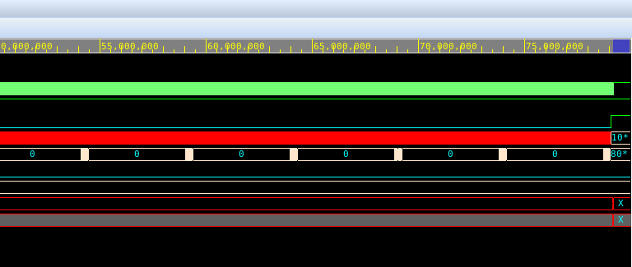
Controller RTL Verification
VCS + Verdi | Original RTL, high-contrast stress fixture
Figure 1. Clock, PEready, count, newBest and output registers across the test.
Figure 2. End of the simulation window
Original 8-bit result
BestDist = FF
motionX, motionY = X, X
The saturated comparator never chooses a valid candidate in this stress test.

Slide 2
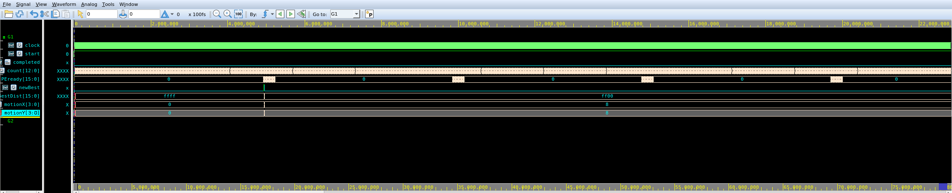
16-bit SAD Verification
VCS + Verdi | Separate precision-corrected RTL and directed stimulus
Figure 3. newBest selects FF00 and the encoded vector (8,8) for the all-FF stress case.
BestDist is input-dependent: these are three different stimulus cases.
Team perfect match
0000
Single-pixel perturbation
0003
All-00 reference / all-FF search
FF00
FF00 is not the expected output of the team's 0000 perfect-match testbench.

Slide 3
14 nm Physical Design Checkpoint
Fusion Compiler + PrimeTime | 520 MHz | Routed V5 results
Physical implementation
PrimeTime: extracted RC
Measured metric
V5 result
Corner
Setup WNS
Hold WNS
Routed cell area
2,781.30 µm²
FAST
+0.52 ns
-0.14 ns
Mapped cells
6,310
TYPICAL
+0.30 ns
-0.12 ns
Sequential cells
449
SLOW
-0.06 ns
-0.09 ns
Memory macros
0
Typical power
0.729 mW
Setup: 17 SLOW failures
Hold: 402 FAST / 120 TYP / 33 SLOW
V5: CTS and routing completed. ICV DRC still reports 18 violations.
Final sign-off requires DRC repair, physical ECO, extraction and PrimeTime setup/hold on the corrected layout.

