Slide 1

SAD Saturation — Original RTL
VCS + Verdi nWave | Directed 16×16 high-contrast corner case
Figure 1: Original 8-bit datapath; full VCS result: completed = 1, BestDist = FF, motionX/Y = X.
Stimulus
Expected 16-bit SAD
Observed failure
Reference pixels = 00; search pixels = FF.
256 × |00 − FF| = 65,280 = FF00.
8-bit output saturates at FF; no newBest event.
Cause: the comparator resets BestDist to FF and accepts a candidate only when newDist < BestDist. FF cannot beat FF.
ENGR 852 | V3 independent verification and SAED14 implementation | Native university Synopsys output
1

Slide 2
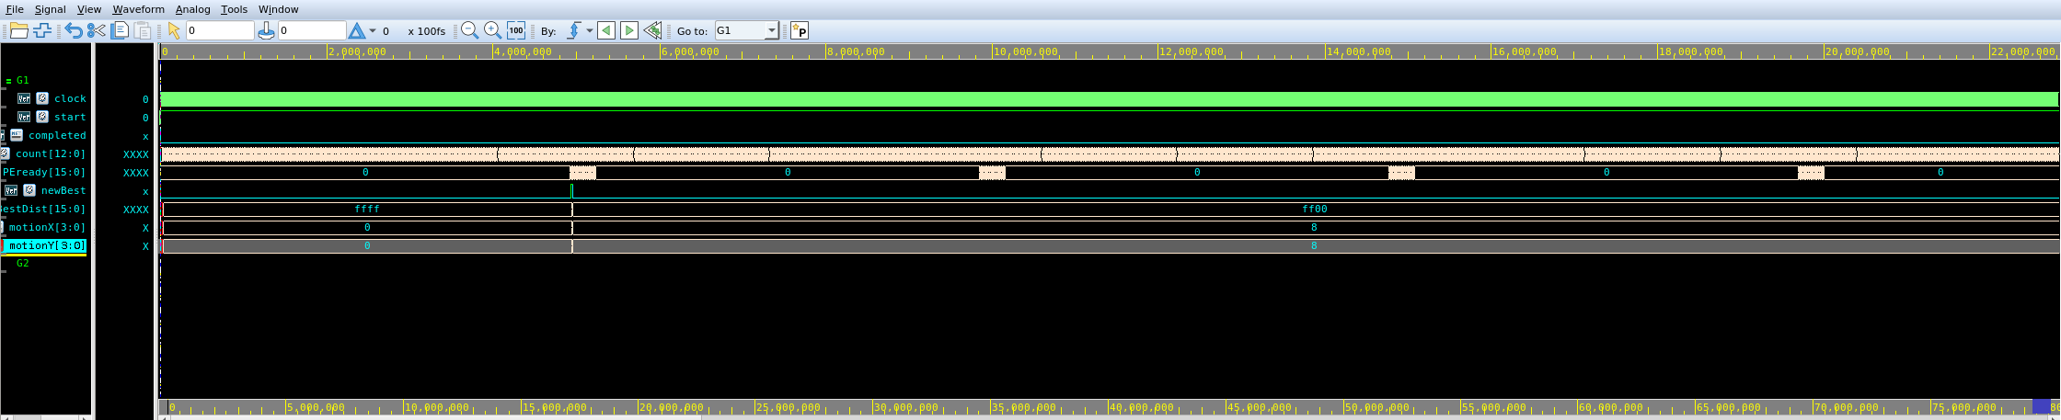
16-bit SAD — Verification After RTL Change
VCS + Verdi nWave | Separate full-precision and completion-hold variant
Figure 2: Synopsys FSDB shown in Verdi nWave; newBest asserts and BestDist becomes FF00.
BestDist
Selected vector
Tie handling
FF00 (65,280 decimal), 16-bit accumulator.
motionX=8, motionY=8 → (−8,−8).
All search candidates equal; first is retained.
Original professor RTL retained separately. The wider accumulator fixes the FF no-selection corner case; further varied-image regression is still required.
ENGR 852 | V3 independent verification and SAED14 implementation | Native university Synopsys output
2

Slide 3
520 MHz ASIC Implementation
Synopsys Fusion Compiler X-2025.06-SP2a | SAED14 RVT library
Measured mapped-design comparison
Required course constraints
Metric
Original 8-bit
16-bit V3B
Clock period: 1.923 ns (520 MHz)
Standard-cell area
881.96 µm²
1,193.03 µm²
Input and output delay: 0.5 ns
Total mapped cells
1,693
1,905
Clock uncertainty: 0.2 ns
Reference/search memories: testbench only
Sequential cells
280
416
Macro / memory cells
0
0
Implementation checkpoint
Synthesis, floorplan and placement completed. CTS / route / DRC / extraction / PrimeTime final setup and hold are not yet verified.
V3B compile-stage setup slack: +0.06 ns (MET).
Area increased by 311.07 µm² (35.3%) versus the 8-bit baseline. This is the area cost of the corrected wider datapath; not post-route area.
ENGR 852 | V3 independent verification and SAED14 implementation | Native university Synopsys output
3

