Slide 1
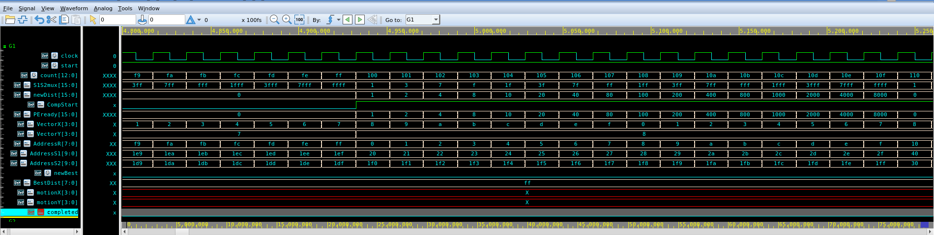
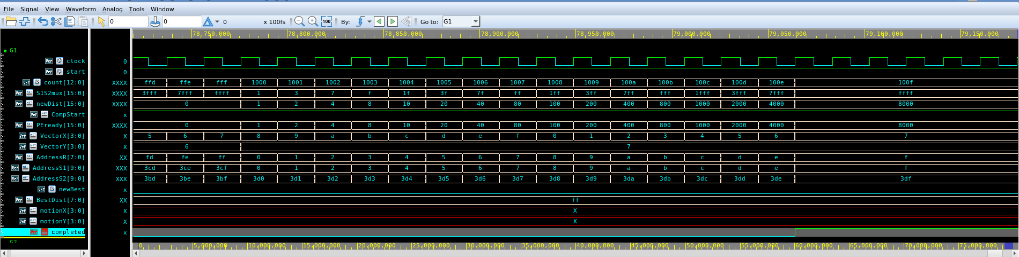
Original 8-bit RTL: High-Contrast Saturation Verification
VCS + Verdi nWave | All-00 Reference vs. All-FF Search Stress Fixture (520 MHz)
Figure 7: First row completion (count = 0x00F9..0x0110) — PEready[15:0] shifts 0x0001..0x8000, newBest stays 0, BestDist[7:0] = 0xFF
Figure 8: Module completion (count = 0x0FFD..0x100F, t = 7,905.45 ns) — completed = 1, BestDist[7:0] = 0xFF, motionX/Y = X (no candidate < 0xFF)

Slide 2
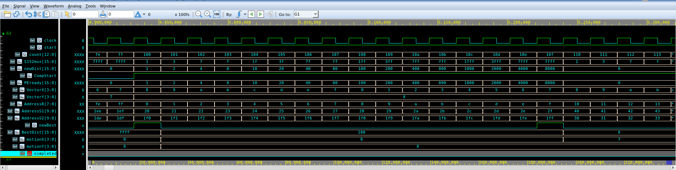
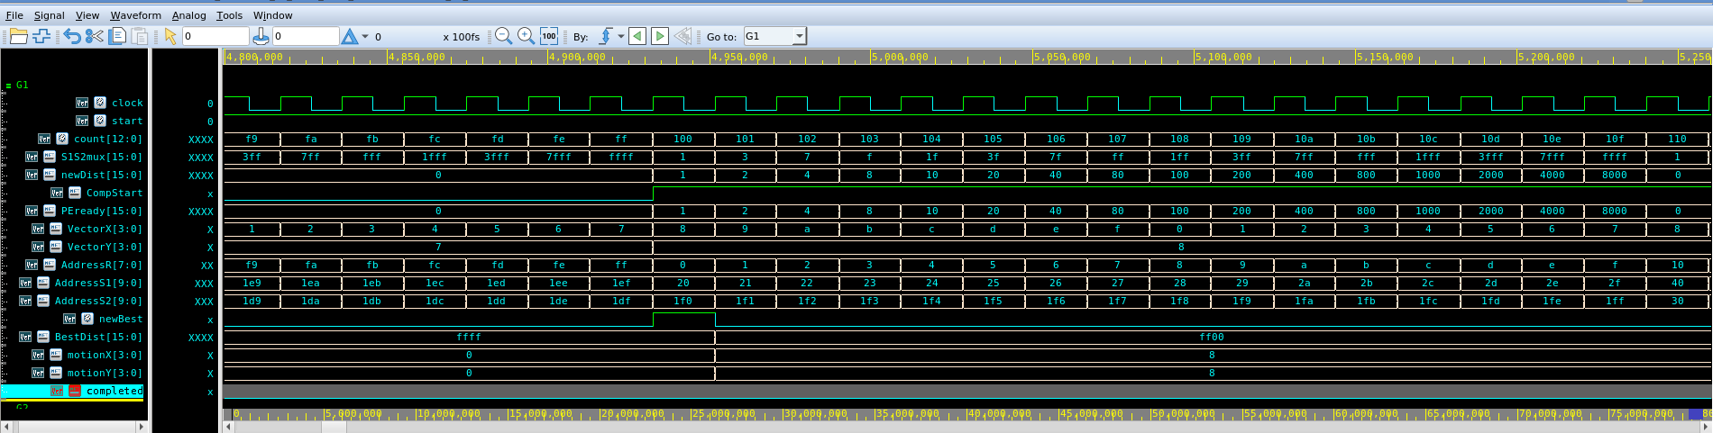
Corrected 16-bit SAD RTL: Full-Precision & Stimulus Comparison
VCS + Verdi nWave | 16-bit Accumulate/PEout/BestDist + Completion Hold at count = 13'h100F
Figure 9: Direct perfect-match fixture (ref.txt / search.txt) — BestDist[15:0] latches 0x0100 at count = 0x0100 and reaches 0x0000 at count = 0x010F
Figure 10: High-contrast stress fixture (All-00 vs. All-FF) — newBest pulses 1 at count = 0x0100, latching BestDist[15:0] = 0xFF00 (65,280) and vector (8,8)
Stimulus Testbench Case (520 MHz)
Observed Cycle & Motion Vector
Final BestDist[15:0]
Team Random / Direct Perfect Match
Exact match at (-2,-3) [E,D] or (+7,-8) [7,8]
0000 (SAD = 0)
Perturbed Imperfect Match (Rmem[0] += 3)
count = 1542 (0x0606), motionX = E (-2), motionY = D (-3)
0003 (SAD = 3)
All-00 Reference vs. All-FF Search Stress
count = 256 (0x0100), motionX = 8 (-8), motionY = 8 (-8)
FF00 (SAD = 65,280)

Slide 3
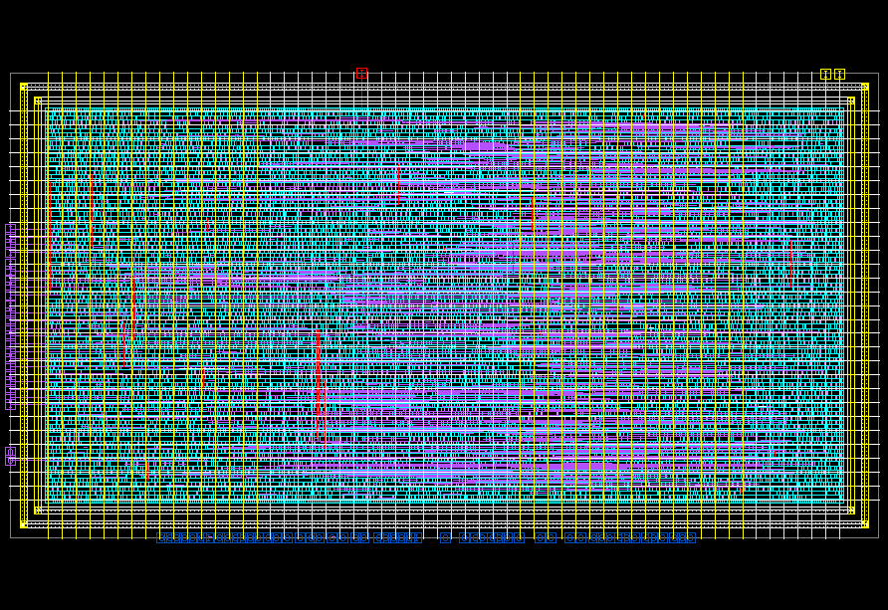
14 nm Physical Design & 3-Corner PrimeTime Sign-Off
Synopsys Fusion Compiler + IC Validator + PrimeTime | SAED14 RVT | 520 MHz (1.923 ns)
Physical Implementation & Sign-Off Metrics
Final Routed 14 nm Chip Layout (top.gds)
Design Parameter
Final Verified Sign-Off Result (V9)
Die / Core Dimensions
125.07 x 62.80 um (7,854.40 um2 die; 6,558.99 um2 core)
Standard-Cell Area
3,416.18 um2 netlist (52.08% util; 6,221.28 um2 w/ fillers)
Placed Cell Count
8,230 logic cells (449 FFs); 15,983 total DEF components
Synthesized Memories
0 memory macros (ROM_R & ROM_S in testbench only)
Total Power (TT 0.8V 25C)
0.890 mW total (0.889 mW dynamic + 0.00089 mW leak)
IC Validator DRC & LVS
CLEAN: 0 DRC violations (242/242 rules), 0 LVS errors
Standalone PrimeTime Post-Layout STA (3 Corners + SPEF)
PVT Corner & Extracted SPEF
Setup WNS (Viol)
Hold WNS (Viol)
FAST (FF 0.88V 125C / minTLU)
+0.71 ns (0 viol)
+0.00 ns (0 viol)
TYPICAL (TT 0.80V 25C / nomTLU)
+0.54 ns (0 viol)
+0.04 ns (0 viol)
SLOW (SS 0.72V -40C / maxTLU)
+0.22 ns (0 viol)
+0.14 ns (0 viol)
SDC Constraints Verified Across All 3 Corners:
• Clock period: 1.923 ns (520 MHz) | Clock uncertainty: 0.200 ns
• Input delay: 0.500 ns | Output delay: 0.500 ns
• GDSII Stream Out: 80 MB merged top.gds (0 unplaced cells, 0 GDS-110)
Figure 11: Synopsys Fusion Compiler routed layout (top/v9_signoff_clean.design) with dual PG ring, M8/M9 mesh, M2-M7 routing, and 242/242 ICV DRC clean sign-off.

