Slide 1
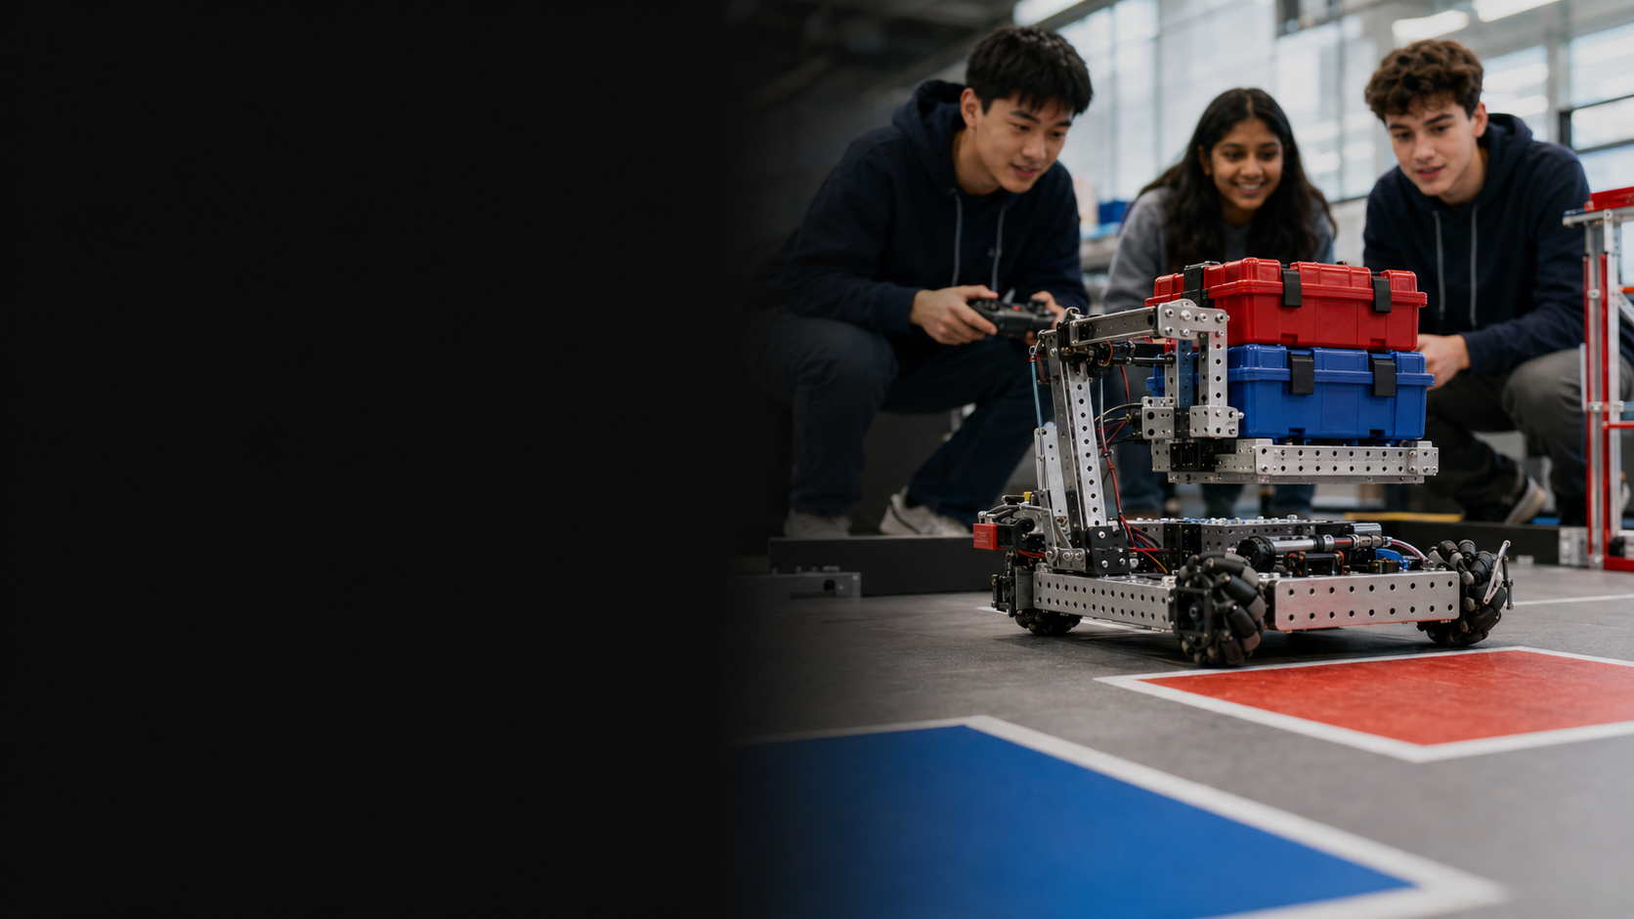
THE SCIENCE EXCHANGE PROGRAM AT LSTS
VEX Rapid
Innovation Challenge
Emergency Supply Delivery Robot
12 students · 4 schools · 3 international teams · 180 minutes
Design. Test. Improve. Defend with evidence.

Slide 2
VEX RAPID INNOVATION CHALLENGE
Robots can go where people cannot
A disaster has made several delivery areas unsafe for people.
SUPPLY ZONE
Your team must adapt a VEX V5 Clawbot to collect emergency supplies and deliver them to designated stations.
CUP
TRAVEL ZONE
PIN
DELIVERY ZONE
Real-world lens: robotic logistics and emergency response
2
2

Slide 3
OUR DRIVING QUESTION
How might we adapt a VEX Clawbot to deliver emergency supplies effectively under different real-world priorities?
There is no single correct answer. Your evidence will make your solution convincing.
3

Slide 4
LEARNING GOALS · KUD
By the end, you will know, understand and do
KNOW
UNDERSTAND
DO
Clawbot components
Engineering Design Process
Baseline, trial and evidence
Many solutions can work
Design involves trade-offs
Data is stronger than opinion
Identify a problem
Build one focused change
Test, analyze and present
4
4

Slide 5
YOUR EQUIPMENT
Use the Override field as your research playground
V5 CLAWBOT
CUPS
PINS
GOALS + ZONES
Base platform — already built and tested
Food and medicine containers
Medical tools and urgent supplies
Collection and delivery stations
01
02
03
04
We borrow selected game elements—not the full competition rules—to create an open engineering challenge.
Source: VEX Robotics, V5RC Override 2026–2027
5

Slide 6
VEX RAPID INNOVATION CHALLENGE
Three international teams, four shared responsibilities
01
DESIGN LEAD
02
MECHANICAL ENGINEER
Keeps the team focused on the problem
Builds and checks the attachment
03
DRIVER + TEST ENGINEER
04
DATA + COMMUNICATION LEAD
Runs every trial consistently
Records evidence and leads the pitch
Everyone contributes ideas, understands the design and speaks during the final presentation.
6
6

Slide 7
YOUR DESIGN PRIORITY CARD
Same mission—three different design priorities
TEAM SPEED
TEAM PRECISION
TEAM VERSATILITY
RAPID RESPONSE
SAFE DELIVERY
MULTI-PURPOSE RESPONSE
Deliver the highest number of supplies in 60 seconds.
Place supplies accurately with the fewest drops and errors.
Handle different objects or delivery locations with one solution.
Your product must reflect this priority.
Your product must reflect this priority.
Your product must reflect this priority.
7
7

Slide 8
DESIGN CONSTRAINTS
Keep the challenge focused and safe
Do not rebuild the drivetrain or main frame.
Make only one major improvement.
Use only the supplied parts and materials.
Keep attachments secure, removable and safe.
Start every trial from the same position.
Complete each trial within 60 seconds.
STOP → CHECK → TEST
8
8

Slide 9
TODAY'S ROADMAP
Your 180-minute sprint has six stages
0–30
BRIEF + TEAM
30–45
BASELINE
45–65
INQUIRE + PLAN
Understand the mission and roles
Observe the original Clawbot
Choose one problem and hypothesis
65–110
BUILD
110–150
TEST + IMPROVE
150–180
PRESENT
Create one focused improvement
Run trials and use the evidence
Demo, defend and reflect
9
9

Slide 10
STAGE 1 · 15 MINUTES
Baseline first: observe before you redesign
Run the original Clawbot for 60 seconds. Do not modify it yet.
OBSERVE
Objects reached
#
What failed?
Where was time lost?
What caused drops?
What was difficult to control?
Successful deliveries
#
Drops / errors
#
Completion time
seconds
10
10

Slide 11
RAPID INQUIRY
Turn one observation into a testable design idea
1
2
3
4
5
OBSERVE
DEFINE
HYPOTHESIZE
DESIGN
PREDICT EVIDENCE
What happened?
What is the main problem?
If we change X…
What will we build?
What result should improve?
Hypothesis frame: If we __________, then the robot will __________ because __________.
11
11

Slide 12
PROTOTYPE · 45 MINUTES
Build one change that directly answers your hypothesis
ATTACHMENT
CLAW ADJUSTMENT
Guide, grip or hold objects more effectively
Change contact, angle or stability
DRIVING STRATEGY
SIMPLE CONTROL CHANGE
Optimize route, approach and action sequence
Adjust speed or add basic assistance
Decision check: Can we build it safely, test it fairly and explain why it should work?
12
12

Slide 13
TEST · 25 MINUTES
Three trials turn a prototype into evidence
TEST
DELIVERED
CORRECT
DROPS / ERRORS
TIME
Baseline
Trial 1
Trial 2
Trial 3
Final Test
13
13

Slide 14
ANALYZE → DECIDE → RETEST
Use the data to make one final improvement
01
What improved most?
02
Was the result consistent?
03
Does the evidence support your hypothesis?
04
What limitation still remains?
Change only what your evidence tells you to change.
14
14

Slide 15
WHAT YOUR TEAM MUST PRODUCE
Your final product is more than a working robot
01
Adapted Clawbot
02
Annotated sketch
03
Question + hypothesis
04
Baseline + 3 trials
05
Mini poster / 1 slide
06
Live demo + evidence pitch
Original solution + visible process + credible evidence
15
15

Slide 16
FINAL PRESENTATION
Tell the story of your design in three minutes
1
Challenge
DEFEND WITH EVIDENCE
2
Observation
What evidence shows improvement?
What trade-off did you make?
How reliable was your solution?
What would you change with one more hour?
3
Hypothesis
4
Solution
5
Evidence
6
Limitation + next step
3 min pitch + 1 min questions
16
16

Slide 17
ASSESSMENT
Success combines innovation, evidence and teamwork
20%
CREATIVITY
20%
TESTING + DATA
15%
PROBLEM + HYPOTHESIS
Distinct solution
Fair trials and evidence
Clear and testable
15%
PRODUCT PERFORMANCE
15%
COLLABORATION
15%
PRESENTATION
Works for the assigned priority
Shared contribution
Clear demo and defense
Robot score is only one part of the story.
17
17

Slide 18
FINAL REFLECTION
Good engineering is not just making a robot work.
It is using evidence to make the next version better.
One thing I learned…
One contribution I made…
One improvement I would make…
Design · Test · Improve · Explain
Reference: VEX Robotics V5RC Override 2026–2027 official resources
18

