Slide 1

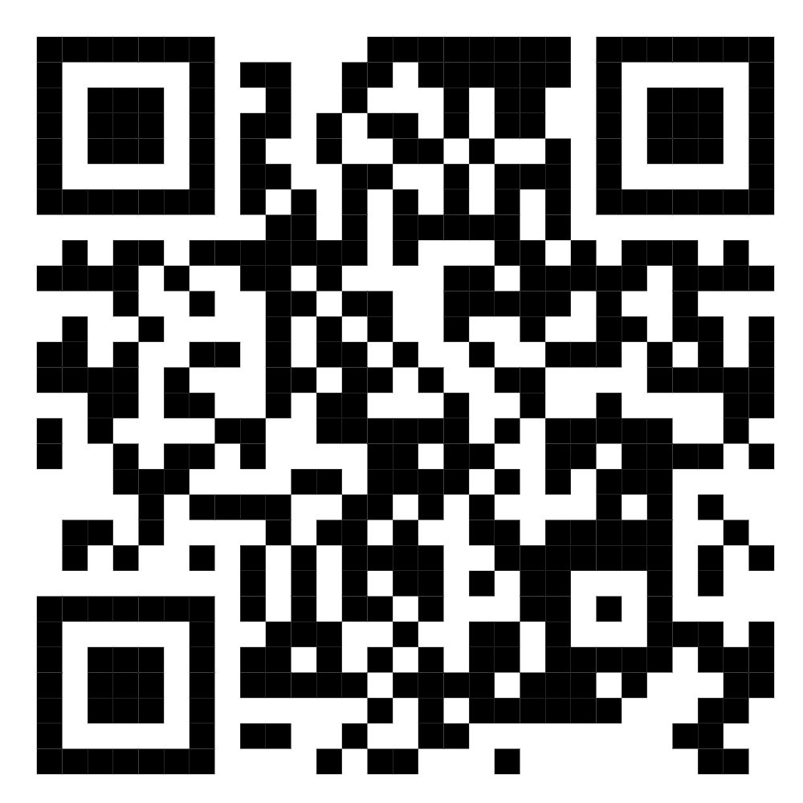
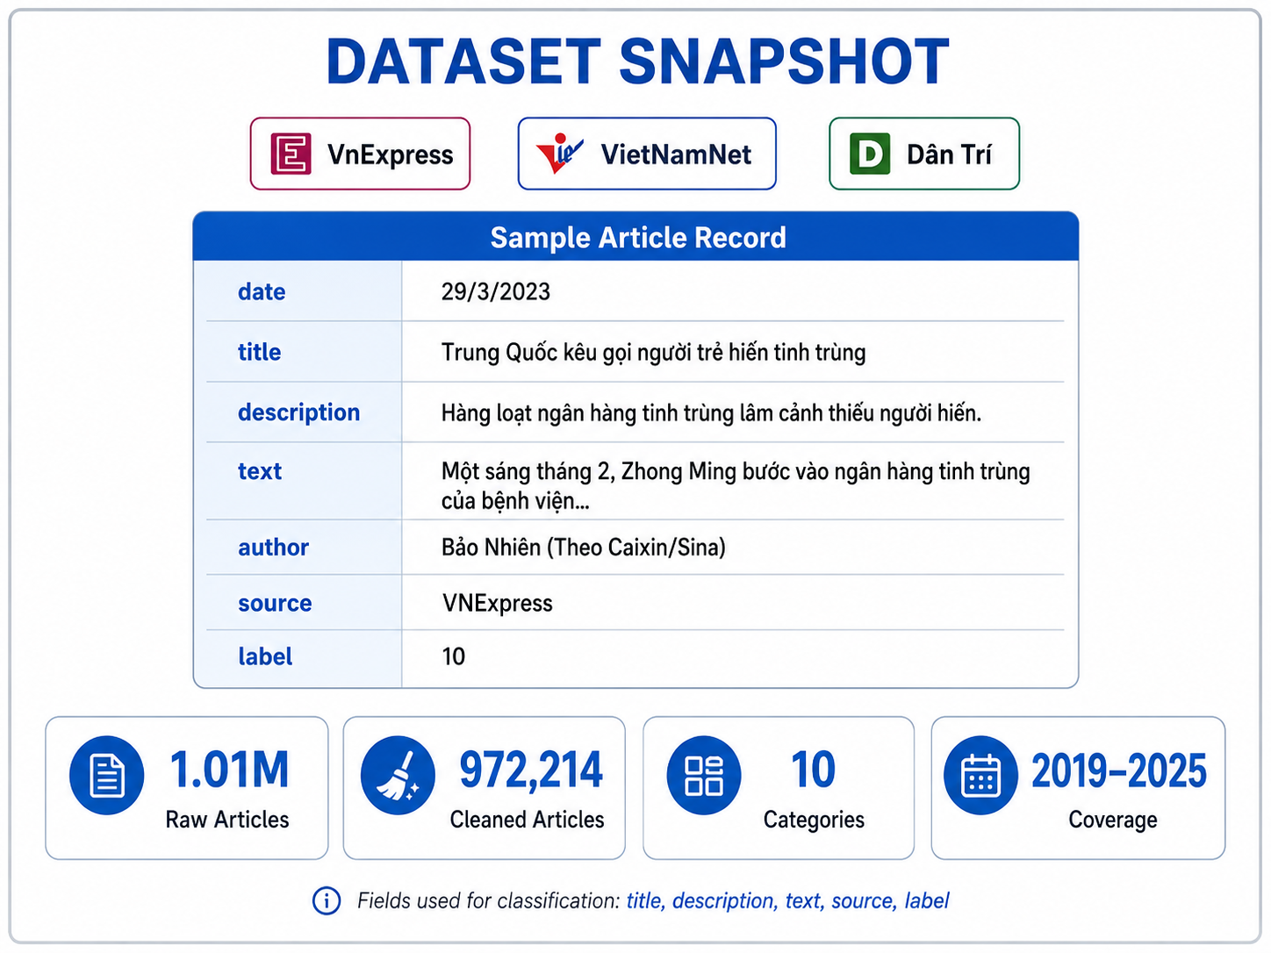
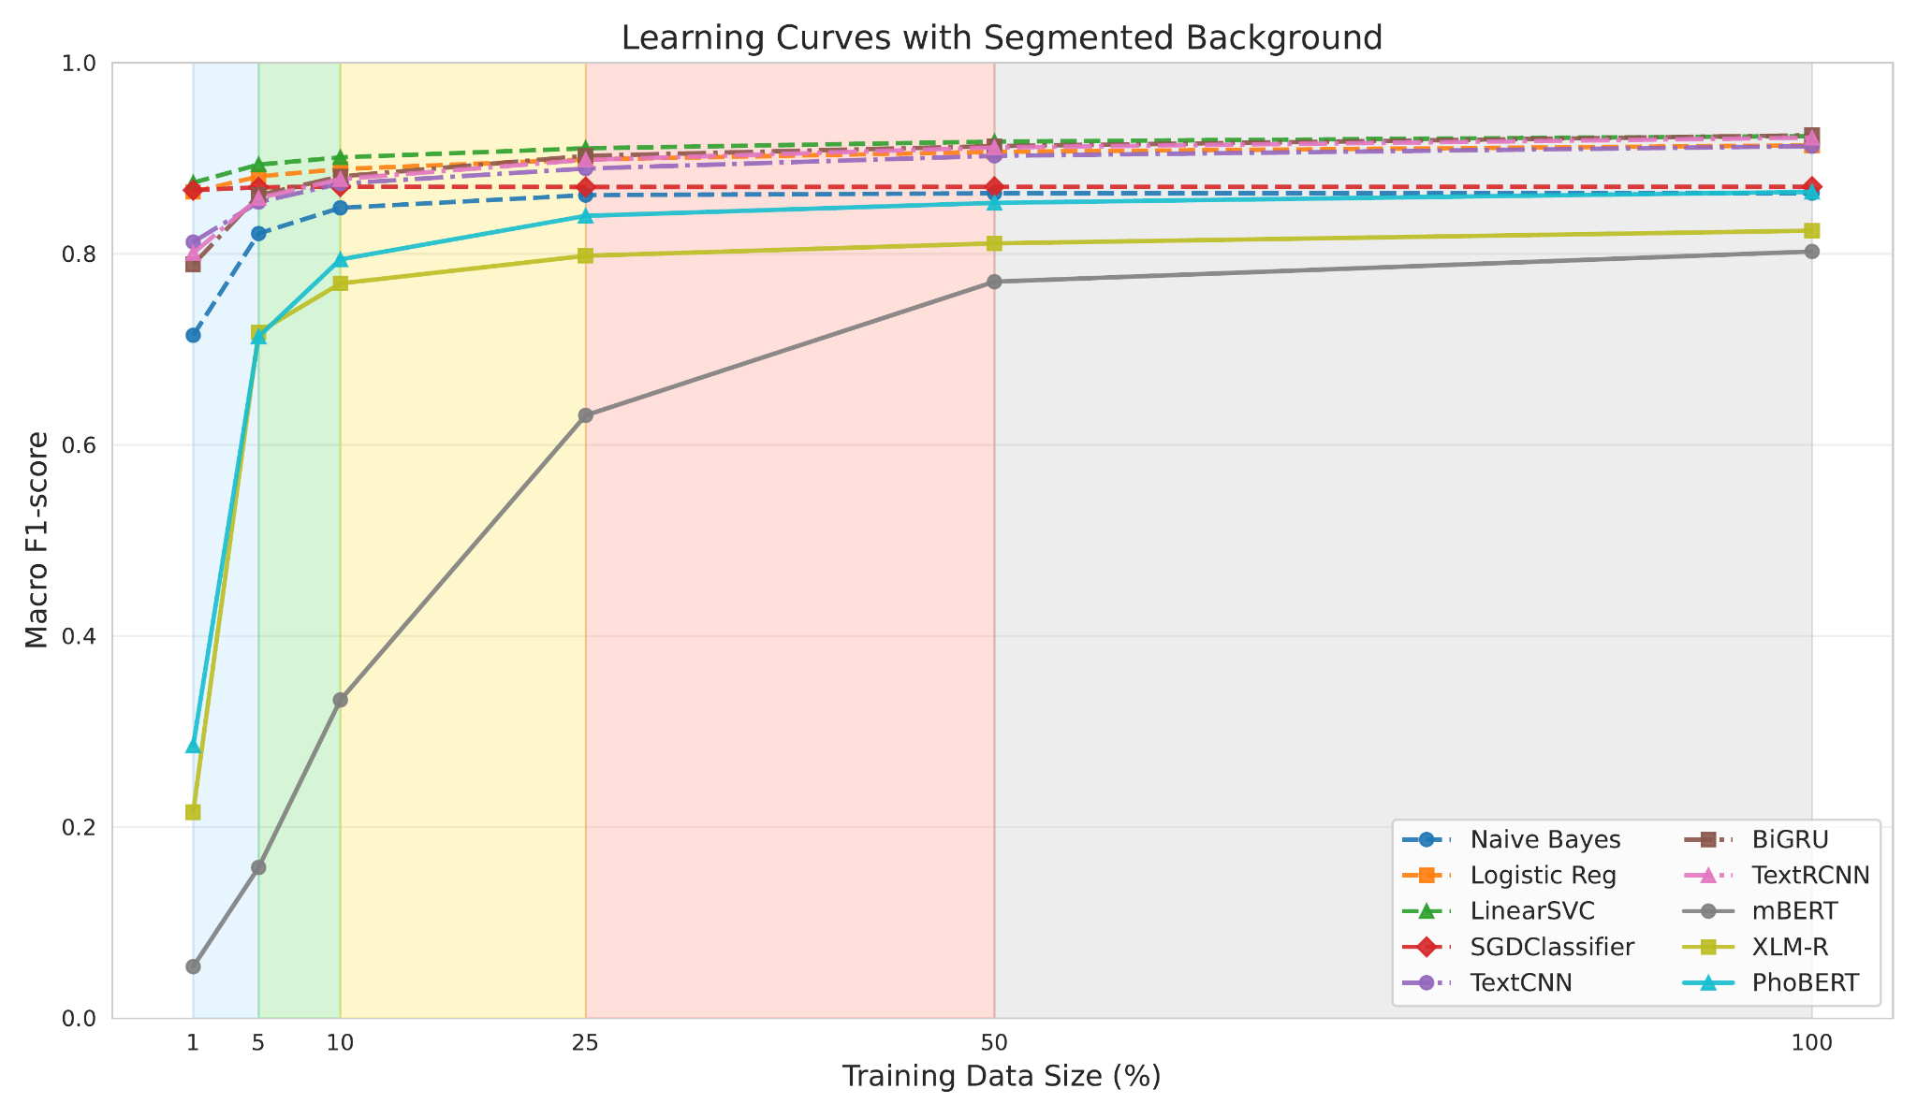
INFORMATION TECHNOLOGY PROJECT
Year of implementation: 2026
Title: A Large-Scale Vietnamese News Dataset for Text Classification: Construction and Evaluation
Châu Bảo Nhân¹, Huỳnh Đăng Khoa², Trần Thanh Phước*
^{1,2} Student of Computer Science, *Supervisor - Faculty of Information Technology
ASBTRACT This paper presents BN-VN3S, a large-scale Vietnamese news dataset with 972,214 cleaned articles from VnExpress, VietNamNet, and Dân Trí, covering 10 topics from 2019 to 2025. Using this dataset, the authors benchmark 10 models, including traditional machine learning, deep learning, and Transformer-based methods. Results show that deep learning and traditional models perform best overall, with BiGRU achieving the highest macro F1-score of 92.42%, followed by LinearSVC at 92.33%. However, Transformers, especially PhoBERT, are more robust under temporal shifts. The study also reveals strong effects of source bias and training data size. BN-VN3S offers a valuable benchmark and practical guidance for Vietnamese news classification. | DATASET
PREPROCESSING PIPELINE Remove HTML, JavaScript, ads and boilerplate text Deduplicate exact and near-duplicate articles Filter atypical article lengths Map source-specific labels to 10 common categories Segment Vietnamese words using VnCoreNLP | OVERALL RESULT
DATA SCALE IMPACT
Model | AUC | Accuracy | Macro-F1 | Recall | Precision
Naive Bayes | 98.83 | 87.06 | 86.36 | 87.09 | 86.03
Logistic Regression | 99.55 | 91.92 | 91.36 | 92.04 | 90.83
LinearSVC | 99.55 | 92.92 | 92.33 | 92.31 | 92.38
SGDClassifier | 98.95 | 87.73 | 87.03 | 87.68 | 86.55
TextCNN | 99.41 | 91.91 | 91.27 | 91.23 | 91.32
BiGRU | 99.61 | 92.43 | 92.42 | 92.47 | 92.43
TextRCNN | 99.59 | 92.12 | 92.16 | 92.20 | 92.12
mBERT | 97.04 | 78.10 | 78.73 | 80.30 | 78.10
XLM-R | 97.94 | 80.80 | 81.60 | 82.78 | 80.80
PhoBERT | 99.01 | 86.10 | 87.98 | 87.98 | 86.10
Notes:
Tên loại: Size: 48; Font: SVN Gilroy Xbold, In hoa tất cả
Năm - ngành: 36 (Năm: SVN Gilroy Semibold + Italic – Ngành: SVN Gilroy + Bold)
Tên đề tài: Size: 46; Font: SVN Gilroy + Bold
Tên người thực hiện: Size: 40; Font: SVN Gilroy + Italic
QR Code: 3’’ x 3’’
Tên loại đề tài:
ĐỀ TÀI NGHIÊN CỨU KHOA HỌC
KHÓA LUẬN TỐT NGHIỆP
BÀI BÁO KHOA HỌC
NGHIÊN CỨU DOANH NGHIỆP

