Slide 1
DMP Docker Common
Dung Vo – June 2024

Slide 2
Outline
VMs vs Docker Containers
Docker architecture core components
Dockerfiles, Images and Containers
The advantages/disadvantages of Docker
Python virtual environment And Docker
Common docker use for DMP

Slide 3
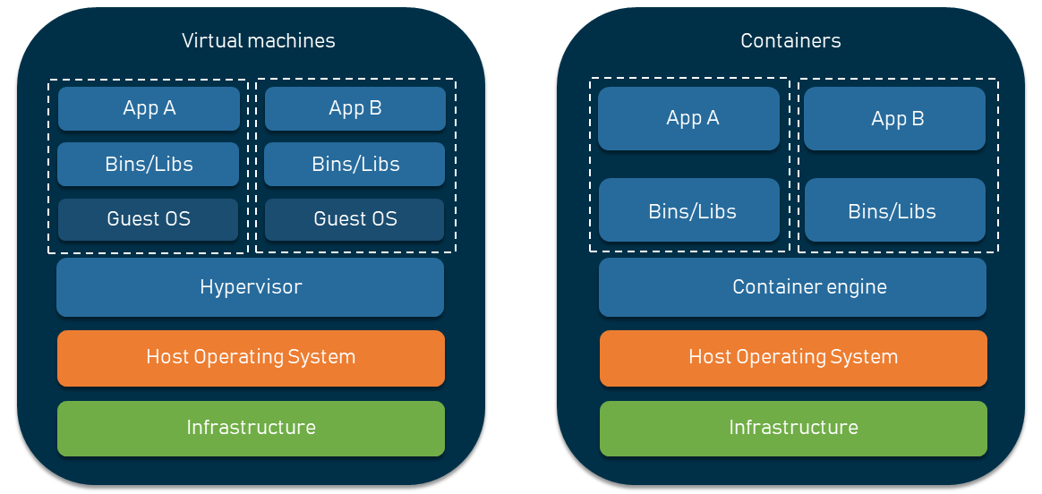
VMs vs Docker Containers
Virtual machines (VM) are an abstraction of a physical server turning one server into many. A hypervisor is installed on the host server allowing multiple VMs to run on a single machine. Each VM includes a full copy of an operating system (OS) making it resource intensive to run and slow to boot.
Containers are an abstraction at the app layer that packages application artifacts and dependencies together. The fundamental difference is containers share the same host operating system, but each container runs in it’s own isolated process controlled by the Docker Engine. Containers are more lightweight than VMs and typically boot in seconds instead of minutes.

Slide 4
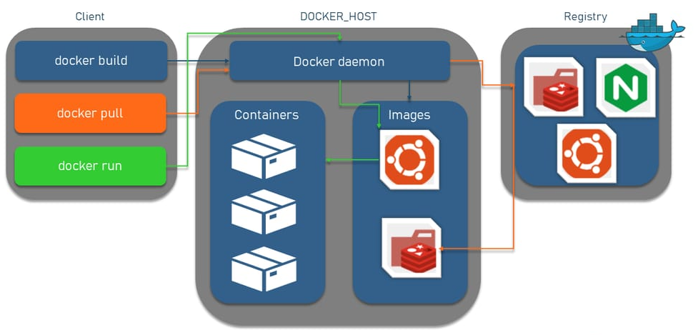
Docker architecture core components
Docker uses a client-server architecture where the Docker client communicates with the Docker daemon via a RESTful API, UNIX sockets, or a network interface.

Slide 5
Docker architecture core components
Docker daemon
The Docker daemon is a server with a persistent background process that manages all Docker objects (we’ll overview them below). It constantly listens to and processes Docker API requests. The Docker daemon is a service that runs on your host operating system.
The Docker daemon uses an “execution driver” to create containers. By default, this is Docker’s own runC driver, but there is also legacy support for Linux Containers (LXC). RunC is very closely tied to the following Linux kernel features, namely.
cgroups: used to manage resources consumed by a container (e.g., CPU and memory usage) and in the Docker pause functionality;
Namespaces: responsible for isolating containers and making sure that a container’s filesystem, hostname, users, networking, and processes are separated from the rest of the system.
Docker client
The Docker client is a Command Line Interface (CLI) that you can use to issue commands to a Docker daemon to build, run, and stop applications. The client can reside on the same host as the daemon or connect to it on a remote host and communicate with more than one daemon.
The main purpose of the Docker client is to provide a means by which Docker images (files used to create Docker containers) can be pulled from a registry and run on a Docker host. Common commands issued by a client are: docker build, docker pull, and docker run.

Slide 6
Docker architecture core components
Docker Engine API
The Docker Engine API is a RESTful API used by applications to interact with the Docker daemon. It can be accessed by an HTTP client or the HTTP library that is part of most modern programming languages.
The API used for communication with the daemon is well-defined and documented, allowing developers to write programs that interface directly with the daemon without using the Docker client.
Docker registries
Docker registries are repositories for storing and distributing Docker images. By default, it is a public registry called Docker Hub. It hosts thousands of public images as well as managed "official" images.
You can also run your own private registry to store commercial and proprietary images and to eliminate the overhead associated with downloading images over the Internet.
The Docker daemon downloads images from the registries using the docker pull request. It also automatically downloads the images specified in the docker run request and within the FROM statement of the Dockerfile if those images are not available on the local system.

Slide 7
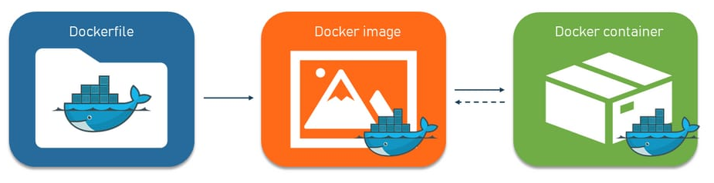
Dockerfiles, Images and Containers

Slide 8
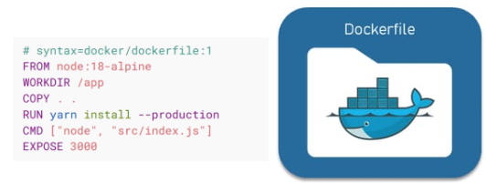
Dockerfiles, Images and Containers
A Dockerfile is used to build a Docker image. A dockerfile is a plain-text file that contains a series of instructions telling Docker what operating system, application dependencies and application source code is required to run the application.

Slide 9
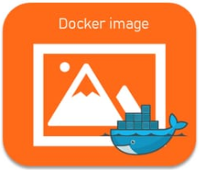
Dockerfiles, Images and Containers
Docker image compose the components: filesystem layers, base image, intermediate layers, union file system, metadata(datetime, Id, size, layer info), manifest, configuration(CMD, ENTRYPOINT, ENV, WORKDIR)
Docker images are used to instruct the Docker daemon on the requirements of how to build containers and hold the entire metadata explaining the capabilities of the container. You can download images from registries like Docker Hub or create a custom image with a Dockerfile.
Every image consists of multiple layers. A layer is a change of an image you create by writing lines in a Dockerfile. When you specify commands in your Dockerfile, you make changes to the previous image and create a new layer or an intermediate image. This is how Docker rebuilds only the layer that was changed and the ones on top of it.

Slide 10
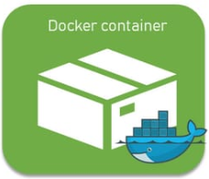
Dockerfiles, Images and Containers
Containers are Docker’s structural units that are used to hold the entire package needed to run the application. They are like directories containing everything you need to create and deploy a system, including the program code, frameworks, libraries, and bins.
Each container is an instance of an image. Containers can be created, started, stopped, moved, or deleted via a Docker API. Each container is isolated and has defined resources.
While the Docker image is read-only, a container is read/write. When Docker starts a container, it creates a read/write layer on top of the image (using the union file system as mentioned earlier) in which the application can be run.
A container can be deleted or removed. However, in this case, any application or data located there will also be scrapped.

Slide 11
The advantages of Docker
Low resource consumption
Compared to virtual machines, containers are much more resource-efficient. Since a complete operating system doesn’t have to be installed on each container, they are significantly smaller and lighter. Also, containers take up less memory and reuse components thanks to images. There’s no need for large physical servers as containers can run entirely on the cloud.
Scalability
Containers are highly scalable and can be expanded relatively easily. Docker allows for both horizontal and vertical scaling. With vertical scaling, you resize the computing resource for a container. To do this, you either add or limit the amount of memory and CPU to use.
With horizontal scaling, you create and deploy multiple containers required for workloads. You have to first deploy an overlay network to allow the connection of containers. Then deploy the containers and load balance them to see the performance.
Moving to the cloud or other hosts can also be implemented quickly.

Slide 12
The advantages of Docker
Flexibility and versatility
Docker allows you to use any programming language and technology stack on the server, eliminating the problem of incompatibility between different libraries and technologies. That's why applications that are designed to run as a set of discrete microservices benefit the most from containers.
Deployment speed
Containers can be deployed very quickly. Creating containers via images makes them ready to use in a few seconds. Installing and configuring operating systems is not necessary: Containers can be implemented with a few lines of code and deployed to the hosts.
Large community
Since its creation, Docker has been an open-source project. This contributed to the upward spiral and continued growth of a vast community. According to the official Docker statistics, in 2021, its community was 15.4 million monthly active developers sharing 13.7 million apps at a rate of 14.7 billion pulls per month.

Slide 13
The advantages of Docker
CI/CD support
As we know, a container is based on a Docker image that can have multiple layers, each representing changes and updates on the base. This feature speeds up the build process. On top of that, it provides version control over the container, enabling developers to roll back to a previous version if the need arises. In other words, you can build the process of updating the application so that updating some containers does not affect the system's performance and the provision of services to users.
Taking this into account, Docker is a favorite of CI/CD practices and DevOps as it speeds up deployments, simplifies updates, and allows teammates to work efficiently together.
Well-written documentation
Docker can boast its top-notch documentation. Even if you have never dealt with containers before, docs will guide you from the beginning to the end of the process, explaining everything in a very concise and clear way. The docs include everything from guides to manuals to samples. On top of that, the documentation comes with a search bar and tags so that users can find the needed answer more quickly. Docker also offers video explainers for those who prefer to listen and watch instead of reading.

Slide 14
User survey
Stack Overflow Developer Survey 2022 showed that Docker became a fundamental instrument for being a developer with 69 percent of professional programmers choosing it as their number one tool.
The technology has a dedicated Slack channel, a community forum, and thousands of contributors on developer websites like Stack Overflow. What’s more, there are over 9 million container images hosted on Docker Hub.

Slide 15
The downside of Docker
Resource Intensive:
Docker can be resource-intensive, especially when running multiple containers or large applications. Each container requires its own resources, including CPU, memory, and disk space, which can lead to resource contention and inefficiencies, particularly on resource-constrained systems. Additionally, Docker's layered file system can consume significant disk space over time, especially with frequent image builds and updates.
Solution: Utilize resource management techniques such as Docker's built-in resource constraints, like CPU and memory limits. Employ orchestration tools like Kubernetes or Docker Swarm to efficiently manage resources and scale applications based on demand. Regularly monitor resource usage and optimize container configurations to minimize overhead.
Security Concerns:
While Docker provides isolation between containers, it's not immune to security vulnerabilities. Shared kernel dependencies and the potential for privilege escalation pose security risks, especially in multi-tenant environments. Vulnerabilities in container images or misconfigurations can lead to breaches and compromise the entire container environment.
Solution: Implement best practices for container security, such as regularly updating base images, scanning images for vulnerabilities, and adhering to least privilege principles. Utilize security-enhancing tools like Docker Content Trust for image signing and verification, and employ network segmentation and access controls to limit container exposure.

Slide 16
Security Concerns
Container Breakout: This is when an attacker escapes from a container to the host system.
Solution: Use proper namespace isolation and limit capabilities using Docker's security options. Apply user namespaces to map container users to non-root users on the host.
Unrestricted Network Access: Containers can potentially access sensitive network resources.
Solution: Configure network policies to control traffic flow between containers. Use tools like Calico or Cilium for network security and segmentation.
Insecure Images: Containers built from untrusted images may contain vulnerabilities.
Solution: Use official and trusted images from reputable sources. Regularly scan images for vulnerabilities using tools like Clair, Trivy, or Anchore.
Insufficient Logging and Monitoring: Lack of visibility into container activities can hinder security incident detection.
Solution: Implement comprehensive logging and monitoring using tools like Prometheus, Grafana, ELK stack, or or Docker's native logging drivers

Slide 17
Security Concerns
Privileged Containers: Running containers with the --privileged flag can grant them excessive permissions.
Solution: Avoid using privileged containers unless absolutely necessary. Use specific capabilities required by the container instead.
Data Persistence: Sensitive data within containers can be vulnerable to breaches.
Solution: Use encrypted volumes for data storage. Ensure sensitive data is not hard-coded in images or environment variables.
Docker Daemon Exposure: The Docker daemon has root privileges and if exposed, can be a significant risk.
Solution: Secure the Docker daemon by enabling TLS, using firewall rules to restrict access, and not exposing it to the internet.
Image Poisoning: Attackers may upload malicious images to Docker registries.
Solution: Use private registries with access controls. Implement image signing and verification to ensure image integrity.
Vulnerable Software in Containers: Containers may run outdated or vulnerable software.
Solution: Regularly update container images and the software within them. Automate security updates and patches.

Slide 18
The downside of Docker
Complex Networking:
Docker's networking capabilities can be complex, especially in distributed or hybrid cloud environments. Managing container networking, service discovery, and load balancing across multiple hosts or clusters requires careful configuration and coordination. Additionally, Docker's default networking mode may not always align with specific networking requirements, leading to additional complexity.
Solution: Leverage Docker's built-in networking features, such as user-defined networks and overlay networks, to create isolated network environments for containers. Consider using external networking solutions like Kubernetes' service mesh or third-party networking plugins to simplify networking configuration and management. Document and automate networking setups to streamline deployment and troubleshooting.

Slide 19
Python virtual environment And Docker
1. Consistency Across Environments
Docker: Ensures that the application runs the same way across different environments (development, testing, production). This is because Docker containers include the application and its dependencies, along with the OS libraries and settings.
Virtual Environment: While a Python virtual environment isolates Python dependencies, it relies on the underlying system's OS and libraries, which can vary across different environments.
2. Isolation
Docker: Provides complete isolation from the host system and other containers. This is crucial when multiple projects require different versions of the same dependency or when avoiding conflicts between system-wide and project-specific dependencies.
Virtual Environment: Isolates Python packages but not other system-level dependencies, which can still lead to conflicts.
3. Portability
Docker: Containers can be shared easily with others and deployed on any system that supports Docker. This makes it straightforward to replicate the exact environment across different machines or teams.
Virtual Environment: Requires setting up the same environment on different machines manually, which can be error-prone and time-consuming.

Slide 20
Python virtual environment And Docker
4. Dependency Management
Docker: Includes all dependencies, including system libraries and binaries, in a single image. This ensures that the application will behave the same regardless of where it is run.
Virtual Environment: Manages only Python dependencies, meaning that system-level dependencies must be managed separately.
5. Environment Replication
Docker: With Docker, you can use a Dockerfile to define the exact steps to create the environment, making it easy to replicate the environment exactly.
Virtual Environment: Requires manually documenting the setup process, which can lead to inconsistencies and errors.
6. Deployment
Docker: Simplifies deployment by packaging the application and its environment into a single container, which can be deployed easily on any Docker-compatible system, including cloud services.
Virtual Environment: Deployment typically involves setting up the same environment on the target system and ensuring that all dependencies are correctly installed.

Slide 21
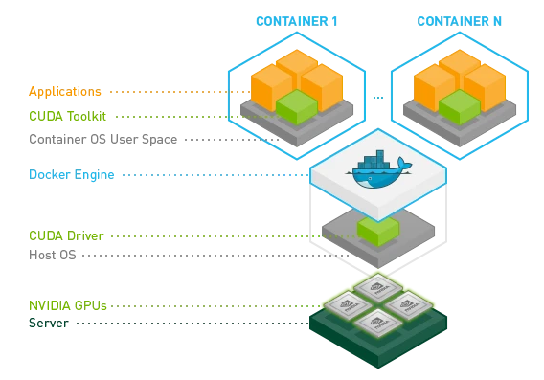
The Docker Utility Engine for NVIDIA GPUs
The NVIDIA Container Toolkit allows users to build and run GPU accelerated Docker containers. The toolkit includes a container runtime library and utilities to configure containers to leverage NVIDIA GPUs automatically.

Slide 22
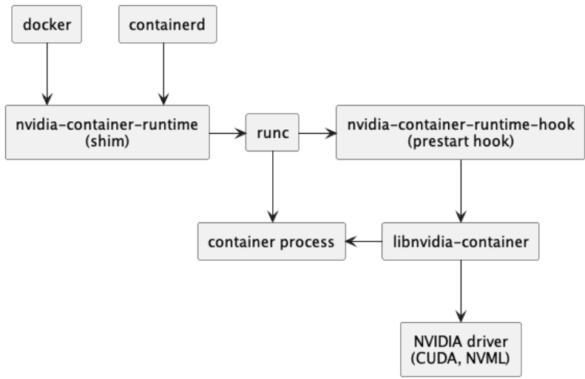
NVIDIA Container Toolkit
The NVIDIA Container Toolkit include:
The NVIDIA Container Runtime (nvidia-container-runtime): it is a thin wrapper around the native runC installed on the host system. nvidia-container-runtime takes a runC spec as input, injects the NVIDIA Container Runtime Hook as a prestart hook into it, and then calls out to the native runC, passing it the modified runC spec with that hook set.
The NVIDIA Container Runtime Hook (nvidia-container-toolkit / nvidia-container-runtime-hook):This component includes an executable that implements the interface required by a runC prestart hook. This script is invoked by runC after a container has been created, but before it has been started
The NVIDIA Container Library and CLI (libnvidia-container1, nvidia-container-cli): These components provide a library and a simple CLI utility to automatically configure GNU/Linux containers leveraging NVIDIA GPUs. The implementation relies on kernel primitives and is designed to be agnostic of the container runtime.

Slide 23
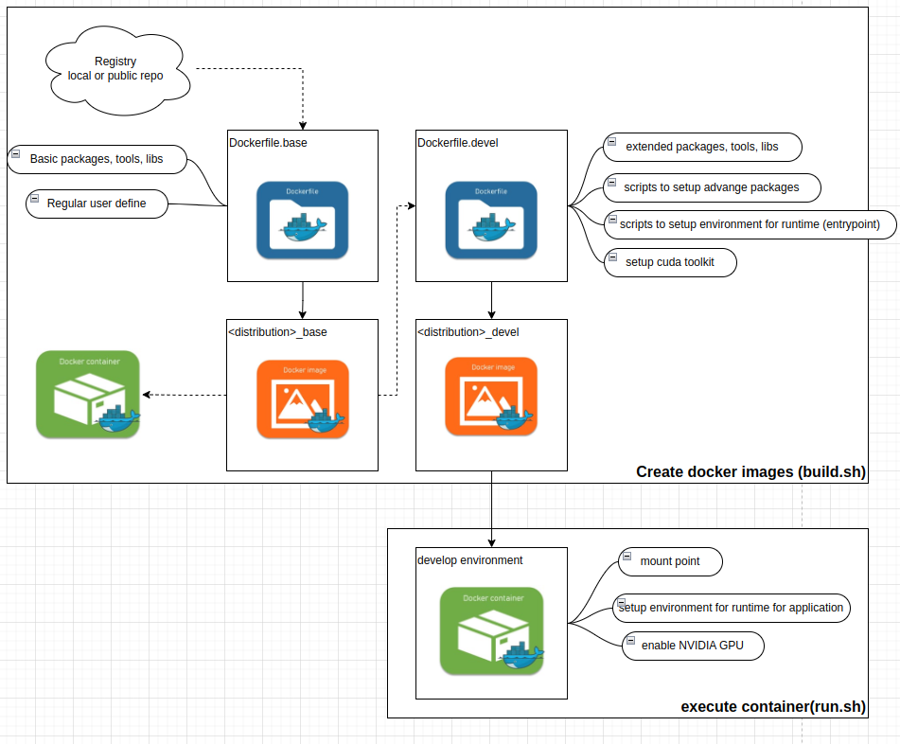
Common docker use for DMP

Slide 24
Common docker use for DMP
The features of common docker:
Create 2 separate docker images:
base image: inherited images from docker hub (https://hub.docker.com/ ), or nvidia containers ( https://catalog.ngc.nvidia.com/containers?filters=&orderBy=weightPopularDESC&query=&page=&pageSize= ), it install some of common tools, libraries, setting. It can use to testing setup extended packages for devel image
develop image: use for development of the specify project
Easy to setup development environment, extended packages with the provided scripts
The containers support to build and run application which require NVIDIA GPU-accelerated
Create images/container the run on PC and NVIDIA device using jetpack 5
Select and setup CUDA, CUDNN versions by parameter
Creating images for Ubuntu 20.04, 22.04, L4T, can update to build more type of Ubuntu versions

Slide 25
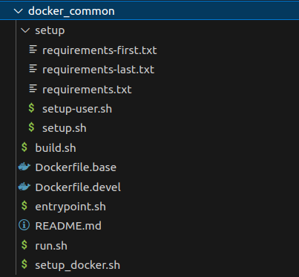
Common docker use for DMP
The docker_common include:
setup: Contains the setup for the extended packages required by the specific project. These packages can include Python packages, libraries, and applications.
Dockerfile.base: This Dockerfile pulls and sets up the configuration for a base image. It sets up basic tools, libraries, and configurations that are common for a base image.
Dockerfile.devel: This Dockerfile inherits from the base image and then continues to set up extended packages and the environment for the development of the specific project.
entrypoint.sh: Defines the commands that will run when a container starts.
setup_docker.sh: Installs Docker Engine, NVIDIA Container Toolkit, and sets up/runs the Docker daemon.
build.sh: Builds a Docker image.
run.sh: Starts or resumes a specific container.

Slide 26
Common docker use for DMP
How to use the common docker:
Refer to the README.md in docker_common (https://caishare.dmprof.com/dmp_inter/docker_common , tag v0.1.0)
Only install a Nvidia driver version on host machine if require use NVIDIA’s GPU
Select Tensorflow version → CUDA version→ nvidia driver version
Check cuda, cudnn dependencies of Tensorflow package python: tf.sysconfig.get_build_info()
Select CUDA version, it compatible with NVIDIA driver version (Table 3 CUDA Toolkit and Corresponding Driver Versions: https://docs.nvidia.com/cuda/cuda-toolkit-release-notes/ )

