Slide 1
Particle Swarm Optimization
How individual memory and social information balance exploration and exploitation
CS420 Introduction to AI · Seminar S01 · November 2026
Văn Tuấn Khải (24125032) · Huỳnh Hữu Phúc Minh (24125068) · Lê Lương Quốc Trung (24125084)
Notes:
Member 1 opens: greet the audience, introduce the three members and the topic, then move to the motivation slide.

Slide 2
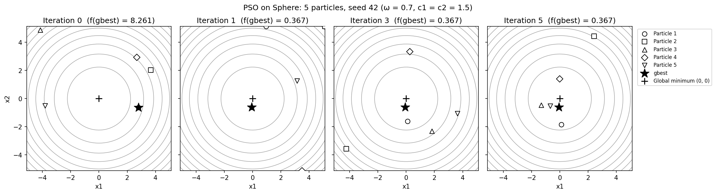
Why particle swarms?
Member 1
Minimise a function with no usable gradient
Local search stops at the first basin
PSO: many particles that share what they find
Guiding question
How does PSO combine individual experience and social information to balance exploration and exploitation?
Figure: five particles on Sphere (team experiment)
Notes:
Our topic is Particle Swarm Optimization. Many real problems, like tuning a model or building a schedule, come down to finding the input that gives the lowest value of some function. Often we have no gradient, and the function has many local minima, so a simple local search can get stuck in the first valley it finds. PSO searches with a whole group of particles that share information. Our guiding question is how PSO mixes what each particle remembers with what the group knows, to balance exploring new regions and refining good ones.

Slide 3
From flocking to an optimiser
Member 1
v ← v + 2·rand()·(pbest − x) + 2·rand()·(gbest − x)
1
pbest
Each agent remembers its own best position ("simple nostalgia")
2
gbest
Best position known to everyone (a group norm)
3
× 2
Mean pull of 1, so agents overshoot about half the time
Unbalanced pulls fail: a much stronger pull to gbest made the flock rush prematurely towards local minima; a stronger pull to pbest made agents wander. Removing the old velocity was "quite ineffective at finding global optima".
Kennedy & Eberhart (1995), pp. 1945–1946
Notes:
PSO was not designed from optimisation theory. Kennedy, a social psychologist, and Eberhart, an electrical engineer, were simulating bird flocks. Each agent remembered the best place it had found, called pbest, and everyone knew the best place found by the group, called gbest. When they removed unnecessary parts, both memories turned out to be essential. If the pull towards gbest is much stronger, the flock rushes into a local minimum too early. The final rule adds two random pulls to the current velocity; the factor 2 makes the average pull one, so particles overshoot about half the time. In their early tests, PSO trained small neural networks about as well as backpropagation.

Slide 4
What changed by 2007
Member 1
 | Kennedy & Eberhart (1995) | Poli et al. (2007)
Velocity control | Fixed coefficient 2, no damping | Inertia ω (1 − ω acts as friction) or constriction χ
Recommended setting | Not studied | χ ≈ 0.7298 ⇔ ω = 0.7298, c₁ = c₂ ≈ 1.496
Who informs a particle | Whole swarm (gbest) | gbest is fast; lbest ring resists local optima
Evidence | A few demonstrations | About 700 application papers reviewed
Our default: ω = 0.7, c₁ = c₂ = 1.5
A rounded version of the standard constriction setting. High ω explores, low ω exploits; we test 0.4, 0.7 and 0.9.
Poli, Kennedy & Blackwell (2007), Sects. 2.2–2.4, 3.1, 6
Notes:
Twelve years later, Poli, Kennedy and Blackwell reviewed how PSO had developed. The coefficient 2 made particles speed up out of control, so two fixes became standard. The inertia weight multiplies the old velocity; one minus omega works like friction. A high omega lets particles travel far and explore; a low omega slows them so they exploit. Clerc's constriction factor gives an equivalent setting of about 0.73 for omega and about 1.5 for both coefficients, which is why our team uses 0.7 and 1.5. The review also shows that the communication structure matters: global best converges fast, a ring is slower but less likely to be trapped. Now my teammate will show how the algorithm works step by step.

Slide 5
Problem, functions and update rule
Member 2
Sphere
f(x) = Σ xᵢ²
One basin: tests convergence speed
Rastrigin
f(x) = 20 + Σ (xᵢ² − 10 cos 2πxᵢ)
Grid of local minima: tests trapping
Both in [−5.12, 5.12]², global minimum 0 at (0, 0); fitness = f(x), lower is better
v ← ω v + c₁r₁(pbest − x) + c₂r₂(gbest − x), x ← x + v
inertia · cognitive: own best · social: swarm best
2,020
evaluations per run: 20 particles × 100 iterations + 20 at start; |v| ≤ 10.24; r₁, r₂ new for every particle, dimension and iteration
Update rule: Poli et al. (2007), Eq. 2. Functions and settings: team design
Notes:
We tested PSO on two functions in two dimensions. Sphere is a smooth bowl with a single minimum. Rastrigin has the same global minimum at the origin, but a cosine term adds a whole grid of local minima, so it tests whether the swarm gets trapped. Fitness is simply the function value; lower is better. Each velocity has three parts: inertia keeps part of the old motion, the cognitive part pulls towards the particle's own best, and the social part pulls towards the swarm's best. The random numbers change for every particle, dimension and iteration. One run uses 20 particles for 100 iterations, which is 2,020 function evaluations.

Slide 6
One step by hand
Member 2
f(x) = x², ω = 0.7, c₁ = c₂ = 1.5; start: x₁ = 3, x₂ = −2 (gbest)
Particle | Inertia | Cognitive | Social | v(1) | x(1) | f(x(1))
1 | 0.35 | 0 | 1.5·0.6·(−5) = −4.5 | −4.15 | −1.15 | 1.3225
2 (gbest) | −0.35 | 0 | 0 | −0.35 | −2.35 | 5.5225
P2: −2 → −2.35 (f 4 → 5.52)
P1: 3 → −1.15 (overshoots, f 9 → 1.32)
−3
−2
−1
0
1
2
3
optimum
Cognitive term is 0 at the first step (pbest = x). One particle gets worse, yet gbest improves from −2 to −1.15.
Team worked example (report Table 2)
Notes:
Here is one update in one dimension. Particle 1 is at 3, particle 2 at minus 2. Particle 2 has the lower value, so it is the global best. For particle 1, inertia gives 0.35. The cognitive term is zero, because at the start the personal best is the current position. The social term is 1.5 times 0.6 times minus 5, which is minus 4.5. So the new velocity is minus 4.15 and the particle jumps to minus 1.15: it overshoots the minimum, but its value drops from 9 to 1.32. Particle 2 is already the best, so only inertia moves it, and it actually gets worse. Still, the swarm's best improves. One particle can get worse while the group gets better.

Slide 7
Five particles, five iterations
Member 2
f(gbest) by iteration
Iteration 0 → 1: only particles 3 and 5 improve
Velocity limit (±10.24) never reached
Code reproduces the hand recomputation exactly
8.26
iter 0
0.37
iter 1
0.37
iter 2
0.37
iter 5
Team experiment: Sphere, 5 particles, seed 42 (report Table 3, Figure 1)
Notes:
Now the full algorithm with five particles on Sphere. At iteration 0 the particles are spread out and particle 1 is the best. The initial velocities can be as large as the domain width, so after one update several particles are pushed to the boundary of the domain, and only particles 3 and 5 improve; particle 3 becomes the new global best with a value of 0.37. No particle reaches the velocity limit. In the next four iterations no particle beats that value, so the best stays at 0.37. With only five particles and five iterations this is a short illustration, not a convergence run. We then ran 20 particles with three inertia weights and five seeds each, and my teammate will now compare PSO with other methods under the same budget.

Slide 8
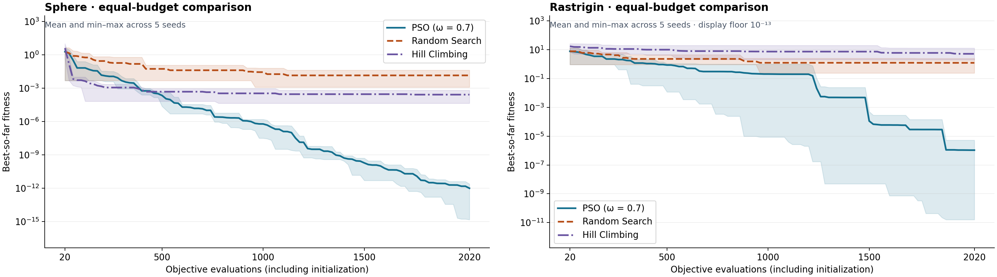
Same budget, two landscapes
Member 3
42.6 vs 216
evaluations to reach 0.01 on Sphere: Hill Climbing first
1.0 × 10⁻¹²
PSO mean final fitness on Sphere, best of the three
5 / 5 vs 0 / 5
Rastrigin runs reaching 0.01: PSO vs each baseline
Team experiments: 2,020 evaluations per run, seeds 0–4 (report Tables 4–5, Figure 2)
Notes:
We gave all three methods the same budget. One PSO batch evaluates 20 points, so the horizontal axis counts candidates instead of iterations. The bands show the best and worst runs across five seeds. On Sphere, Hill Climbing reaches fitness below 0.01 after about 43 evaluations on average. PSO takes longer to cross that mark, but keeps improving and ends far lower. On Rastrigin, all five PSO runs cross the threshold, and neither baseline does within the budget.

Slide 9
Inertia and the velocity limit
Member 3
Mean final fitness | A: ω = 0.4 | B: ω = 0.7 | C: ω = 0.9
Sphere | 8.8 × 10⁻³⁰ | 1.0 × 10⁻¹² | 3.6 × 10⁻⁴
Rastrigin | ≈ 0 | 1.1 × 10⁻⁶ | 0.164
1
Sphere: One basin: strong damping (low ω) settles and refines fastest
2
Rastrigin: All five ω = 0.4 runs reach ≈ 0; ω = 0.9 is worst
3
Velocity limit: With v_max = 2.0 or 5.12, one ω = 0.4 run stalls at 0.995
Team experiment: 20 particles, c₁ = c₂ = 1.5, v_max = 10.24, seeds 0–4 (report Tables 6–7)
Notes:
We changed only inertia in this sweep, with the velocity limit set to the domain width, 10.24. Inertia 0.4 gave the lowest mean fitness on both functions: on Sphere because strong damping lets the swarm settle and refine, and on Rastrigin because all five runs reached the global minimum. The highest inertia, 0.9, was the worst on both, since the particles kept moving too much within 100 iterations. One caveat: an earlier version of our experiments used a tighter limit of 2. With that limit, one run with inertia 0.4 stalled near 0.995 on Rastrigin, so 0.7 looked best there. The ranking on Rastrigin therefore depends on the velocity limit. Because only inertia changed, we can attribute the difference in this sweep to inertia; we would need another sweep to compare the other coefficients.

Slide 10
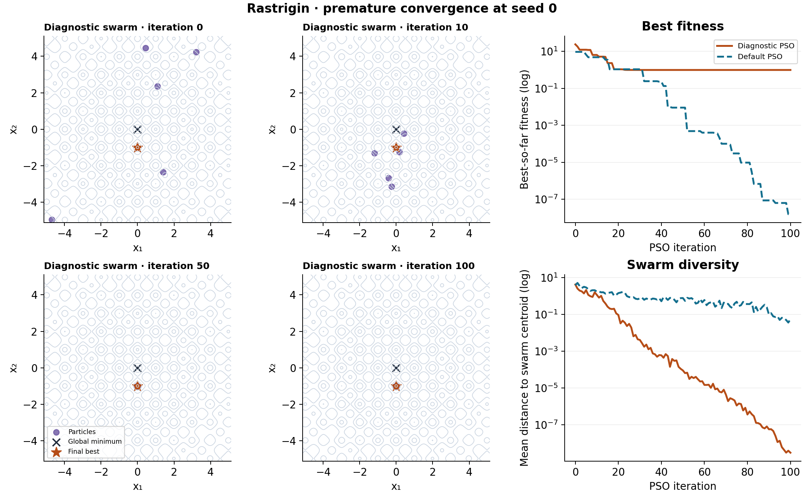
Where the swarm got stuck
Member 3
Setting
5 particles, ω = 0.4, c₁ = 0.5, c₂ = 2.5
Result
Local minimum at (0, −0.995), f ≈ 0.995
Diversity
Mean distance to centroid 4.18 → 3.0 × 10⁻⁹
Default run
Same seed stays spread out, f ≈ 1.6 × 10⁻⁸
Team experiment: Rastrigin, seed 0 (report Figure 3)
Notes:
This is a separate diagnostic. We ran 20 seeds with five particles and a strong pull to the swarm best, and all 20 ended above 0.9, so this setting traps the swarm very often; we show seed 0. The dots show where the particles were at four iterations; the star is the final best and the cross is the global minimum. By iteration 10 the particles have clustered near the star, and the diversity curve falls by about nine orders of magnitude. The default run with the same seed stays more spread out and finds a much better point. It also has more particles and uses more evaluations, so this example cannot tell us which setting caused the difference.

Slide 11
Exploration and exploitation
Member 3
1
2
3
Personal best
keeps each particle's discoveries and the swarm's diversity
Global best
focuses the swarm on the best region found so far
Inertia
decides how far particles carry on past what attracts them
Too much exploitation (low inertia, strong social pull, few particles) can collapse the swarm onto a suboptimal basin.
Applications: image analysis, power systems and control lead PSO use (Poli et al., 2007), e.g. solar power tracking (Alshareef et al., 2019) and UAV path planning (Phung & Ha, 2021).
Limits: two 2-D functions with the optimum at the origin, five seeds, one topology.
Notes:
A particle can use what it found before and what the group has found. This helps the swarm refine a good answer quickly. When too many particles follow the same best and lose momentum, they may stop exploring other regions. Published studies apply PSO to tracking the maximum power point of solar panels under partial shading and to planning UAV flight paths, but those problems have different objectives and constraints. In the solar study, a local method was trapped on a local peak, much like our Hill Climbing baseline on Rastrigin. We tested only two functions in two dimensions, both with the optimum at the centre. A follow-up could change the swarm size or one coefficient at a time, shift the functions, and test restarts under the same budget.

Slide 12
Thank you · Questions?
Kennedy, J. & Eberhart, R. (1995). Particle swarm optimization. Proc. ICNN'95, 1942–1948.
Poli, R., Kennedy, J. & Blackwell, T. (2007). Particle swarm optimization: An overview. Swarm Intelligence 1, 33–57.
Alshareef, M. et al. (2019). PSO for PV power point tracking. Energies 12(4), 623.
Phung & Ha (2021). Spherical vector-based PSO for UAV path planning. Appl. Soft Comput. 107, 107376.
AI tools (Claude, OpenAI Codex) assisted with code and drafting; all results were checked by the team.
Notes:
Thank the audience and invite questions. Each member answers at least one question about their own part.

