Slide 1
Process, Thread, Mutex
Presenter: Pham Nhu Cong Luong Duy Huynh Hoang The Dieu

Slide 2
Agenda
Process
Thread
Mutex

Slide 3
Process

Slide 4
Process
What is a process
Classification
Operation

Slide 5
What is a process ?
Program
Process
VS
Program is a group of instructions to carry out a specified task.
Process is a program in execution
Stored on disk in some file
Not require any other resources.
Process holds resources such as CPU, memory address, disk, I/O etc.
Requied
Longer: it is stored in the memory until it is not manually deleted
Limited: it gets terminated after the completion of the task.
Lifespan

Slide 6
Process Control Block
Process Control Block (PCB)
ID
Program counter
Priority
States
CPU register
Accounting information

Slide 7
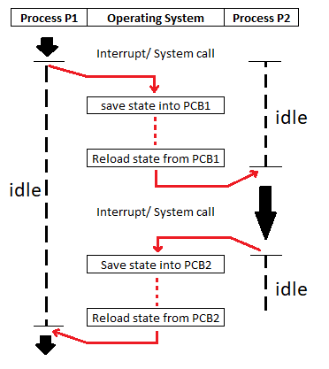
Process Control Block

Slide 8
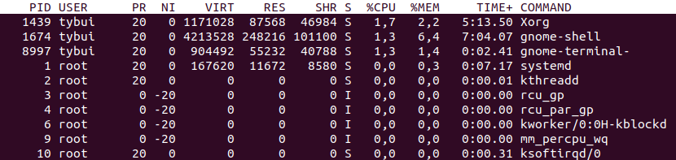
Attributes
PID: Process Identifier
PPID: Parent’s process identifier
PR: Process priority
S: state of process

Slide 9
Classification
Process
Relationship
Parent
Child
Status
Orphan
Zombie
Characteristics
I/O-Bound process
Processor-Bound process
Daemons

Slide 10
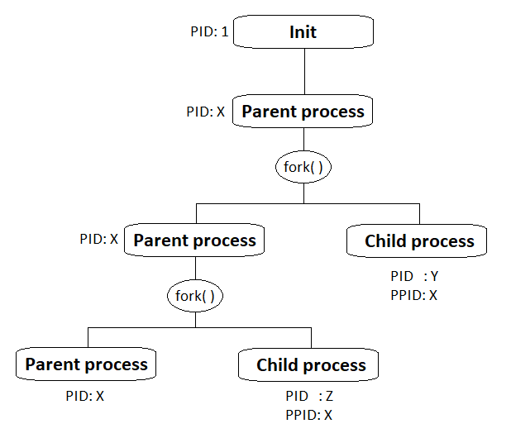
Parent & Child process

Slide 11
Orphan & Zombie
Orphan
A child process is running but the parent process is killed
The system recognizes the orphan child process. It’s adopted by Init process
Zombie
A process that has completed execution but still has an entry in the process table.
It become “lost” in the system
It still takes resources, having too many orphan process will overload init process.
It takes very tiny memory(description info) but will take process ID which is limited

Slide 12
I/O – CPU bound processes
Spend most of their time waiting for I/O operations, like a network request or keyboard operation, to complete
Often run for a short time because they block while waiting for I/O operations to complete
I/O bound process
Are built around operations that need only the CPU to be completed
The performance of such algorithms will be delimited by the CPU in which they are running, and solely upgrading the CPU will usually improve their performance.
CPU bound process

Slide 13
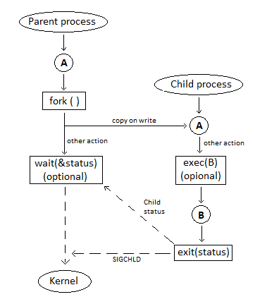
Operation
The execution of a process is a complex activity.
It uses various system call to operate:
Fork ( )
Wait ( )
Exec ( )
Exit ( )

Slide 14
Fork ( )
Operation
Returned value
Child
It’s PID: getpid();
It’s parent PID: getppid();
Parent
Child’ PID: creat_chid
Used to create child processes in a C program. It is used where parallel processing is required in your application.
defined in the headers sys/types.h and unistd.h
It returns an integer of the type pid_t:
pid_t creat_child = fork(void);
== 0
> 0

Slide 15
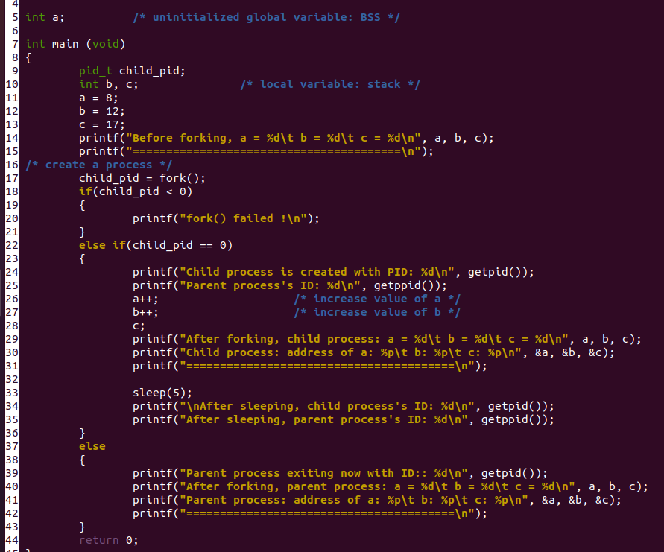
Fork ( )

Slide 16
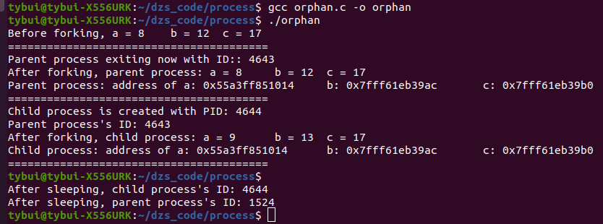
Fork ( )

Slide 17
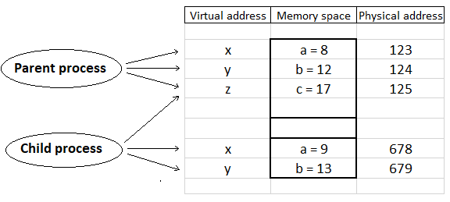
Fork ( )
Copy-on-write:
Firstly, they share the same pages in memory and these shared pages will be marked as copy-on-write
If any of these processes will try to modify the shared pages, the modifications will be done on the copy of pages so not affecting the other process.

Slide 18
Wait ( )
The wait system call blocks the caller until one of its child process terminates.
If the caller doesn’t have any child processes, wait returns immediately without blocking the caller.
Using wait( ) the parent can obtain the exit status of the terminated child.
int status;
pid = wait(&status); ➔ return: PID of terminated process
WIFEXITED(status): true if the child terminated normally
WEXITSTATUS(status): the exit status of the child
WIFSIGNALED(status): true if the child process was terminated by a signal.
WTERMSIG(status): number of the signal that caused the child process to terminate
WIFSTOPPED(status): true if the child process was stopped by delivery of a signal
WSTOPSIG(status): number of the signal which caused the child to stop

Slide 19
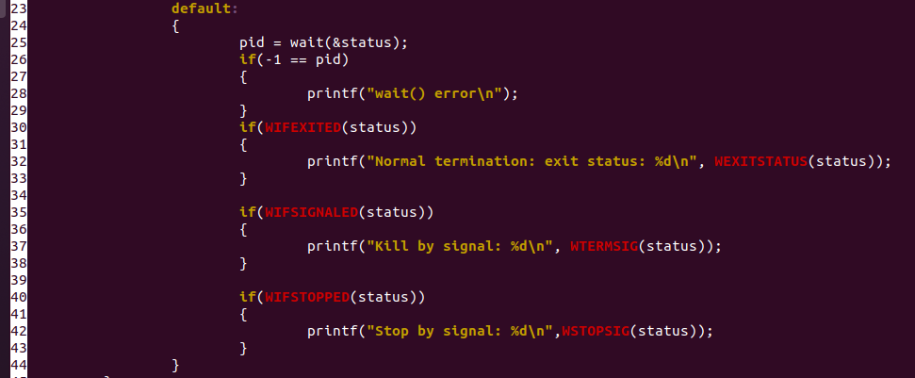
Wait ( )
Result:
Normal termination: exit status: 1

Slide 20
Waitpid ( )
stt = waitpid ( pid, &status, option );
Child’s ID: OK
==0:
== -1: error
-1 : wait any child
< -1: wait any child have ID group = |pid|
0 : wait any child have same parent
> 0 : wait child = pid
0 : blocking
WNOHANG: return immediately if no child has exited
pid
option

Slide 21
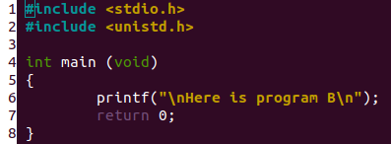
Exec()
The exec family of functions replaces the current running process with a new process.
It comes under the header file unistd.h.
There are many members in the exec family which have different behaviors:
l: argument is passed as a list of strings to main () function.
v: argument is passed as a string to main () function.
p: path / s to search for new running program
e: the environment can be specified by the caller

Slide 22
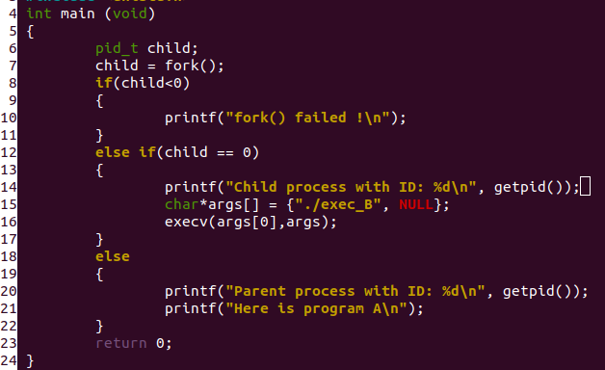
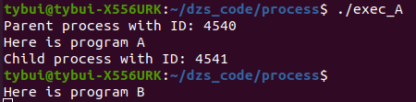
Exec()

Slide 23
Exit ()
void exit(int status) terminates the calling process immediately.
This function does not return any value and it send a SIGCHLD signal to parent process
“Status” is returned to the parent process as the process’s exit status, and can be collected using one of the wait() family of calls.
Terminates the whole program, wherever you call it from
Returns the program's control to the operating system or thread which is calling the program (main() function)
Terminates the function
Returns the program's control to the calling function from called function.

Slide 24
EXE
1. #include <stdio.h> #include <stdio.h>
2. void test() void text()
3. { {
4. printf("Executing\n"); printf("Executing\n");
5. return; exit(0);
6. } }
7. int main()
8. {
9. test();
10. printf("Back from test()\n");
11. }
Executing Executing
Back from test()

Slide 25
Thread

Slide 26
THREAD
Definition
A thread is a basic unit of CPU utilization,consisting of a program counter,a stack, and a set of register, (and a thread ID).
A thread is also called a light weight process.
© 2020 DASAN Zhone Solutions – Proprietary and Confidential
26

Slide 27
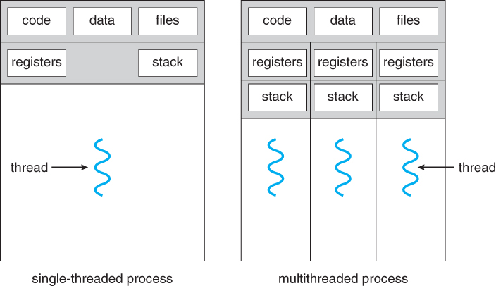
THREAD
© 2020 DASAN Zhone Solutions – Proprietary and Confidential
27

Slide 28
THREAD
2. Why need Thread
Responsiveness
Fast context switch
Resource sharing
Communication
© 2020 DASAN Zhone Solutions – Proprietary and Confidential
28

Slide 29
THREAD
3. Thread Creation
int pthread_create(pthread_t *thread,
const pthread_attr_t *attr,
void *(*start_routine(void*), void *arg);
Return: 0 if success; an error number if error
© 2020 DASAN Zhone Solutions – Proprietary and Confidential
29

Slide 30
THREAD
3. Thread Creation
Initialize and destroy thread attributes object
int pthread_attr_init(pthread_attr_t *attr);
int pthread_attr_destroy(pthread_attr_t *attr);
© 2020 DASAN Zhone Solutions – Proprietary and Confidential
30

Slide 31
THREAD
3. Thread Creation
Set cancelability state and type
int pthread_setcancelstate(int state, int *oldstate);
state:
PTHREAD_CANCEL_ENABLE
PTHREAD_CANCEL_DISABLE
int pthread_setcanceltype(int type, int *oldtype);
type:
PTHREAD_CANCEL_DEFERRED
PTHREAD_CANCEL_ASYNCHRONOUS
© 2020 DASAN Zhone Solutions – Proprietary and Confidential
31

Slide 32
THREAD
4. Thread Termination
void pthread_exit(void *retval);
int pthread_cancel(pthread_t thread);
© 2020 DASAN Zhone Solutions – Proprietary and Confidential
32

Slide 33
THREAD
5. Join and Detach Threads
int pthread_join(pthread_t thread, void **retval);
int pthread_detach(pthread_t thread);
© 2020 DASAN Zhone Solutions – Proprietary and Confidential
33

Slide 34
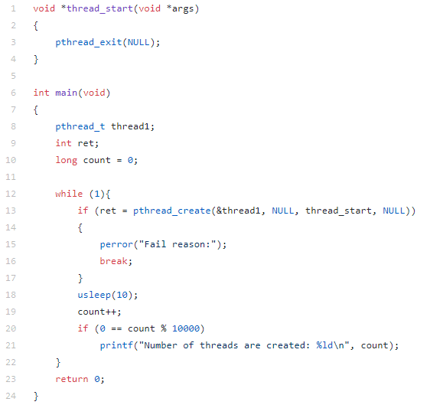
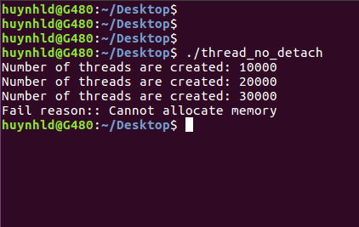
THREAD
5. Join and Detach Threads
Example
© 2020 DASAN Zhone Solutions – Proprietary and Confidential
34

Slide 35
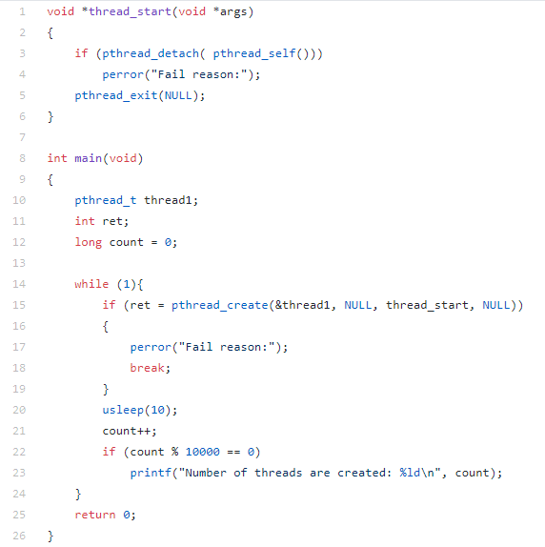
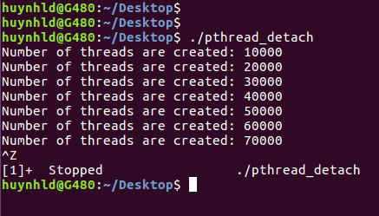
THREAD
5. Join and Detach Threads
Example
© 2020 DASAN Zhone Solutions – Proprietary and Confidential
35

Slide 36
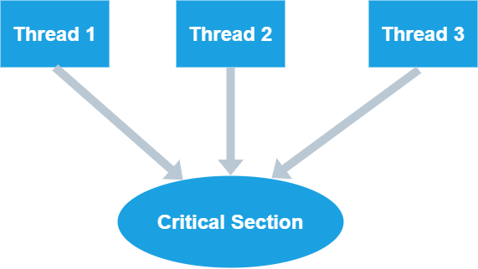
THREAD
6. Thread Issues
Race conditions
© 2020 DASAN Zhone Solutions – Proprietary and Confidential
36

Slide 37
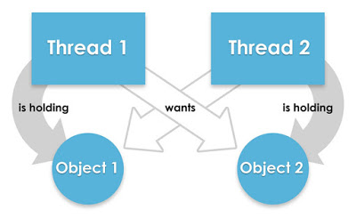
THREAD
6. Thread Issues
Deadlock
© 2020 DASAN Zhone Solutions – Proprietary and Confidential
37

Slide 38
THREAD
7. Thread Synchronization
Mutual exclusion lock (Mutex)
Semaphores
Condition variables
© 2020 DASAN Zhone Solutions – Proprietary and Confidential
38

Slide 39
THREAD
5. Thread Synchronization
Creat and Destroy Condition Variable
pthread_cond_t cv = PTHREAD_COND_INITIALIZER;
int pthread_cond_init(pthread_cond_t *cond, const pthread_condattr_t *attr);
pthread_cond_destroy(pthread_cond_t *cond);
© 2020 DASAN Zhone Solutions – Proprietary and Confidential
39

Slide 40
THREAD
5. Thread Synchronization
Waiting on condition
int pthread_cond_wait( pthread_cond_t *cond, pthread_mutex_t *mutex);
int pthread_cond_timedwait( pthread_cond_t *cond, pthread_mutex_t *mutex, const struct timespec *abstime);
© 2020 DASAN Zhone Solutions – Proprietary and Confidential
40

Slide 41
THREAD
5. Thread Synchronization
Waking thread base on condition
int pthread_cond_signal(pthread_cond_t*cond);
int pthread_cond_broadcast(pthread_cond_t *cond);
© 2020 DASAN Zhone Solutions – Proprietary and Confidential
41

Slide 42
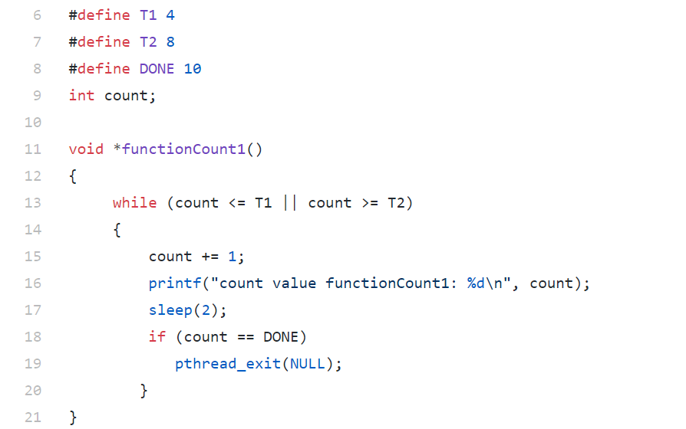
THREAD
5. Thread Synchronization
Example
© 2020 DASAN Zhone Solutions – Proprietary and Confidential
42

Slide 43
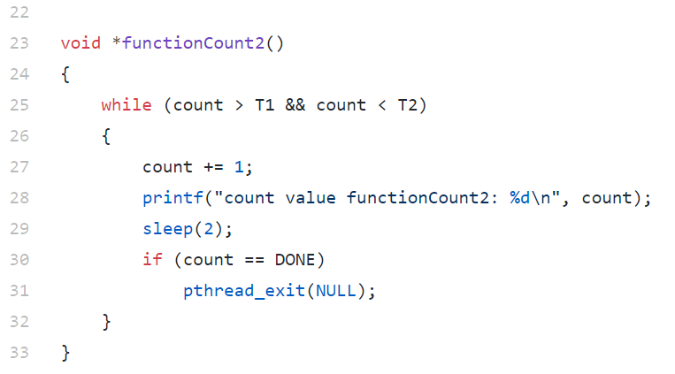
THREAD
5. Thread Synchronization
Example
© 2020 DASAN Zhone Solutions – Proprietary and Confidential
43

Slide 44
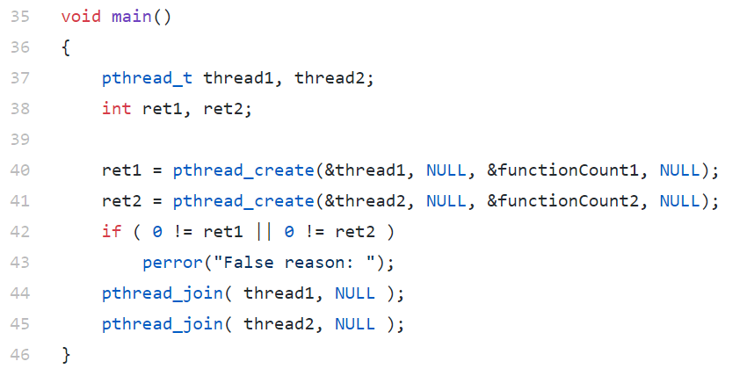
THREAD
5. Thread Synchronization
Example
© 2020 DASAN Zhone Solutions – Proprietary and Confidential
44

Slide 45
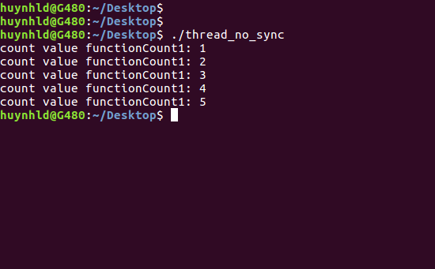
THREAD
5. Thread Synchronization
Example
© 2020 DASAN Zhone Solutions – Proprietary and Confidential
45

Slide 46
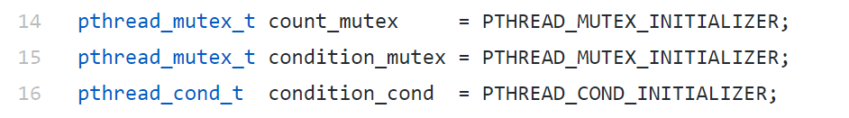
THREAD
5. Thread Synchronization
Example
© 2020 DASAN Zhone Solutions – Proprietary and Confidential
46

Slide 47
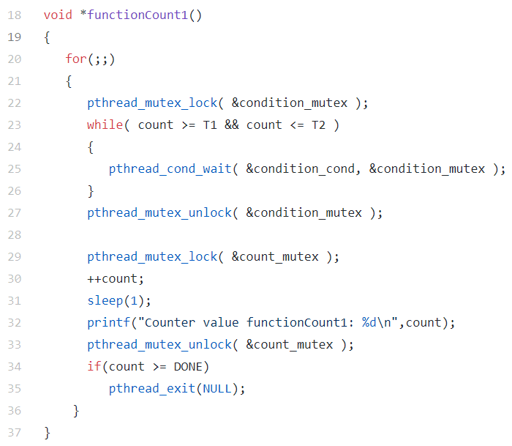
THREAD
5. Thread Synchronization
Example
© 2020 DASAN Zhone Solutions – Proprietary and Confidential
47

Slide 48
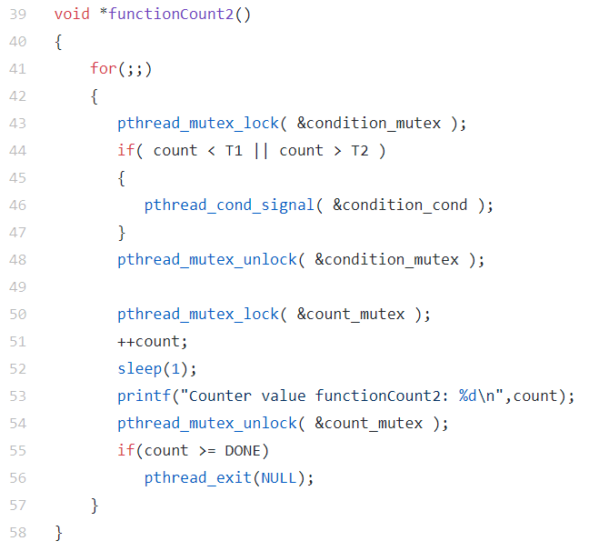
THREAD
5. Thread Synchronization
Example
© 2020 DASAN Zhone Solutions – Proprietary and Confidential
48

Slide 49
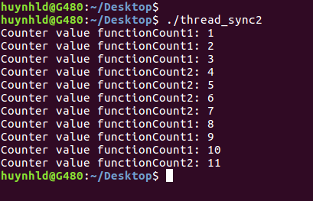
THREAD
5. Thread Synchronization
Example
© 2020 DASAN Zhone Solutions – Proprietary and Confidential
49

Slide 50
Mutex

Slide 51
Mutex
What is Mutex?
Why do we use Mutex?
Attention when using Mutex.

Slide 52
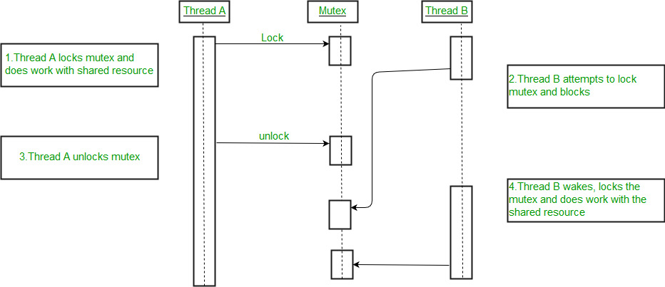
Definition
The mutual exclusion (referred to as mutex) technique is used to protect shared resources, which are essentially shared variables between threads.
Notes:
- Định nghĩa: Kỹ thuật mutual exclusion (gọi tắt là mutex) dùng để bảo vệ tài nguyên chia sẻ (shared variable) mà chủ yếu là biến chia sẻ (shared variable) giữa các thread
- Các bước thực hiện:
+ Thread A khóa mutex và hoạt động với tài nguyên được chia sẻ khi đó các thread khác không được quyền truy cập vào tài nguyên đó
+ Thread B cố gắng khóa mutex và bị chặn (đưa vào chế độ sleep)
+ Thread A mở khóa mutex
+ Thread B được đánh thức , khóa mutex và hoạt động với các tài nguyên được chia sẻ

Slide 53
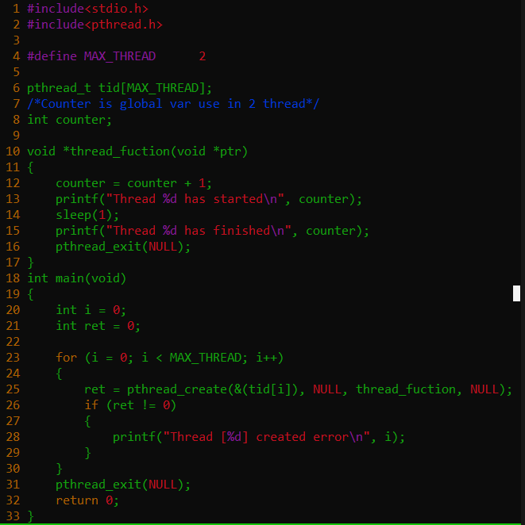
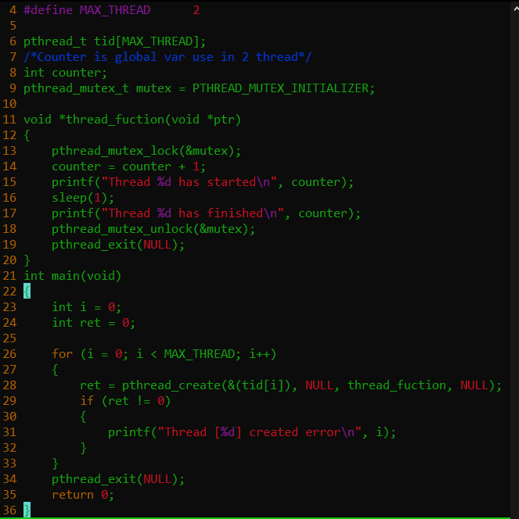
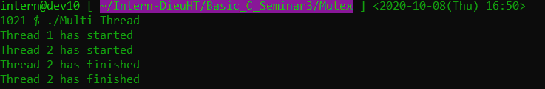
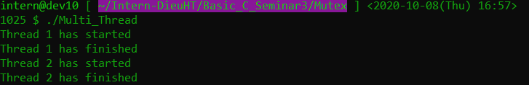
Example
Don't use Mutex
Use Mutex

Slide 54
Implementation
1. Init Mutex
Init Mutex
Static initialization
Dynamic
initialization

Slide 55
Implementation
Static initialization
pthread_mutex_t mutex = PTHREAD_MUTEX_INITIALIZER;
Notes:
Trong cách khởi tạo tĩnh, macro PTHREAD_MUTEX_INITIALIZER dùng để khởi tạo một mutex với các thuộc tính (thread attribute) mặc định

Slide 56
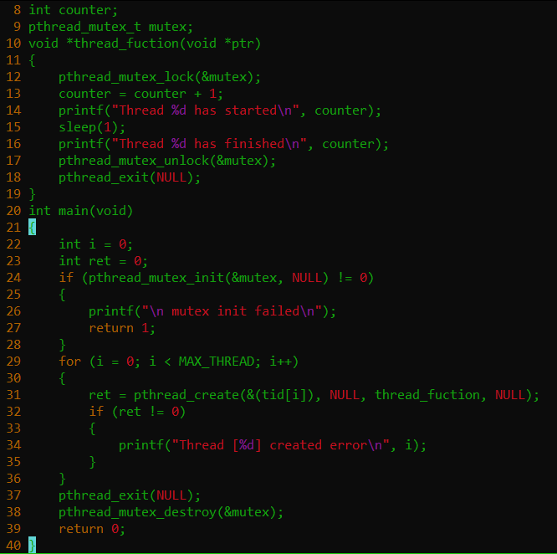
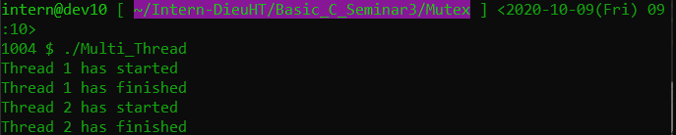
Implementation
Dynamic initialization
int pthread_mutex_init(pthread_mutex_t *mutex, const pthread_mutexattr_t *attr);
int pthread_mutex_destroy(pthread_mutex_t *mutex);
Notes:
- Trong khi hàm pthread_mutex_init() trong cách khởi tạo động cho phép khởi tạo và thiết lập thuộc tính cho mutex. Nếu không cần quan tâm đến thuộc tính của thread, ta có thể truyền NULL vào đối số pthread_mutexattr_t *attr
/*Trả về 0 nếu thành công, hoặc 1 số dương mã lỗi*/
- Khởi tạo động ta cần phải hủy Mutex nếu không được sử dụng bằng hàm pthread_mutex_destroy()
/*Trả về 0 nếu thành công, hoặc 1 số dương mã lỗi*/
- (khởi tạo tĩnh bằng macro PTHREAD_MUTEX_INITIALIZER không cần destroy mutex)

Slide 57
Implementation
Lock/unlock mutex
int pthread_mutex_lock(pthread_mutex_t *mutex);
int pthread_mutex_unlock(pthread_mutex_t *mutex);
Notes:
- Để khóa 1 mutex, ta truyền địa chỉ của mutex đó vào hàm pthread_mutex_lock(). Nếu một mutex đang ở trạng thái unlock, hàm này sẽ khóa mutex đó và return. Nếu mutex đó đã bị khóa bởi thread khác, hàm này sẽ bị block cho đến khi mutex được mở.
- Nếu một thread khóa một mutex mà chính nó đang giữ khóa thì sẽ xảy ra deadlock (thread rơi vào trạng thái chờ vô hạn).

Slide 58
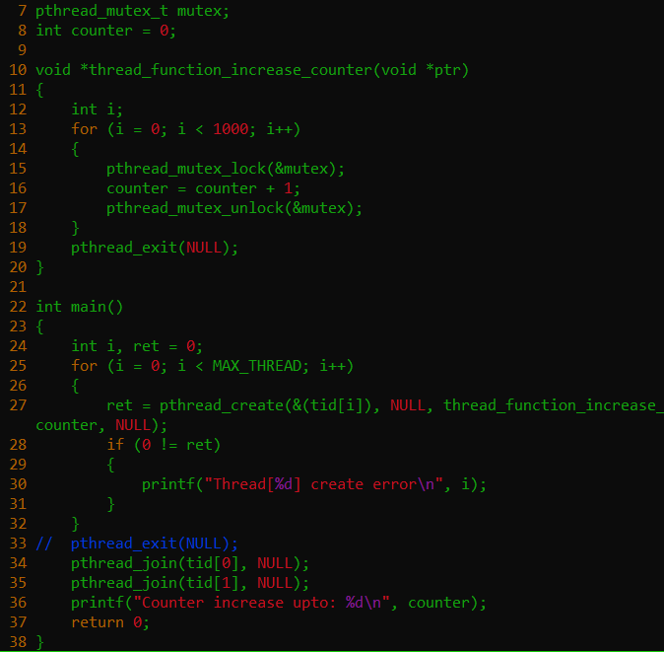
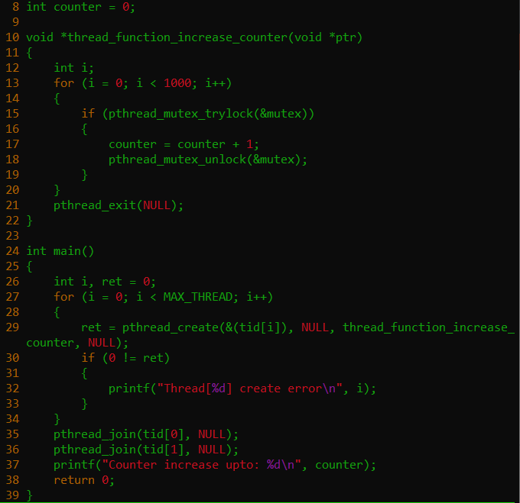


Implementation
trylock mutex
int pthread_mutex_trylock(pthread_mutex_t *mutex);
Notes:
Hàm pthread_mutex_trylock() hoạt động khác pthread_mutex_lock() ở chỗ: nếu mutex đang bị khóa, nó sẽ không block thread mà sẽ return ngay lập tức với mã lỗi là EBUSY.

Slide 59
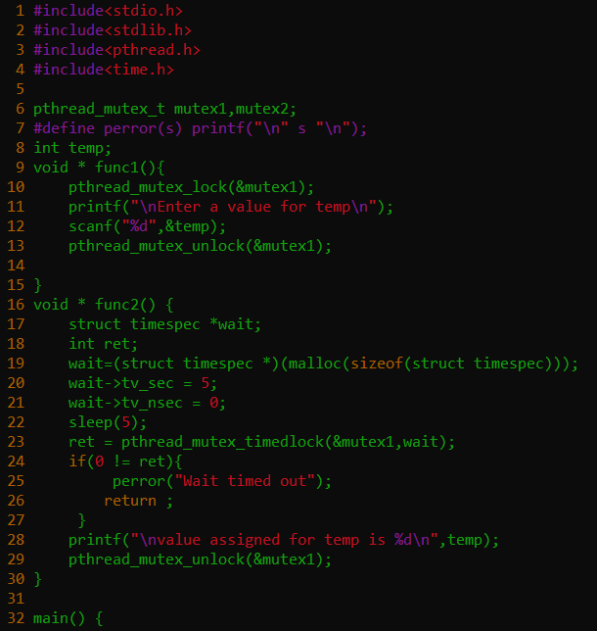
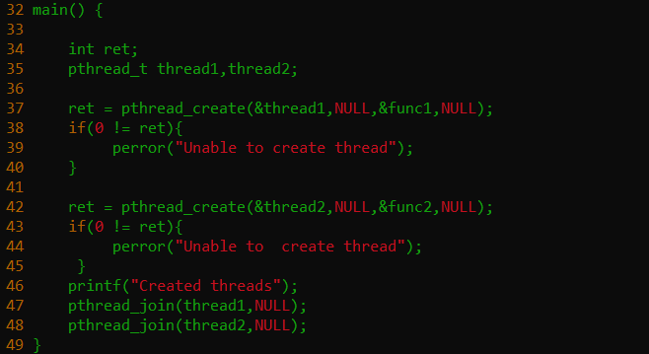
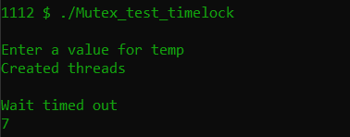
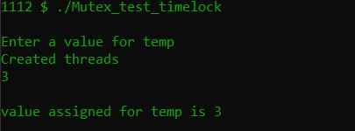
Implementation
timedlock mutex
int pthread_mutex_timedlock(pthread_mutex_t *restrict mutex,const struct timespec *restrict abs_timeout);
Notes:
Hàm pthread_mutex_timedlock() được thêm vào đối số abs_timeout để thiết lập thời gian tối đa thread có thể chờ; nếu sau khoảng thời gian "abs_timeout " mà thread đó chưa sở hữu được mutex, nó sẽ return và trả về mã lỗi ETIMEDOUT.

Slide 60
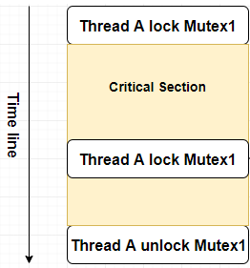
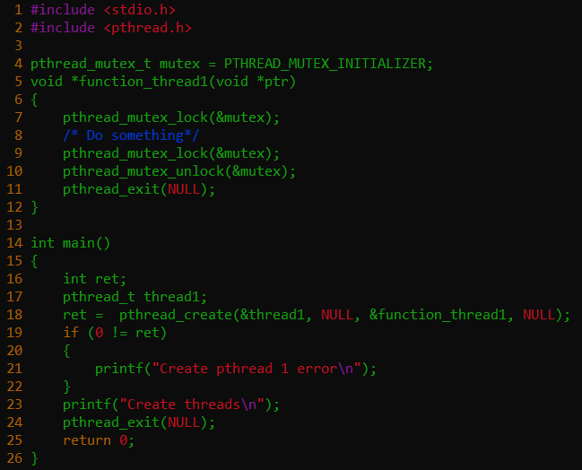
Mutex Deadlock
Notes:
- Thread A chờ Mutex1 được mở khóa và đi vào trạng thái block
- Vì thread A bị block nên kbh chạy đến unlock mutex1 được

Slide 61
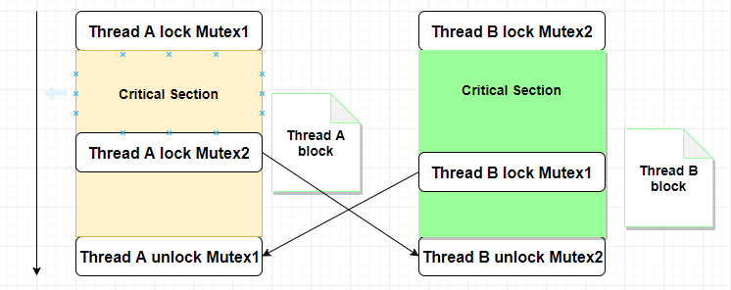
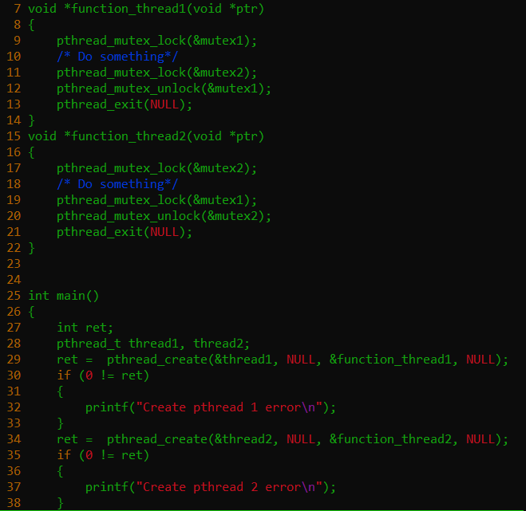

Mutex Deadlock

Slide 62
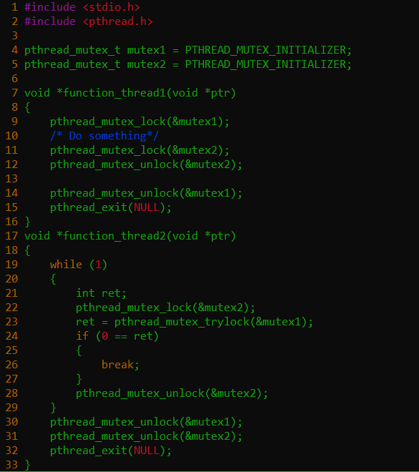
Mutex Deadlock
Advice:

Slide 63
Mini Project
Snake Game
Features Of the Game
A very user-friendly game
Simple and easy game to play

Slide 64
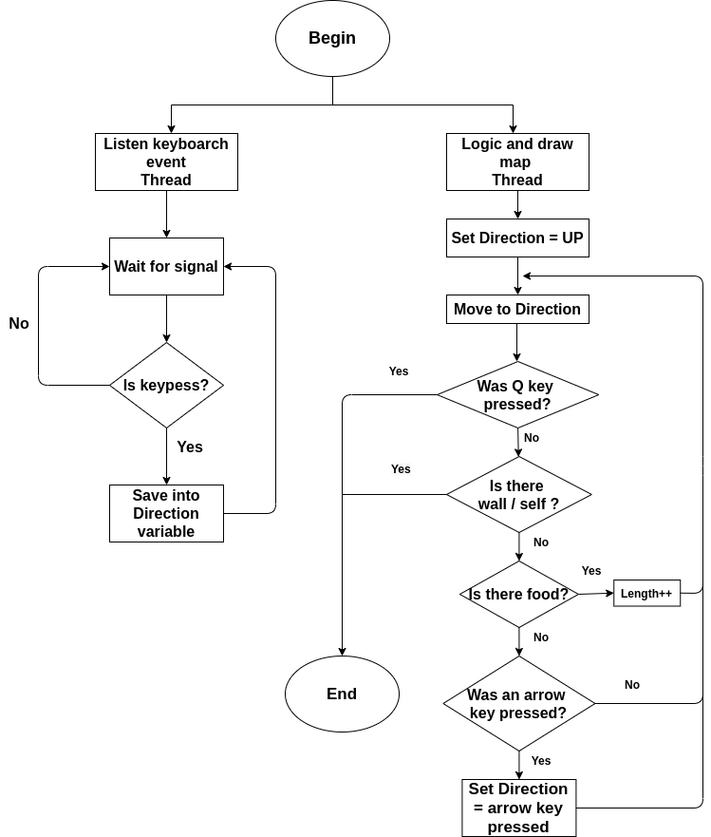
Mini Project
Snake Game

Slide 65

References
https://docs.oracle.com/cd/E19683-01/806-6867/mtintro-75924/index.html
https://elixir.bootlin.com/linux/latest/source
https://vimentor.com/vi/lesson/giai-phap-mutex

