Slide 1
UDP RELAY, DHCP, DHCP-Snooping
Author: hdlinh@tma.com.vn

Slide 2
Organization of the seminar
1 UDP Relay
1.1 Overview
1.2 Basic Operation
1.3 Both of these services are for UDP packets.
1.4 DHCP Relay Agent Service
1.5 Generic UDP Relay Service

Slide 3
2. DHCP
2.1 A brief history
2.2 Purpose
2.3 Overview
2.4 Design Goals
2.5 Message Formats
2.6 Types of DHCP messages
2.7 Event flows
2.8 State Machine
2.9 Enhancements
2.10 Performance issues

Slide 4
3. DHCP-snooping
3.1 Overview
3.2 Trusted and Untrusted Sources
3.3 DHCP Attacker impact to Network
3.4 Feature
3.5 DHCP Snooping configuration
3.6 The following related requirement
3.7 ISF (Ingress Source Filtering)
3.8 Option-82

Slide 5
UDP Relay
1.1 Overview
This task is the forwarding engine of this UDP Relay feature for the DHCP Relay Agent Service and the generic UDP Relay Service. Based on the VLAN that the packet is coming in from and the configured IP destination or VLANs, this task will forward the data packet accordingly.
This task is to setup connections to Chassis Supervision, the MIP Library, IP CMM, Linux IP Stack.

Slide 6
1.2 Basic Operation
This feature provides 2 services to the network users. The first one is the DHCP Relay Agent Service and the second one is the Generic UDP Relay Service.
DHCP Relay Agent Service is to allow end station to dynamically obtain an IP address from the DHCP server that resides on a different VLAN.
Generic UDP Relay Service is to forward broadcast packet with pre-configured destination UDP port to destination VLAN or VLANS.

Slide 7
1.3 Both of these services are for UDP packets.
The operation or the forwarding decision is different between the 2 services. The destination for DHCP Relay Agent Service is a set of specific IP destinations while the destinations for the Generic UDP Relay Service are for a set of destination VLANS.
The DHCP Relay Agent Service is to support the BOOTP/DHCP protocol, specifically UDP port 67 and 68.
For UDP port 67 and 68, BOOTP/DHCP Relay Service and Generic UDP Relay Service are mutually exclusive. User can only configure either ip helper or ip udp relay service BOOTP but not both at the same time.
When configuring the “Per VLAN Mode” of the DHCP Relay Agent Service, the VLANs are the source VLANs.
When configuring the Generic UDP Relay Service, the VLANs are destination VLANs.

Slide 8
1.4 DHCP Relay Agent Service
This service allows a device to obtain an IP address using the DHCP protocol. User is to specify the next hop IP address so that the DHCP Relay Agent and forward the DHCP packet from the device trying to obtain an IP address to the DHCP server. The next hop does not have to be a DHCP server.
        Standard Mode
        Per VLAN Mode
        DHCP Relay Agent Information Option support (RFC 3046)
        PXE Support
        Obtaining an IP address for VLAN 1 on system startup

Slide 9
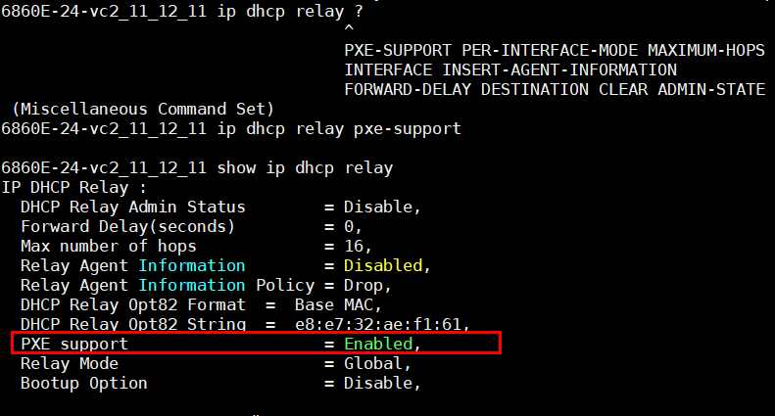
List of Commands

Slide 10
1.5 Generic UDP Relay Service
This service support the forwarding of broadcast packet to destination VLANs based on the destination UDP port. User is to configure the destination UDP port and the destination VLANs that the packet is to be forwarded to, there are three to config ip udp relay service.

Slide 11
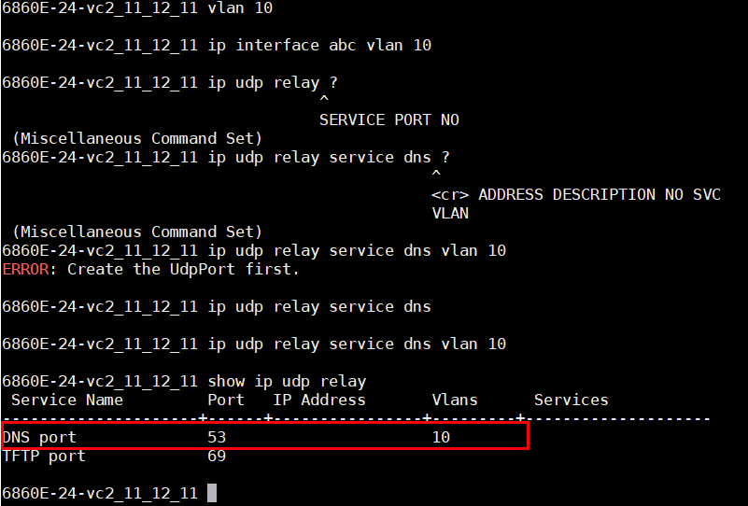
List of Commands

Slide 12
Introduction DHCP
DHCP (Dynamic Host Configuration Protocol) is a communication protocol that lets network administrators manage centrally and automate the assignment of Internet Protocol addresses in an organization’s network. (basically it frees a network administrator from having to manually configure each host connected to network).

Slide 13
2.1 When and Who
DHCP was created by the Dynamic Host Configuration Working Group of the Internet Engineering Task Force in the year 1987.
It's definition was recorded in the RFC 1531 initially and was made obsolete by RFC’s 1541 and 2131 subsequently.

Slide 14
About BOOTP
DHCP is an extension of the Bootstrap protocol (BOOTP).
BOOTP was designed for manual pre-configuration of the host information in a server database.

Slide 15
2.2 Purpose
To deliver host-specific configuration parameters from a DHCP server to a host.
Allocation of network addresses to hosts.

Slide 16
2.3 Overview
DHCP is an application-layer protocol in the TCP/IP model.
DHCP supports three mechanisms for IP address allocation.
      Automatic allocation
      Dynamic allocation
      Manual allocation

Slide 17
Components of DHCP
DHCP Server
DHCP Client
DHCP/BOOTP relay agent

Slide 18
2.4 Design Goals
Mechanism rather than a policy.
Client should require no manual reconfiguration.
It should not require a server on a subnet.
It must interoperate with the BOOT relay agents and provide service to BOOTP clients.

Slide 19
DHCP must
Guarantee unique network address.
Retain DHCP client configuration across a client reboot.
Allow automated assignment of configuration parameters to new clients.
Support fixed allocation of configuration parameters to specific clients.

Slide 20
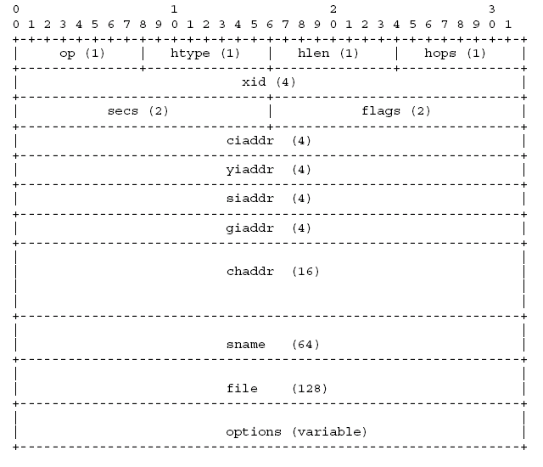
DHCP Message Format
Figure 1. DHCP Message

Slide 21
2.5 DHCP Messages
DHCPDISCOVER - Client broadcast to locate available servers.
DHCPOFFER - Server to client in response to DHCPDISCOVER with offer of configuration parameters.
DHCPREQUEST - Client message to servers either (a) requesting offered parameters from one server and implicitly declining offers from all others, (b) confirming correctness of previously allocated address after, e.g., system reboot, or (c) extending the lease on a particular network address.
DHCPACK - Server to client with configuration parameters, including committed network address.

Slide 22
DHCP Messages (..Contd)
DHCPNAK - Server to client indicating client's notion of network address is incorrect (e.g., client has moved to new subnet) or client's lease as expired
DHCPDECLINE - Client to server indicating network address is already in use.
DHCPRELEASE - Client to server relinquishing network address and canceling remaining lease.
DHCPINFORM - Client to server, asking only for local configuration parameters; client already has externally configured network address.

Slide 23
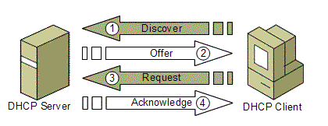
Dynamic allocation of a network address
Figure 2. DHCP sever and client working model

Slide 24
2.6 Event Flow Diagram
Two cases:
    Client-server interaction while allocating a new network address
    Client-server interaction while reusing previously allocated network address

Slide 25
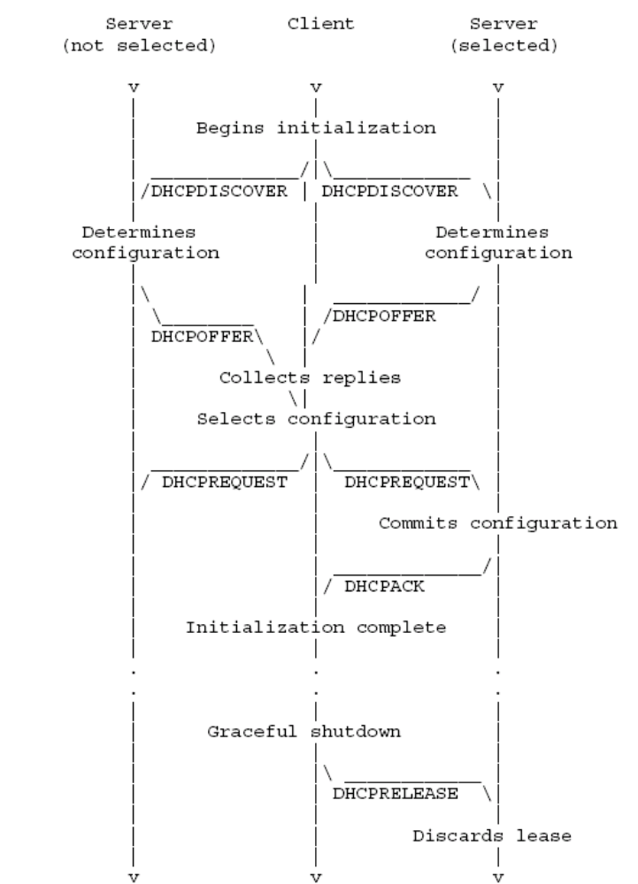
Allocating new network address
Figure 3. DHCP new network address model

Slide 26
Step-by-step
Client broadcasts DHCPDISCOVER
Server respond with DHCPOFFER
Server check for address
Client broadcasts DHCPREQUEST
Server selected commits binding, sends DHCPACK
Server sends DHCPNAK Client responds to DHCPACK
Client sends DHCPDECLINE if address in use
Client responds to DHCPNAK
No DHCPACK/DHCPNAK
Client sends DHCPRELEASE

Slide 27
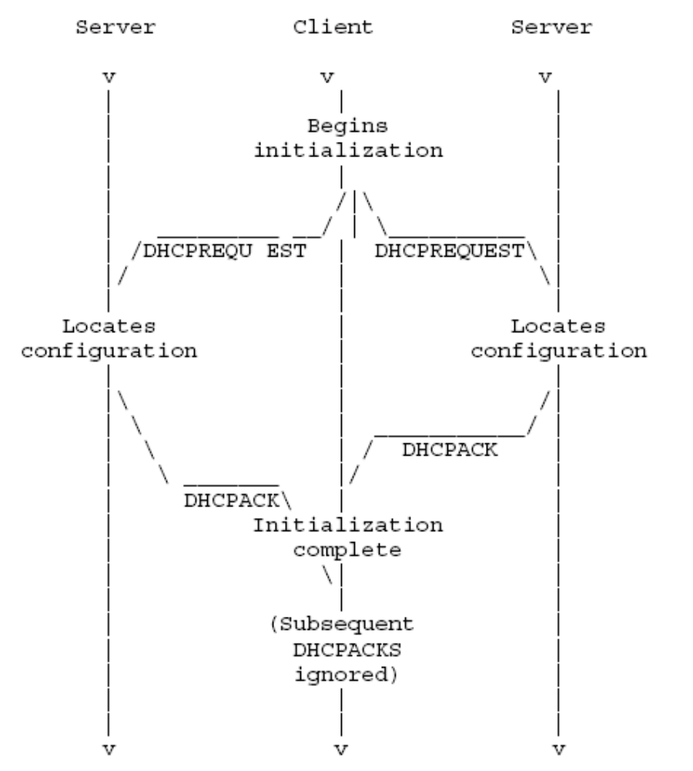
Reusing previous network address
Figure 4. DHCP new network address model

Slide 28
Step-by-step
Client broadcasts DHCPREQUEST
Server responds with DHCPACK
Server SHOULD NOT check for network address
Client is configured
Client detects address in use sends DHCPDECLINE
Client receives DHCPNAK
No DHCPACK/DHCPNAK
Client sends DHCPRELEASE

Slide 29
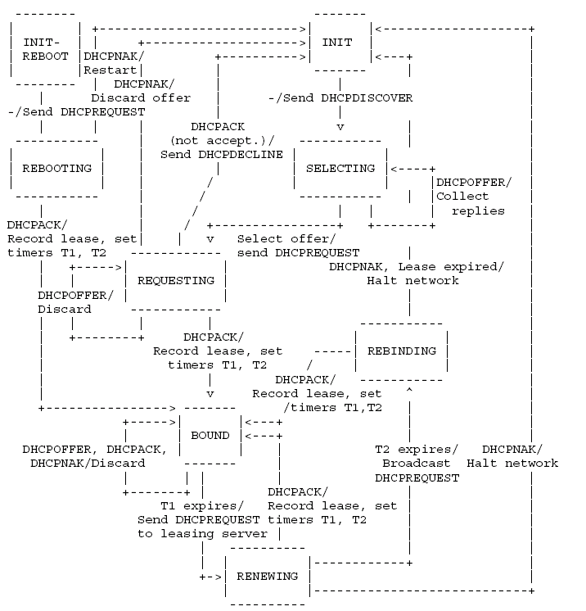
2.7 State transition diagram

Slide 30
Steps-initialization and allocation of network address
Client begins in INIT state.
DHCPDISCOVER
    ciaddr=0x00000000
    parameter request list
    network addr, lease time
    chaddr
    client identifier
    transaction ID-xid
After DHCPACK, client moves to BOUND state.

Slide 31
Steps-initialization with known network address
Client begins in INIT-REBOOT state
Sends DHCPREQUEST
After DHCPACK, it moves to BOUND state

Slide 32
2.8 Reacquisition and expiration
Times T1 and T2 to extend its lease
At T1, client enters RENEWING state
At T2, client enters REBINDING state
T1<T2<lease expiration time
In either of two states client sends DHCPREQUEST
If lease expires before DHCPACK, client moves to INIT state

Slide 33
2.9 Enhancements
Integration of DHCP with DNS
Multicast Address allocation
Unauthorized DHCP server detection
Clustering for high availability

Slide 34
2.10 Performance Issues
Appropriate lease durations
Lengthening lease duration for large, fixed networks
Shortening lease duration for variable networks with fewer IP addresses
Reserve addresses with reservations
Integrate DHCP with other services

Slide 35
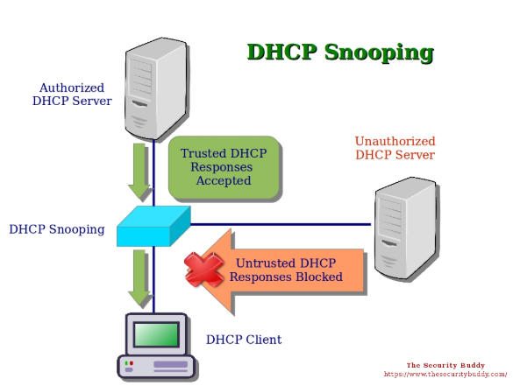
3. Introduction DHCP-snooping
Figure 5. DHCP-snooping model

Slide 36
• We need DHCP Snooping to prevent a man-in-the middle attack on our network.
• The potential exists for an attacker to pretend (spoof) to be the DHCP server and respond to DHCPDISCOVER messages before the real server has time to respond.
• DHCP Snooping allows switches on the network to trust the port a DHCP server is connected to (this could be a trunk) and not trust the other ports. It also maintains a list of DHCP address bindings by inspecting traffic flowing between clients and the DHCP server, which provides certainty around who the real hosts are.
• The binding information collected by DHCP Snooping is used by other security features like IPSG and DAI.

Slide 37
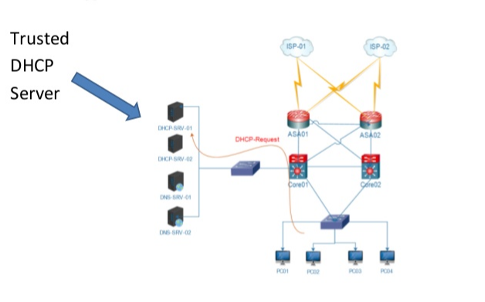
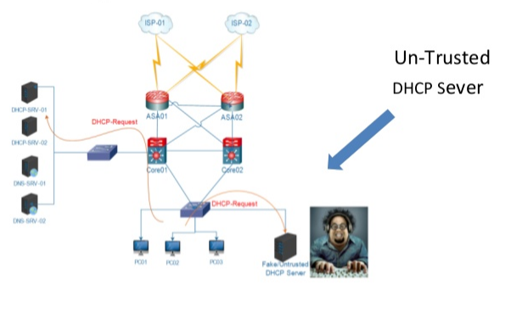
3.1 Overview
DHCP Server in Network
Figure 6. DHCP Server

Slide 38
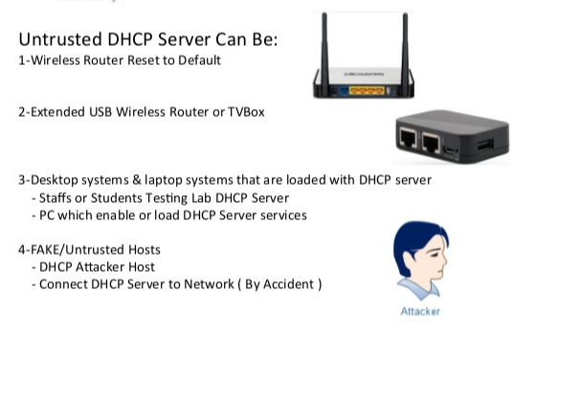
Spurious DHCP server

Slide 39
3.2 Trusted and Untrusted Sources
Trusted Host: devices under adminnistrative control are trusted sources includes the switches, routers, and servers in your network.
Untrusted Host : A DHCP server that is on your network without your knowledge on an untrusted port is called a spurious load DHCP server.

Slide 40
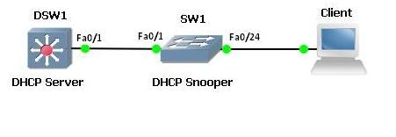
Our client connects to an untrusted port; all ports are untrusted by default. When the client machine sends a DHCPDISCOVER message with DHCP Snooping enabled, the switch will only send the DHCP broadcast message to trusted ports.
• In this case our distribution switch is acting as the DHCP server, but a DHCP server running external to the switch could also be used. A trusted port is the only port which is allowed to send DHCP Server responses such as DHCPOFFER.

Slide 41
• Let’s jump onto SW1 and enable DHCP Snooping:
SW1(config)#dhcp-snooping admin-state enable
SW1(config)#
• We also need to enable it for our VLANs. In this case we’re only using VLAN 1: SW1(config)#dhcp-snooping vlan 1 admin-state enable
SW1(config)#
• Now, we make Fa0/1 facing DSW1 a trusted port:
SW1(config)#ip interface Fa0/1 address 1.2.3.4
SW1(config-if)#dhcp-snooping port 1/1/2 trust
SW1(config-if)#

Slide 42
Let’s take a look at the DHCP Snooping config:
• SW1#show dhcp-snooping
DHCP Snooping :
DHCP Snooping Status = Switch-Level Enabled,
Option 82 Data Insertion Per Switch = Enabled,
MAC Address Verification Per Switch = Enabled,
DHCP Snooping Bypass Opt82-Check = Disabled,
DHCP Snooping Opt82 Format = Base MAC,
DHCP Snooping Opt82 String = e8:e7:32:ae:f1:61,
DHCP Snooping Binding DB Status = Enabled,
Database Sync Timeout = 1,
Database Last Sync Time = Jan 27 2014 09:27,
Binding Persistency Status = Disabled,
DHCP Snooping Option-82 Policy = Replace,

Slide 43
We can see the DHCP binding has been captured by DHCP Snooping:
• The DHCP Snooping binding table contains the MAC address, IP, lease time, lease type, VLAN ID and attached interface for each client
SW1# dhcp-snooping binding 01:02:03:04:05:06 port 1/1/2 vlan 10 address 1.2.3.4
SW1# show dhcp-snooping binding
Total Number of Binding Entries: 1
MAC IP Lease VLAN Binding
Address Port Address Time ID Type
-----------------+-----------+-----------------+---------------+--------+-----------
01:02:03:04:05:06 1/1/2 1.2.3.4 - 10 Static

Slide 44
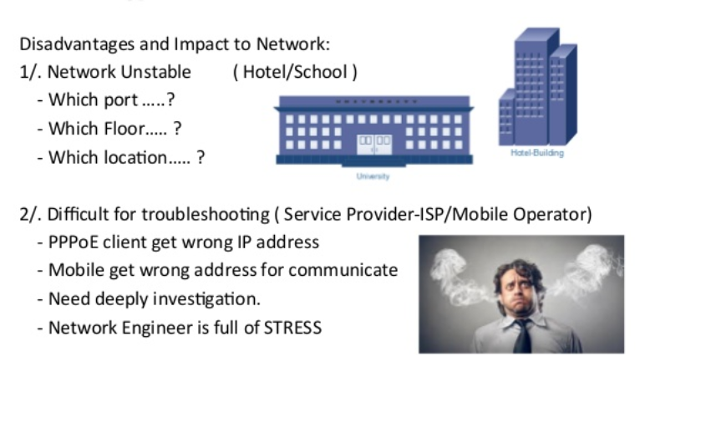
3.3 Impact to Network

Slide 45
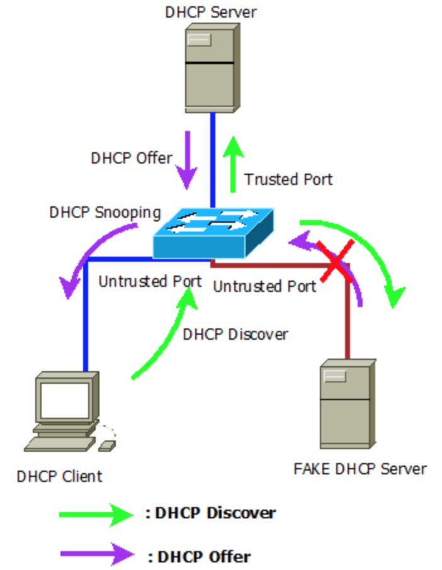
3.4 DHCP snooping Feature
Enable DHCP snooping on Untrusted port
Filters out invalid messages
Rate-limits traffic trusted & untrusted
Maintains DHCP snooping binding databse
By default, it is inactives on all VLANs.
Figure 8. DHCP snooping Feature model

Slide 46
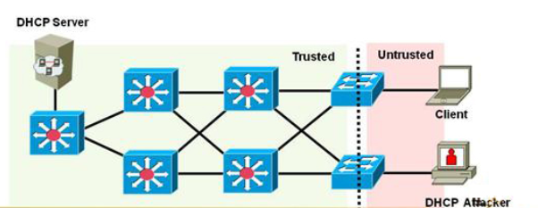
Notification of DHCP Snooping
DHCP snooping allow the configuration of port as trusted and untrusted
Untrusted ports cannot process DHCP replies
Configure DHCP snooping on uplinks port to DHCP server.
Don’t configure DHCP snooping on client ports
Figure 9. Notification of DHCP Snooping model

Slide 47
3.5 DHCP snooping also has the following related requirement
The DHCP Snooping feature can be enabled/activated at two levels, namely:
The vlan level
The switch level
Note: The Switch Level DHCP Snooping and the VLAN Level DHCP Snooping are mutually exclusive. That is, they cannot be configured/enabled at the same time.

Slide 48
VLAN Level DHCP Snooping
Once DHCP Snooping is enabled on the VLAN, this implies that, all the DHCP packets through the interfaces that belong to this VLAN are subject to be filtered/screened. In AOS, we say that those interfaces of the vlan are in “DHCP Client Only” mode.

Slide 49
Switch Level DHCP Snooping
When DHCP Snooping is enabled against the switch, all the DHCP packets through all the interfaces are subject to be filtered/screened. By default, all the interfaces will allow “DHCP Client only” traffic. In this case, the DHCP-trusted interface(s) need to be properly configured to allow DHCP server traffic to go through. In addition, there will be the following two global/switch-level parameters:
DHCP Option-82 data insertion
MAC address verification
The behavior of DHCP Snooping at the switch level, and the impact of enabling/disabling of the above two parameters are the same as at the VLAN level.

Slide 50
3.6 Ingress Source Filtering
In addition to filtering untrusted DHCP messages, DHCP Snooping can allow user to configure Ingress Source Filtering as a security feature. When Ingress Source Filtering (ISF) is enabled on a port or linkagg port, the initial packets permitted for traffic are DHCP, DNS and ARP so as to allow the client to obtain and IP address from the DHCP server in which a MAC-IP Binding entry is created in the DHCP Snooping task, it will then allow packets that match the IP address/MAC address/ port combination that is obtained from the DHCP snooping binding table entry. Other non-matching packets will be dropped.
When ISF is enabled on a vlan then the vlan ID is added to the matching criteria as an additional parameter that must be matched.

Slide 51
Ingress Source Filtering (ISF) can be enabled via the CLI or other management interface such as SNMP and WebView.
Ingress Source Filtering relies on the content of the DHCP Snooping Binding Table:
If there is no entry found in the DHCP Snooping Binding Table for a particular MAC on a given port, ISF cannot be created for the MAC address.
Each port can have one entry for a given MAC address.
For device using static IP address, user will have to manually create a “Static Binding entry” to DHCP Snooping Binding Table.
The total maximum number of DHCP binding entries that a system can learn is 4096.

Slide 52
There are 2 ways that a TCAM entry is being used up by a system. The first one is the configuration of ISF – we will refer this as the Bind Enablement operation. The second is the creation of a DHCP binding entry – we will refer this as the Bind Creation operation.
Port Level ISF:
Port level ISF can be enabled on a fixed port or on a linkagg port. For fixed port the Bind Enablement and Bind Creation operate on the NI that the port is on. For linkagg port the Bind Enablement and Bind Creation operate on all member ports of the linkagg.
VLAN level ISF:
For VLAN level ISF, Bind Enablement for each VLAN will take up 3 TCAM entries on all NIs. User can only enable ISF on 32 VLANs.
On Bind Creation, each DHCP binding entry will require one TCAM entry for fixed port and one TCAM entry for each member port of the linkagg.

Slide 53
Ingress Source Filtering Commands
dhcp-snooping ip-source-filter [port <chassis/slot/port> | linkagg <linkAggId>] admin-state <enable/disable>
( The status of IP source filtering on a specified port. Default is disabled.)
dhcp-snooping ip-source-filter vlan <vlanID> admin-state <enable/disable>
( Enables/disables ingress source filtering on the specified vlan. Default is disabled.)

Slide 54
3.7 DHCP OPTION 82
Option 82 in UDP Relay (ip helper agent information) is to provide additional information for the DHCP server to know about the identity of the client for the purpose of assigning an IP address for the client.
Option 82 in DHCP Snooping can provide additional information for the DHCP server for IP address assignment but it is used for port identification for DHCP Snooping purpose. Option 82 is inserted by DHCP snooping when sending the DHCP packet to the DHCP Server and the DHCP Snooping will strip off this option if it is present in the packet sent from the DHCP server to the client. Some DHCP server does not echo back this option at all (i.e. DHCP Reply does not contain the Option 82 information from DHCP Request packet).

Slide 55
The Option 82 Format type in both 6.X and 7.X remains the same. The available Option 82 format types are:
MAC Address
System Name
User String
Interface Alias
Auto Interface Alias
ASCII

Slide 56
References
RFCs 1531,1533,1541, 2131,2132, http://ietf.org/rfc.html
DHCP FAQ
http://www.dhcp-handbook.com/dhcp_faq.html
Microsoft Windows Server 2003 whitepaper
http://www.microsoft.com/technet/prodtechnol/windowsserver2003/

Slide 57
Thank You

