Slide 1
F-Deli

Slide 2

Strategy Initiation
REPRESENTATIVE ISSUES IN E-STRATEGY INITIATION
First-Mover Advantage
Has a large delivery network
There are many customers
Markes needs
Low shipping costs
Door to door
Ensure the integrity of the goods

Slide 3
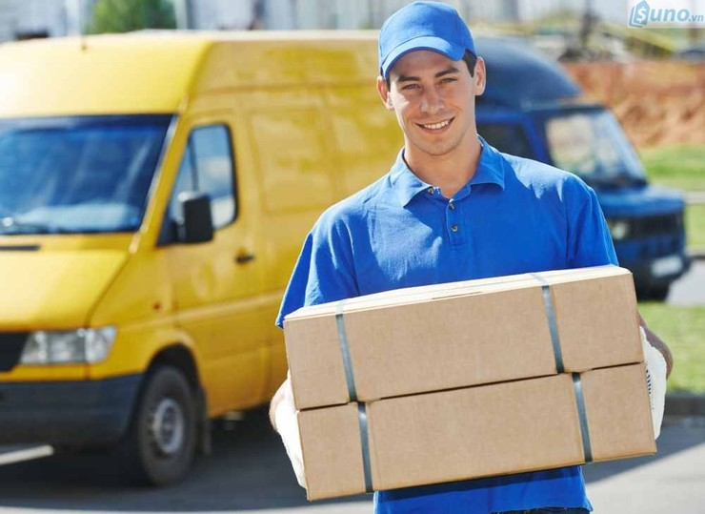
Strategy Initiation
STRATEGY IN THE WEB 4.0 ENVIRONMENT AND IN SOCIAL NETWORKING
Focus on retail stores, individuals selling online
Door to door service
Ensure safety for the goods
Receive reviews from customers.

Slide 4
Strategy Formulation
Planning:
Target audience: all people
Activate:
Customer: Post information to ship
Staff: Pick up and deliver to the buyer
Web goal
Attract online sellers to use the website

Slide 5
Strategy Formulation
Operating cost:
Server rental cost
Advertising cost
Employee hiring cost
Warehouse rental cost
Revenue:
Shipping fee income through orders
Target
Attracted 1000 users in a month

Slide 6
Strategy Implementation
What:
F-deli website
Who:
Design and Code
Tester
Manage web
Telesale
When:
Meeting to plan: 1 week
Design and code: over week
Recruit delivery staff
Provide a demo after month
Call customer advice

Slide 7
Strategy Assessment
Strengths:
High applicability
Demand for freight forwarding is growing
Manage orders
Allows customers to track delivery progress.
Weaknesses:
Need a large capital
Transport system takes time to build
Entice customers, when they get used to the old system before

Slide 8
Strategy Assessment
Opportunities:
Access to growing online shopping demand
Expand abroad
There are many potential customers
Threats:
The preservation of goods in the warehouse
Delivery time may be affected by weather

