Slide 1

Mid term meeting – elbow dysplasia

Slide 2
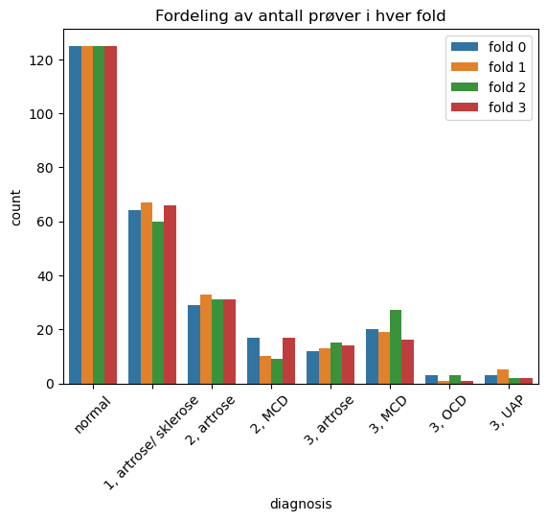
Binary experiments Dataset:
Total amount of samples: 1090
Training set: fold 0 and 1
Validation set: fold 2
Test set: fold 3

Slide 3


5 best results

Slide 4
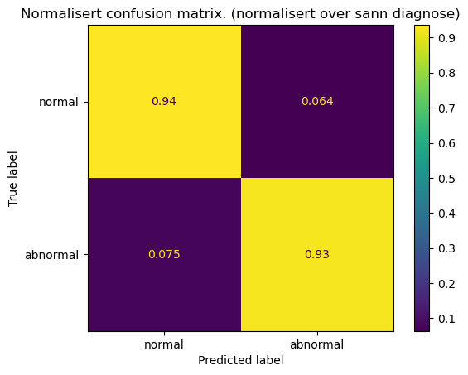
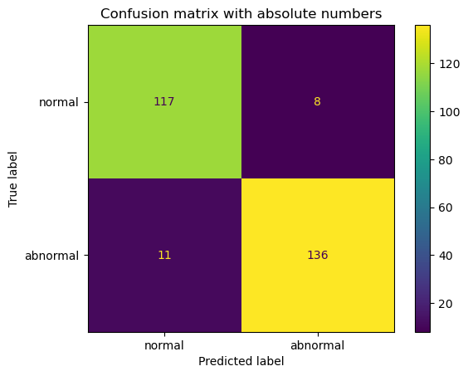
Confusion matrices: abnormal is positive class

Slide 5
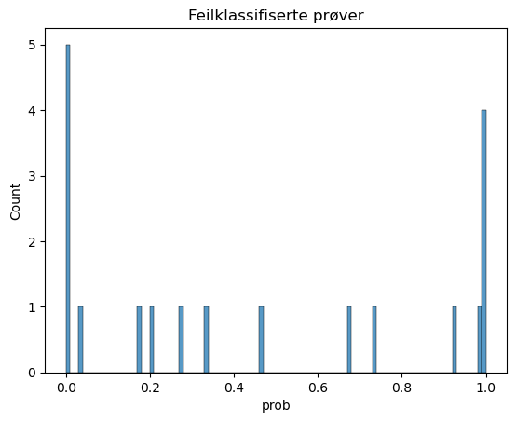
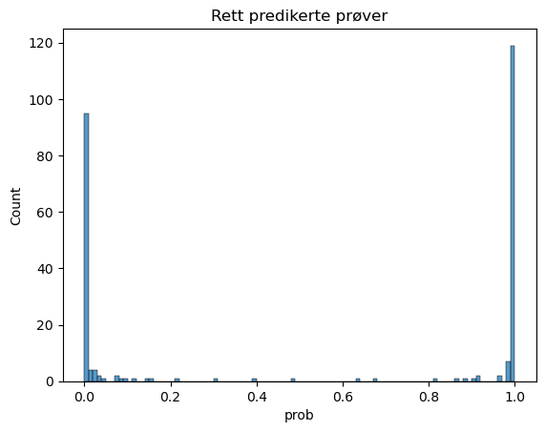

Confidence in predictions

Slide 6
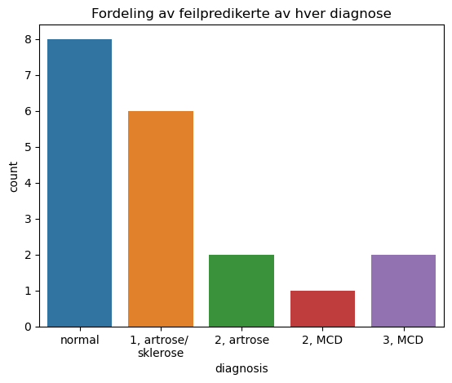
Number of samples from each diagnosis that were wrongly classified
Both level 2 arthrosis samples were unconfident predictions

Slide 7
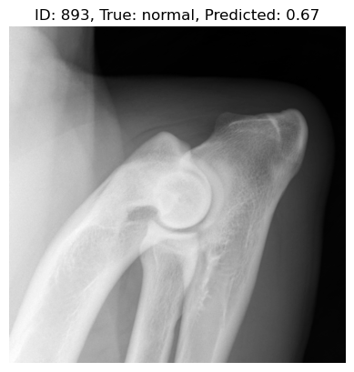
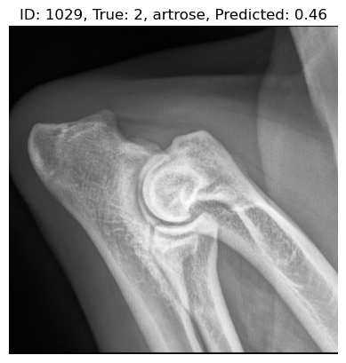
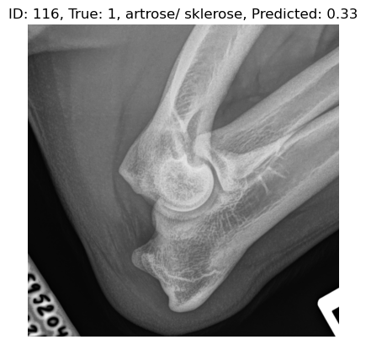
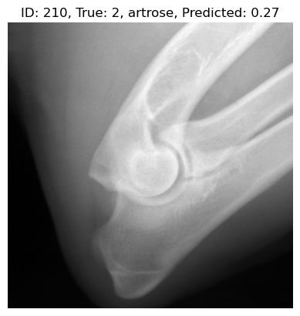
Unconfident wrongly classified samples

Slide 8
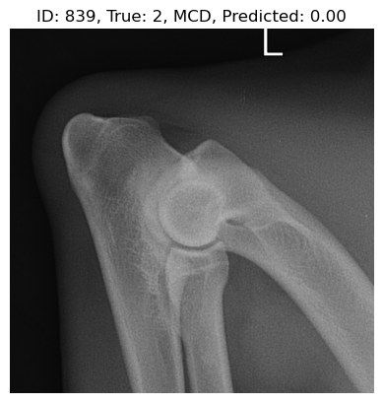
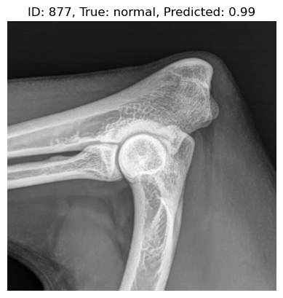
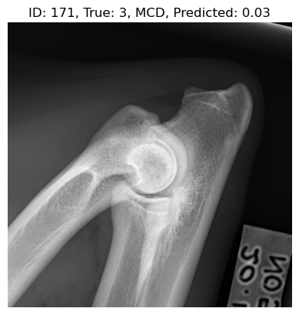
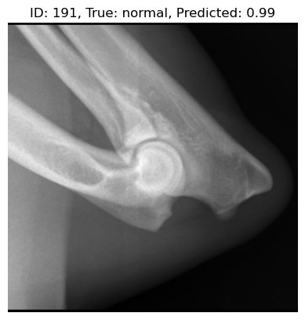
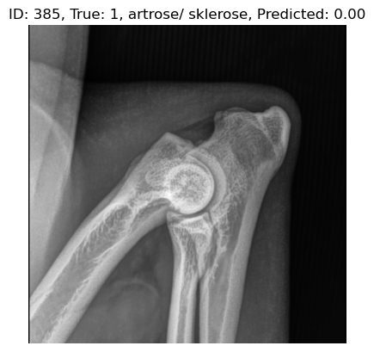
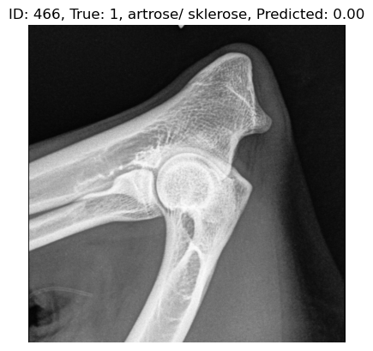
Confident wrongly classified samples
Notes:
Hvilke feilpredikeringer er interessante å undersøke videre?

Slide 9

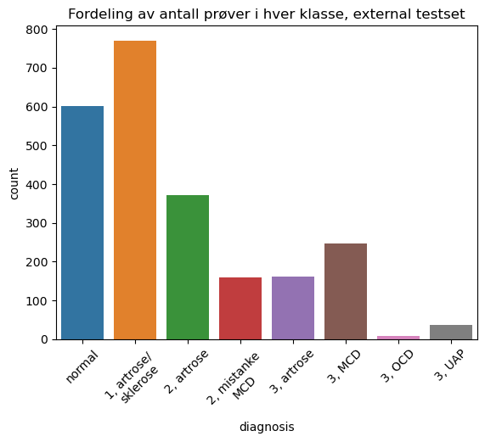
External test on best model
accuracy: 0.913
mcc: 0.79
f1: 0.94 (highest of all)
Total: 2355

Slide 10
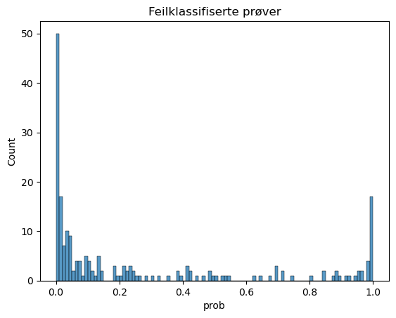
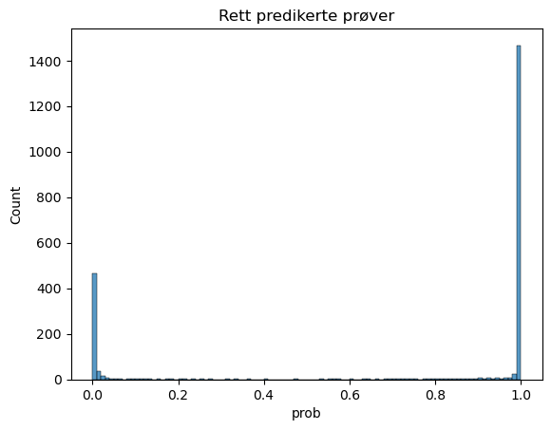
Confidence in predictions

Slide 11
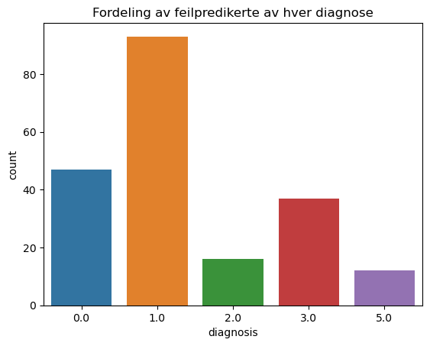
External test
Test on training dataset

Slide 12
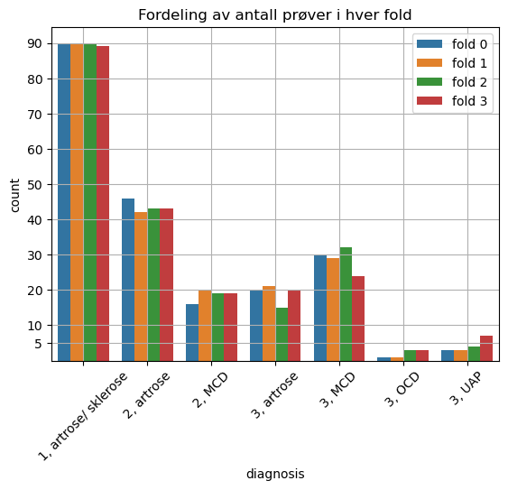
Multiclass experiments: by level
Only abnormal samples
Level 1, 2 and 3 correspond to class 0, 1 and 2

Slide 13
5 best results
But validation may indicate poor generalization
Notes:
Lowest accuracy was 0.47

Slide 14
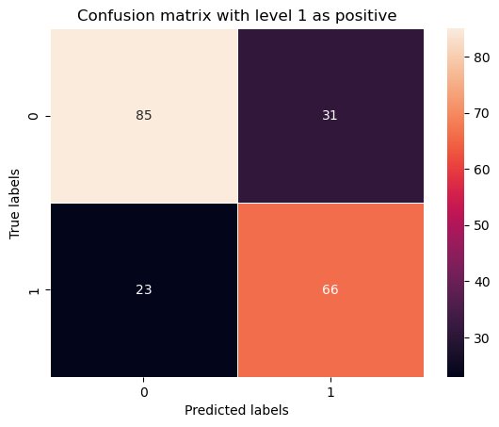
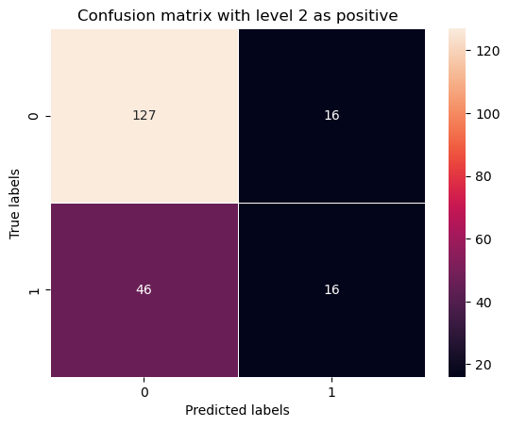
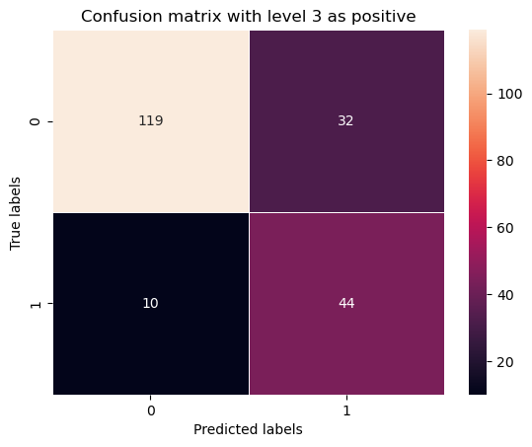
Confusion matrices with absolute numbers

Slide 15
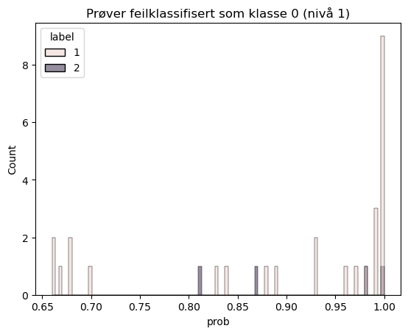
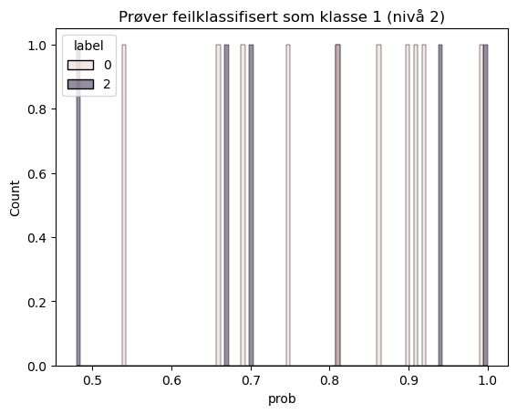
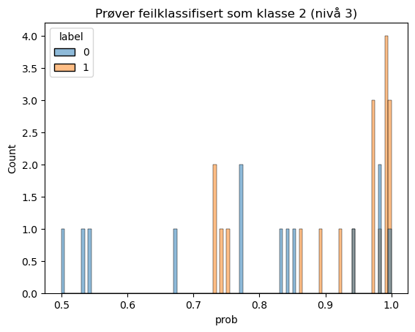
Confidence in wrong predictions
Confidences span from around 0.5 to 1.0

Slide 16
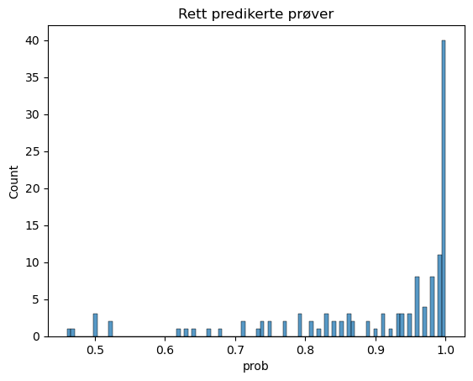
Confidence in correct predictions

Slide 17
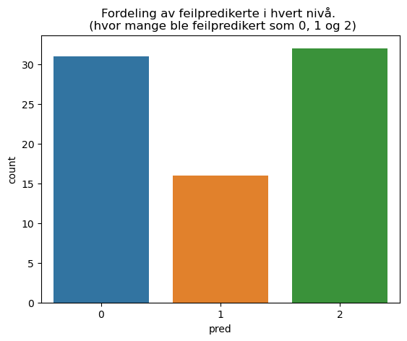
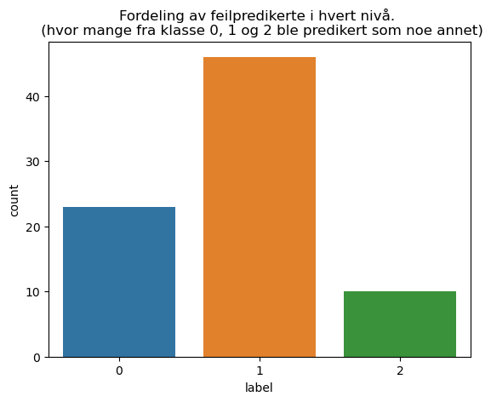
Distributions of wrongly predticted samples
Class 0: level 1
Class 1: level 2
Class 2: level 3

Slide 18
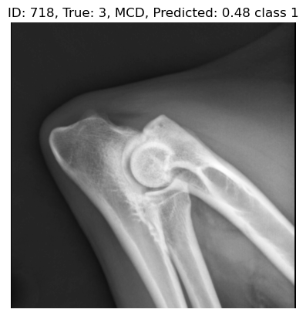
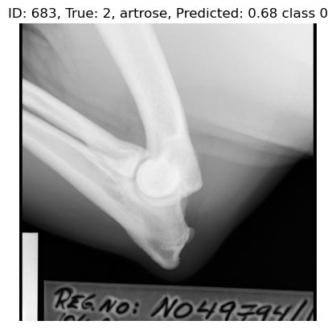
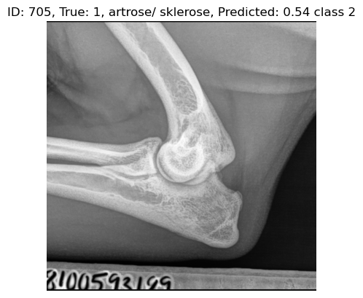
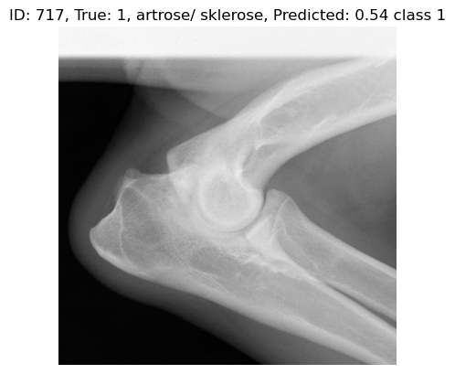
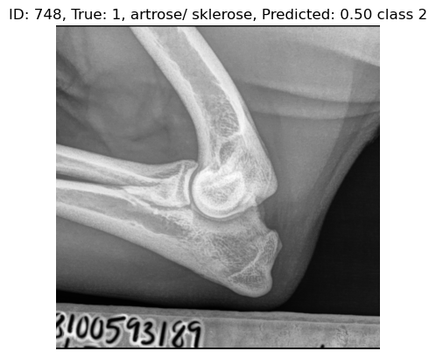
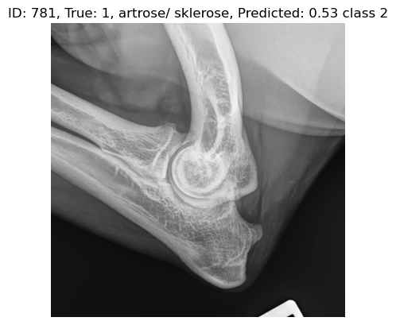
Unconfident wrongly classified samples

Slide 19
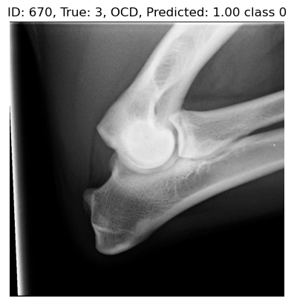
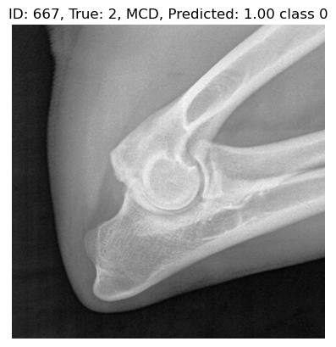
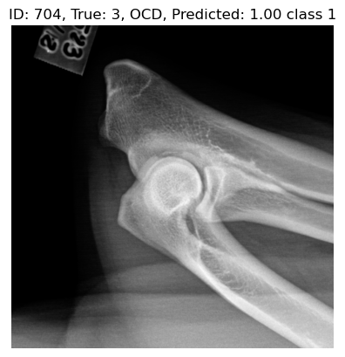
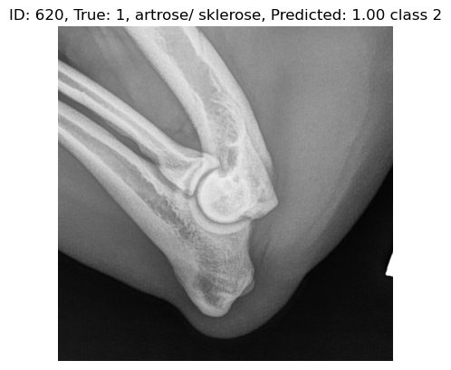
Confident wrongly predicted samples

Slide 20
Spørsmål til radiologene
Who collected all the images from the different clinics?
What is NKK’s role in this project?
How is personal privacy handled?
Were all images taken for screening, or because of suspicion of illness?
What dogs in Norway are included in this project?
Are all images from Norway?
How do you evaluate the images?

Slide 21
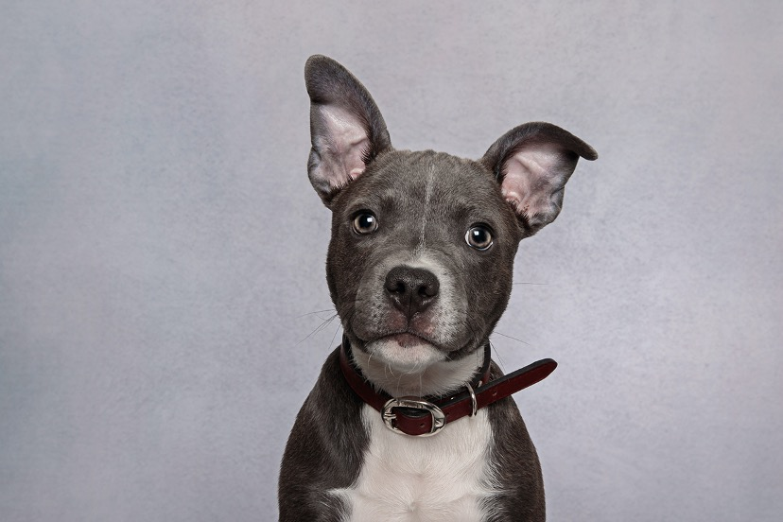
Other

