Slide 1
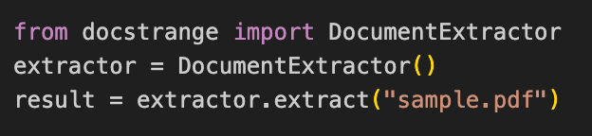
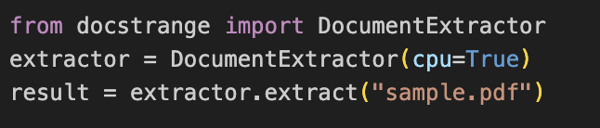
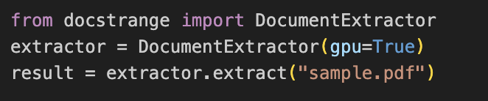
docstrange==1.1.8
Processing happens in DocStrange cloud
Requires internet
Usually fast
Just support GPU
docstrange==1.1.3 & cpu mode
Fully offline
Runs ML models locally
Works on Mac / Linux / Windows
Slower for large documents
docstrange==1.1.3 & gpu mode
Requirements
NVIDIA GPU (or MPS)
Advantages
5–20× faster
Best for large PDFs
Notes:
Local CPU mode - Common underlying models (from the DocStrange stack):
Layout detection → DocLayout / LayoutLM-based models
OCR → PaddleOCR
Table structure → TableTransformer / PPStructure

Slide 2
Trade-offs
PDF
DOCX
Input PDF ⟶ Image Rendering ⟶ OCR ⟶ Convert ⟶ Output
Input DOCX ⟶ File Unzipping ⟶ XML Parsing ⟶ Structural Mapping⟶ Convert ⟶ Output
Uses OCR because files may contain scanned images instead of text.
No OCR needed, content and tables are stored in structured XML, enabling more accurate table extraction than PDF.
This step is heavy: using GPU is faster but uses more memory, while using CPU uses less memory but takes more time.
Because of its struture, we process DOCX in CPU or GPU, it will use less memory and take less time than PDF.

Slide 3

DocumentExtractor - Constructor
Parameter | Type | Default | Meaning
api_key | str | None | Nanonets API key for cloud tier. Omit to use cached login or free tier.
model | str | None | Cloud model: "nanonets" (default), "gemini", or "openapi".
ocr_enabled | bool | True | Use to activate OCR (but PDF mandatory uses OCR).
cpu | bool | False | Force local CPU mode. Requires docstrange[local-llm] + Ollama running.
gpu | bool | False | Force local GPU (CUDA) mode. Fastest local option. Requires CUDA + Ollama.

Slide 4


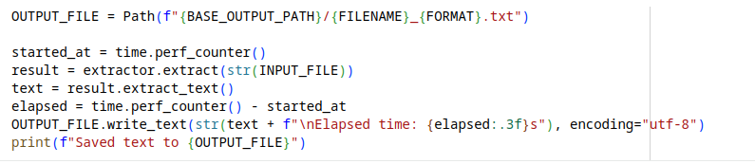
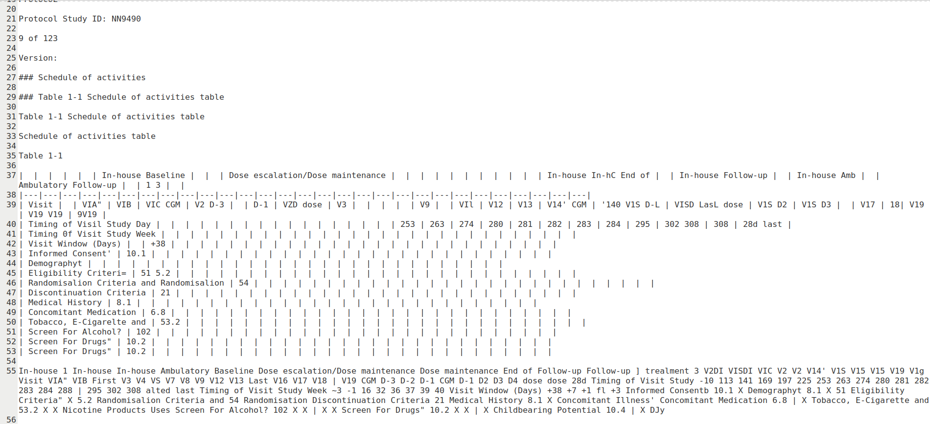
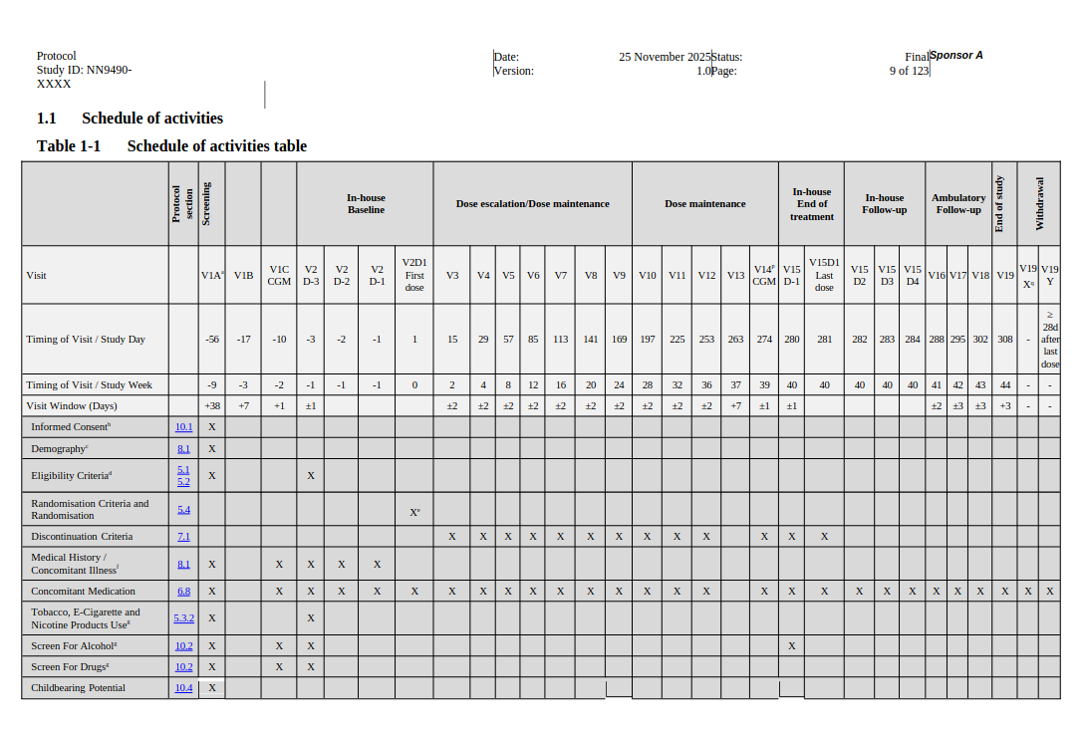
extract_text()
DocumentExtractor: class from the docstrange library, use to read document, extract content
extractor.extract(str(INPUT_FILE)): call method and return ConversionResult object containing parsed data (text, tables, metadata, etc.).
result.extract_text(): all textual content found in the document.

Slide 5
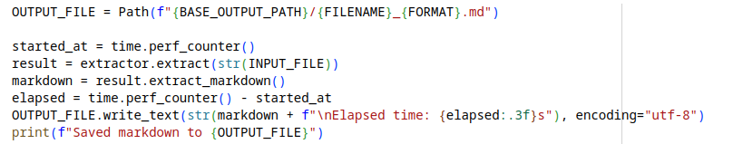
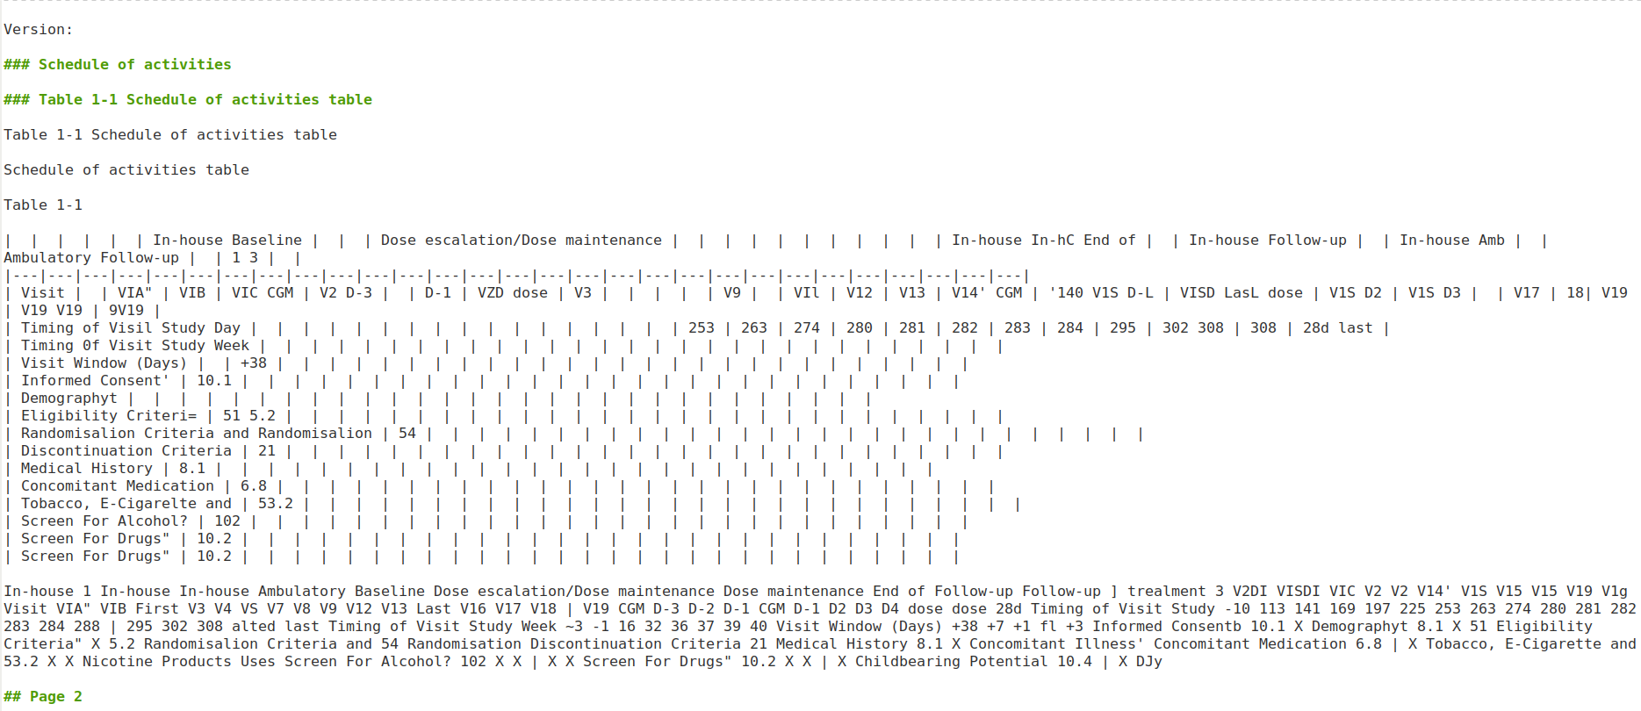
extract_markdown()
DocumentExtractor: class from the docstrange library, use to read document, extract content
extractor.extract(str(INPUT_FILE)): call method and return extraction result object containing parsed data (text, tables, metadata, etc.).
extract_markdown(): returns the document as Markdown, preserving structure like headings, lists, and tables.

Slide 6
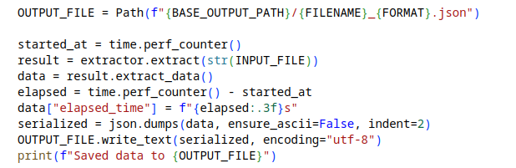
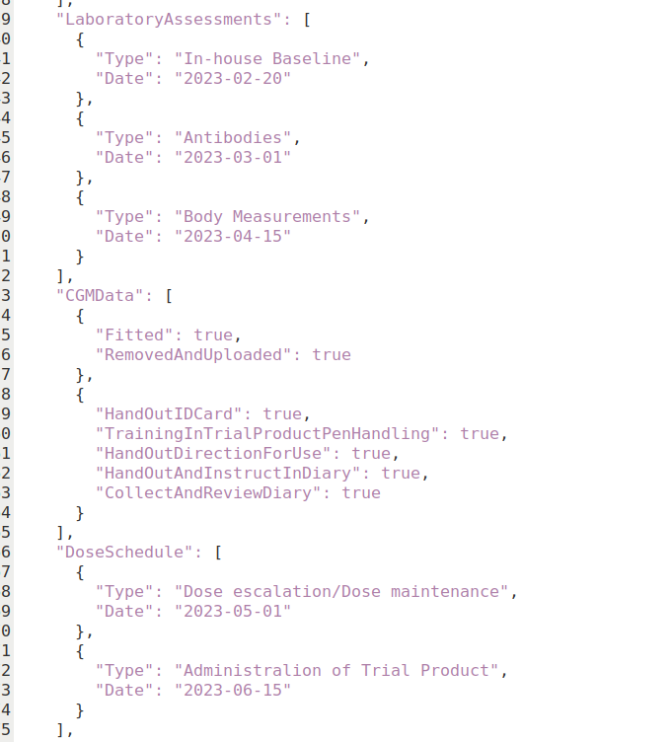
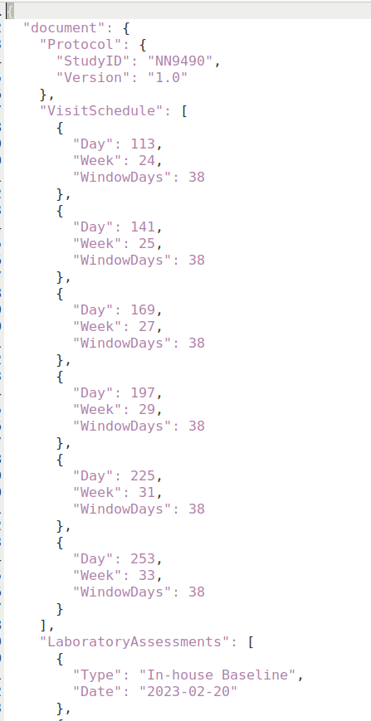
extract_data()
extract_data(): returns the json data
Parameter | Type | Description
specified_fields | List[str] | Extract only specific fields
json_schema | Dict | Enforce structured schema

Slide 7
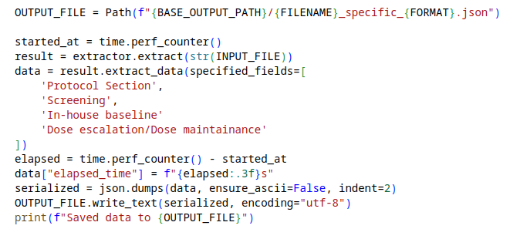
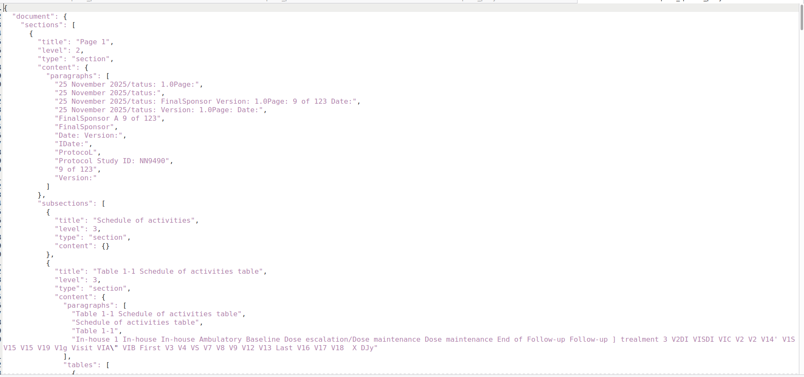
extract_data() -> specified_fields

Slide 8
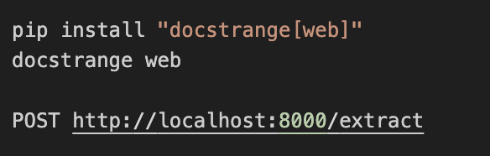
Local REST API mode
The REST server uses the same models as local mode:
Layout model
OCR model
Table parser
Dependency when installing docstrange[web]
+ DocStrange
+ FastAPI server
+ Uvicorn runtime
+ Upload handling
+ API schema/validation
The web version currently supports cloud processing only
Notes:
uname –a
DocStrange GPU requires CUDA, which only works with NVIDIA GPUs on Linux/Windows.
Pdfplumber or unstructured => best case
PDF → pdfplumber DOCX → python-docx Images → tesseract

Slide 9
Executation time statistics
File Pages | Input Format | Output Format | CPU (TMA Computer) Exe.Time (secs) | GPU T4 (Google Colab) Exe.Time (secs)
1 pages (4 paragraphs 1 table) | PDF | Markdown | 22.803
 |  | Text | 23.137
 |  | CSV | 171.146
 |  | JSON | 234.781
 | DOCX | Markdown | 8.251 | 0.044
 |  | Text | 8.856 | 0.022
 |  | CSV | 151.917 | 7.879
 |  | JSON | 114.918 | 6.303

Slide 10
