Slide 1
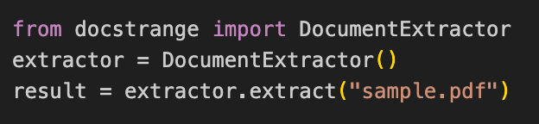
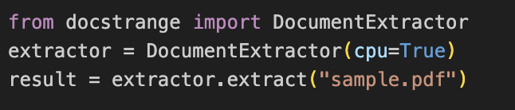
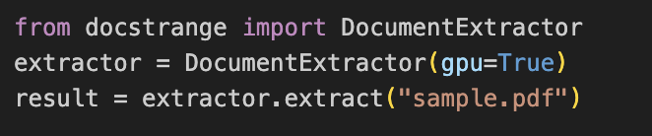
docstrange==1.1.8
Processing happens in DocStrange cloud
Requires internet
Usually fast
No GPU/CPU requirement locally
docstrange==1.1.3 & cpu mode
Fully offline
Runs ML models locally
Works on Mac / Linux / Windows
Slower for large documents
docstrange==1.1.3 & gpu mode
Requirements
NVIDIA GPU
CUDA
PyTorch CUDA
Advantages
5–20× faster
Best for large PDFs
Notes:
Local CPU mode - Common underlying models (from the DocStrange stack):
Layout detection → DocLayout / LayoutLM-based models
OCR → PaddleOCR
Table structure → TableTransformer / PPStructure

Slide 2
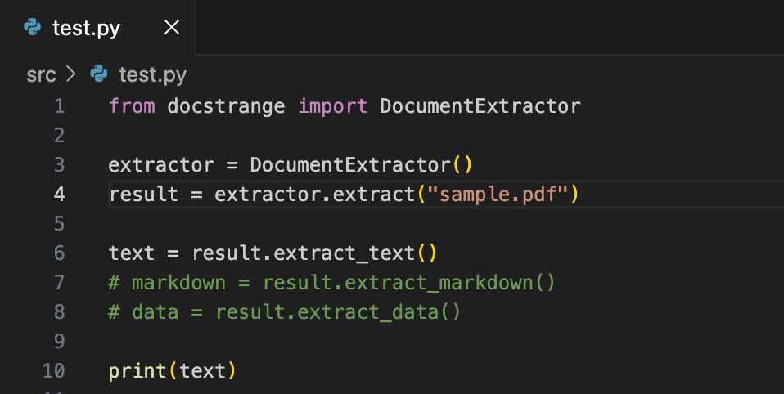
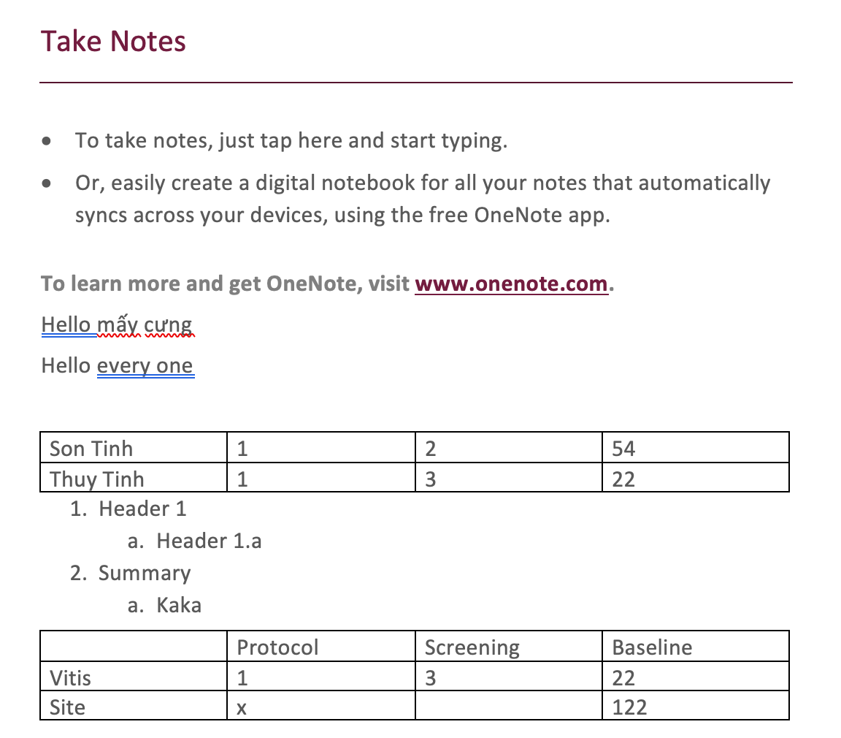
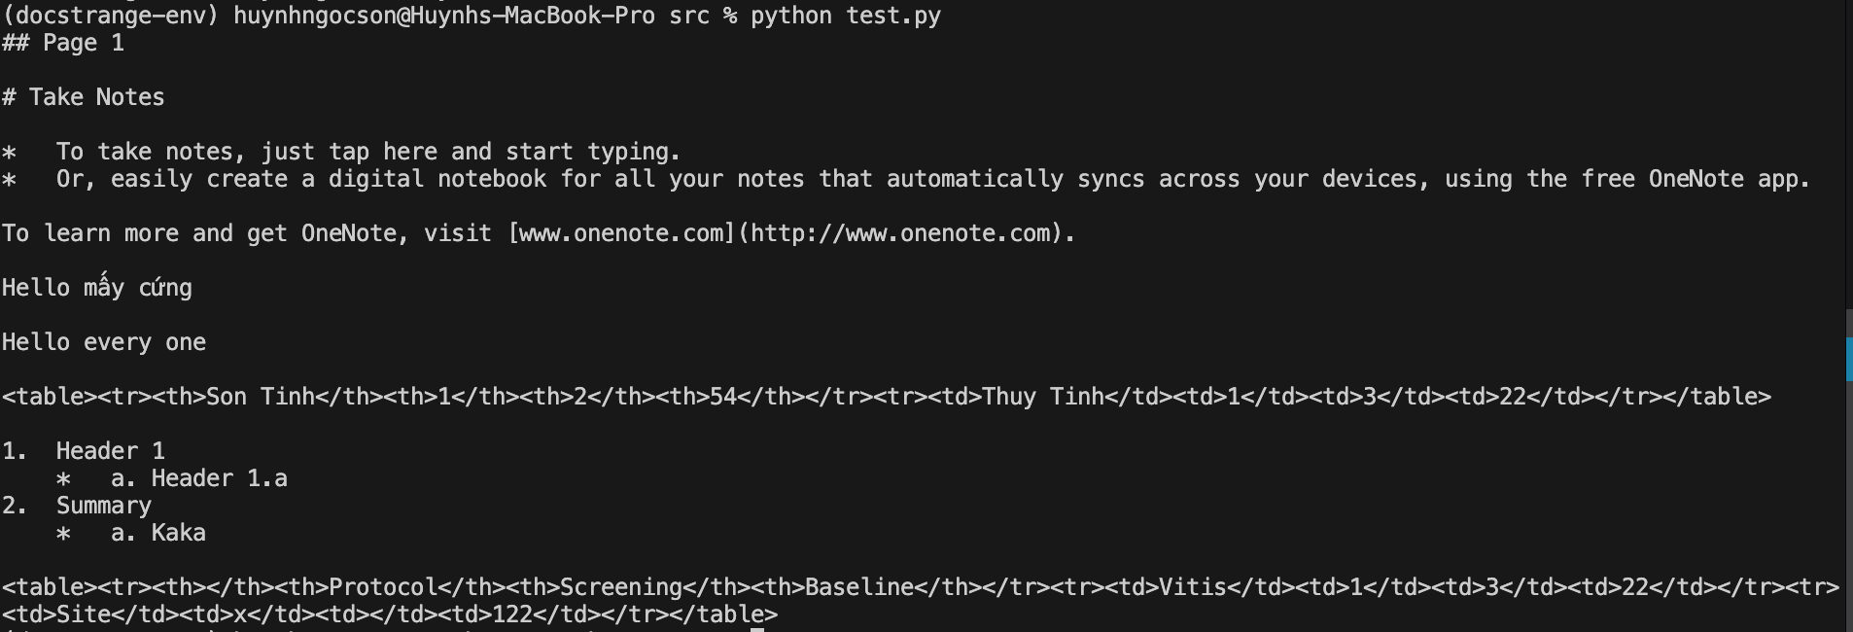
extract_text()
DocumentExtractor: class from the docstrange library, use to read document, extract content
extractor.extract("sample.pdf"): call method and return ConversionResult object containing parsed data (text, tables, metadata, etc.).
result.extract_text(): all textual content found in the document.

Slide 3
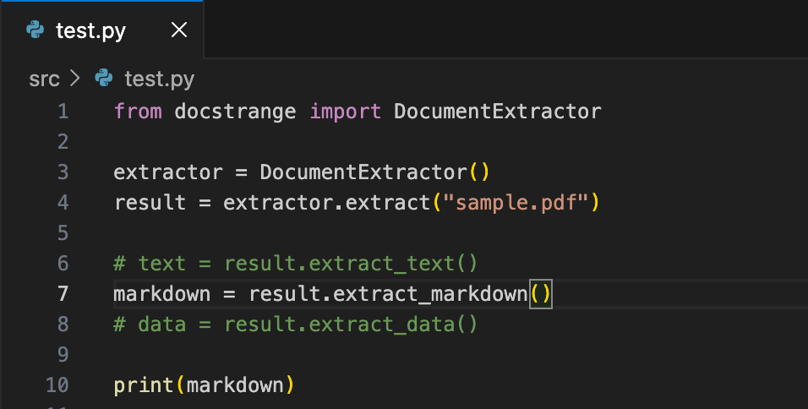
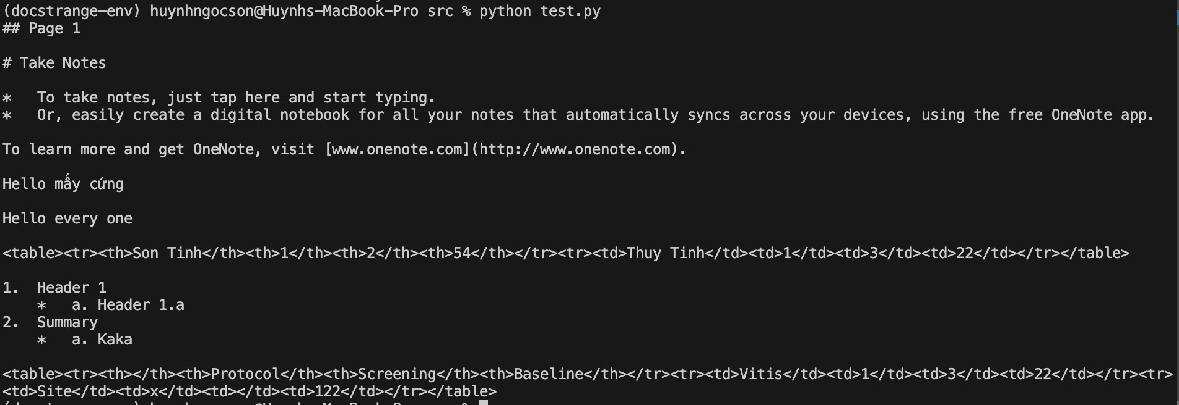
extract_markdown()
DocumentExtractor: class from the docstrange library, use to read document, extract content
extractor.extract("sample.pdf"): call method and return extraction result object containing parsed data (text, tables, metadata, etc.).
extract_markdown(): returns the document as Markdown, preserving structure like headings, lists, and tables.

Slide 4
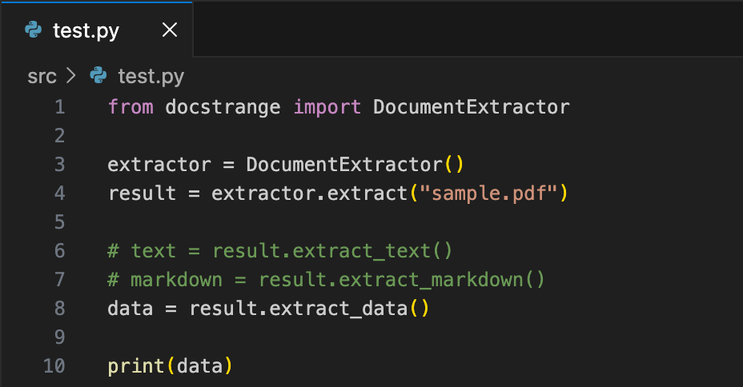
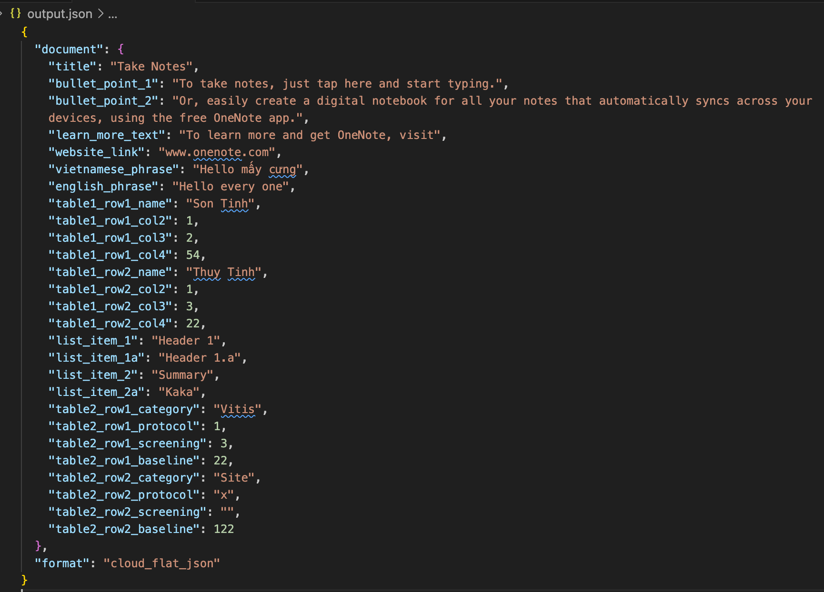
extract_data()
extract_data(): returns the json data
Parameter | Type | Description
specified_fields | List[str] | Extract only specific fields
json_schema | Dict | Enforce structured schema

Slide 5
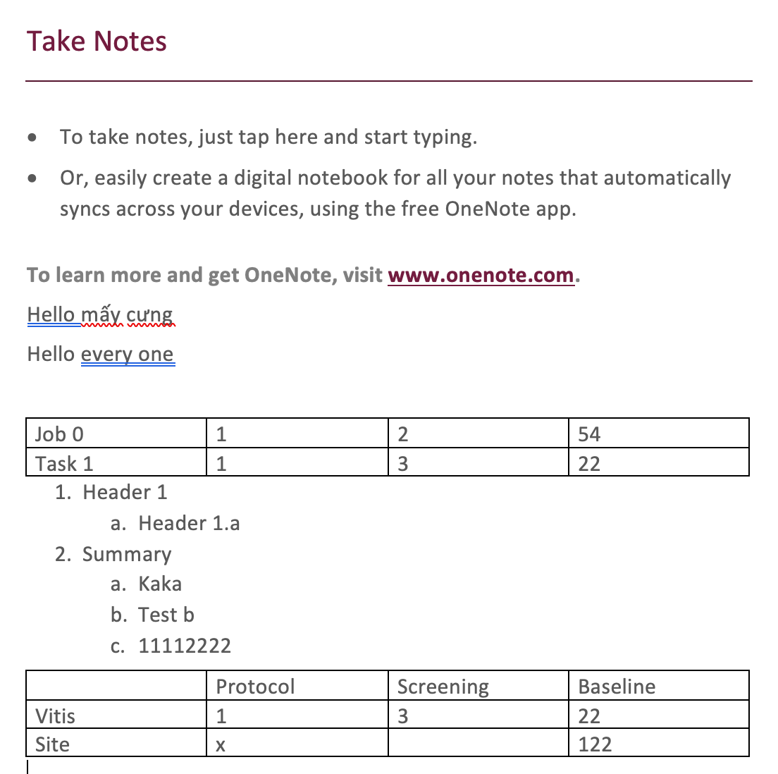
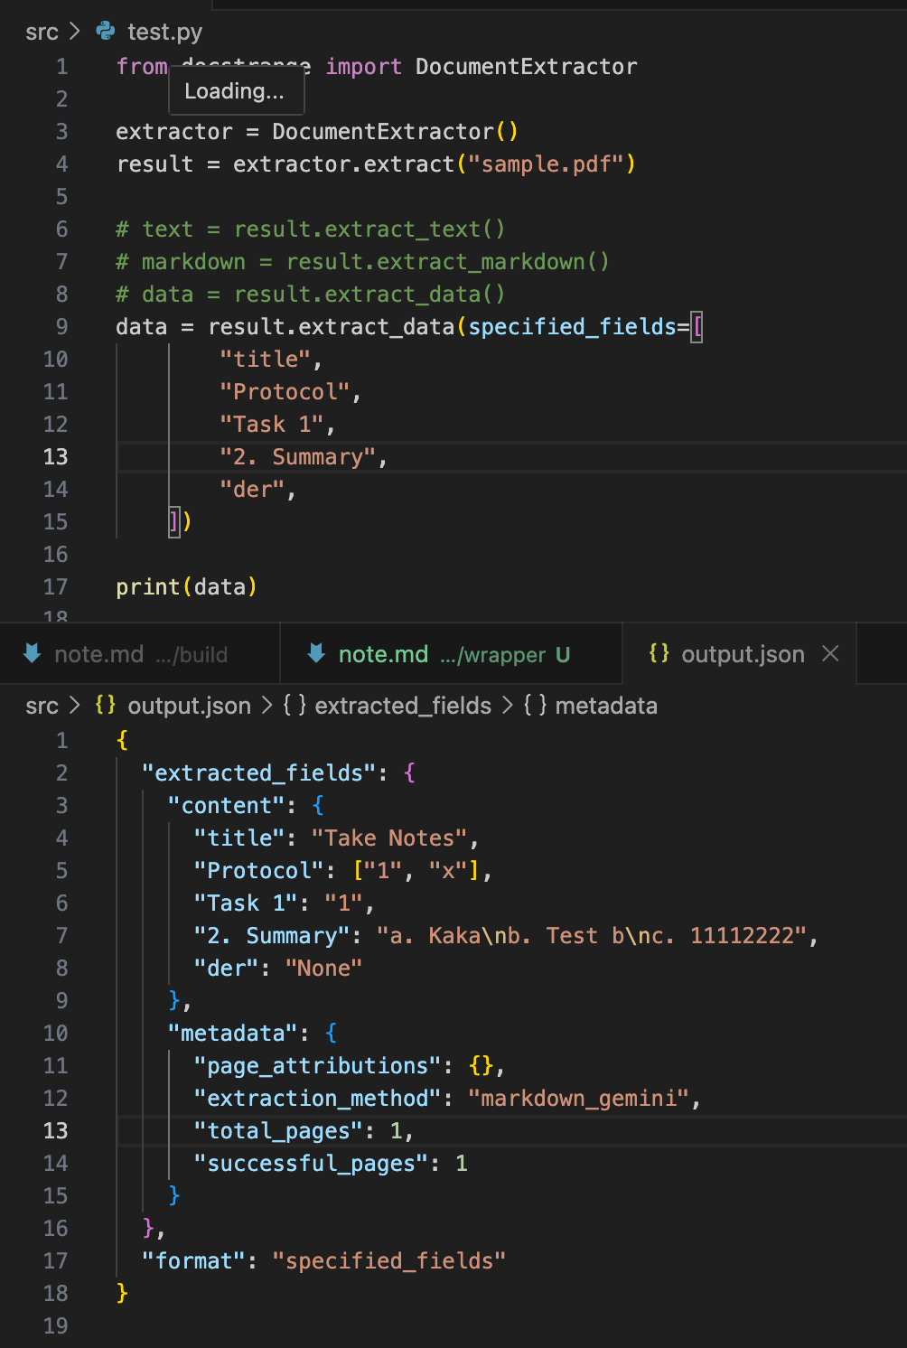
extract_data() -> specified_fields

Slide 6
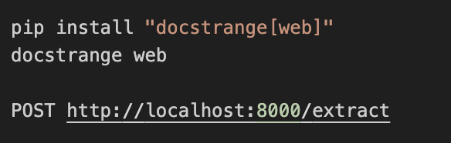
Local REST API mode
The REST server uses the same models as local mode:
Layout model
OCR model
Table parser
Dependency when installing docstrange[web]
+ DocStrange
+ FastAPI server
+ Uvicorn runtime
+ Upload handling
+ API schema/validation
Mode | Models | Speed
Cloud | DocStrange cloud models | Fast
Local CPU | layout + OCR + table models | Medium
Local GPU | same models with CUDA | Very fast
REST API | same local models | depends CPU/GPU
Notes:
uname –a
DocStrange GPU requires CUDA, which only works with NVIDIA GPUs on Linux/Windows.
Pdfplumber or unstructured => best case
PDF → pdfplumber DOCX → python-docx Images → tesseract

