Slide 1
Recursion

Slide 2
Contents
1- Introduction to recursion.
2- Describing a recursive operation.
3- Implementing a recursive method.
4- Classifying recursive functions
5- How to manage running functions?
6- Anatomy of a Recursive Call
7- Evaluating performance of recursive methods.
8- Eliminating recursion
9- Backtracking (15 exercises)

Slide 3
Learning Outcomes
LO3.1 Describe the basic ideas of recursion and how to set up recursive systems that represent certain real-world phenomena.
LO3.2 Know how to develop recursive algorithms and programs
LO3.3 Write programs in Java using recursion to solve some problems, like creating the Fibonacci sequence.
LO3.4 Analyze a recursive function to find out its’ output without running.
LO3.5 Explain type of recursive functions, give examples and comparing them.
LO3.6 Compare recursion with iteration, analyze their pros and cons

Slide 4
1- Introduction to Recursion
Definition:
Recursion is a technique in which a concept/an operation is defined by itself ( đệ: đưa ra, quy: quay về).
Examples
Person = a child of other two persons
n! = n* (n-1)! ( factorial)
F(n) = F(n-1) + F(n-2) // Fibonacci sequence
a(n) = a(n-1)+ d: Arithmetic progression – CS cộng
b(n) = q*b(n-1) // geometric progression- CS nhân
public static int fibo (int n){
if (n<3) return 1;
return fibo(n-1) + fibo(n-2);
}

Slide 5
1- Introduction to Recursion
How to understand Recursion?
We use a reverse deduction (suy diễn ngược) with an initial data.
Examples:
Person = a child of other two persons
Initial persons: Adam, Eve
1 3 5 7 9 …..
A(n) = 1, n=1
A(n) = A(n-1) + 2, n> 1
1, 1, 2, 3, 5, 8, 13, …
F(n) = 1, n<3
F(n) = F(n-1) + F(n-2)
public static int fibo ( int n){
if (n<3) return 1;
return fibo(n-1) + fibo(n-2);
}
A recursive method:

Slide 6
1- Introduction to Recursion
Where recursion are used?
The Fibonacci sequence:
1- Recursion is used to generate new elements of a group.
2- Recursion is used to test whether a value belonging a group or not.
3- Recursion is a another way to express a loop when number of executions is not known in advance.
n | 1 | 2 | 3 | 4
F(n) | 1 | 1 | 2 | 3
F(10) =?
Test whether 34 is an element of the Fibo sequence or not?
F(n) = 1, n<=2 = F(n-2)+F(n-1), n>2 | public int fiboRec( int n) { if (n<3) return 1; return fiboRec(n-2) + fiboRec(n-1); } | public int fiboLoop ( int n) { int result =1, t1 =1, t2=1; for (int i=3; i<=n; i++) { result = t1 + t2; t1 = t2; t2= result; } return result; }

Slide 7
2- Describing a recursive operation
A recursive definition consists of two parts:
The anchor or ground case or base case, the basic elements that are the building blocks of all other elements of the set
Rules that allow for the construction of new objects out of basic elements or objects that have already been constructed

Slide 8
2- Describing a recursive operation
Practice: Recursive expression of numeric sequences
Use the Divide and conquer principle– chia để trị
(1) Write numbers in a line: d1, d2, d3, d4, d5, ………, dn
(2) Some beginning values can be anchors.
(3) Find out relationship next values with previous values → Deduction
Example: Examine the Fibonacci sequence:
1 1 2 3 5 8 13 21 34
Anchors: 1, n<=2
Deductive rule: F(n) = F(n-2) + F(n-1), n>2

Slide 9
2- Describing a recursive operation
Practice: Recursive expression of operations :
- With recursive methods, there may be more difficulties.
Use the Divide and conquer principle
Write the operation in details
Right side may be anchor
Left side is the same operation with smaller input
Example: Calculate n!
n! = 1.2.3.4.5.6.…(n-1).n
= (n-1)! . n = n.(n-1)!
Anchors: 1, n<2
Deductive rule: n! = n.(n-1)!

Slide 10
2- Describing a recursive operation
Practice: Recursive operations on an array
Example: Sum of an array, named a, having n elements
Sum(a,n) = a[0] + a[1] + … + a[n-2] + a[n-1]
Sum(a, n-1)
Return 0,n=0
Return a[n-1] + Sum (a, n-1);

Slide 11
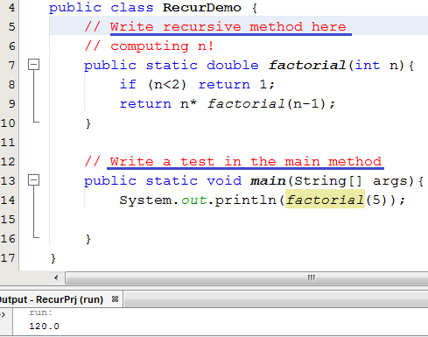
3- Implementing a recursive method
Pseudo-code
n! = 1, n<2
= n* (n-1)!, n>=2
2 lines
// Other recursive method
Lab 1
includes all simple demonstrations
// Other test
Để dễ tiếp thu bài học, xin đừng thắc mắc “Hàm đệ quy chạy như thế nào?”. Câu hỏi này sẽ được trả lời ở phần sau của chương. Ở đây, chúng ta chú tâm vào cách suy nghĩ đệ quy, diễn đạt đệ quy và viết hàm đệ quy cho quen đã nhé.

Slide 12
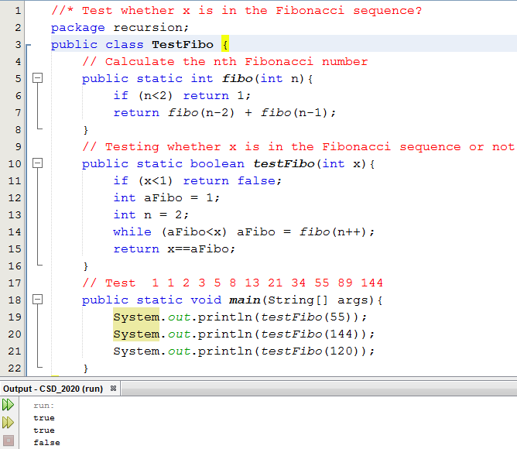
3- Implementing a recursive method
Lab1:
Demo 2
Recursive definitions serve two purposes:
Generating new elements
Testing whether an element belongs to a set
Demo: The Fibonacci sequence

Slide 13
3- Implementing a recursive method
Lab1: Demo 3
1.5 3.5 5.5 7.5 9.5 11.5
Compute the n^{th} item of an arithmetic progression having the first item a and common difference d:
ap(n, a, d) = a, n=1
= ap(n-1, a, d) + d, n>1
public static double ap( int n, double a, double d) {
<Code yourself>
}
// Test 1.5 3.5 5.5 7.5 9.5 11.5
System.out.println( ap(6, 1.5, 2 )); // → 11.5

Slide 14
3- Implementing a recursive method
Lab 1: Demo 4
Compute the n^{th} item of a geometric progression having the first item a and common multiplier q:
gp (n, a, q) = a , n=1
= gp(n-1, a, q) * q, n>1
public static double gp( int n, double a, double q) {
<Code yourself>
}
// Test 1.5 3 6 12 24 48
System.out.println( gp(6, 1.5, 2)); // → 48

Slide 15
3- Implementing a recursive method
Lab 1: Demo 5
Calculate sum of integral array having n elements
Sum(a,n) = 0 + a[0] + a[1] + …….. + a[n-2] + a[n-1]
Sum(a, n) = 0, n=0;
= Sum(a, n-1) + a[n-1], n>1
public static double sum( double[] a, int n) {
<Code yourself>
}
// Test :
double a[] = { 1.5, 2, 4, 5, 2, 6.5 };
System.out.println( sum(a, 6)); // → 21

Slide 16
3- Implementing a recursive method
Lab 1: Demo 6
Calculate the maximum value in an integral array having n elements
1 5 9 7 2 10 19
max(a, n) := if (n==1) return a[0]
int m= max(a, n-1) // 10
return m>a[n-1]? m : a[n-1]
public static int max( double[] a, int n) {
<Code yourself>
}
// Test :
int b[] = { 1, 5, 9, 7, 2, 19,10 };
System.out.println( max(b, 7)); // → 19

Slide 17
3- Implementing a recursive method
Lab 1: Demo 7
Calculate the minimum value in an integral array having n elements
min (a,n) = (Do yourself)
public static int min( int[] a, int n) {
<Code yourself>
}
// Test : int b[] = { 1, 5, 9, 7, 2, 19,10 };
System.out.println( min(b, 7)); // → 1

Slide 18
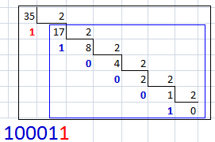

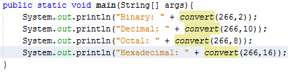
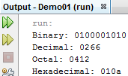
3- Implementing a recursive method
Lab 1: Demo 8
Convert a decimal integer to a b-based numeric string:
n= 35, base=2 ➔ 100011
“100011” = “10001” + “1”
convert(35,2) = convert(17,2) + digit of 35%2
convert(n,base) = convert(n/base,base) + digit of n%base
Anchor: If n==0 return “0”

Slide 19

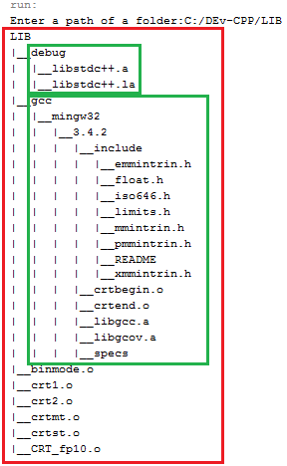
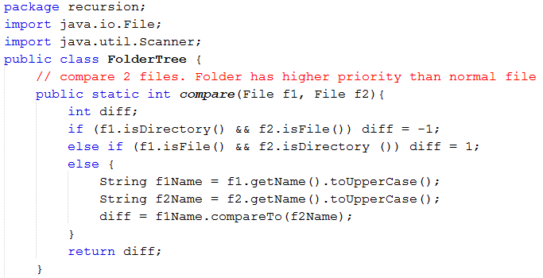
3- Implementing a recursive method
Lab 2:
Printing contents of a folder in a tree format:

Slide 20
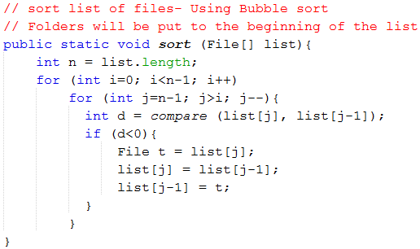
3- Implementing a recursive method
Lab 2:
Printing contents of a folder in a tree format:

Slide 21
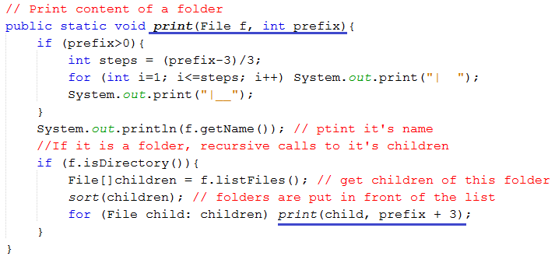
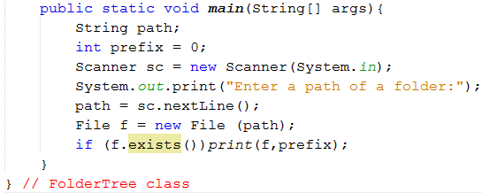
3- Implementing a recursive method
Lab 2:
Printing contents of a folder in a tree format:

Slide 22
4- Classifying Recursive Functions
Aspect | Types
Position where a recursive call is put | Tail/ non-tail | Head/ non-head recursion
Number of recursive calls | Linear/ non-linear recursion
Recursive call is easily detected | Direct/ indirect recursion

Slide 23
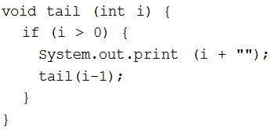
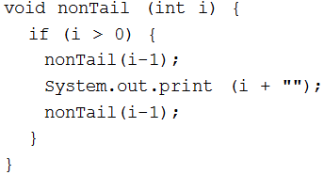

4- Classifying Recursive Functions
Tail recursion is characterized by the use of only one recursive call at the very end of a method implementation.
The last operation is a multiplication.
→ It is not a tail recursion

Slide 24
4- Classifying Recursive Functions
Based on number of recursive calls: Linear, non-linear recursion.
int factorial ( int n) {
if (n==1) return 1;
return n*factorial(n-1);
}
int fibo ( int n) {
if (n<3) return 1;
return fibo(n-2) + fibo(n-1);
}
Two recursive calls
→ Binary recursion

Slide 25
4- Classifying Recursive Functions
Based on number of functions included in recursive call: → Indirect recursion.
Direct recursion→ Recursive call is put in the body of itself
receive(buffer)
while buffer is not filled up
if information is still incoming
get a character and store it in buffer;
else exit();
decode(buffer);
decode(buffer)
decode information in buffer;
store(buffer);
store(buffer)
transfer information from buffer to file;
receive(buffer);

Slide 26
5- How to Manage Running Functions?
This data group is called as method’s Activation record
How to manage a thing? ➔ We need its data.
How to manage a running method? ➔ … ?
Data of a method:
- Its parameters (data type, value)
- Its return data type
- Its extra local variables
- Return address in its caller
- Dynamic link: Address of its caller activation record
The function F1() calls the function F2()
F1(): Caller
F2(): Callee
Data needed when the callee runs
Address of the next instruction in the caller after the callee terminates
Address of the caller’s activation record. It will be the current AR after the callee terminates

Slide 27
5- How to Manage Running Functions?
Activation record in details:
Activation records contain the following:
Values for all parameters to the method, location of the first cell if an array is passed or a variable is passed by reference, and copies of all other data items
Local (automatic) variables that can be stored elsewhere.
The return address to resume control by the caller, the address of the caller’s instruction immediately following the call.
A dynamic link, which is a pointer to the caller’s activation record
The returned value for a method not declared as void

Slide 28
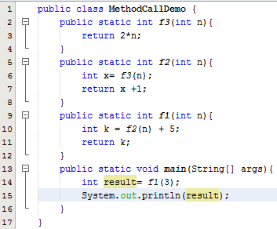

5- How to Manage Running Functions?
A demo.
Parameters and Local variables ( n )
Activation record of
f3(…)
Dynamic link (4000)
=
Return Address ( = )
5000
Return value ( int )
Parameters and Local variables ( n, x )
Activation record of
f2(…)
+
Dynamic link (3000)
Return Address ( + )
4000
Return value ( int )
Parameters and Local variables (n, k)
Activation record of
f1(…)
=
Dynamic link (2000)
Return Address ( = )
3000
Return value ( int )
Parameters and Local variables (args, result)
Activation record of
main(…)
Contents of the run-time stack when main() calls method f1(), f1() calls f2(), and f2() calls f3()
Dynamic link (1000)
Return Address ( null )
2000
Return value (void)
Constants
1000
All methods use Dynamic links to access constants.

Slide 29
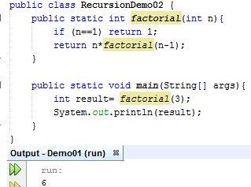
6- Anatomy of a Recursive Call
AR of factorial(1)
AR of factorial(2)
AR of factorial(2)
AR of factorial(2)
AR of factorial(3)
AR of factorial(3)
AR of factorial(3)
AR of factorial(3)
AR of factorial(3)
AR of main
AR of main
AR of main
AR of main
AR of main
AR of main
AR of main

Slide 30
7- Evaluating Performance of Rec. Methods
Advantage: Natural thinking
Disadvantages:
So many ARs need to be allocated.
→ High memory cost
So many method calls
→ High time cost
AR of factorial(1)
AR of factorial(2)
AR of factorial(2)
AR of factorial(2)
AR of factorial(3)
AR of factorial(3)
AR of factorial(3)
AR of factorial(3)
AR of factorial(3)
AR of main
AR of main
AR of main
AR of main
AR of main
AR of main
AR of main

Slide 31
7- Evaluating Performance of Rec. Methods
Disadvantages of Recursive Call:
So many ARs need to be allocated → High memory cost
So many method calls →High time cost
double fact1(int n) {
if (n<2) return 1;
return n*fact1(n-1);
}
double fact2 (int n) {
double result =1;
for (int i=2; i<=n; i++)
result *= i;
return result;
}
fact1(100); // ➔ 100 activation records
fact2(100); // ➔ 1 activation record

Slide 32
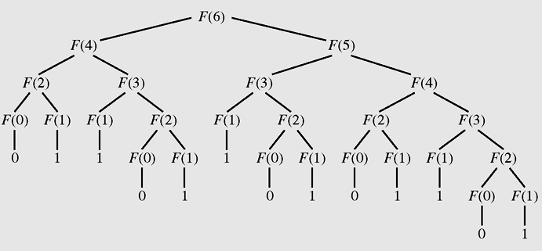
7- Evaluating Performance of Rec. Methods
Disadvantages of Recursive Call
- So many ARs need to be allocated → High memory cost
So many method calls → High time cost
One operation must be performed many times.
The tree of calls for Fib(6)

Slide 33
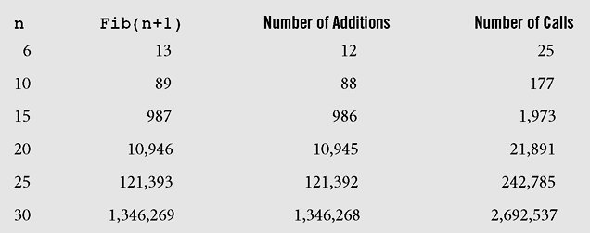
7- Evaluating Performance of Rec. Methods
Number of addition operations and number of recursive calls to calculate Fibonacci numbers

Slide 34
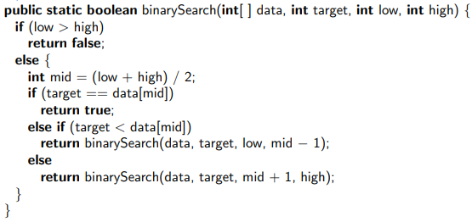
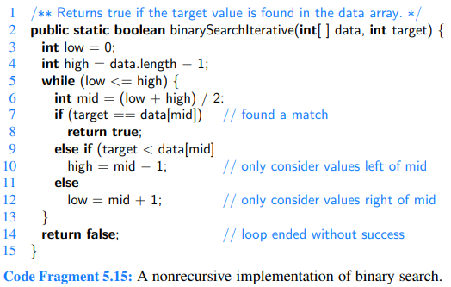
8- Eliminate Tail Recursion
If you can, you should eliminate recursive methods.
How? → Use loop statement + Stack for storing data.
An example: Binary Search the target in an sorted array.
Recursive version
Loop version, no additive memory is needed.

Slide 35
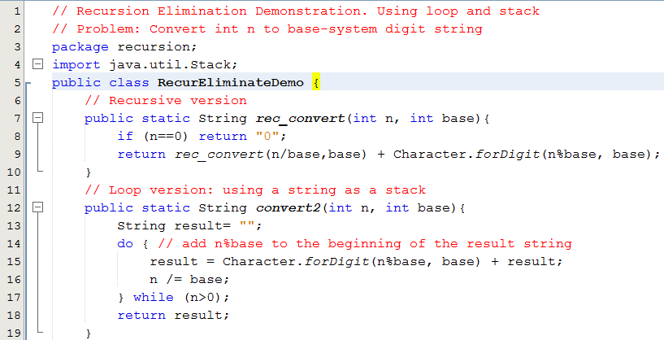
8- Eliminate Tail Recursion
Lab 3: Convert an integer to string numbers.

Slide 36
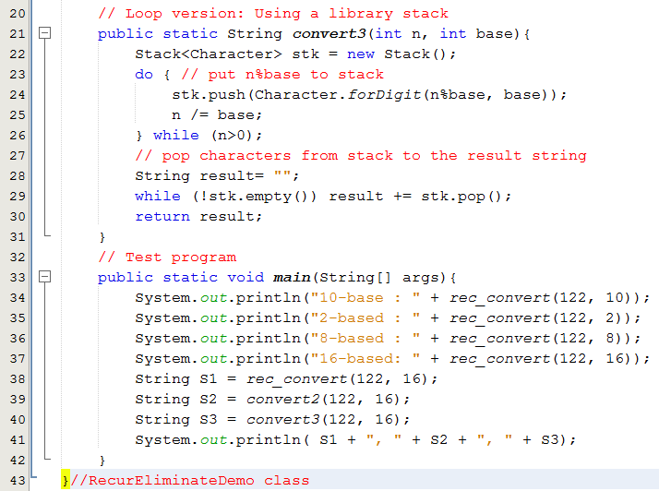
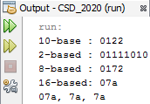
8- Eliminate Tail Recursion
Lab 3 : Convert an integer to string numbers.

Slide 37
Bonus: Backtracking on the 8-queen Problem
Tự đọc nhé: Lab 4
Hồi quy, backtracking, là một kỹ thuật sau khi gán trị cho biến vars[i] thì đi xem xét gán trị cho biến phía sau vars[i+1] nếu có thể được. Trong tình huống bị bí thì quay lui lại phần tử trước đó.
Hồi quy một bước (one-step): Khi không thể gán trị cho biến x_{i} thì tìm trị khác để gán cho biến x_{i-1}
Hồi quy một k bước (k-step): Khi không thể gán trị cho biến x_{i} thì tìm trị khác để gán cho biến x_{i-k}
Khác biệt giữa đệ quy và hồi quy: Góc nhìn thực thi
Đệ quy
Hồi quy
Giống nhau giữa đệ quy và hồi quy dưới góc nhìn hiện thực: Hàm hồi quy cũng gọi chính nó như trong đệ quy nhưng là đệ quy TỚI

Slide 38
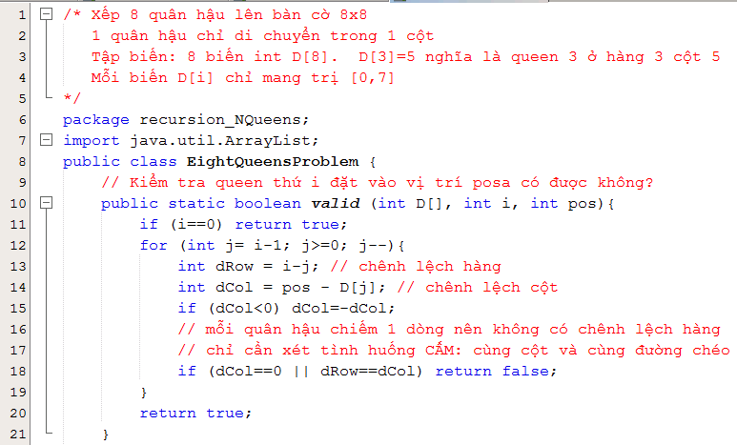

Bonus: Backtracking on the 8-queen Problem
Tự đọc nhé

Slide 39
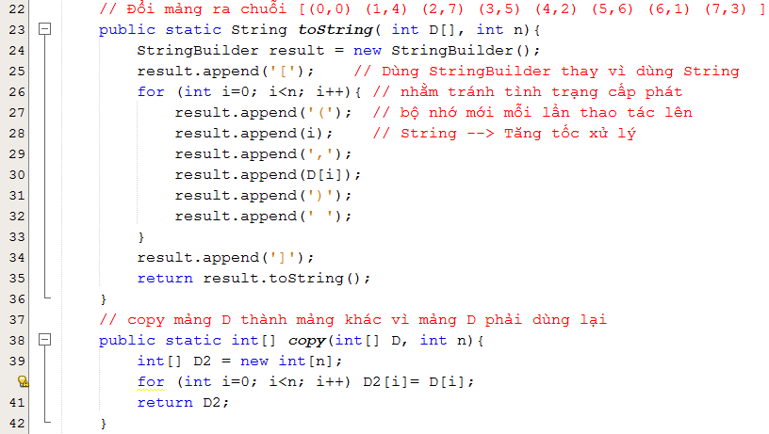
Bonus: Backtracking on the 8-queen Problem
Tự đọc nhé

Slide 40
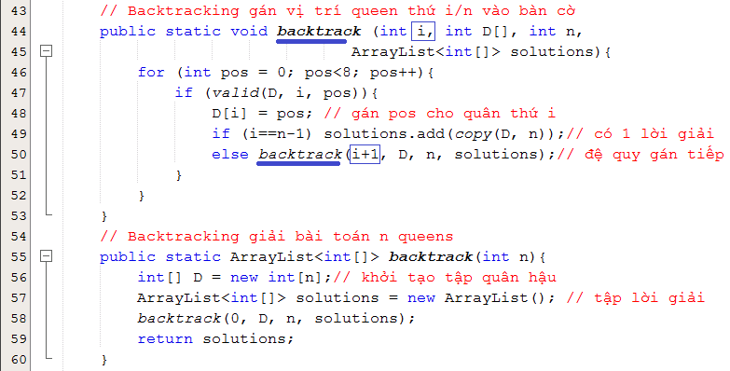
Bonus: Backtracking on the 8-queen Problem
Tự đọc nhé

Slide 41
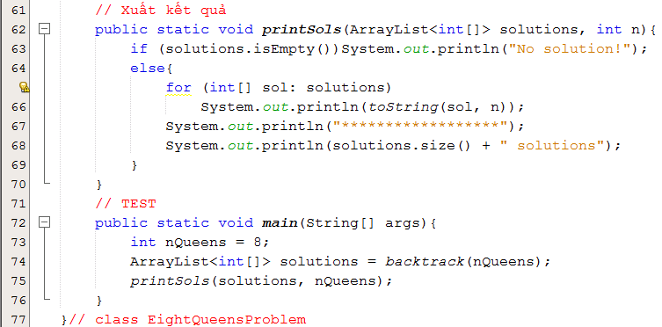

Bonus: Backtracking on the 8-queen Problem
Tự đọc nhé

Slide 42
Summary

LO3.1 Describe the basic ideas of recursion and how to set up recursive systems that represent certain real-world phenomena.
LO3.2 Know how to develop recursive algorithms and programs
LO3.3 Write programs in Java using recursion to solve some problems, like creating the Fibonacci sequence.
LO3.4 Analyze a recursive function to find out its’ ouput without running.
LO3.5 Explain type of recursive functions, give examples and comparing them.
LO3.6 Compare recursion with iteration, analyzes their pros and cons






Slide 43
Ôn tập – Viết vào vở
1- Đệ quy là gì?
2- Con người có dùng kỹ thuật đệ quy hay không? Cho hai thí dụ.
3- Làm sao con người hiểu được đệ quy?
4- Tác vụ đệ quy được mô tả như thế nào? Cho thí dụ.
5- Làm sao có được kỹ năng diễn đạt đệ quy?
6- Đệ quy được dùng để làm gì?
7- Đệ quy đuôi là gì?
8- Đệ quy đầu là gì?
9- Đệ quy tuyến tính là gì?
10- Đệ quy phi tuyến là gì?
11- Đệ quy gián tiếp là gì?
12- Đệ quy hỗ tương là gì?
13- Làm sao hệ thống có thể quản lý các hàm đang thực thi?
14- Hãy cho biết activation record của một hàm gồm có những gì cùng với ý nghĩa của từng thành phần.
15- Tại sao hàm đệ quy khi thực thi lại tốn bộ nhớ?
16- Tại sao hàm đệ quy thực thi lại chậm?
17- Khử đệ quy là gì? Tại sao lại nên khử đệ quy?
18- Khử đệ quy bằng cách nào?
Tìm hiểu thêm:
- Hồi quy là gì?
- Kỹ thuật hồi quy có thể được dùng trong những bài toán nào? Cho ví dụ.

