Slide 1
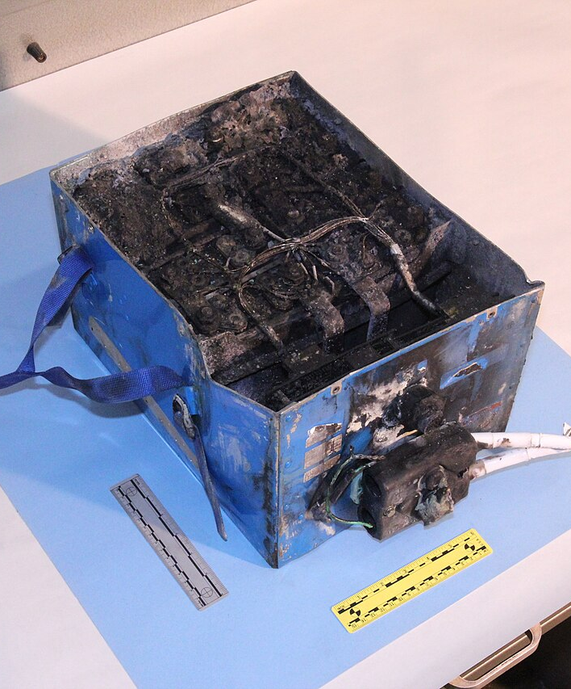
AIoT InnoWorks 2026 · Semi-final
Edge-AI Thermal Safety Monitor
for EV Battery Packs
Team Hu Tieu · ICTU – Thai Nguyen University
We look for the failing cell before it becomes a fire.
Photo: lithium-ion pack destroyed by thermal runaway (JAL 787 APU battery) — NTSB, public domain

Slide 2
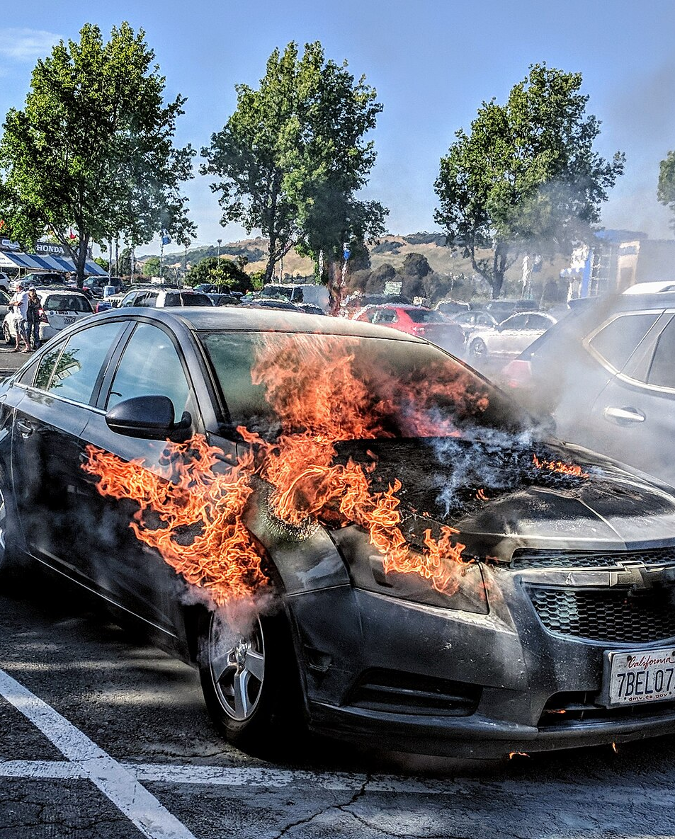
The problem
A pack does not fail all at once.
One weak cell heats up first.
Once thermal runaway starts, it feeds itself.
~31%
of EV fires start while the vehicle is parked
~25%
happen in underground car parks
1.5–12M
VND to replace one e-motorbike pack
Photo: vehicle fire in a car park (not an EV) — Jim Heaphy, CC BY-SA 3.0 · Fire statistics: EV FireSafe

Slide 3
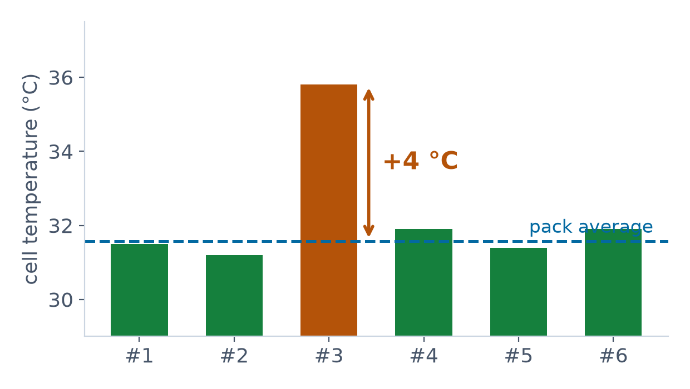
Every BMS already has a 60 °C cut-off. So why AI?
Because the dangerous signal appears long before any absolute limit.
FIXED THRESHOLD
Verdict: all normal
Nothing is near 60 °C.
OUR EDGE AI
Verdict: abnormal cell
Cell #3 is +4 °C above the rest, under the same load.
The model reads relations between cells — not absolute degrees.

Slide 4
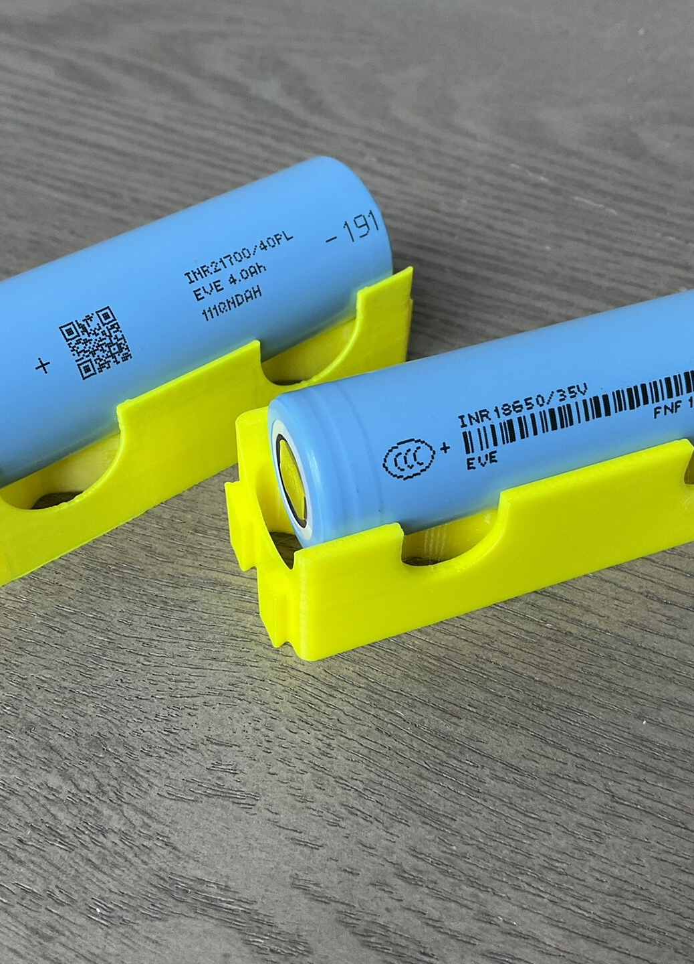
Our solution
A low-cost module that watches every cell and thinks on the device.
1
DETECT
An autoencoder on the ESP32-S3 flags the odd cell every second. No cloud needed.
2
PREDICT
A cloud model reads each charge curve and reports battery health and remaining life.
3
ACT
A 4-level local alarm: buzzer and LED fire even with the network down.
Photo: 18650 / 21700 cells — Wikimedia Commons, CC0

Slide 5
System architecture
Two AI layers, split by how fast each answer is needed.
6-cell test pack
6 × DS18B20 · INA228
1 sample / second
ESP32-S3
LAYER 1 — autoencoder
runs on-device, every second
MQTT / WISE-PaaS
/wisepaas/scada/{nodeId}/data
Cloud
LAYER 2
health / remaining life
1× per charge
LOCAL ALARM
buzzer + LED · works offline
Store & forward
buffered in flash while offline
Safety never depends on the network. The device detects and alarms on its own; the cloud adds dashboards and long-term prediction.

Slide 6
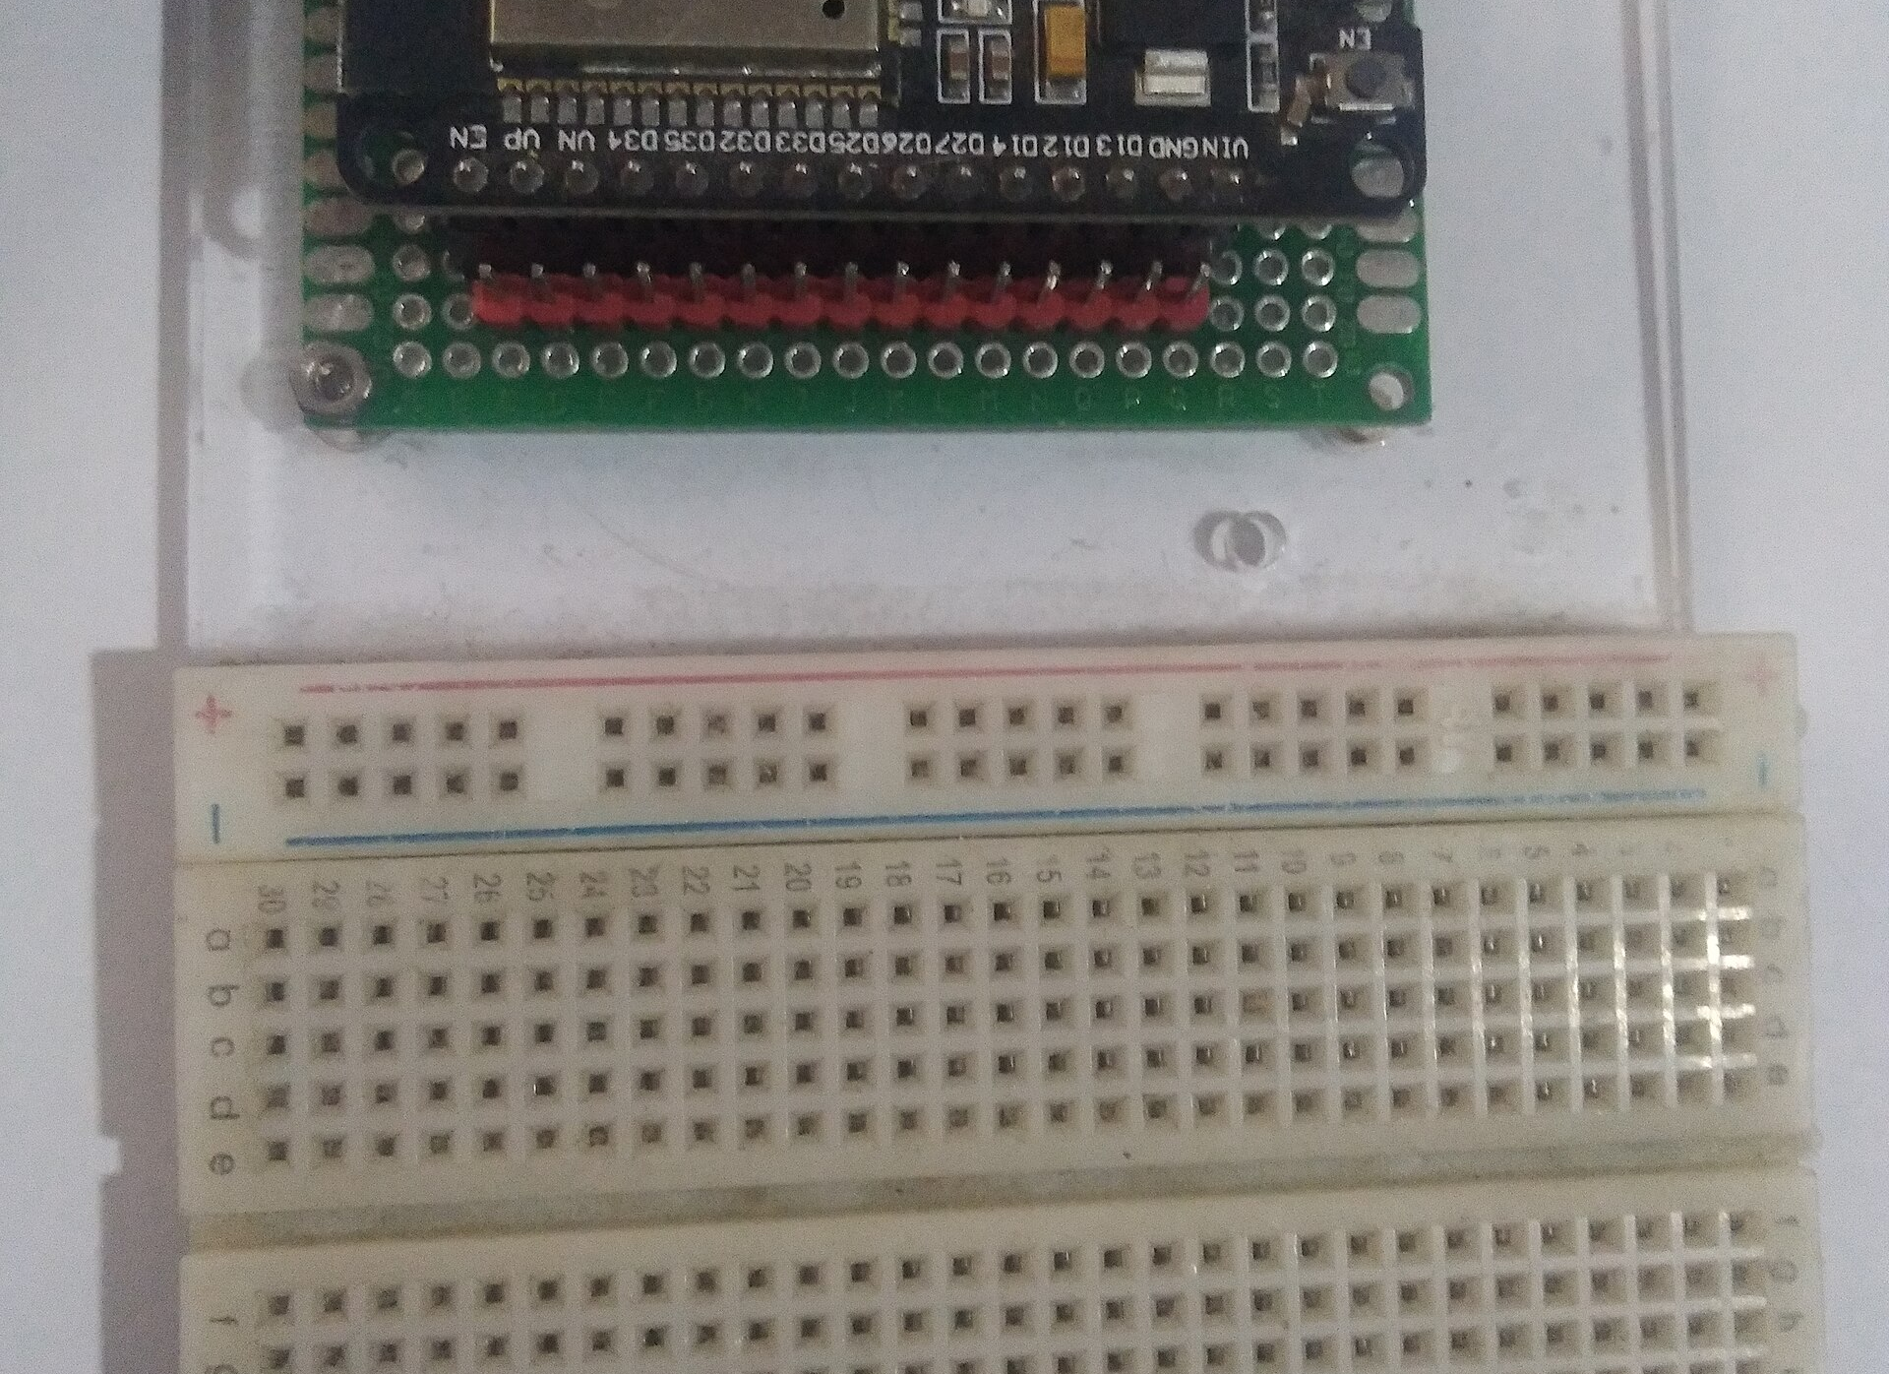
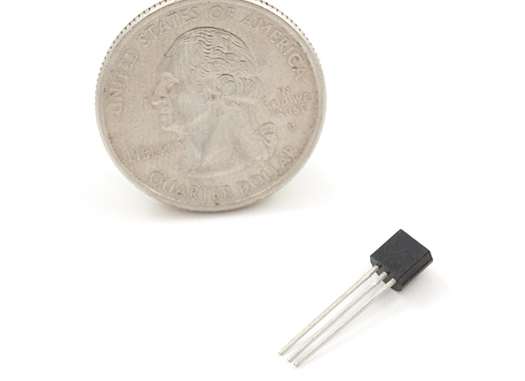
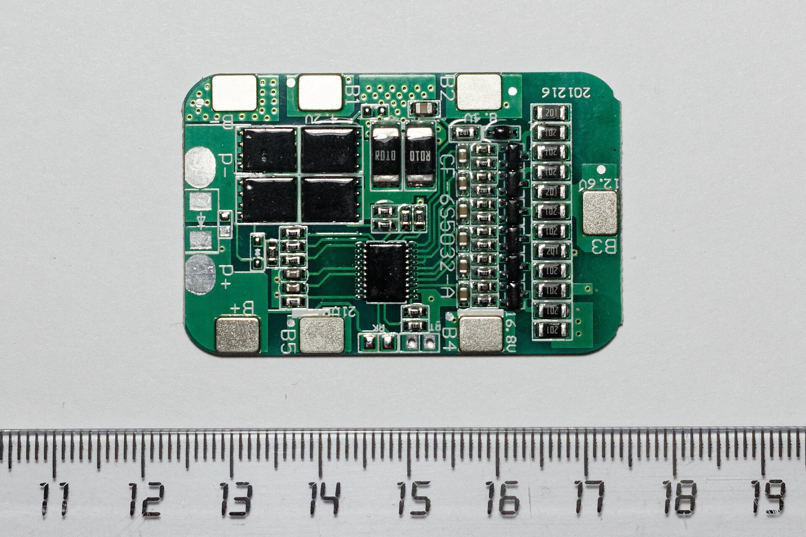
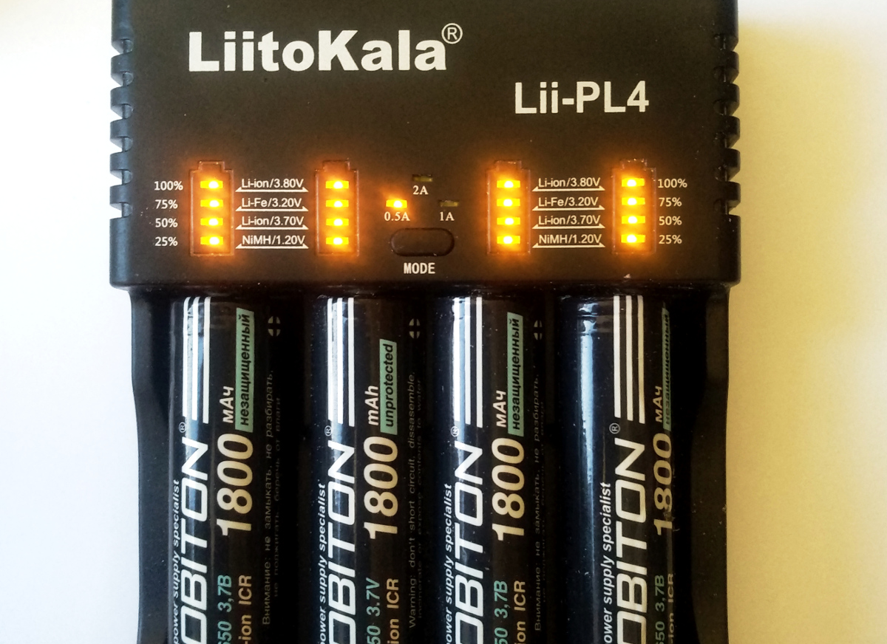
The hardware we built
A 6-cell 18650 test pack — every cell has its own probe.
ESP32-S3-DevKitC-1
vector instructions for ML
6 × DS18B20
one probe per cell
6S BMS with balancing
the part that cuts out
6 matched 18650 cells
same batch, same age
Faults are induced safely: a ceramic power resistor warms one cell. Firmware hard-cuts the heater at 60 °C. No cell is ever abused.
Component photos: Wikimedia Commons (CC BY-SA 4.0 / CC BY 2.0 / CC0)

Slide 7
Layer 1 — the odd-cell detector
Runs on the microcontroller itself, every second, with no internet.
It reads relations, not degrees
· how far it sits from the pack average
· whether it heats up faster than the others
· slow drift (ageing) vs. sudden jump (fault)
tiny
1 Hz
about 1 KB
of flash
inference rate
on the device
offline
60 °C
It alarms only if the signal persists for half a minute — noise alone never triggers it.
detection needs
no network
hard threshold,
outside the AI
If the model is ever wrong, the hard threshold still fires. That line is never removed.

Slide 8
What we have tested so far
A lab pack of similar cells, plus public datasets from real packs — not an EV pack in service.
Sensors and data path, on the bench
live on the dashboard, buffered while offline
Alarm logic, full bench test
all four levels correct, even with the AI disabled
Public dataset, injected cell fault
detected reliably
Independent real pack, unseen in training
faulty runs separate clearly from healthy
These are results on the bench and on public datasets. Warming a cell on our own pack, and measuring an EV pack in service, are the next two steps — we have not done them yet.

Slide 9
The test we failed — and what it taught us
We report this because it is the strongest engineering result we have.
1 · FAILED
On a real pack we had never trained on, the model alarmed on a healthy run.
Worse than on the faulty one.
2 · DIAGNOSED
The absolute inputs — ambient, current, charge level — had drifted far outside the training range.
They are the same for every cell, so they lifted all cells at once.
3 · FIXED
Dropped them. Kept only cell-to-cell relations.
Fewer false alarms, better detection, and the model now transfers to unseen packs.
This is also what makes mass production possible: one identical model ships in every unit.

Slide 10
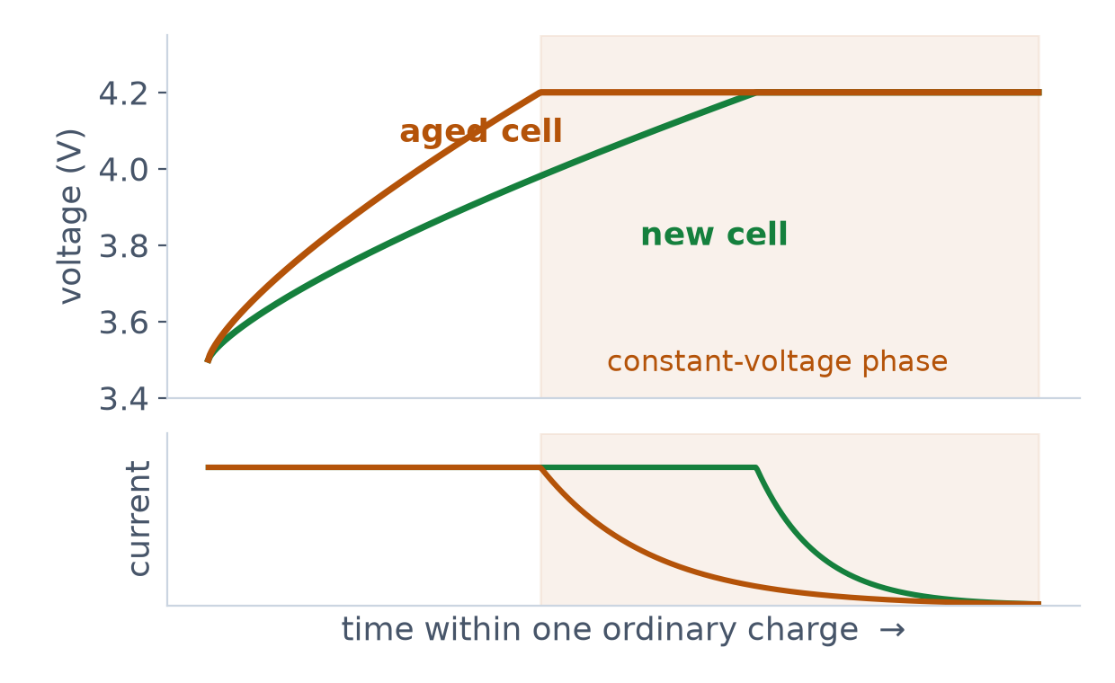
Layer 2 — how long will this pack last?
You cannot deep-discharge a pack every week. But everyone charges every day.
Read the shape of the charge curve.
An aged cell reaches the voltage limit early, then stays in constant-voltage far longer.
Measured during an ordinary charge — nobody has to do anything.
Layer 2 runs in the cloud on purpose: improving the model must not require reflashing every vehicle.

Slide 11
Four alarm levels, not one buzzer
"Keep an eye on it" and "cut the charger now" are different orders.
OK
WATCH
ALARM
CRITICAL
normal
one cell drifting
AI, sustained
any cell over 60 °C
SENSOR LOST is blue, not red.
"I cannot see the pack" ≠ "the pack is dangerous".
Mute exists — and mute never kills the light.
A buzzer you cannot silence gets its wires cut.

Slide 12
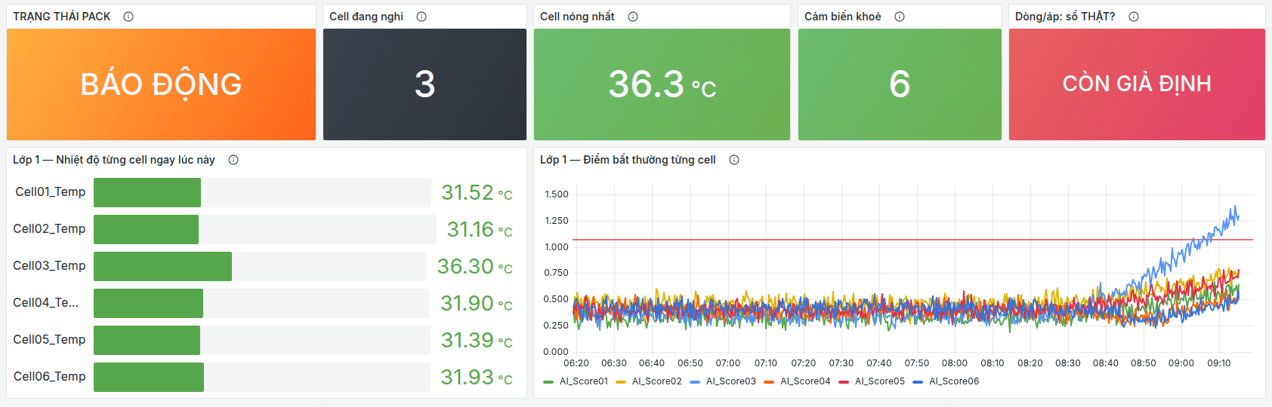
Where the system runs today
We already speak the WISE-PaaS protocol — we are simply hosting the layers ourselves.
ESP32-S3
WISE-PaaS payload
Mosquitto
MQTT broker
Node-RED
parse + Layer 2
InfluxDB
time series
Grafana
dashboard
topic /wisepaas/scada/{nodeId}/data — the same format as Advantech's own Edge SDK
Why this stack?
These are the same components WISE-PaaS is built on.
Nothing here is a workaround we would have to throw away.
Our own Grafana dashboard — data shown is simulated for this screenshot

Slide 13
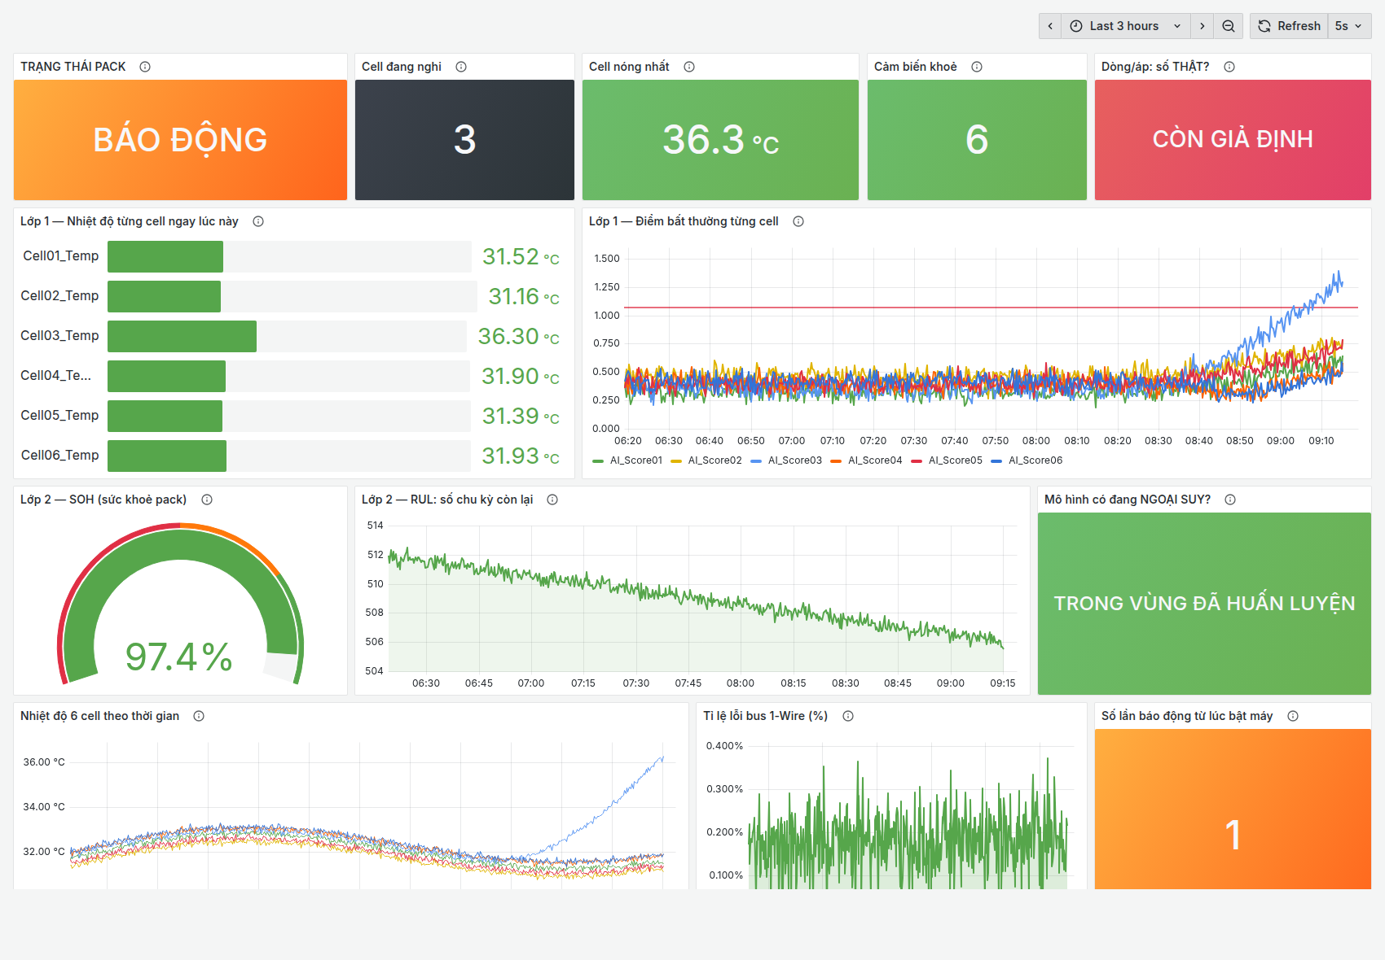
What the operator actually sees
Three seconds to answer: is the pack safe, which cell, and can I trust the number?
Top row first
Pack state, suspect cell, hottest cell, sensor health — no chart reading required.
Cell #3 stands out
The bar gauge is a spatial comparison, so the odd cell is obvious at a glance.
Honest by design
Numbers that are still assumptions label themselves on screen.
Our own Grafana dashboard. The data in this screenshot is simulated to show the scenario.

Slide 14
With a WISE-PaaS account
A config change, not a rewrite — the firmware does not change by a single line.
ESP32-S3
unchanged firmware
same payload, same topic
WISE-PaaS IoT Hub
device management + TLS
WISE-PaaS Dashboard
AFS — Layer 2 model serving
only the broker host + credentials change
Device management
Dashboards & rules
AFS for Layer 2
Provisioning, TLS and OTA handled by the platform.
WISE-PaaS Dashboard replaces our Grafana.
Retrain and redeploy without touching a vehicle.

Slide 15
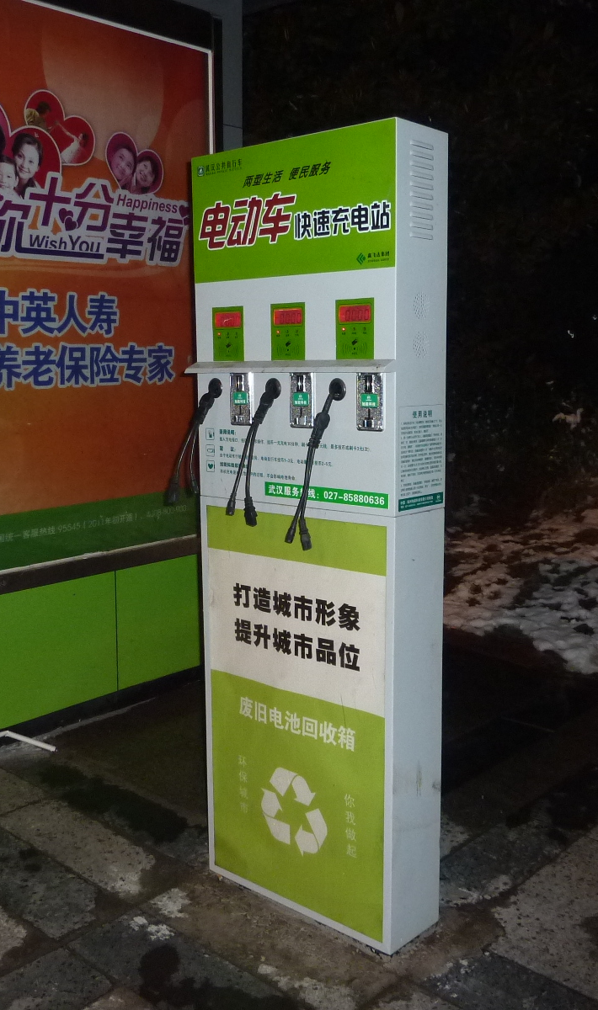
Live demo — 90 seconds
1
The dashboard is streaming live cell temperatures.
2
We unplug the network in front of you.
3
We warm one cell with the resistor.
4
The module detects it and sounds the alarm — still offline.
5
Network back: the offline data lands on the dashboard, at the right timestamps.
Edge AI, local alarm and store-and-forward — all proven in one run.
Photo: e-scooter charging station — Wikimedia Commons, CC BY-SA 3.0

Slide 16
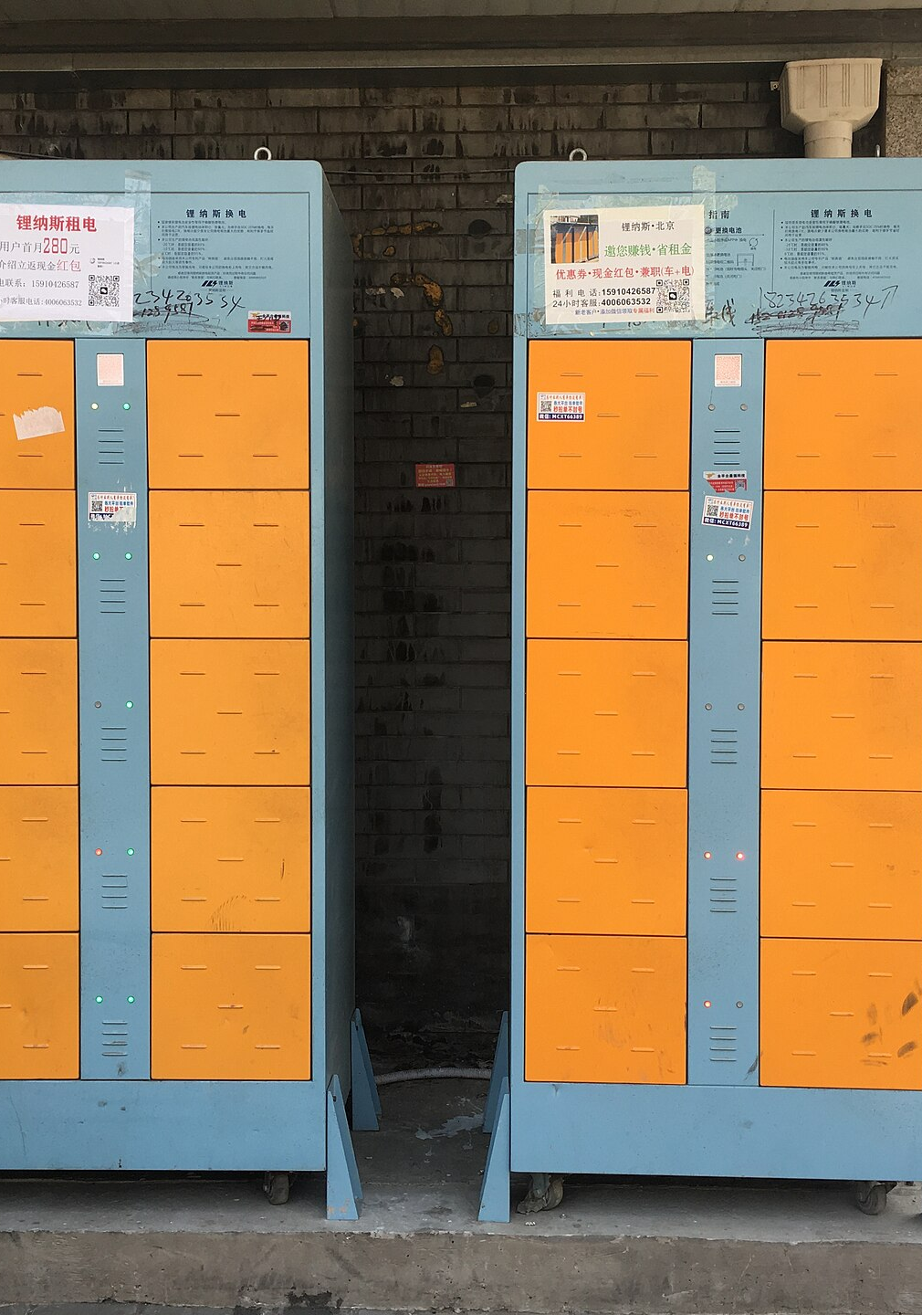
Who pays for this
Fleet operators and battery-swap networks — where one company owns the packs.
Owner = payer
The operator owns the packs, so whoever loses money on a dead pack is whoever can buy the device.
Planned, not urgent
Pack replacement becomes scheduled maintenance instead of an emergency.
No SIM needed
Packs come back to a station daily — station Wi-Fi is the uplink.
Individual riders are the emotional story. Fleets are the business model — and we know the difference.
Photo: e-scooter battery-swap cabinets — Wikimedia Commons, CC BY-SA 4.0

Slide 17
What we have not proven yet
We would rather say it than be asked it.
A whole pack overheating uniformly
No deviation between cells, so Layer 1 stays silent. The hard 60 °C threshold covers it — not yet tested on hardware.
A real EV pack in service
So far: a lab pack of similar cells, plus public datasets. Measuring a vehicle in daily use is next.
Ageing prediction on a worn pack
Our cells are new — one point at the top of the scale. We plan to borrow a degraded pack.
Nothing in this deck is claimed to be more than what we actually measured.

Slide 18
From semi-final to final
27 November 2026
NOW
OCT
NOV
6-cell rig, Layer 1 on the device, 4-level alarm, cloud stack running
Current sensing → real charge cycles → real Layer 2 results
Worn-pack validation · enclosure · cost model · fleet interviews

Slide 19

One cell starts it.
We watch every one of them.
Team Hu Tieu · ICTU – Thai Nguyen University
Thank you. Questions welcome — especially the hard ones.
Photo: 18650 cell after thermal runaway — Wikimedia Commons, CC BY 4.0

