Slide 1

EQUALIZER INVESTIGATION
April 2016
Date April.29 2016
Name Phan Nhat Vu
R-Car Software Solution 2 Group
Audio Project

Slide 2
Agenda
Introduction 3
Required specification 9
Equalizer flow chart 14
Equalizer core functions 16
Equalizer operations 26

Slide 3

Introduction

Slide 4
Introduction
Equalization (British: equalisation) is the process of adjusting the balance between frequency components within an electronic signal.
Equalizer strengthens (boost) or weakens (cut) the energy of specific frequency bands.
It includes 4 functions:
Parametric Equalizer and/or Graphic Equalizer
Bass-Treble
Surround
Dynamic Range Compression

Slide 5
PARAMETRIC EQUALIZER AND/OR GRAPHIC EQUALIZER
It is difficult to build full range speakers in a TV and speakers built in a TV are small and their location are not proper position. So, it is necessary to adjust frequency characteristics of sound to correct the characteristics of speakers.
Graphic Equalizer is also used to correct the speaker characteristics. It has a fixed band frequency and band width. When the gain of all band are the same, the total frequency response have to be flat.

Slide 6
Bass-Treble
The small sound of low frequency and high frequency is hardly perceived by acoustic sense of human. And it is necessary to boost low frequency and high frequency sound.

Slide 7
REQUIRED SPECIFICATION

Slide 8
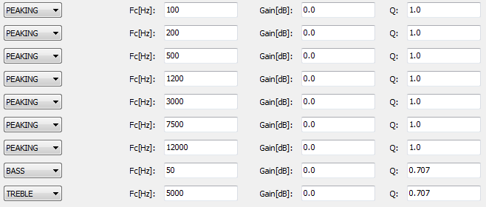
Parametric Equalizer
Composed of 7 biquad filters in cascade connection for one channel and 2 Bass-Treble filters.
Coefficients can be set to each biquad filters arbitrarily.
Filter type of each Biquad filter can be selected from ‘Peaking/Notch’, ‘Bass’ and ‘Treble’ filter.
GUI of a parametric equalizer

Slide 9
User setting parameters for Parametric Equalizer

Slide 10
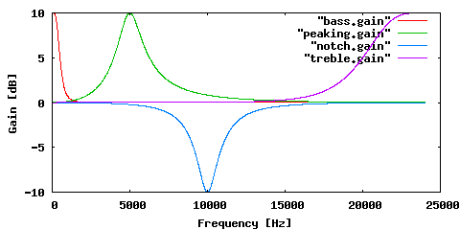
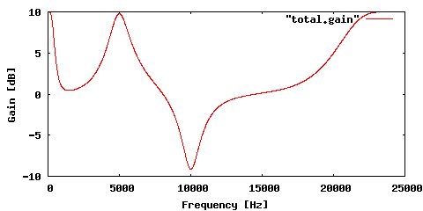
Parametric Equalizer EXAMPLE
Total gain of example filters
Frequency response of Peaking/Notch, Bass, and Treble filters signal.

Slide 11
EQUALIZER FLOW CHART

Slide 12
FLOW CHART
Get audio data
Get parameter( channel, fs,bits)
Set coefficients of Biquad filters
Reset Biquad filters
Execute Biquad filters
Write data

Slide 13
EQUALIZER CORE FUNCTIONS
Calculate Peak filter coefficients
Calculate Bass filter coefficients
Calculate Treble filter coefficients
Calculate Through filter coefficients

Slide 14
Calculate Peak filter coefficients Formula
Transfer function of peaking/notch filter in z-domain is given by the following.
A: Gain at a center frequency of Peak filter
Q: Band width of Peak filter

Slide 15
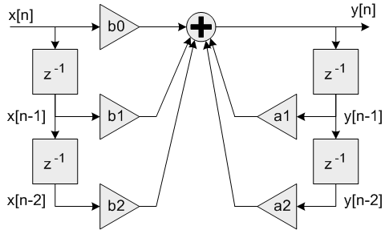
Calculate Peak filter coefficients Formula
Coefficients of Peak filter:

Slide 16
Calculate Peak filter coefficients Implementation
EQ_calcPeakingCoef( long *coef, long fs, long fc, long gain, long q, int nn, int dn )
Input parameter:
fs: Sampling Frequency
fc: Peaking/Notch Frequency
gain: Gain (not dB)
q: Band Width Parameter
nn: Numerator coefficients shift down number
dn: Denominator coefficients shift down number

Slide 17
Calculate Peak filter coefficients Implementation
Step 1: Convert Gain (Q4.28) and Q (Q5.27) data format to format of Biquad filter coefficients (Q6.26).
Step 2: Calculate:
=> Result format is Q6.26. 1 value is also converted to Q6.26
Step 3: Then calculate all coefficients of Biquad filter with format Q6.26
Example:
Step 4: convert coefficients to integer 32 bit

Slide 18
Calculate Bass filter coefficients Formula
Transfer function of bass filter in z-domain is given by the following.
A: Gain at a center frequency of Bass filter
Q: Band width of Bass filter

Slide 19
Calculate Bass filter coefficients Formula
Coefficients of Bass filter:

Slide 20
Calculate Bass filter coefficients Implementation
EQ_calcBassCoef( long *coef, long fs, long fc, long gain, long q, int nn, int dn, long gain_base )
Input parameter:
fs: Sampling Frequency
fc: Peaking/Notch Frequency
gain: Gain at center frequency (not dB)
q: Band Width Parameter
nn: Numerator coefficients shift down number
dn: Denominator coefficients shift down number
gain_base Gain for all frequency

Slide 21
Calculate Bass filter coefficients Implementation
Step 1: Convert Gain Calculate: => Result format is Q6.26
(Q4.28) and Q (Q5.27) data format to format of Biquad filter coefficients (Q6.26).
Step 2: Calculate:
=> Result format is Q6.26. 1 value is also converted to Q6.26
Step 3: Then calculate all coefficients of Biquad filter with format Q6.26
Example:
Step 4: convert coefficients to integer 32 bit

Slide 22
Calculate Treble filter coefficients Formula and implementation
Treble filter coefficients are derived from Bass filter coefficients calculation.
Set Fc = (Fs/2 – Fc) and calculate Bass coefficients.
Then, treble filter coefficients are given by changing the sign of b[1] and a[1] (b[1] = -b[1] and a[1] = -a[1]).

Slide 23
EQUALIZER OPERATIONS
Multiplication Operation
Division Operation
Tang Operation
Square root Operation

Slide 24
Multiplication Operation
{ long aH, aL, bH, bL;
long resultL, resultM, resultM0, resultM1, resultH;
long result;
aH = (a >> 16);
aL = (a & 0xffff);
bH = (b >> 16);
bL = (b & 0xffff);
resultL = aL * bL;
resultM0 = aH * bL;
resultM1 = aL * bH + (long)((unsigned long)resultL >> 16);
resultM = (resultM0 >> (15 - n)) + (resultM1 >> (15 - n)) + 1; // rounding
resultH = aH * bH;
result = (resultH << n) + (resultM >> 1);
return result; }
EQ_mul( long a, long b, int n )
Input parameter:
a: input data0
b: input data1
n: integer part bits of input data
Format data of result is fixed point n.32-n (Q6.26)

Slide 25
Division Operation
Tang Operation
EQ_div( long a, long b, int n )
Input parameter:
a: input data0
b: input data1
n: integer part bits of input data
Format data of result is fixed point n.32-n (Q6.26)
EQ_tan32i( long angle, int n )
Input parameter:
angle: radian
n: integer part bits of input data
Format data of result is fixed point n.32-n (Q6.26)
EQ_sqrt32i( long data, int n )
Input parameter:
Data
n: integer part bits of input data
Format data of result is fixed point n.32-n (Q6.26)
Square root Operation

