Slide 1

Lesson 02: What is LINQ?
TEDU.COM.VN
Bach Ngoc Toan
Facebook: https://facebook.com/teduchannel

Slide 2
What is LINQ?
Language-Integrated Query (LINQ) is a powerful query language introduced with .Net 3.5 & Visual Studio 2008.
LINQ can be used with C# or Visual Basic to query different data sources.
Basic knowledge of .Net Framework3.5/4.5, C#, Visual Studio is required.

Slide 3
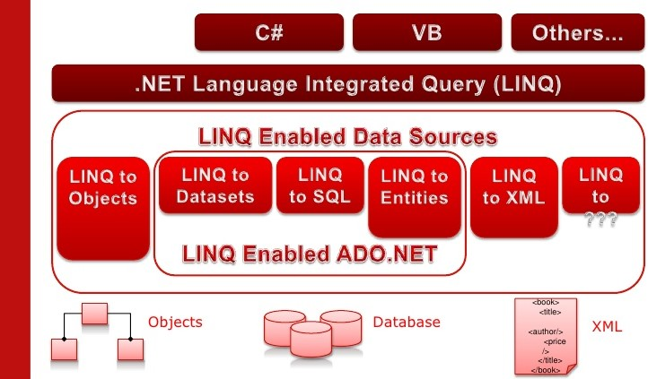
Data sources

