Slide 1

Lesson 04: IQueryable vs IEnumerable?
TEDU.COM.VN
Bach Ngoc Toan
Facebook: https://facebook.com/teduchannel

Slide 2
LINQ API
We can write LINQ queries for the classes that implement IEnumerable<T> or IQueryable<T> interface.
The System.Linq namespace includes the following classes and interfaces require for LINQ queries.
LINQ queries uses extension methods for classes that implement IEnumerable or IQueryable interface.
The Enumerable and Queryable are two static classes that contain extension methods to write LINQ queries.

Slide 3
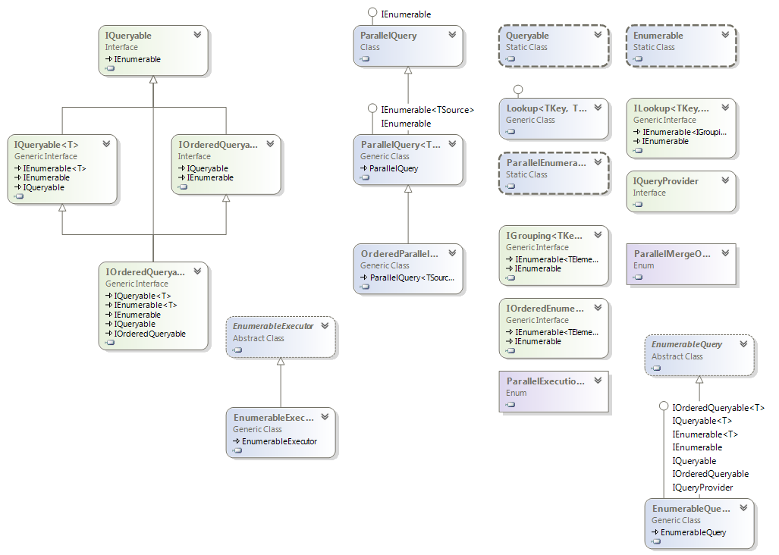
Class diagram

Slide 4
Enumerable
The Enumerable class includes extension methods for the classes that implement IEnumerable<T> interface.
For the IEnumerable<T> case, it will be LINQ-to-object, meaning that all objects matching the original query will have to be loaded into memory from the database.

Slide 5
Queryable
The Queryable class includes extension methods for classes that implement IQueryable<t> interface.
IQueryable<T> is the interface that allows LINQ-to-SQL (LINQ.-to-anything really)
So if you further refine your query on an IQueryable<T>, that query will be executed in the database, if possible.

Slide 6
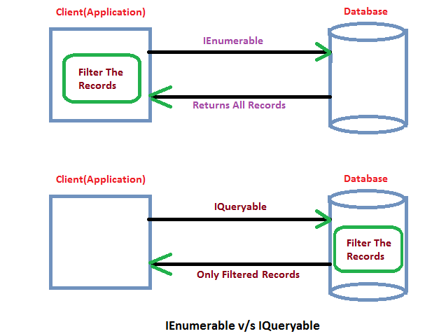
Diference between Queryable vs Enumerable

Slide 7
Difference API
The IEnumerable version signature is: Where(Func<Customer, bool> predicate)
The IQueryable version signature is: Where(Expression<Func<Customer, bool>> predicate)
You've probably been using both of those without realizing it because both are called using identical syntax:
e.g. Where(x => x.City == "<City>") works on both IEnumerable and IQueryable
When using Where() on an IEnumerable collection, the compiler passes a compiled function to Where()
When using Where() on an IQueryable collection, the compiler passes an expression tree to Where(). An expression tree is like the reflection system but for code. The compiler converts your code into a data structure that describes what your code does in a format that's easily digestible.

Slide 8
Convert to IQueryable?
Why bother with this expression tree thing? I just want Where() to filter my data.
The main reason is that both the EF and Linq2SQL ORMs can convert expression trees directly into SQL where your code will execute much faster.
Oh, that sounds like a free performance boost, should I use AsQueryable() all over the place in that case?
No, IQueryable is only useful if the underlying data provider can do something with it.
Converting something like a regular List to IQueryable will not give you any benefit.

Slide 9
Points to Remember
Use System.Linq namespace to use LINQ.
LINQ api includes two main static class Enumerable & Queryable.
The static Enumerable class includes extension methods for classes that implements the IEnumerable<T> interface.
IEnumerable<T> type of collections are in-memory collection like List, Dictionary, SortedList, Queue, HashSet, LinkedList.
The static Queryable class includes extension methods for classes that implements the IQueryable<T> interface.
Remote query provider implements e.g. Linq-to-SQL, LINQ-to-Amazon etc.
Difference between IEnumberable vs IQueryable

