Slide 1

Lesson 05: Extension method
TEDU.COM.VN
Bach Ngoc Toan
Facebook: https://facebook.com/teduchannel

Slide 2
Extension method
Extension methods enable you to "add" methods to existing types without creating a new derived type, recompiling, or otherwise modifying the original type.
An extension method will never be called if it has the same signature as a method defined in the type.
Extension methods are brought into scope at the namespace level.
For example, if you have multiple static classes that contain extension methods in a single namespace named Extensions, they will all be brought into scope by the using Extensions; directive.

Slide 3
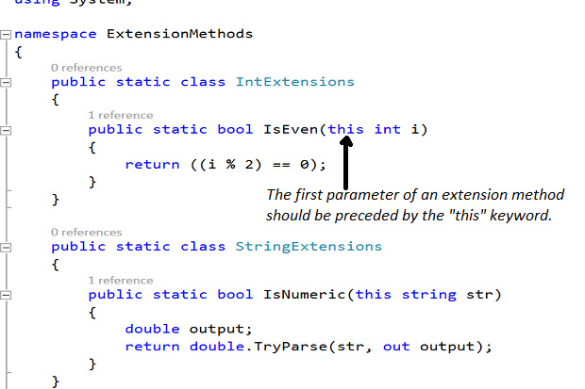
Example

