Slide 1

Lesson 06: Understand Lamda Expression
TEDU.COM.VN
Bach Ngoc Toan
Facebook: https://facebook.com/teduchannel

Slide 2
Concept
C# 3.0(.NET 3.5) introduced the lambda expression along with LINQ.
The lambda expression is a shorter way of representing anonymous method using some special syntax.
Reference: https://docs.microsoft.com/en-us/dotnet/csharp/programming-guide/statements-expressions-operators/lambda-expressions

Slide 3
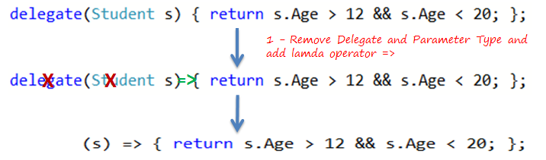
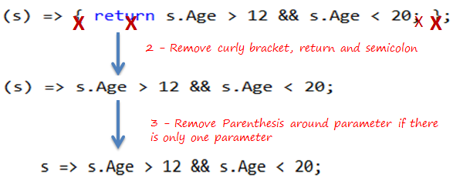
Convert from anonymous

