Slide 1

Lesson 07: Understand Func vs Act type
TEDU.COM.VN
Bach Ngoc Toan
Facebook: https://facebook.com/teduchannel

Slide 2
Concept
Action is a delegate (pointer) to a method, that takes zero, one or more input parameters, but does not return anything.
Func is a delegate (pointer) to a method, that takes zero, one or more input parameters, and returns a value (or reference).
Predicate is a special kind of Func often used for comparisons.

Slide 3
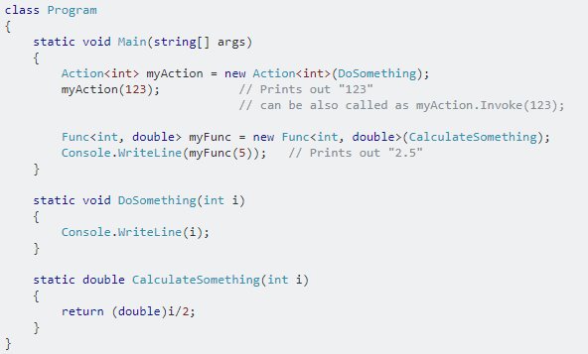
Example

