Slide 1
Project report Water Level Prediction
Reporter: … Email: ….

Slide 2
Content
01
02
03
04
Data & Preprocess
06
Problem
Method
Result

Slide 3
Problem
01
The problem of predicting water levels in the upcoming days based on historical water level data at rivers and reservoirs, along with known discharge station information:
Input:
Historical water level data at rivers and reservoirs in several provinces and cities
Water level data at discharge stations that have been or will be conducted
Output: Forecasted water level information for the next 2 days in Hanoi
Approach: Using AI to train a model for predicting future water levels

Slide 4
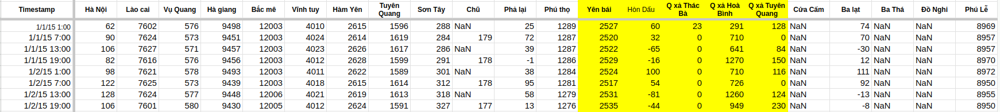
Data & Preprocess
02
Time period: January 1, 2015 → September 28, 2024
Measurements per day: 4 times (1:00 AM, 7:00 AM, 1:00 PM, 7:00 PM)
Water level unit: cm above sea level
Number of rivers and reservoirs measured across provinces: 17
Number of discharge stations: 5

Slide 5
Data & Preprocess
02
Handle missing value:
Drop columns if the percentage of missing values is greater than 0.35%
Fill remaining missing values with interpolation
Normalization: use standard normalization for each measurement location
Splitting dataset:
Training: all data from 2015 to 2022
Validation: data in 2023
Testing: data in 2024

Slide 6
Data & Preprocess
02
Generate data points: at time t, a data point to predict the water level at time t+x (upcoming 2 days or 8 timesteps) in Hanoi is structured as follows:
Input:
Measuring station data: historical data from rivers and reservoirs (experiments with 7-10 days, 28 to 40 hours ago)
Discharge station data: discharge station data up to time t + x
Time: information about the day and month in each year
Output: Actual water level in Hanoi at time t + x
A window with a length of 1 day (4 timesteps) is shifted to generate data points.
The data at each station within the window is in discrepancy to this median.

Slide 7
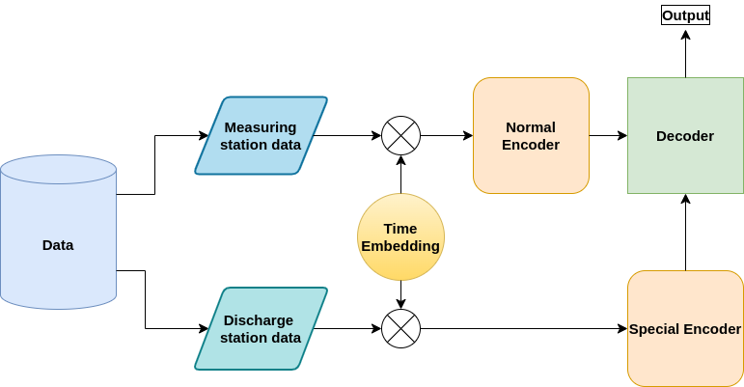
Method
03
Transformer:
Add temporal features
Encoder:
Measuring station data (E1)
Discharge station data (E2)
Decoder:
Cross attention E1 with E2 to enrich
Predict water level difference
Output: Interpolated to data format

Slide 8
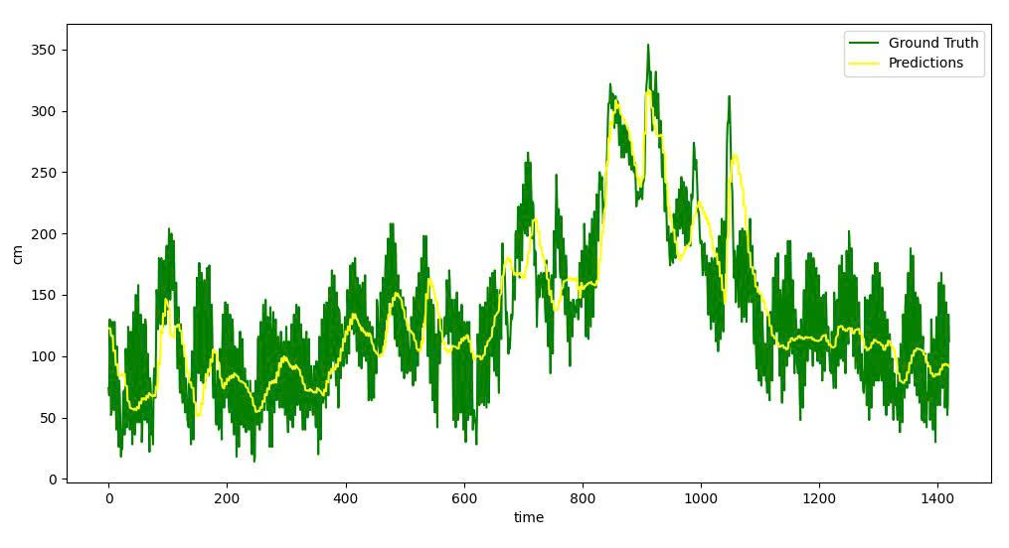
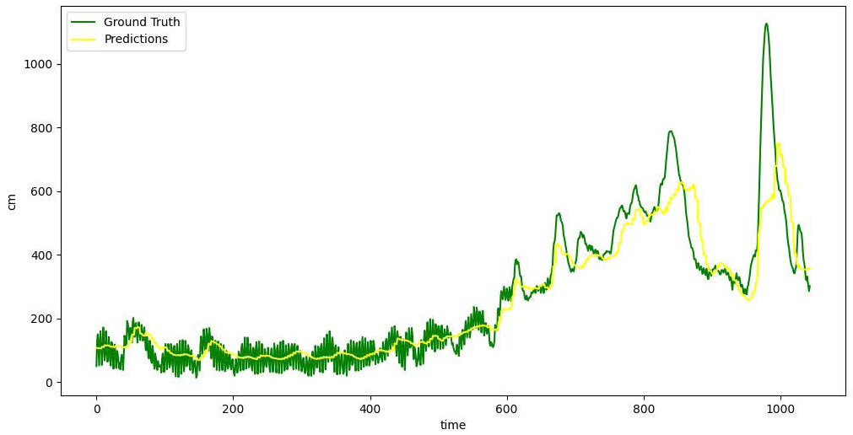
Result
04
2023 - MAE: 31.04 cm
2024 - MAE: 50.78 cm

Slide 9
Any questions?
Thank you for listening

