Slide 1
Chart.js Angular v2
Install chart.js
Register and New Chart
Chart Types
Chart Config
Defaults and Overrides
Actions
Event
Mixed Chart Types
Ng2-chart
Documents

Slide 2
1. Install chart.js
Chart.js uses the HTML Canvas Graphics tag to draw shapes.
Install using npm
npm install chart.js
Link: https://www.chartjs.org/docs/latest/getting-started/installation.html
(current version is 3.2.1)

Slide 3
2. Register and New Chart
Register the controllers, elements, scales and plugins you are going to use (recommend using this method).
import { BarController, BarElement, CategoryScale, LinearScale,
Chart, ChartConfiguration, Legend, Title, Tooltip } from 'chart.js’;
chart: Chart;
Chart.register(
BarController, BarElement,
CategoryScale, LinearScale,
Title, Tooltip, Legend,
);
const ctx = document.getElementById('barChart') as HTMLCanvasElement;
this.chart = new Chart(ctx, {…});

Slide 4
2. Register and New Chart
Register auto and new Chart as usual. In case there is an error, update the tsconfig.json file.
"noImplicitAny": false,
import Chart from 'chart.js/auto’;
@ViewChild('lineChart') lineChart: ElementRef;
chart: Chart;
this.chart = new Chart(this.lineChart.nativeElement, {…});

Slide 5
2. Register and New Chart
Import chart.min.js in angular.json file and declare variable Chart.
"scripts": [
"./node_modules/chart.js/dist/chart.min.js"
]
declare var Chart: any;
@ViewChild('pieChart') pieChart: ElementRef;
const chart = new Chart(this.pieChart.nativeElement, config);

Slide 6
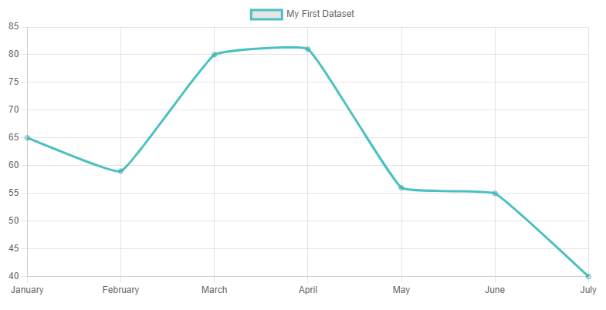
3. Chart Types

Slide 7
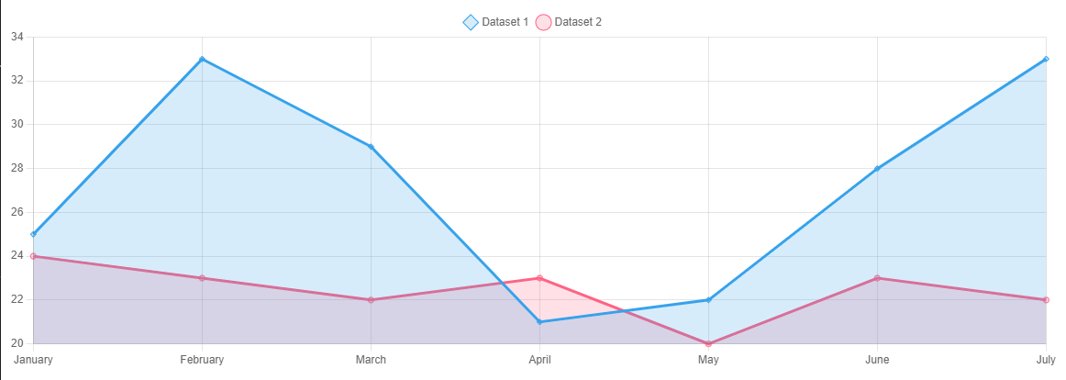
3. Chart Types

Slide 8
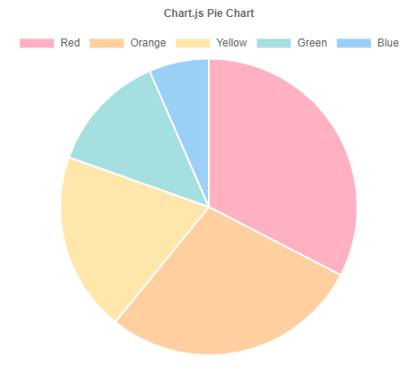
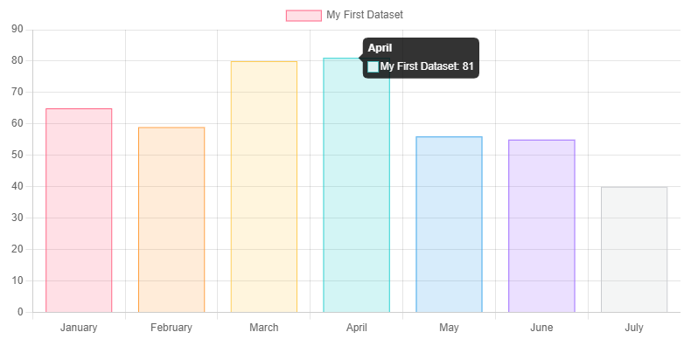
3. Chart Types
See also charts: https://www.chartjs.org/docs/latest/charts/bubble.html

Slide 9
4. Chart Config
const config: ChartConfiguration = {
type: 'pie',
data: {
labels: [ ],
datasets: [{ }],
},
options: {},
};
Chart config includes 3 parts
Type: chart type
(line, bar, radar, pie, polarArea, doughnut, bubble and scatter)
Data:
lables: [ ] label name for each index.
datasets: [ { } ] data and configuration for point data.
Options: configure scales, plugins, animations, events,...

Slide 10
4. Chart Config
Basic config only needs type and data to create new Chart.
const config: ChartConfiguration = {
type: 'bubble',
data,
};

Slide 11
4. Chart Config
Each type chart can have different specific properties.
Depending on the type of chart, the constructor data import will also be different.
// type line, bar, pie
datasets: [
{
label: 'Dataset 1',
data: [65, 59, 80, 81, 56],
borderColor: 'rgb(75, 192, 192)’,
tension: 0.5,
},
]
// type bubble
datasets: [
{
label: 'Dataset 1',
data: [
{ x: 10, y: 5.5, r: 10 },
{ x: 2, y: 6.1, r: 13 },
{ x: 1.5, y: 3, r: 5 },
],
hoverRadius: 15,
},
]

Slide 12
5. Defaults and Overrides
Defaults: default global for Chart.
Overrides: ...
// default element width of bar chart
Chart.defaults.datasets.bar.maxBarThickness = 100;
Chart.defaults.datasets.bar.minBarLength = 50;
// default title
Chart.defaults.plugins.title.text = 'Chart Example';
Chart.defaults.plugins.title.display = true;
Chart.defaults.plugins.title.color = 'red';
// overrides
Chart.overrides.bar.backgroundColor = 'red';
Chart.overrides.bar.borderColor = 'blue';

Slide 13
6. Actions
API for Chart
https://www.chartjs.org/docs/latest/developers/api.html
this.chart = new Chart(ctx, config);
// clean up any references stored to the chart object within Chart.js
this.chart.destroy();
// update of the chart
this.chart.data.datasets[0].data[2] = 50;
this.chart.update();
// shows dataset at index 1 and does 'show' animation.
this.chart.show(1);

Slide 14
7. Event
export interface ChartEvent {
type:
| 'contextmenu'
| 'mouseenter' | 'mousedown' | 'mousemove' | 'mouseup' | 'mouseout'
| 'click' | 'dblclick'
| 'keydown' | 'keypress' | 'keyup'
| 'resize';
native: Event | null;
x: number | null;
y: number | null;
}

Slide 15
7. Event
<canvas #pieChart id="pieChart" width="500" height="400" (click)="onClick()“
(dblclick)="onDblclick()" (mousedown)="mousedown()">
Your browser does not support the canvas element.
</canvas>

Slide 16
8. Mixed Chart Types
Link: https://www.chartjs.org/docs/latest/charts/mixed.html
datasets: [
{
type: 'line',
label: 'Dataset 1',
data: randomData(7, 20, 35),
backgroundColor: 'rgba(54, 162, 235, 0.2)',
},
{
type: bar',
label: 'Dataset 2',
data: randomData(7, 20, 25),
backgroundColor: 'rgba(255, 99, 132, 0.2)',
}
]

Slide 17
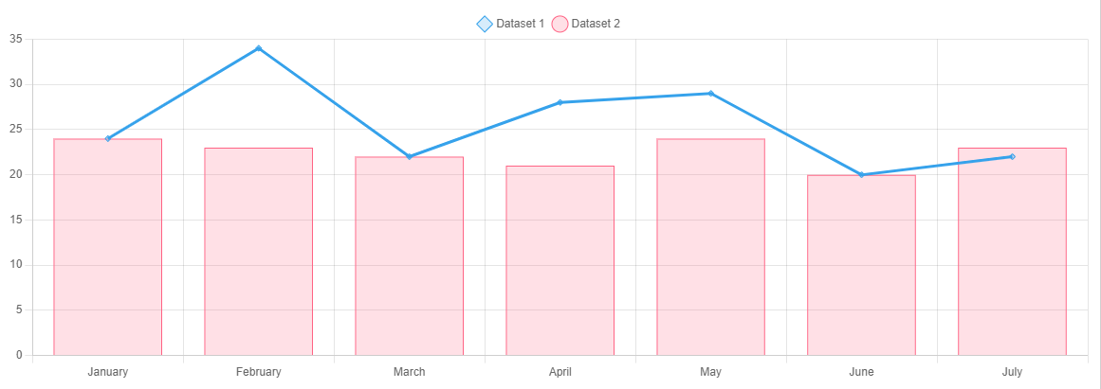
8. Mixed Chart Types

Slide 18
9. Ng2-chart
Install using npm
npm install ng2-charts
npm install chart.js
Link: https://valor-software.com/ng2-charts/#/GeneralInfo

Slide 19
9. Ng2-chart
Use typescript.
Refer to chart.js to write as directive.
8 types of charts: line, bar, radar, pie, polarArea, doughnut, bubble and scatter.
<canvas baseChart
[data]="polarAreaChartData" [labels]="polarAreaChartLabels" [legend]="polarAreaLegend" [chartType]="polarAreaChartType">
</canvas>

Slide 20
9. Ng2-chart
Currently the latest versions of ng2-charts and chart.js are not compatible, so a fresh installation will cause problems.
ng2-charts is compatible with chart.js version 2
npm install ng2-charts
npm install chart.js＠2.9.4
Note: Chart.js v2 compared to Chart.js v3 changes the config quite a lot
https://www.chartjs.org/docs/latest/getting-started/v3-migration.html

Slide 21
10. Documents
Samples Other Chart, Title, ToolTip, Plugins...
https://www.chartjs.org/docs/latest/samples/bar/vertical.html
Chart Custom
https://www.chartjs.org/docs/latest/developers/charts.html
Interfaces
https://www.chartjs.org/docs/latest/api/
In the source can refer to the interfaces in the file index.esm.d.ts

Slide 22
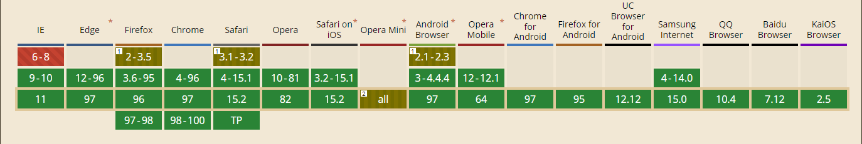
10. Documents
MDN Web Docs CanvasRenderingContext2D
https://developer.mozilla.org/en-US/docs/Web/API/CanvasRenderingContext2D
Basic support (2022/01/20)

