Slide 1
Chart.js Angular v2
Install chart.js
Register and New Chart
Chart Types
Chart Config
Data structures
Scriptable Options
Defaults and Overrides
Actions
Event
Mixed Chart Types
Ng2-chart
Documents

Slide 2
1. Install chart.js
Chart.js uses the HTML Canvas Graphics tag to draw shapes.
Install using npm
npm install chart.js
Link: https://www.chartjs.org/docs/latest/getting-started/installation.html
(current version is 3.2.1)

Slide 3
2. Register and New Chart
Register the controllers, elements, scales and plugins you are going to use (recommend using this method).
import { BarController, BarElement, CategoryScale, LinearScale,
Chart, ChartConfiguration, Legend, Title, Tooltip } from 'chart.js’;
chart: Chart;
Chart.register(
BarController, BarElement,
CategoryScale, LinearScale,
Title, Tooltip, Legend,
);
const ctx = document.getElementById('barChart') as HTMLCanvasElement;
this.chart = new Chart(ctx, {…});

Slide 4
2. Register and New Chart
Register auto and new Chart as usual. In case of error with 'any' type, update the tsconfig.json file.
"skipLibCheck": true,
import Chart from 'chart.js/auto’;
@ViewChild('lineChart') lineChart: ElementRef;
chart: Chart;
this.chart = new Chart(this.lineChart.nativeElement, {…});

Slide 5
2. Register and New Chart
Import chart.min.js in angular.json file and declare variable Chart.
"scripts": [
"./node_modules/chart.js/dist/chart.min.js"
]
declare var Chart: any;
@ViewChild('pieChart') pieChart: ElementRef;
const chart = new Chart(this.pieChart.nativeElement, config);

Slide 6
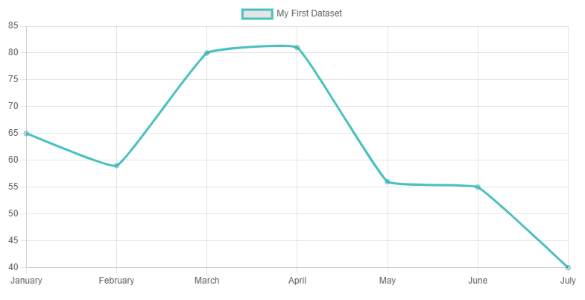
3. Chart Types

Slide 7
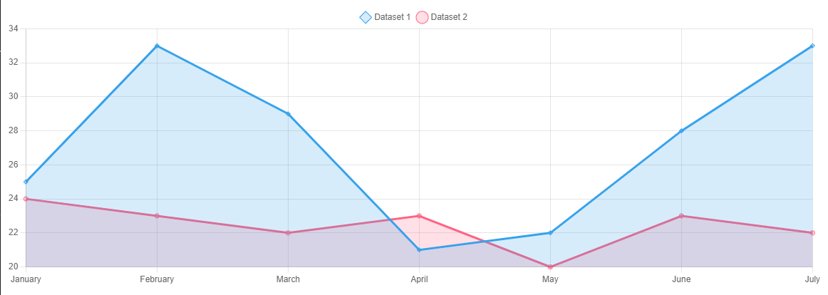
3. Chart Types

Slide 8
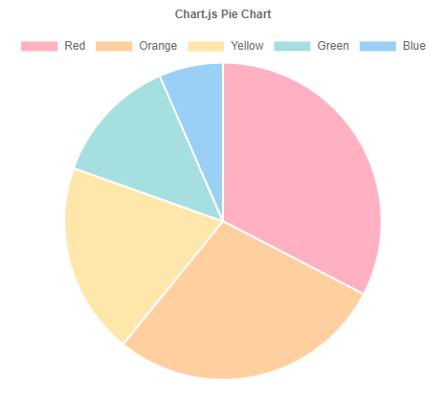
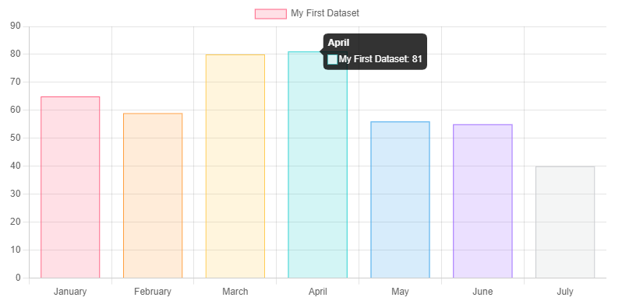
3. Chart Types
See also charts: https://www.chartjs.org/docs/latest/charts/bubble.html

Slide 9
4. Chart Config
const config: ChartConfiguration = {
type: 'pie',
data: {
labels: [ ],
datasets: [{ }],
},
options: {},
};
Chart config includes 3 parts
Type: chart type
(line, bar, radar, pie, polarArea, doughnut, bubble and scatter)
Data:
lables: [ ] label name for each index.
datasets: [ { } ] data and configuration for point data.
Options: configure scales, plugins, animations, events,...

Slide 10
4. Chart Config
Basic config only needs type and data to create new Chart.
const config: ChartConfiguration = {
type: 'bubble',
data,
};

Slide 11
4. Chart Config
Options example
const config = {
type: 'line',
data: data,
options: {
responsive: false,
indexAxis: 'y',
interaction: {
intersect: true, mode: 'index',
},
scales: { x: { }, y: { } },
plugins: {},
animations: {},
events: ['click'],
}
};

Slide 12
4. Chart Config
The events option defines the browser events that the chart should listen to for tooltips and hovering.
For example, to have the chart only respond to click events:
const chart = new Chart(ctx, {
type: 'line',
data: data,
options: {
// This chart will not respond to mousemove, etc
events: ['click']
}
});

Slide 13
4. Chart Config
Each type chart can have different specific properties.
Depending on the type of chart, the constructor data import will also be different.
// type line, bar, pie
datasets: [
{
label: 'Dataset 1',
data: [65, 59, 80, 81, 56],
borderColor: 'rgb(75, 192, 192)’,
tension: 0.5,
},
]
// type bubble
datasets: [
{
label: 'Dataset 1',
data: [
{ x: 10, y: 5.5, r: 10 },
{ x: 2, y: 6.1, r: 13 },
{ x: 1.5, y: 3, r: 5 },
],
hoverRadius: 15,
},
]

Slide 14
5. Data structures
Primitive[]
type: 'bar',
data: {
datasets: [{
data: [20, 10],
}],
labels: ['a', 'b']
}

Slide 15
5. Data structures
Object
type: 'line',
data: {
datasets: [{
data: {
January: 10,
February: 20
}
}]
}

Slide 16
5. Data structures
Object[]
type: 'line',
data: {
datasets: [{
data: [{x:'2016-12-25', y:20}, {x:'2016-12-26', y:10}]
}]
}

Slide 17
5. Data structures
Object[] using custom properties
type: 'bar',
data: {
datasets: [{
data: [{id: 'Sales', nested: {value: 1500}}, {id: 'Purchases', nested: {value: 500}}]
}]
},
options: {
parsing: {
xAxisKey: 'id',
yAxisKey: 'nested.value'
}
}

Slide 18
5. Data structures
Object[] using custom properties
type: 'doughnut',
data: {
datasets: [{
data: [{id: 'Sales', nested: {value: 1500}}, {id: 'Purchases', nested: {value: 500}}]
}]
},
options: {
parsing: {
key: 'nested.value' // When using the pie/doughnut chart type
}
}

Slide 19
6. Scriptable Options
grid: {
drawBorder: true,
borderColor: 'red',
tickColor: 'red',
color: (context) => {
if (context.tick.value > 0) {
return 'lightgrey';
} else if (context.tick.value < 0) {
return 'lightblue';
}
return 'rgb(255, 159, 64)';
},
},

Slide 20
7. Defaults and Overrides
Defaults: default global for Chart.
Overrides: ...
// default element width of bar chart
Chart.defaults.datasets.bar.maxBarThickness = 100;
Chart.defaults.datasets.bar.minBarLength = 50;
// default title
Chart.defaults.plugins.title.text = 'Chart Example';
Chart.defaults.plugins.title.display = true;
Chart.defaults.plugins.title.color = 'red';
// overrides
Chart.overrides.bar.backgroundColor = 'red';
Chart.overrides.bar.borderColor = 'blue';

Slide 21
8. Actions
API for Chart
https://www.chartjs.org/docs/latest/developers/api.html
this.chart = new Chart(ctx, config);
// clean up any references stored to the chart object within Chart.js
this.chart.destroy();
// update of the chart
this.chart.data.datasets[0].data[2] = 50;
this.chart.update();
// shows dataset at index 1 and does 'show' animation.
this.chart.show(1);

Slide 22
9. Event
export interface ChartEvent {
type:
| 'contextmenu'
| 'mouseenter' | 'mousedown' | 'mousemove' | 'mouseup' | 'mouseout'
| 'click' | 'dblclick'
| 'keydown' | 'keypress' | 'keyup'
| 'resize';
native: Event | null;
x: number | null;
y: number | null;
}

Slide 23
9. Event
<canvas #pieChart id="pieChart" width="500" height="400" (click)="onClick()“
(dblclick)="onDblclick()" (mousedown)="mousedown()">
Your browser does not support the canvas element.
</canvas>

Slide 24
10. Mixed Chart Types
Link: https://www.chartjs.org/docs/latest/charts/mixed.html
datasets: [
{
type: 'line',
label: 'Dataset 1',
data: randomData(7, 20, 35),
backgroundColor: 'rgba(54, 162, 235, 0.2)',
},
{
type: bar',
label: 'Dataset 2',
data: randomData(7, 20, 25),
backgroundColor: 'rgba(255, 99, 132, 0.2)',
}
]

Slide 25
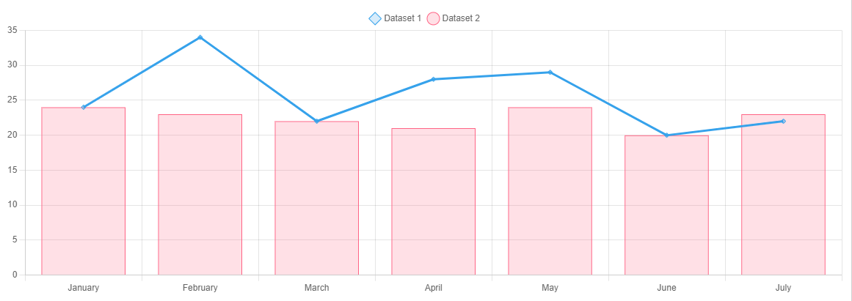
10. Mixed Chart Types

Slide 26
11. Ng2-chart
Install using npm
npm install ng2-charts
npm install chart.js
Link: https://valor-software.com/ng2-charts/#/GeneralInfo

Slide 27
11. Ng2-chart
Use typescript.
Refer to chart.js to write as directive.
8 types of charts: line, bar, radar, pie, polarArea, doughnut, bubble and scatter.
<canvas baseChart
[data]="polarAreaChartData" [labels]="polarAreaChartLabels" [legend]="polarAreaLegend" [chartType]="polarAreaChartType">
</canvas>

Slide 28
11. Ng2-chart
Currently the latest versions of ng2-charts and chart.js are not compatible, so a fresh installation will cause problems.
ng2-charts is compatible with chart.js version 2
npm install ng2-charts
npm install chart.js＠2.9.4
Note: Chart.js v2 compared to Chart.js v3 changes the config quite a lot
https://www.chartjs.org/docs/latest/getting-started/v3-migration.html

Slide 29
12. Documents
Samples Other Chart, Title, ToolTip, Plugins...
https://www.chartjs.org/docs/latest/samples/bar/vertical.html
Chart Custom
https://www.chartjs.org/docs/latest/developers/charts.html
Interfaces
https://www.chartjs.org/docs/latest/api/
In the source can refer to the interfaces in the file index.esm.d.ts

Slide 30
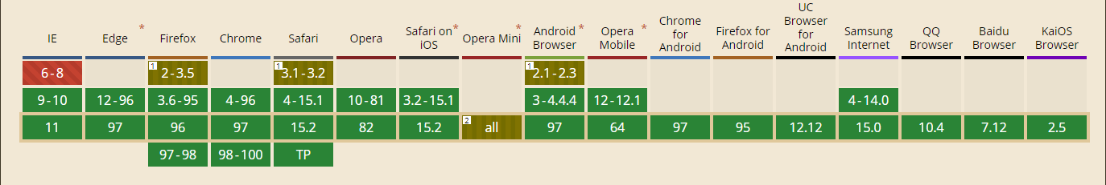
12. Documents
MDN Web Docs CanvasRenderingContext2D
https://developer.mozilla.org/en-US/docs/Web/API/CanvasRenderingContext2D
Basic support (2022/01/20)

