Slide 1

Semantic Path Based Personalized Recommendation System (SemRec) in Weighted Heterogeneous Information Network (WHIN)
Advisor:
Assoc. Prof. Dr. Do Phuc
Nguyen Duc Huy - 14521166
Huynh Tuan Kiet - 14521168

Slide 2
Outline
Motivation
Preliminaries
Introduction
Traditional Collaborative Filtering
HIN - Based Approach
The Data Storage
Algorithms
Experiment
Evaluation Metric
Experiment Result
Conclusion
References

Slide 3
Motivation
The main disadvantage is its scalability. This might be slow, extremely time-consuming, or unable to execute, as the number of tens of millions data
Therefore, we want to compare between traditional method and graph - based method in case of the huge datasets to prove the scalability of the graph which can replace the traditional method in the future.

Slide 4
Introduction
Preliminaries
Calculating the similarity measure
Predicting the rating scores
Recommended Results
Traditional CF
User-Item ratings matrix
Cosine Similarity
Prediction
HIN - Based Approach:
HIN
Path - based Similarity (PathSim)
Prediction
Notes:
These are characteristic stages in a recommendation system includes in the 2 important phases:
The first important phase is Calculate the similarity between the target user and the rest of the users
and then, we select a subset of the neighbors according to their similarity with the target user
and the second important is Compute the prediction using the neighbor ratings
In this thesis, we only focus on comparing these two methods, especially two ways of calculating similarity: Cosine similarity in Traditional CF and Path – based Similarity in Graph database

Slide 5
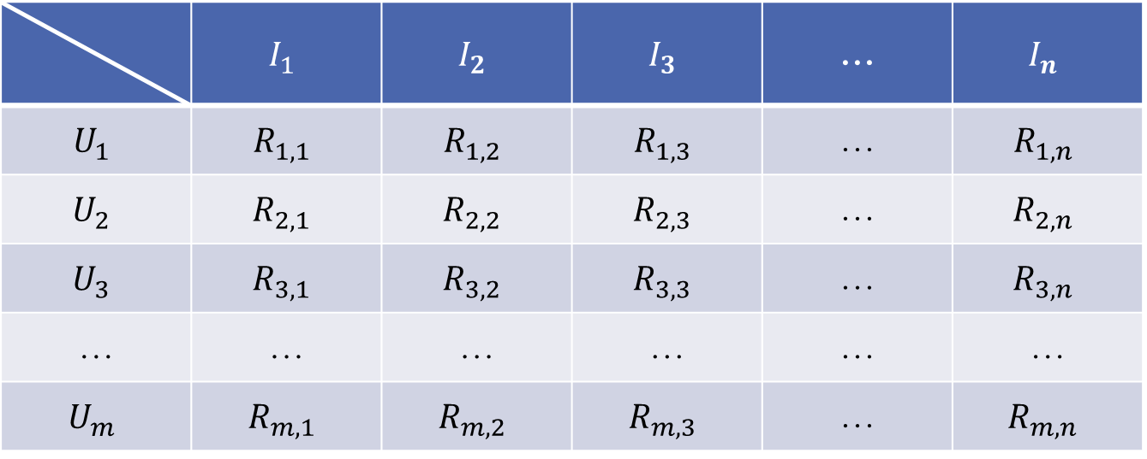
Traditional Collaborative Filtering
Preliminaries
User-Item ratings matrix
 | $$I_{1}$$ | $$I_{2}$$ | $$I_{3}$$ | … | $$I_{n}$$
$$U_{1}$$ | $$R_{1,1}$$ | $$R_{1,2}$$ | $$R_{1,3}$$ | … | $$R_{1,n}$$
$$U_{2}$$ | $$R_{2,1}$$ | $$R_{2,2}$$ | $$R_{2,3}$$ | … | $$R_{2,n}$$
$$U_{3}$$ | $$R_{3,1}$$ | $$R_{3,2}$$ | $$R_{3,3}$$ | … | $$R_{3,n}$$
… | … | … | … | … | …
$$U_{m}$$ | $$R_{m,1}$$ | $$R_{m,2}$$ | $$R_{m,3}$$ | … | $$R_{m,n}$$
Item
User
Notes:
Generally, input data in recommendation system based on the CF technology
consists of user, item, and user ratings on items
as a matrix m × n as shown in table above.
In there, Symbol m is the total number of
users and n symbolizes the total number of items.
$R_{m,n}$ is the score of item In rated by user Um.
The user ratings are stored in a table known as the rating matrix. This table is processed in order to generate the recommendations.

Slide 6
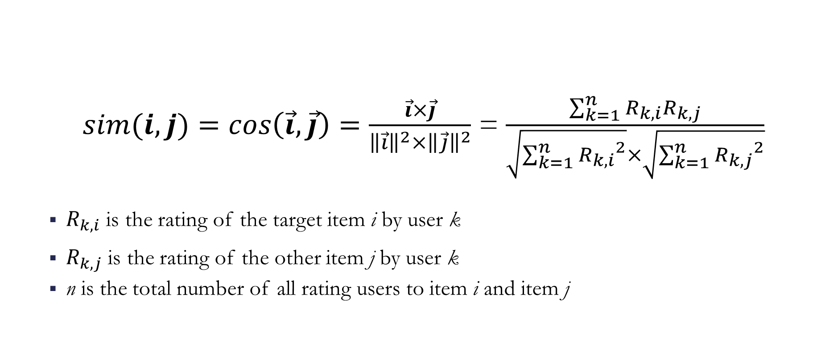
Cosine Similarity measure
Traditional CF
$sim(i,j)=cos\left(\vec{i},\vec{j}\right)=\frac{\vec{i}×\vec{j}}{{\left\|\vec{i}\right\|}^{2}×{\left\|\vec{j}\right\|}^{2}}$ = $\frac{\sum_{k=1}^{n}{R_{k,i}R_{k,j}}}{\sqrt{\sum_{k=1}^{n}{{R_{k,i}}^{2}}}×\sqrt{\sum_{k=1}^{n}{{R_{k,j}}^{2}}}}$
$R_{k,i}$ is the rating of the target item i by user k
$R_{k,j}$ is the rating of the other item j by user k
n is the total number of all rating users to item i and item j
Notes:
We use Cosine because of its popularity.
Cos(i, j) = (scalar product) / (cross product)
Similarity is the cosine of the angle between the 2 vectors of the item vectors of i and j
The Cosine Similarity is defined in vectors $\vec{A}$ and $\vec{B}$ as:
cosine($\vec{A}$, $\vec{B}$) = $\vec{A}$ $.\vec{B}$ / ||$\vec{A}$ ||.||$\vec{B}$||
for a vector $\vec{A}$ = ($a_{1},a_{2}$), ||$\vec{A}$ || is defined as sqrt($a_{1}^{2}$ + $a_{2}^{2}$)
for a vector $\vec{B}$ = ($b_{1},b_{2}$), ||$\vec{B}$ || is defined as sqrt($b_{1}^{2}$ + $b_{2}^{2}$)
for vector $\vec{A}$ = ($a_{1},a_{2}$) and $\vec{B}$ = ($b_{1},b_{2}$), $\vec{A}$ $.\vec{B}$ is define as ($a_{1}b_{1}$ + $a_{2}b_{2}$
for vector $\vec{A}$ = ($a_{1},a_{2}$) and $\vec{B}$ = ($b_{1},b_{2}$), the cosine similarity is given as:
($a_{1}b_{1}$ + $a_{2}b_{2}$) /sqrt($a_{1}^{2}$ + $a_{2}^{2}$). sqrt($b_{1}^{2}$ + $b_{2}^{2}$)
This is another measure of user similarity that treats users as vectors of item ratings. Then it measures the cosine between the vectors
of two users [Breese et al. 1998]. A value close to 1 indicates similarity, while a value less than zero indicates just the opposite.

Slide 7

Example Cosine Similarity
Traditional CF
$R_{k,j}$ is the rating of the other item j by user k
Notes:
We use Cosine because of its popularity.
Cos(i, j) = (scalar product) / (cross product)
Similarity is the cosine of the angle between the 2 vectors of the item vectors of i and j
The Cosine Similarity is defined in vectors $\vec{A}$ and $\vec{B}$ as:
cosine($\vec{A}$, $\vec{B}$) = $\vec{A}$ $.\vec{B}$ / ||$\vec{A}$ ||.||$\vec{B}$||
for a vector $\vec{A}$ = ($a_{1},a_{2}$), ||$\vec{A}$ || is defined as sqrt($a_{1}^{2}$ + $a_{2}^{2}$)
for a vector $\vec{B}$ = ($b_{1},b_{2}$), ||$\vec{B}$ || is defined as sqrt($b_{1}^{2}$ + $b_{2}^{2}$)
for vector $\vec{A}$ = ($a_{1},a_{2}$) and $\vec{B}$ = ($b_{1},b_{2}$), $\vec{A}$ $.\vec{B}$ is define as ($a_{1}b_{1}$ + $a_{2}b_{2}$
for vector $\vec{A}$ = ($a_{1},a_{2}$) and $\vec{B}$ = ($b_{1},b_{2}$), the cosine similarity is given as:
($a_{1}b_{1}$ + $a_{2}b_{2}$) /sqrt($a_{1}^{2}$ + $a_{2}^{2}$). sqrt($b_{1}^{2}$ + $b_{2}^{2}$)

Slide 8
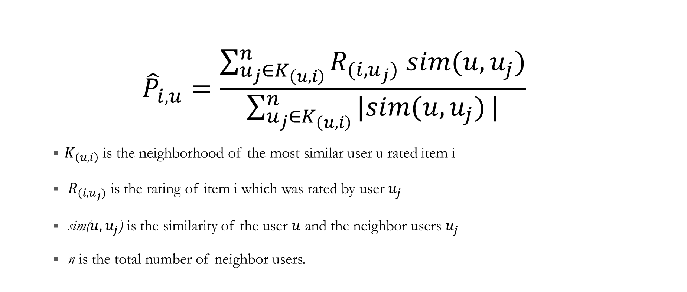
Prediction
Traditional CF
$${\hat{P}}_{i,u}=\frac{\sum_{u_{j}∈K_{\left(u,i\right)}}^{n}{R_{(i,u_{j})} sim(u,u_{j})}}{\sum_{u_{j}∈K_{\left(u,i\right)}}^{n}{|sim(u,u_{j})}|}$$
$K_{\left(u,i\right)}$ is the neighborhood of the most similar user u rated item i
$R_{(i,u_{j})}$ is the rating of item i which was rated by user $u_{j}$
sim($u,u_{j}$) is the similarity of the user $u$ and the neighbor users $u_{j}$
n is the total number of neighbor users.
Notes:
Why did you choose this formula? => in CF it’s a popular method
Don gian, pho bien trong hau het he thong RS deu su dung.
N(u,i) là tập hợp k users trong neighborhood (tức có similarity cao nhất) của u mà đã rated i.

Slide 9

Drawbacks
Traditional CF
Performance in big-matrix:
Scalability: The numbers of users and items grow, traditional CF algorithms will suffer serious scalability problems.
Time consuming: User-based uses the entire database every time it makes a prediction.
Notes:
Disadvantages:
User-based Collaborative Filtering is a type of Memory-based Collaborative Filtering that uses all user data in the database to create recommendations. Comparing the pairwise correlation of every user in your dataset is not scalable. If there were millions of users, this computation would be very time consuming.
Possible ways to get around this would be to implement some form of dimensionality reduction, such as Principal Component Analysis, or to use a model-based algorithm instead.
It uses the entire database every time it makes a prediction, so it needs to be in memory it is very, very slow.
Even when in memory, it uses the entire database every time it makes a prediction, so it is very slow.
It can sometimes not make a prediction for certain active users/items. This can occur if the active user has no items in common with all people who have rated the target item.
Overfits the data. It takes all random variability in people's ratings as causation, which can be a real problem. In other words, memory-based algorithms do not generalize the data at all.

Slide 10
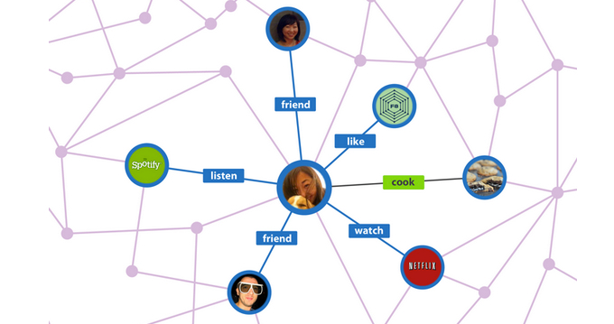

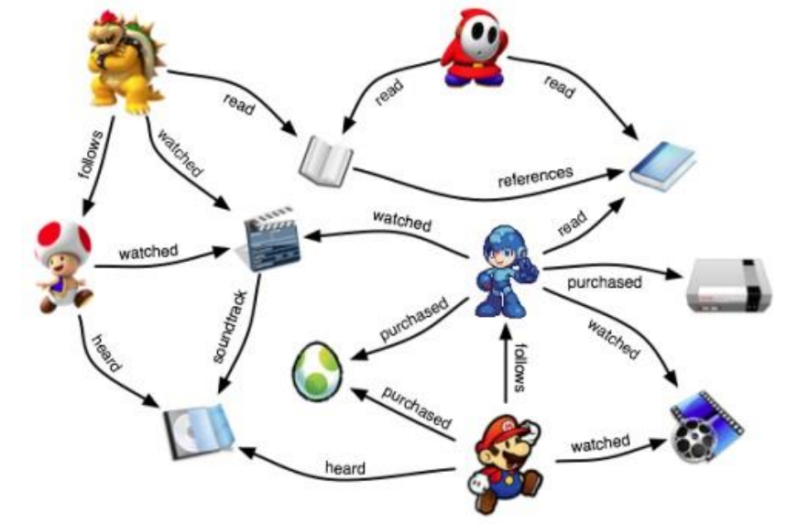
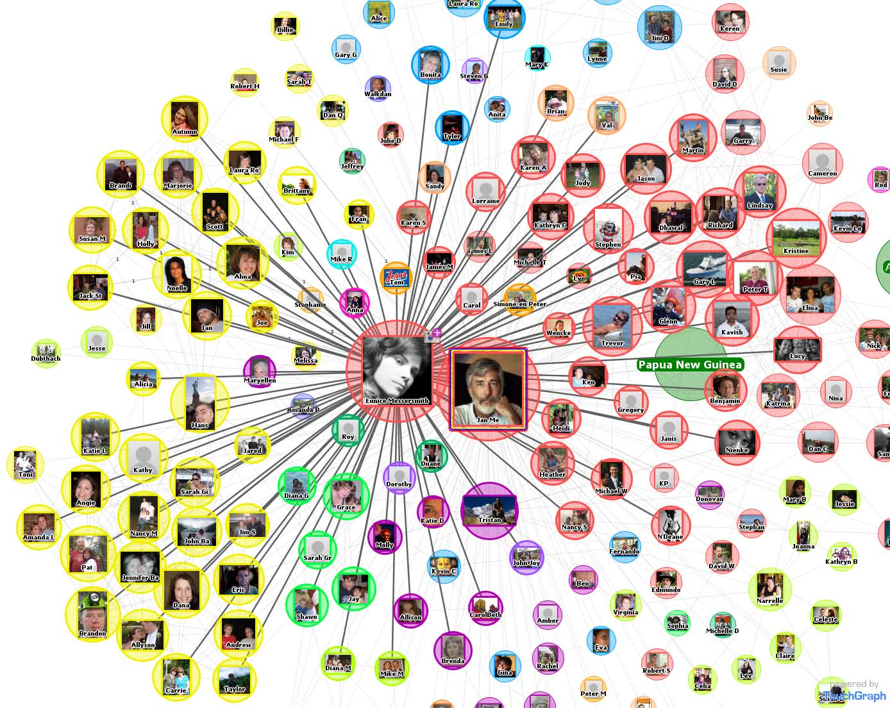
Heterogeneous Information Network
(HIN)
Notes:
So I think needless to say nowadays we see a lot of different kinds of the databases, and this databases are typically represented as a graph to represent the HIN and also unstructured manner of the data and so we often call this as a kind of a heterogeneous information network.

Slide 11
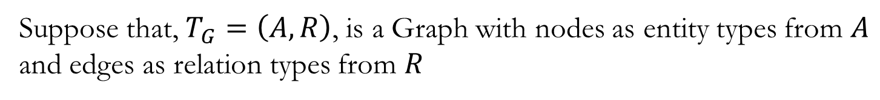
Heterogeneous Information Network
HIN Based Approach
Suppose that, $T_{G}=\left(A,R\right)$, is a Graph with nodes as entity types from $A$ and edges as relation types from $R$
$$\left[{\text{The} \text{types} \text{of} \text{objects}\text{ |}\text{A}\text{| > 1} \atop \text{T}\text{he} \text{types} \text{of} \text{relations}\text{ |}\text{R}\text{| >}1}\right.⇔Heterogeneous Information Network$$
Notes:
Most previous researches on information networks focuses on homogeneous information networks, which involve one type of nodes and one type of links, e.g., social networks with friendship links, webpage networks with hyper-links
But in this thesis, we will mention to Heterogeneous Information Network
So what is Heterogeneous Information Network?
Assume that, we have a directed graph with entity types is A and relation types is R. So Heterogeneous Information Network will be defined as follows:
HIN is a directed graph which either contain the number of the types of objects over 1 or
the number of the types of relations over 1

Slide 12
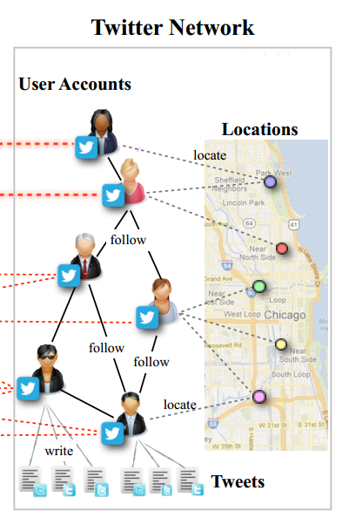
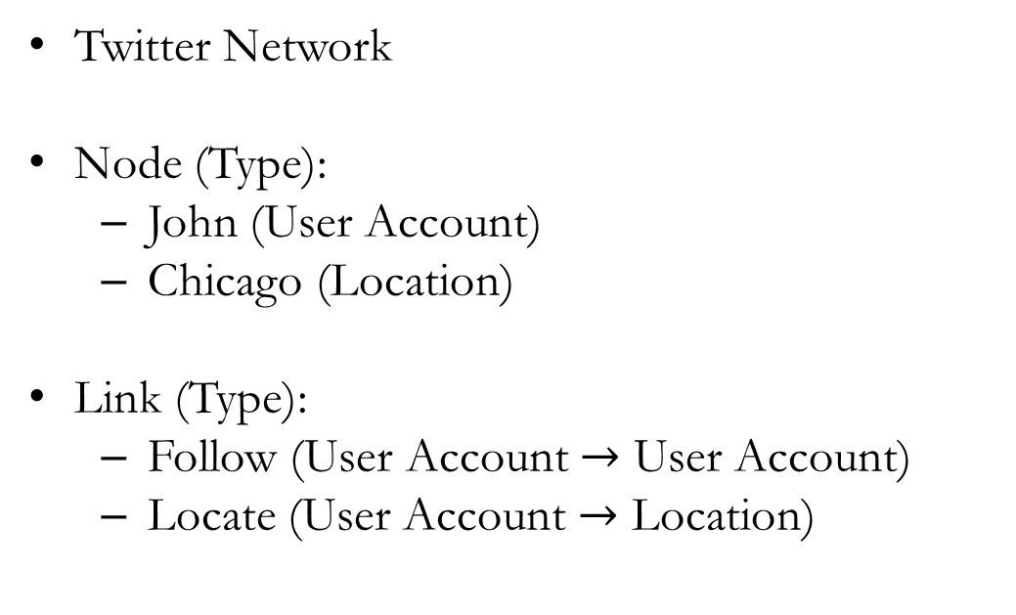
HIN Based Approach
Example HINs
Twitter Network
Node (Type):
John (User Account)
Chicago (Location)
Link (Type):
Follow (User Account $→$ User Account)
Locate (User Account $→$ Location)
Notes:
And then, let me give you some examples, so even though I mean you briefly understand what this is.
The first example is Twitter Network is represented by graph form. Twitter as a social media can also be considered as an information network, containing
Objects types such as User Account, Location
for instance you have the different user account and location, you have a John as a User Account and Chicago is location
And you have different kinds of relations as
for instances an User Account locate at Location, or User account follow the other User Account
In summary, we have the number of types of object and relation is 2 more than 1
Therefore, we have a HIN

Slide 13
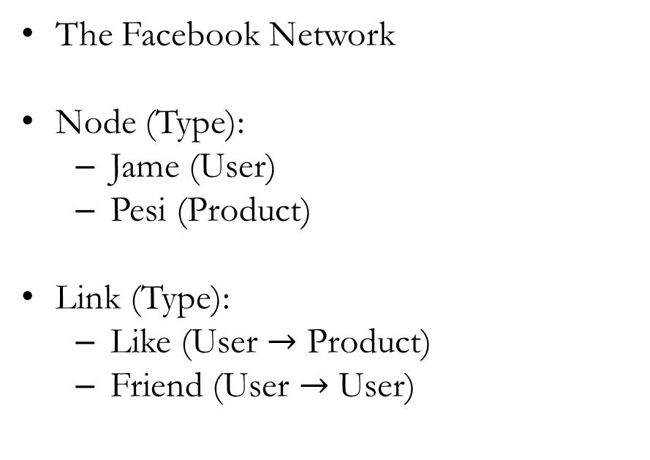
HIN Based Approach
Example HINs
The Facebook Network
Node (Type):
Jame (User)
Pesi (Product)
Link (Type):
Like (User $→$ Product)
Friend (User $→$ User)
Notes:
And a similar example, we have a Facebook Network is also a HIN

Slide 14
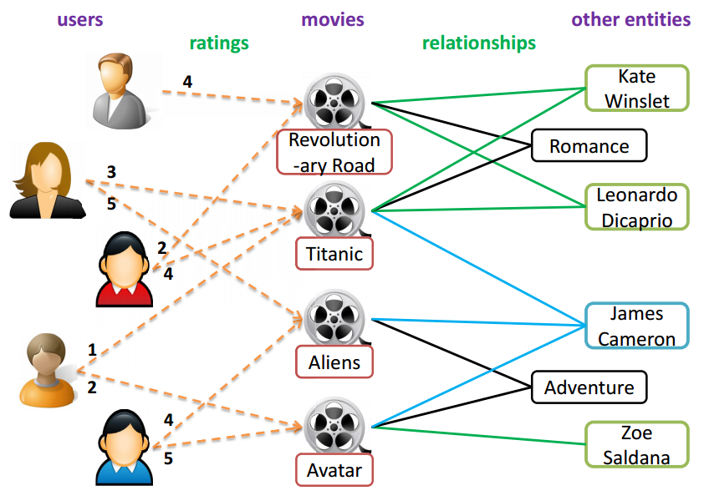
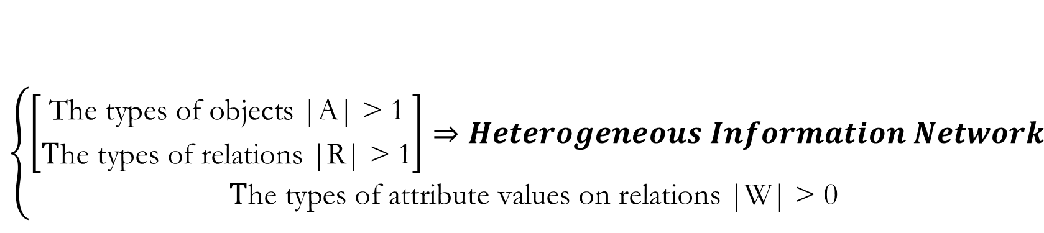
HIN Based Approach
$$\left\{\begin{aligned}\left[{\text{The} \text{types} \text{of} \text{objects}\text{ |}\text{A}\text{| > 1} \atop \text{T}\text{he} \text{types} \text{of} \text{relations}\text{ |}\text{R}\text{| > 1}}\right]⇒Heterogeneous Information Network \\ \text{T}\text{he} \text{types} \text{of} \text{attribute} \text{values} \text{on} \text{relations}\text{ |}\text{W}\text{| > 0 }\end{aligned}\right.$$
What is the Weighted Heterogeneous Information Network?
Weighted Heterogeneous Information Network
Notes:
In the 2 above example, we know the conditions to have a HIN. In case of Weighted Heterogeneous Information Network, we will have more one condition is the number of types of attribute values more than zero.
For example, we have this image
the network contains one type of attribute value on the rating relation between users and movies, which take values from 1 to 5
Therefore, we will call this is a Weighted Heterogeneous Information Network

Slide 15
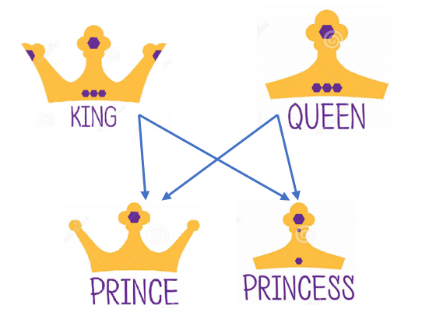
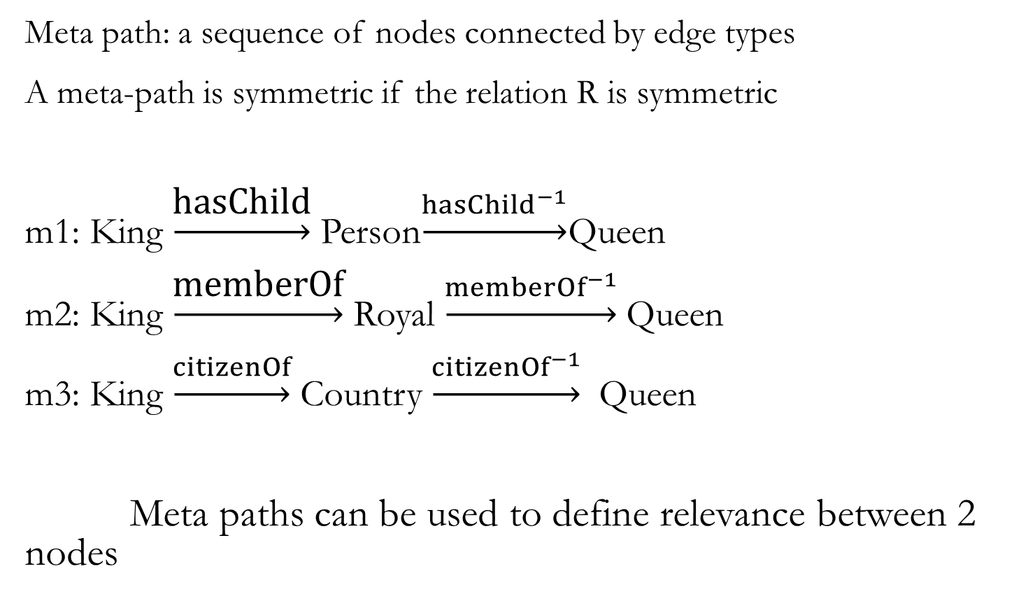
Meta Path
HIN Based Approach
Meta path: a sequence of nodes connected by edge types
A meta-path is symmetric if the relation R is symmetric
m1: King $\underset{→}{\text{hasChild}}$Person$\underset{→}{{hasChild}^{−1}}$Queen
m2: King $\underset{→}{\text{memberOf}}$Royal $\underset{→}{{memberOf}^{−1}}$Queen
m3: King $\underset{→}{citizenOf}$Country $\underset{→}{{citizenOf}^{−1}}$Queen
Meta paths can be used to define relevance between 2 nodes
Notes:
Meta path is the essential concept in HIN
Meta path is a series of nodes which were connected by relation types
we have the concept about symmetric meta path
We say a meta-path is symmetric if the relation R is symmetric
Here are 3 symmetric meta path because King and Queen are the same type. In this case, type can call be the parent For example, in this image, the composite relation two Person King and Queen co-created a person Prince or Princess can be described as meta path 1
And meta path 2 it means King and Queen are the members of the same Royal
And meta path 3 it means King and Queen are citizens of the same Country
Therefore, …

Slide 16
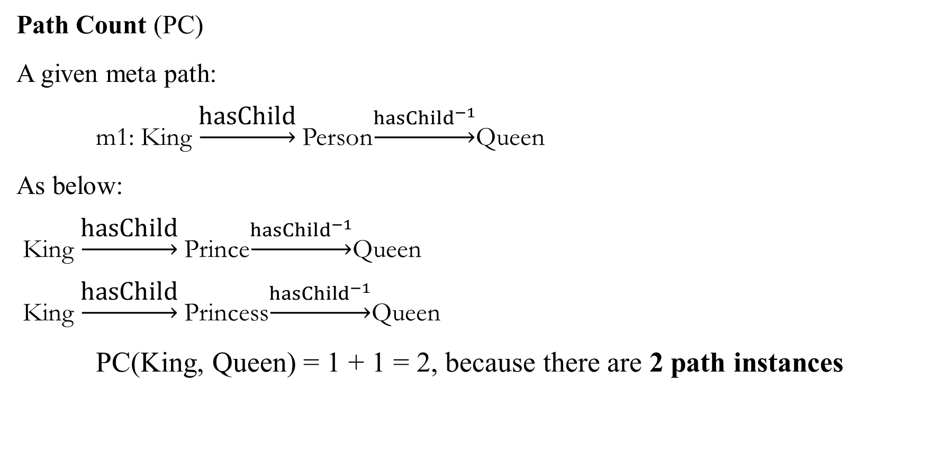
Meta Path Relevance 1: Path Count (PC)
HIN Based Approach
Path Count (PC)
A given meta path:
m1: King $\underset{→}{\text{hasChild}}$Person$\underset{→}{{hasChild}^{−1}}$Queen
As below:
King $\underset{→}{\text{hasChild}}$Prince$\underset{→}{{hasChild}^{−1}}$Queen
King $\underset{→}{\text{hasChild}}$Princess$\underset{→}{{hasChild}^{−1}}$Queen
PC(King, Queen) = 1 + 1 = 2, because there are 2 path instances
Notes:
PC is the related concept in Meta path
Path count it means the number of path instances between 2 nodes
For example, we have pc between 2 node king and queen is 2 because
the first path instance is king …
the second path instance is ….

Slide 17

Meta Path Relevance 2: Path – based Similarity measure
HIN Based Approach
$$s\left(x,y\right)=\frac{2×\left|\left\{p_{x→y }: p_{x→y}∈P\right\}\right|}{\left|\left\{p_{x→x }: p_{x→x}∈P\right\}\right|+\left|\left\{p_{y→y }: p_{y→y}∈P\right\}\right|}$$
Properties of PathSim:
$s\left(x_{i},x_{y}\right)=s\left(x_{y},x_{i}\right)$
$s\left(x_{i},x_{j}\right)∈\left[0, 1\right], and s\left(x_{i},x_{i}\right)=1$
Notice that we do consider the attribute value of a path instance as the weight of path instance
Notes:
Path –based Similarity is a fomular to calculate the similarity measure between 2 nodes
In here, we have the pathsim between 2 nodes x and y
the numerator is the sum of path instances between x and y
and the denominator is the sum of path instances between x and x plus the sum of path instances between y and y

Slide 18
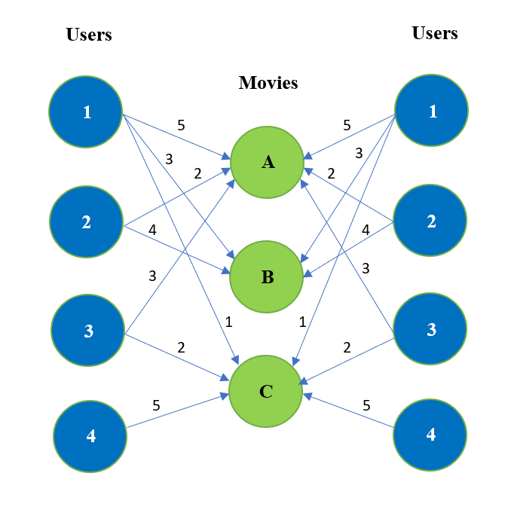
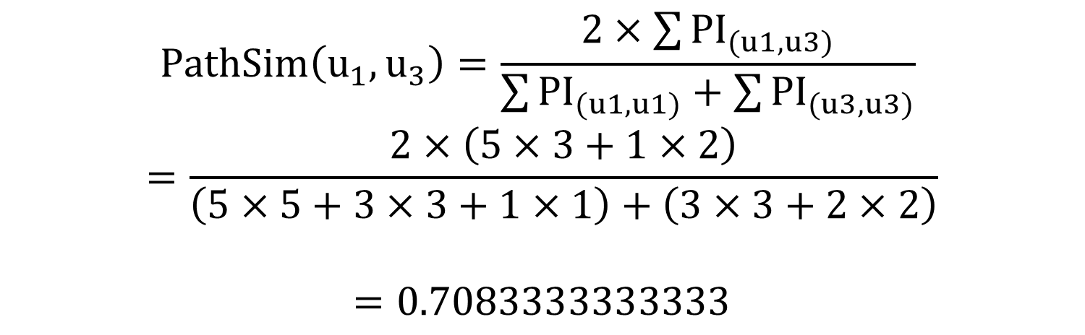
Example of PathSim
HIN Based Approach
$$PathSim\left(u_{1},u_{3}\right)=\frac{2×\sum{{PI}_{(u1,u3)}}}{\sum{{PI}_{(u1,u1)}+\sum{{PI}_{(u3,u3)}}}}$$
$$=\frac{2×\left(5×3+1×2\right)}{\left(5×5+3×3+1×1\right)+\left(3×3+2×2\right)}$$
$$=0.7083333333333$$
Single path: User(i)Movie(j)User, as i,j is the weight on links

Slide 19

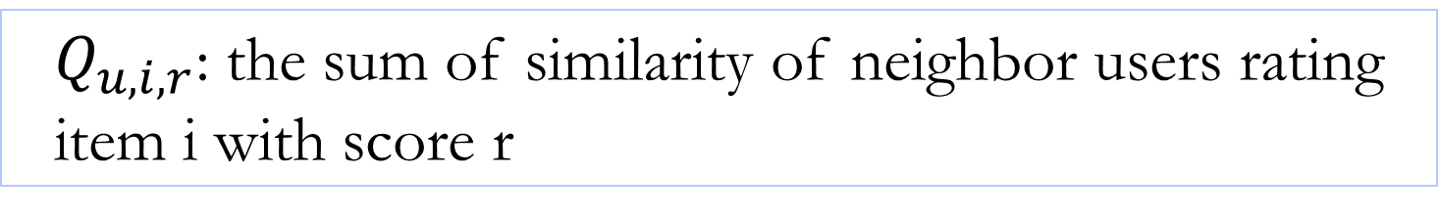
Prediction
HIN Based Approach
$${\hat{R}}_{u,i}=\sum_{r=1}^{N}{r}×\frac{Q_{u,i,r}}{\sum_{k=1}^{N}{Q_{u,i,r}}}$$
$Q_{u,i,r}$: the sum of similarity of neighbor users rating item i with score r

Slide 20
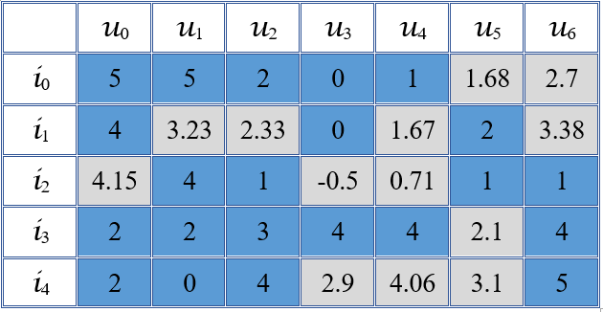
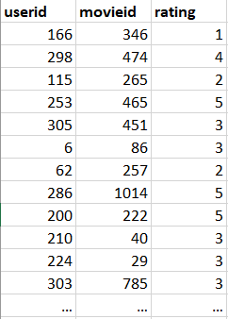
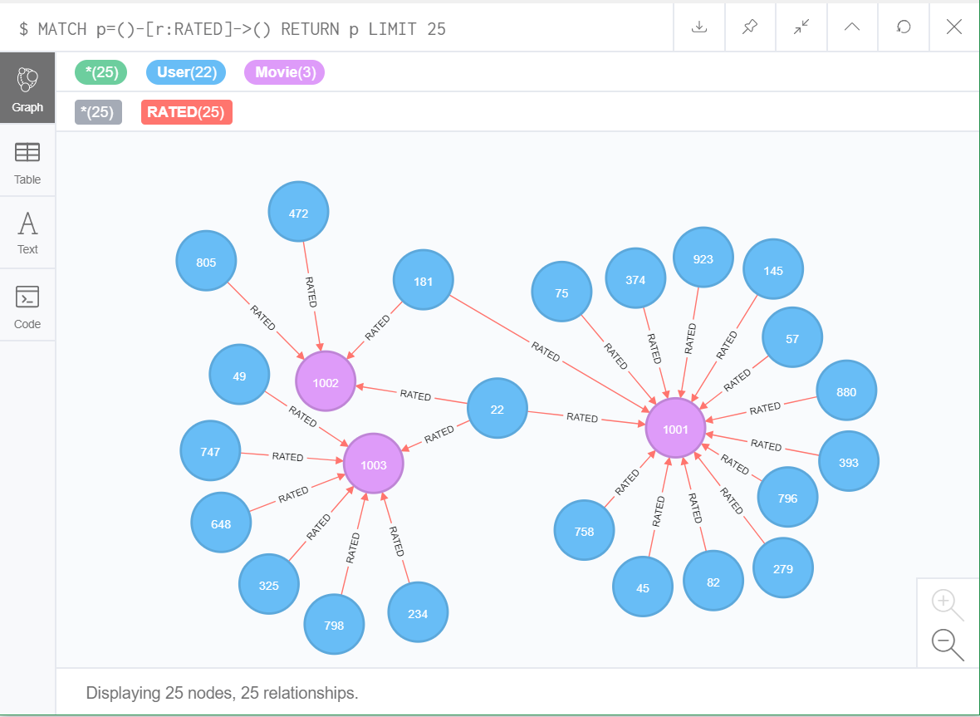
The Data Storage
Matrix
Graph
Raw datasets
Notes:
By using a graph, we do not worry about table joins and index lookups because graph is structured by individual entity and its relationships with other individual entities.

Slide 21
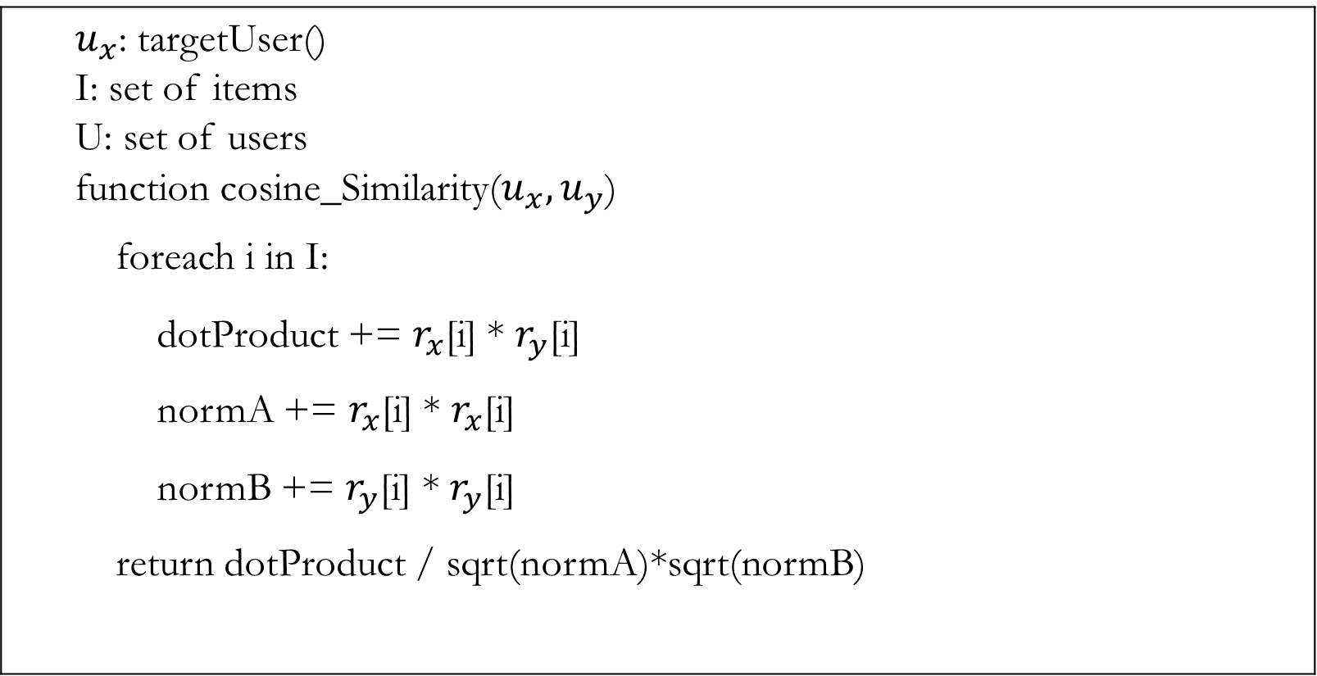
Algorithms
Cosine Similarity pseudocode (after normalized):
$u_{x}$: targetUser() I: set of items U: set of users function cosine_Similarity($u_{x},u_{y}$) foreach i in I: dotProduct += $r_{x}$[i] * $r_{y}$[i] normA += $r_{x}$[i] * $r_{x}$[i] normB += $r_{y}$[i] * $r_{y}$[i] return dotProduct / sqrt(normA)*sqrt(normB)
Notes:
Giai thich

Slide 22
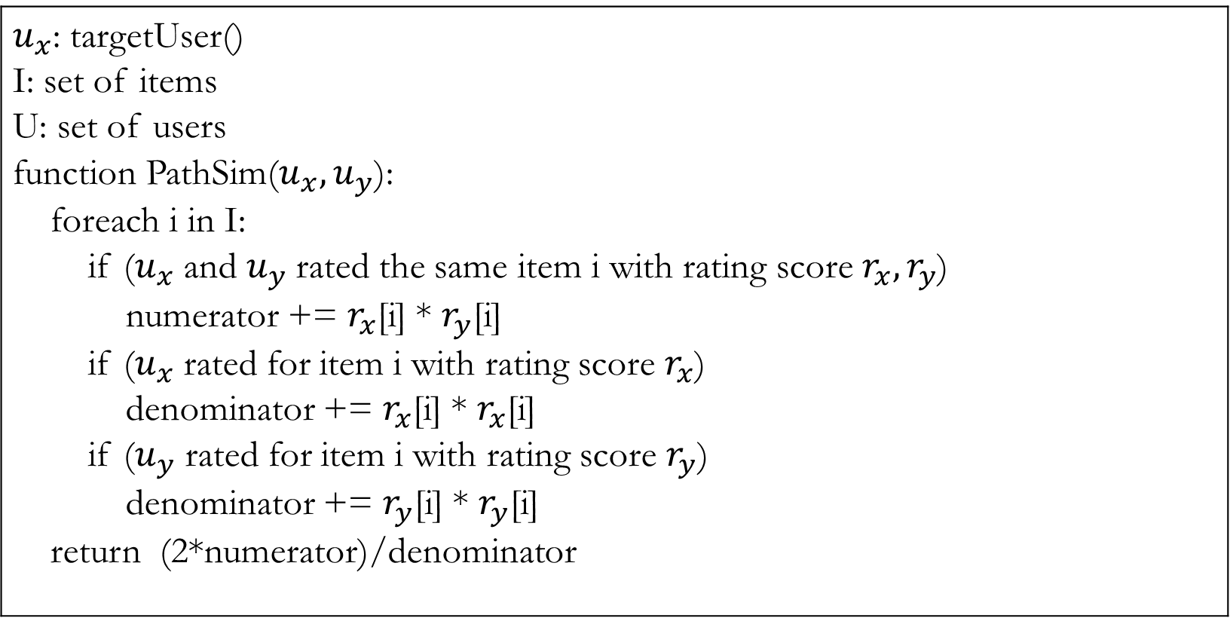
Algorithms
Path - based Similarity Pseudocode:
$u_{x}$: targetUser() I: set of items U: set of users function PathSim($u_{x},u_{y}$): foreach i in I: if ($u_{x}$ and $u_{y}$rated the same item i with rating score $r_{x},r_{y}$) numerator += $r_{x}$[i] * $r_{y}$[i] if ($u_{x}$ rated for item i with rating score $r_{x}$) denominator += $r_{x}$[i] * $r_{x}$[i] if ($u_{y}$ rated for item i with rating score $r_{y}$) denominator += $r_{y}$[i] * $r_{y}$[i] return (2*numerator)/denominator
Notes:
Giai thich

Slide 23
Experiment
Environments:
Processor: Intel Core – i7
Memory: 8GB 1866MHz LPDDR3
Storage: 512GB SSD
Operation System: Windows 10
Language: Python
Tools: SQLite, and Neo4j Desktop (free version)

Slide 24
Datasets
Movielens – 100k:
100,000 ratings (1-5) for 1682 movies by 943 users (100K dataset which we used it in the first step of our experiments). Each user has rated at least 20 movies. Users and items are numbered consecutively from 1. The data is randomly ordered.
Movilens – 1M:
1 million ratings (1-5) for 3900 movies by 6040 users
We split the u data into a training set and a test set with exactly 10 ratings per user in the test set, include in 2 smaller datasets: ua.base, ua.test, ub.base, and ub.test. The sets ua.test and ub.test are disjoint.

Slide 25

Evaluation Metric
$$RMSE=\sqrt{\frac{1}{\left|Q\right|}\sum_{(u,i)∈Q}{{(r_{ui}−{\hat{r}}_{ui})}^{2}}}$$
Q is the test set
$r_{u,i}$ represents the user’s true ratings
${\hat{r}}_{ui}$ represents the prediction rating of the recommendation system
Notes:
The principal reason for using this metric is that these errors can have the greatest impact on the user decision. For example, on a 5-point scale, a 1-point error may not be perceptible by the user (items rated with either 4 or 5 points are good recommendations), while with a 4-point error, the algorithm could be recommending a very bad item

Slide 26
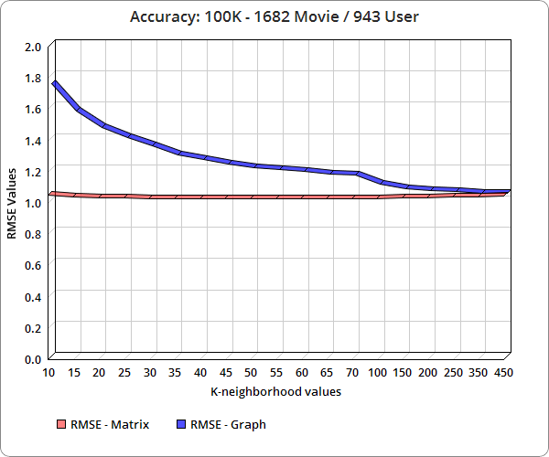
Experiment Result
K-neighborhood values | RMSE-Matrix | RMSE-Graph
10 | 1.04861122 | 1.742388
15 | 1.037894548 | 1.565377
20 | 1.032763404 | 1.460149
25 | 1.030238442 | 1.395637
30 | 1.028444872 | 1.340109
35 | 1.027688872 | 1.286397
40 | 1.027760522 | 1.255153
45 | 1.02776354 | 1.225625
50 | 1.027433409 | 1.204477
55 | 1.027637549 | 1.190593
60 | 1.028241791 | 1.177809
65 | 1.0286041 | 1.163393
70 | 1.028804371 | 1.152236
100 | 1.029211123 | 1.094498
150 | 1.029826424 | 1.065008
200 | 1.032013414 | 1.053908
250 | 1.036295234 | 1.047114
350 | 1.039103812 | 1.03857
450 | 1.041223454 | 1.036322
The RMSE accuracy is tested on MovieLens 100k dataset
Notes:
K la gi, k thay doi thi RE values se doi.
Vs k = 50 thi matrix ok nhat
Nhung vs graph thi k cang tang thi RMSE cang nho?

Slide 27
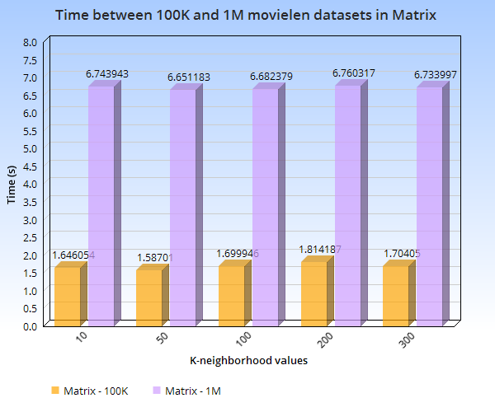
Experiment Result
K neighbor | MovieLen 100K |  | MovieLen 1M
 | Time
10 | 1.646053839 | 6.743942642 | 6.743942642
50 | 1.587010145 | 6.65118261 | 6.65118261
100 | 1.699946295 | 6.682378769 | 6.682378769
200 | 1.814186573 | 6.760316515 | 6.760316515
300 | 1.704050207 | 6.733996997 | 6.733996997
The Time between 100K and 1M movielen datasets in Matrix

Slide 28
Experiment Result
K | MovieLen 100K |  | MovieLen 1M
 | Worst Environment | Best Environment
 | dbms.memory.initial_size = 64mb | dbms.memory.initial.max_size = 3gb
 | dbms.memory.heap.max_size = 64mb | dbms.memory.heap.max_size = 3gb
 | dbms.memory.pagecache.size = 64mb | dbms.memory.pagecache.size = 3gb
10 | 6.062740755 | 3.464908648 | 3.018565941
 | dbms.memory.heap.max_size = 256mb
50 | 14.12811604 | 11.26191415 | 3.671197271
 | dbms.memory.heap.max_size = 512mb
100 | 22.71672974 | 20.3498989 | 5.635204047
 | dbms.memory.heap.max_size = 1024mb
200 | 38.32942591 | 35.052765 | 9.467647409
300 | 48.94541826 | 44.9792767 | 15.13639278
The time between 100K and 1M movielen datasets in Graph

Slide 29
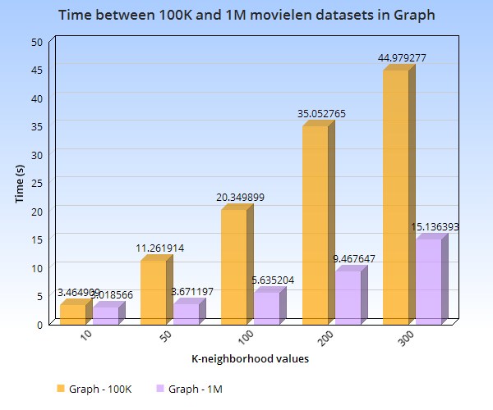
Experiment Result
The time between 100K and 1M movielen datasets in Graph

Slide 30
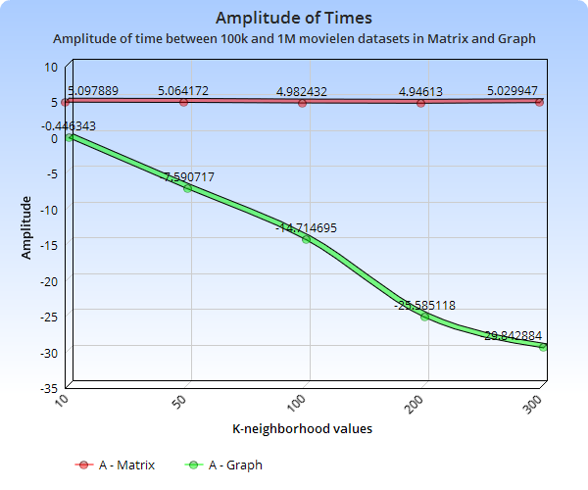
Experiment Result
Amplitude of time between 100K and 1M movielen datasets in Matrix and Graph

Slide 31
Conclusion
In industry 4.0, Big Data is one of the outstanding technologies that all countries, including Vietnam, are aiming for. I predict that the traditional recommendation system will be replaced by the graph-based recommendation system in the future, because They can handle with big data superbly.
Future work concerns a deeper analysis of particular mechanisms, new proposals to try different methods, or simply curiosity.
Sửa lại

Slide 32
References
Yunkyoung Lee, “Recommendation systems using collaborative filtering”, Thesis, San Jose State University, 2015.
Changping Meng, Reynold Cheng, Silviu Maniu, Pierre Senellart and Wangda Zang, “Discovering Meta-Paths in Large Heterogeneous Information Networks”, 2015.
Jiawei Han, “A Meta Path Based Approach for Similarity Search and Mining of Heterogeneous Information Networks”, Department of Computer Science , University of Illinois at Urbana-Champaign, August 2, 2012.
Yizhou Sun, Jiawei Han, Xifeng Yan, Philip S. Yu and Tianyi Wu, "PathSim: Meta Path-Based Top-K Similarity Search in Heterogeneous Information Networks", University of Illinois at Urbana-Champaign, Urbana, IL, University of California at Santa Barbara, Santa Barbara, CA, University of Illinois at Chicago, Chicago, IL, 2011.
Chenguang Wang, Yangqiu Song, Haoranli, Yizhou Sun, Ming Zhang, and Jiawei Han ,“Distant Meta-Path Similarities for Text-Based Heterogene ous Information Networks”

