Slide 1
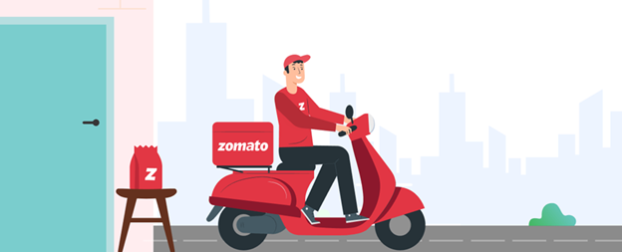
Zomato Delivery Analysis
Presenter: Huỳnh Vũ
Date: 27-May-2025

Slide 2
1. Introduction
With the rising demand for online food delivery services, companies like Zomato face increasing pressure to optimize logistics while maintaining high service standards. This project analyzes Zomato's delivery dataset.

Slide 3

2. Purpose
Evaluate key factors affecting delivery time and customer experience in Zomato’s delivery operations.
By applying data analytics and predictive modeling, the project seeks to understand how internal and external variables (e.g., traffic, vehicle condition, delivery personnel rating) influence delivery outcomes.
The insights will help inform operational decisions and improve efficiency.

Slide 4
3. Outcome
This project will provide a comprehensive, data-driven assessment of Zomato's delivery system. Expected outcomes include:
Identify key factors affecting delivery time and customer experience.
Analyze internal & external variables (traffic, vehicle, ratings) influencing outcomes.
Inform operational decisions and improve efficiency.

Slide 5
4. Dataset Information
Source: Zomato Delivery Dataset
https://www.kaggle.com/datasets/saurabhbadole/zomato-delivery-operations-analytics-dataset
Delivery staff
Delivery_person_ID
Delivery_person_Age
Delivery_person_Ratings
Vehicles
Vehicle_condition
Type_of_vehicle
Multiple_deliveries
Order timing
Time_Ordered
Type_of_order
Festival
Weather and traffic conditions
Weather_conditions
Road_traffic_density
Area
Restaurant_latitude/longitude
Delivery_location_latitude/longitude
City

Slide 6
5. Tools and Technologies
- Python (Pandas, Matplotlib, Seaborn)
- Jupyter Notebook for scripting
- Power BI for interactive dashboards.

Slide 7
6.1 Analysis Plan - Preparation
- Fix types
- Handle missing values (median/mode)
- Standardize strings
- Handle outliers

Slide 8
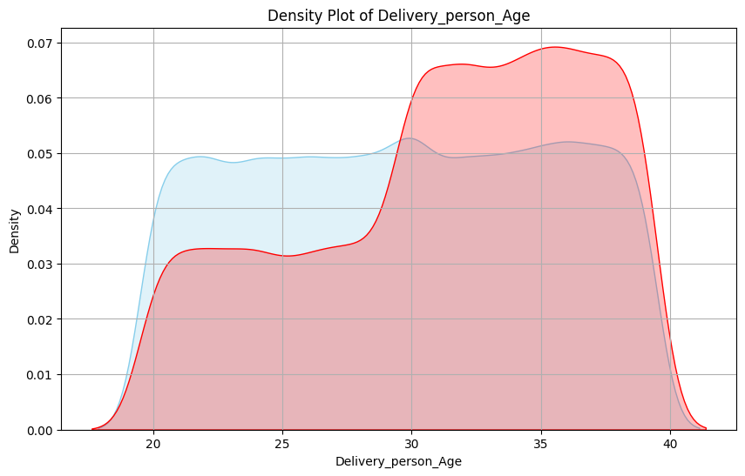
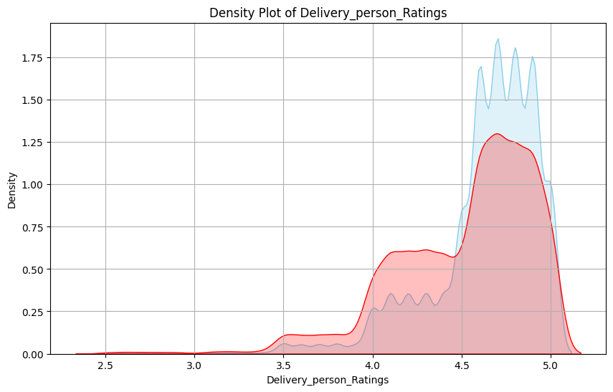
6.2 Analysis Plan - EDA
Delivery staff
>>>> Insight: Employees aged 29 and under have a faster delivery time rate.
>>>> Insight: Faster delivery times tend to receive higher ratings.

Slide 9
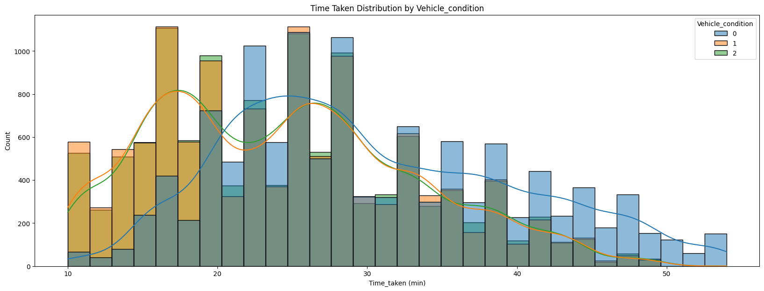
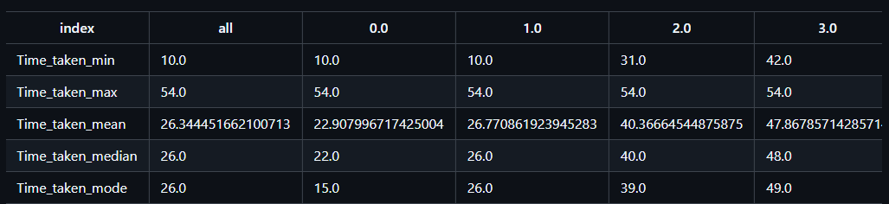
6.2 Analysis Plan - EDA
Vehicles
>>>> Insight: The condition of the vehicle affects the delivery time. A good vehicle condition ensures faster delivery.
>>>> Insight: Multiple deliveries affect the delivery time.

Slide 10
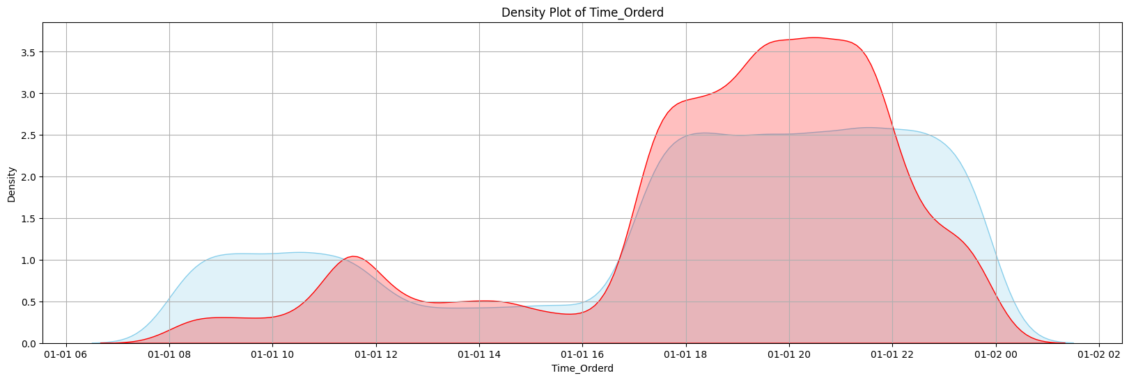
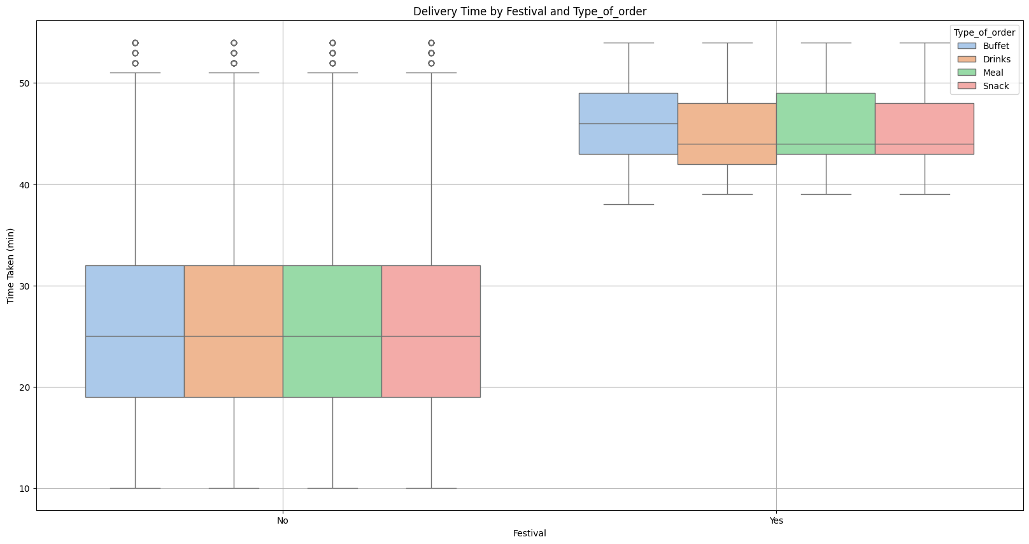
6.2 Analysis Plan - EDA
Order - Timing
>>>> Insight: The time frame from 5 PM to 10 PM has a longer delivery rate than average.
>>>> Insight: Delivery times during the Festival are always higher.

Slide 11
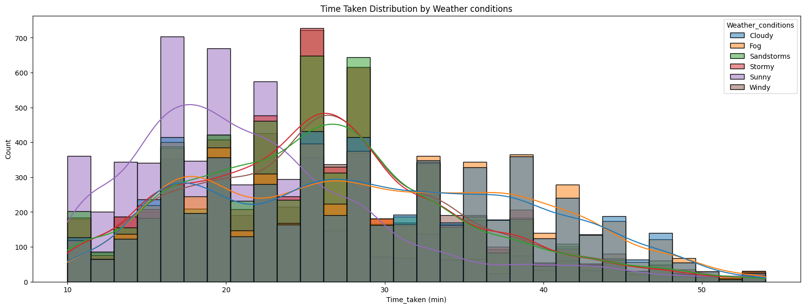
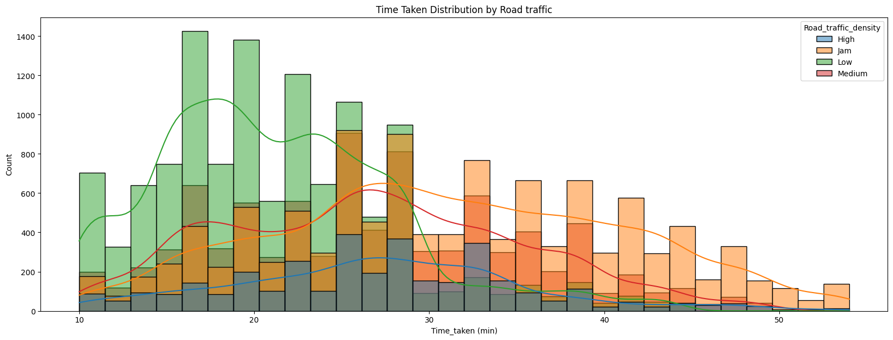
6.2 Analysis Plan - EDA
Weather and Traffics
>>>> Insight: Weather conditions affect delivery time, sunny is the best.
>>>> Insight: Road Traffic affect delivery time.

Slide 12
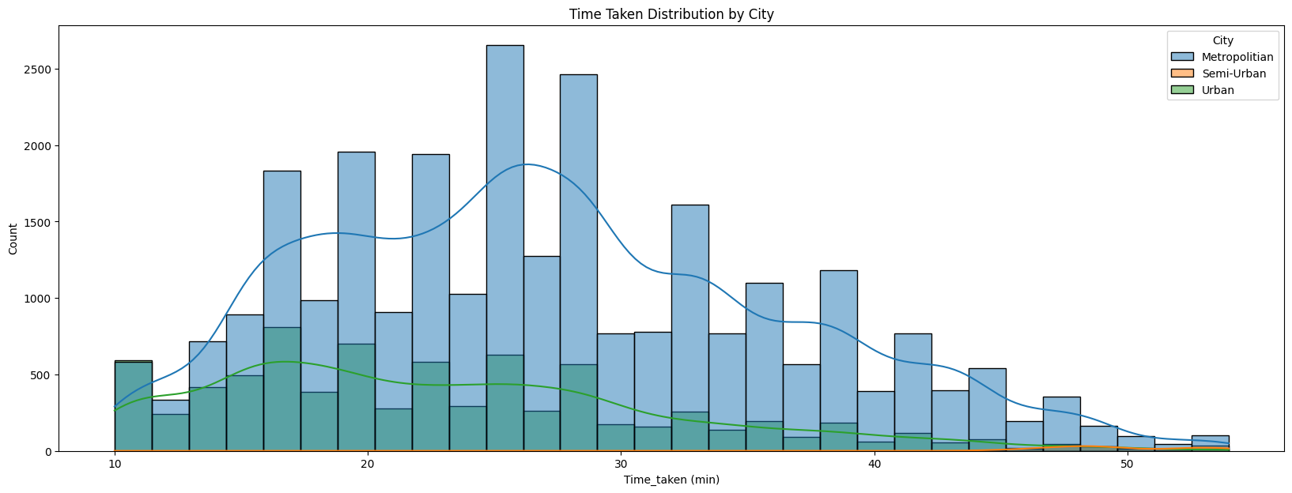
6.2 Analysis Plan - EDA
Area
>>>> Insight: Semi-Urban have Time - Taken is so high.

Slide 13
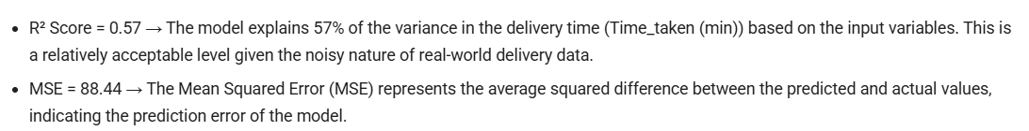
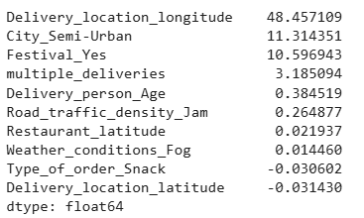
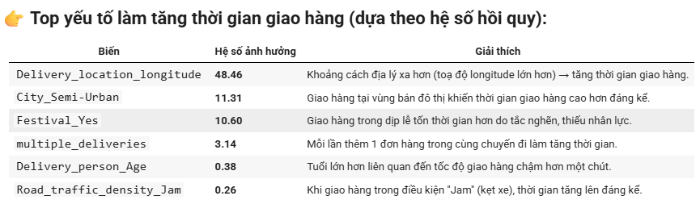
6.2 Analysis Plan - EDA
Linear Progression

Slide 14
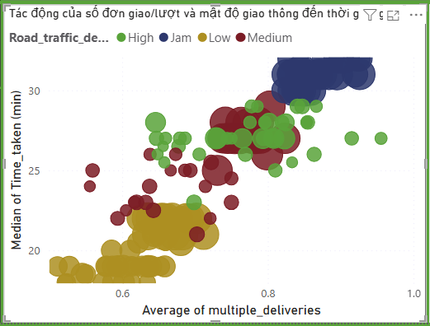
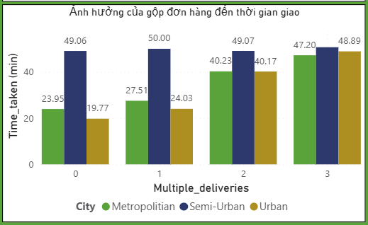
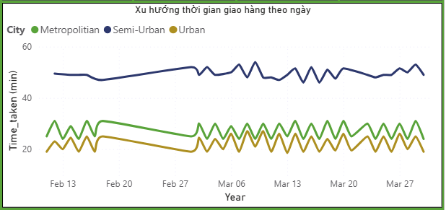
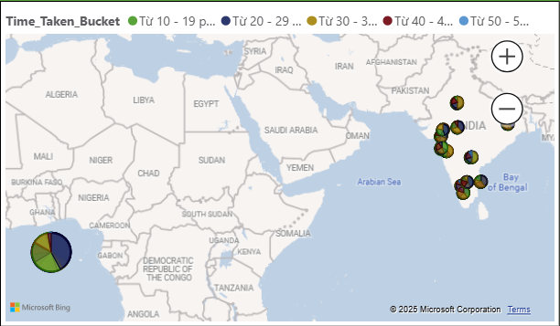
6.3 Visualization and Reporting

Slide 15
7. Conclusions
Delivery staff
Vehicles
Order timing
Delivery_person_Age:
Employees aged 29 and under have a faster delivery time rate.
Delivery_person_Ratings:
Faster delivery times tend to receive higher ratings.
Vehicle_condition:
The condition of the vehicle affects the delivery time. A good vehicle condition ensures faster delivery.
Multiple_deliveries:
Multiple deliveries affect the delivery time.
Time_Orderd :
The time frame from 5 PM to 10 PM has a longer delivery rate than average.
Festival :
Delivery times during the Festival are always higher.
Weather and traffic condition
Area
Weather_conditions :
Weather conditions affect delivery time, sunny is the best.
Road_traffic_density :
Road Traffic affect delivery time.
City :
Semi-Urban have Time - Taken is so high.

Slide 16
8. Recommendations
Delivery staff
Vehicles
Order timing
Delivery_person_Age:
Prioritize recruiting younger delivery personnel (under 28 years old) or conduct training programs focused on improving delivery speed for older staff.
Delivery_person_Ratings:
Introduce performance-based incentives tied to high customer ratings.
Vehicle_condition:
Implement mandatory regular maintenance for all delivery vehicles, particularly those with poor condition scores (0 or 1).
Introduce incentive policies for drivers to use newer or better-maintained vehicles, boosting overall delivery performance.
Multiple_deliveries:
Limit the number of orders per trip when route optimization is not feasible.
Use smart order allocation algorithms to minimize average delivery time for multiple orders.
Time_Orderd:
Peak Hours (5 PM – 10 PM): Increase delivery personnel by at least 20–30% to mitigate delays during this time frame.
Prioritize delivery of snacks or beverages during morning and midday slots, when delivery times are generally lower.
Festival:
There is a need to plan for staffing for the Festival.

Slide 17
8. Recommendations
Weather and traffic condition
Area
Weather_conditions:
Monitor weather conditions to adjust staffing and routing strategies, especially during festival days.
Road_traffic_density:
Deploy real-time routing systems, integrating traffic and weather data to avoid congested or adverse areas (e.g., high traffic density or bad weather).
Train delivery personnel on identified fast routes based on data analysis.
City:
Deploy more resources to Semi-Urban areas to improve delivery speed, as these regions show longer delivery times.

Slide 18
9. Q&A

Slide 19



