Slide 1
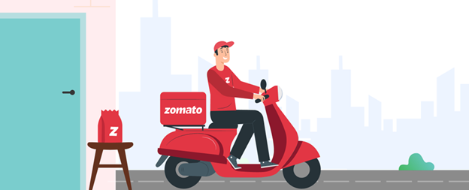
Zomato Delivery Analysis
Presenter: Huỳnh Vũ
Date: 27-May-2025

Slide 2
1. Introduction
With the rising demand for online food delivery services, companies like Zomato face increasing pressure to optimize logistics while maintaining high service standards. This project analyzes Zomato's delivery dataset.

Slide 3

2. Purpose
Evaluate key factors affecting delivery time and customer experience in Zomato’s delivery operations.
By applying data analytics and predictive modeling, the project seeks to understand how internal and external variables (e.g., traffic, vehicle condition, delivery personnel rating) influence delivery outcomes.
The insights will help inform operational decisions and improve efficiency.

Slide 4
3. Outcome
This project will provide a comprehensive, data-driven assessment of Zomato's delivery system. Expected outcomes include:
Identify key factors affecting delivery time and customer experience.
Analyze internal & external variables (traffic, vehicle, ratings) influencing outcomes.
Inform operational decisions and improve efficiency.

Slide 5
4. Dataset Information
Source: Zomato Delivery Dataset
https://www.kaggle.com/datasets/saurabhbadole/zomato-delivery-operations-analytics-dataset
Delivery staff
Delivery_person_ID
Delivery_person_Age
Delivery_person_Ratings
Vehicles
Vehicle_condition
Type_of_vehicle
Multiple_deliveries
Order timing
Time_Ordered
Type_of_order
Festival
Weather and traffic conditions
Weather_conditions
Road_traffic_density
Area
Restaurant_latitude/longitude
Delivery_location_latitude/longitude
City

Slide 6
5. Tools and Technologies
- Python (Pandas, Matplotlib, Seaborn)
- Jupyter Notebook for scripting
- Power BI for interactive dashboards.

Slide 7
6.1 Analysis Plan - Preparation
- Fix types
- Handle missing values (median/mode)
- Standardize strings
- Handle outliers

Slide 8
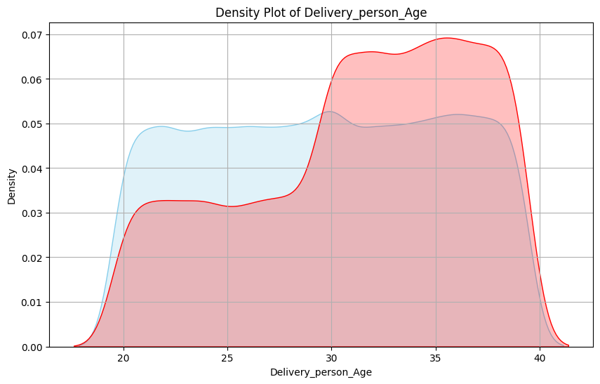
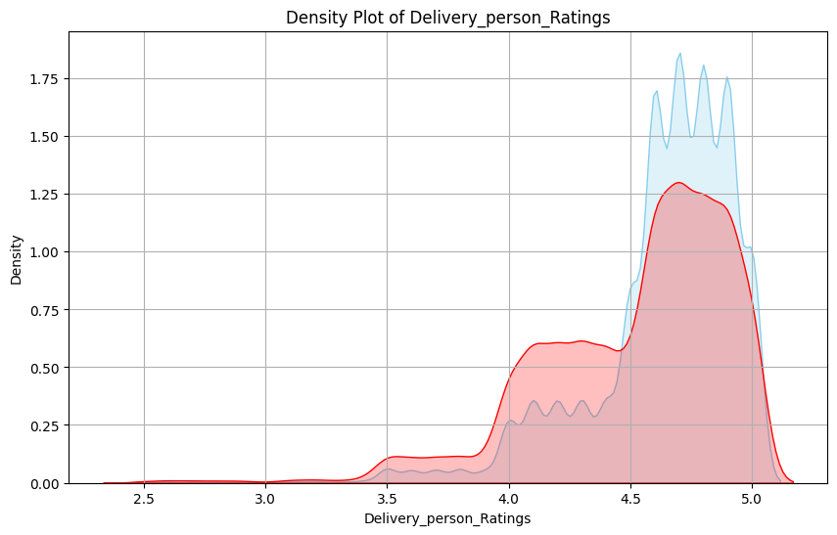
6.2 Analysis Plan - EDA
Delivery staff
>>>> Insight: Employees aged 29 and under have a faster delivery time rate.
>>>> Insight: Faster delivery times tend to receive higher ratings.

Slide 9
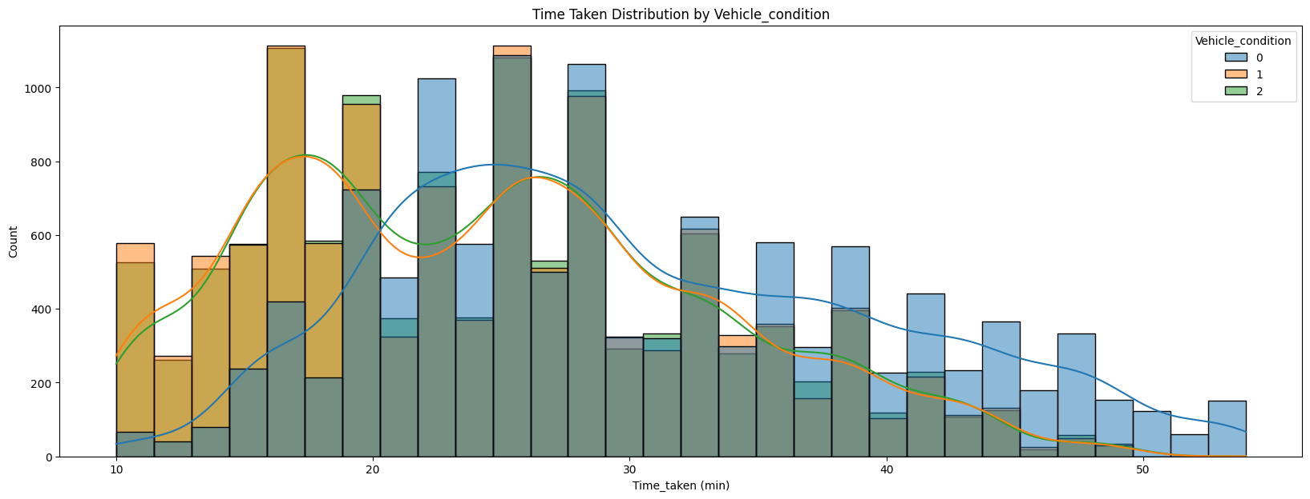
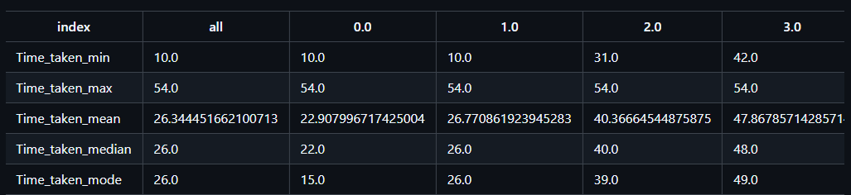
6.2 Analysis Plan - EDA
Vehicles
>>>> Insight: The condition of the vehicle affects the delivery time. A good vehicle condition ensures faster delivery.
>>>> Insight: Multiple deliveries affect the delivery time.

Slide 10
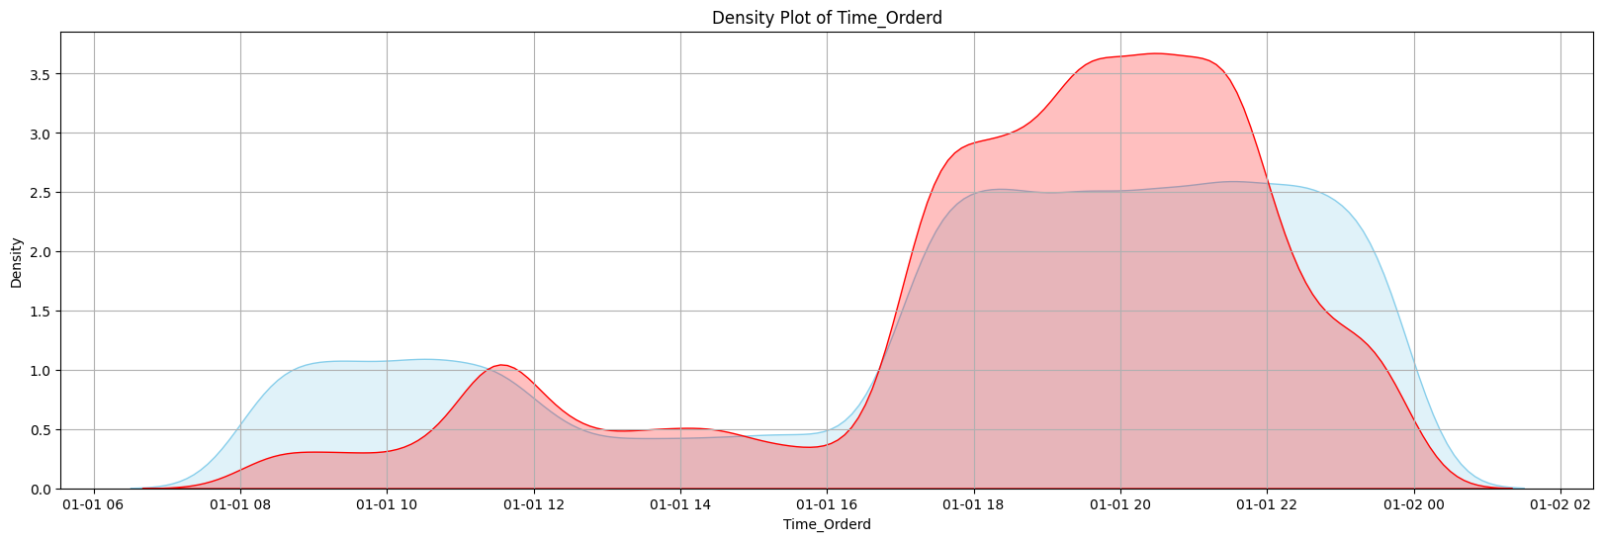
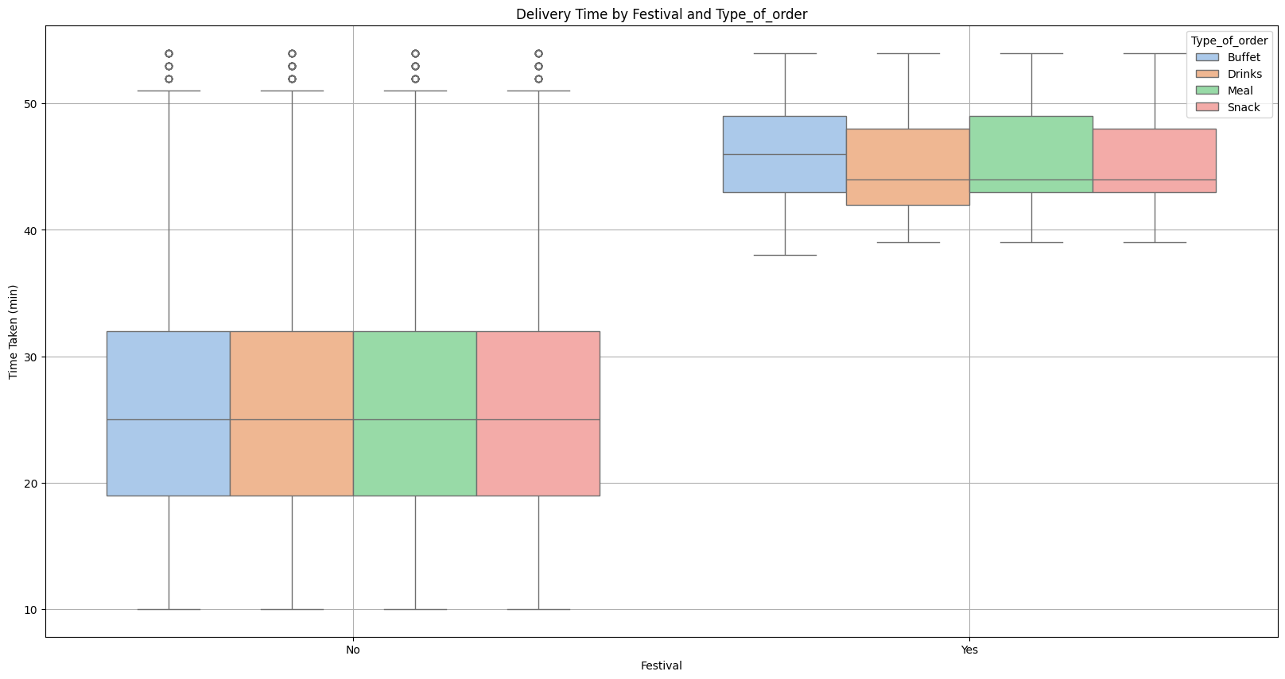
6.2 Analysis Plan - EDA
Order - Timing
>>>> Insight: The time frame from 5 PM to 10 PM has a longer delivery rate than average.
>>>> Insight: Delivery times during the Festival are always higher.

Slide 11
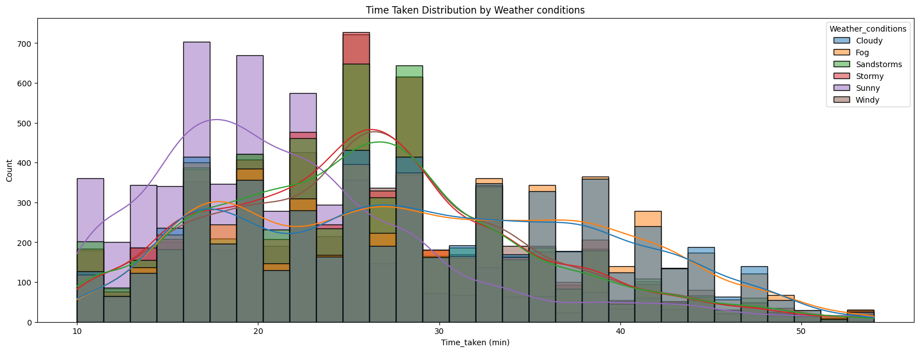
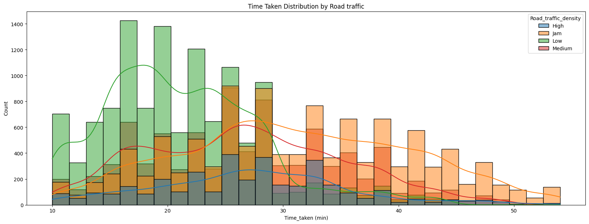
6.2 Analysis Plan - EDA
Weather and Traffics
>>>> Insight: Weather conditions affect delivery time, sunny is the best.
>>>> Insight: Road Traffic affect delivery time.

Slide 12
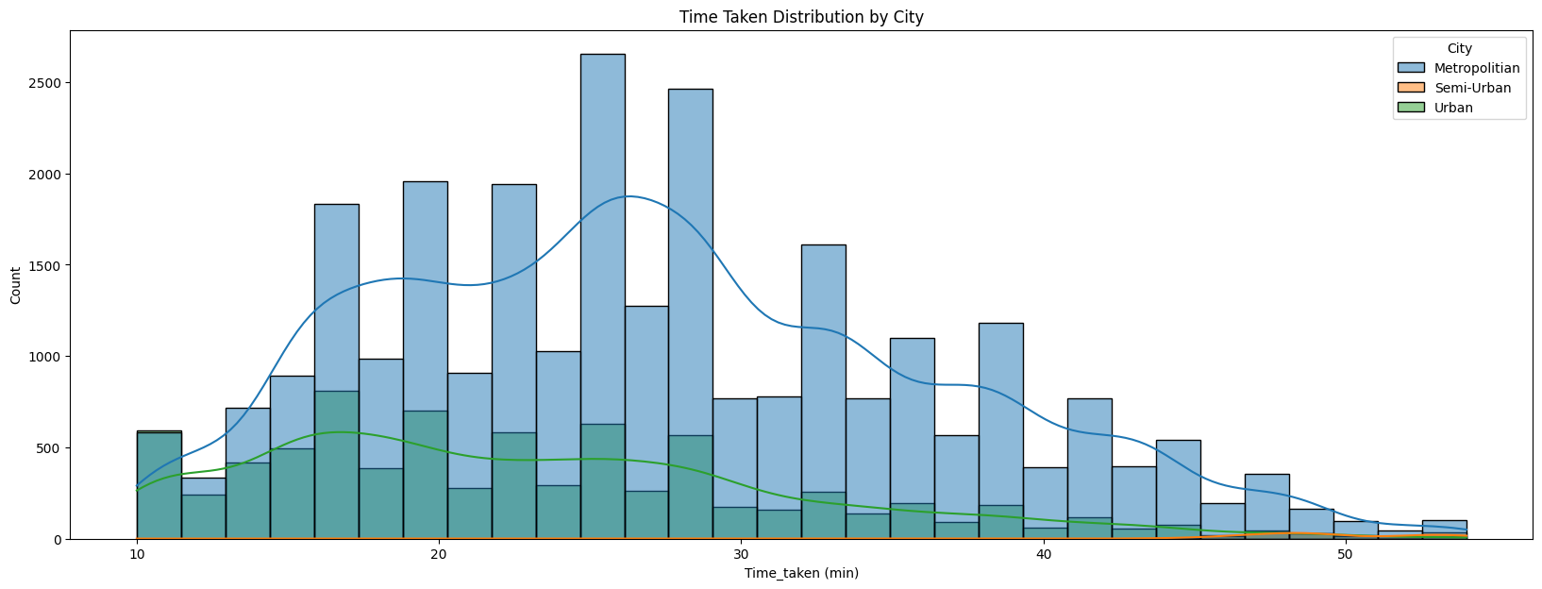
6.2 Analysis Plan - EDA
Area
>>>> Insight: Semi-Urban have Time - Taken is so high.

Slide 13
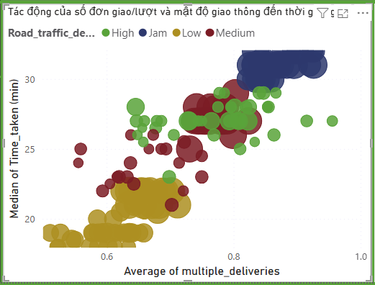
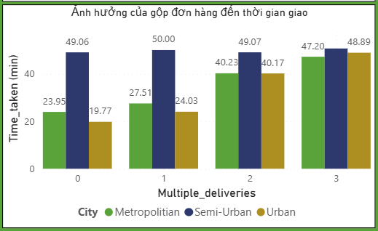
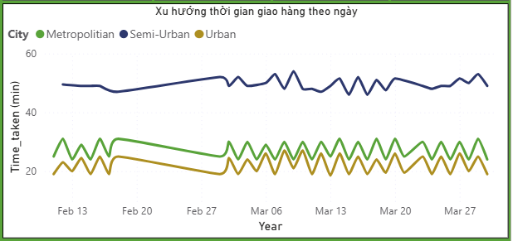
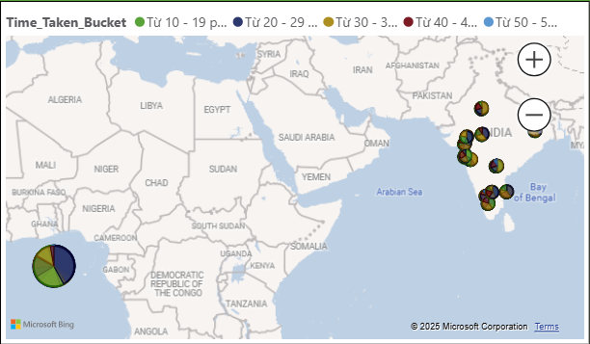
6.3 Visualization and Reporting

Slide 14
6.4 Predictive model
Linear Progression
R² Score = 0.57 → Mô hình giải thích được 57% phương sai của biến phụ thuộc (thời gian giao hàng). Đây là mức tương đối khá, cho thấy mô hình đã nắm bắt được phần lớn xu hướng dữ liệu, nhưng vẫn còn 43% phương sai chưa giải thích được. Điều này có thể do:
✔️ Chưa đưa vào đầy đủ các biến đầu vào quan trọng (ví dụ: chi tiết quãng đường, loại hàng hóa).
✔️ Mối quan hệ giữa các biến và thời gian giao hàng có thể phi tuyến tính, cần các mô hình phi tuyến để cải thiện.MSE = 38.44 → Sai số trung bình bình phương của dự báo khá thấp, cho thấy mô hình dự đoán gần đúng so với thực tế, tốt hơn so với các lần thử trước (ví dụ MSE = 88.44, 39.84).

Slide 15
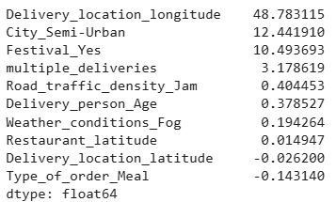
6.4 Predictive model
Linear Progression
Delivery_location_longitude (48.78): The longitude coordinate has a strong and positive effect on delivery time – meaning that as the delivery location’s longitude increases, the delivery time also increases significantly. This may reflect the additional time needed to reach farther delivery points along the longitude direction.
City_Semi-Urban (12.44): Deliveries in semi-urban areas significantly increase delivery time compared to other regions.
Festival_Yes (10.49): During festivals, delivery time increases by approximately 10.5 minutes on average – due to higher traffic volumes and increased demand.
Multiple_deliveries (3.18): Each instance of multiple deliveries in a single trip increases delivery time by approximately 3.2 minutes, reflecting the additional handling and routing involved.
Road_traffic_density_Jam (0.40): Traffic jams increase delivery time by approximately 0.4 minutes – a minor but notable impact.
Delivery_person_Age (0.38): Older delivery personnel tend to take longer to deliver, though the effect is relatively small.
Weather_conditions_Fog (0.19): Foggy conditions slightly increase delivery time – the impact is smaller compared to festivals or semi-urban areas.
Restaurant_latitude (0.01): The latitude coordinate of the restaurant has a small effect on delivery time.
Delivery_location_latitude (-0.026): Conversely, the latitude of the delivery location slightly reduces delivery time, but the effect is very small.
Type_of_order_Meal (-0.14): Meal orders tend to slightly reduce delivery time – likely because meal orders are simpler and quicker to handle.
COEF

Slide 16
7. Conclusions
🧑‍🔧Delivery staff
🚚 Vehicles
⏰Order - Timing
Younger delivery personnel (under 29) tend to have faster delivery times.
Higher customer ratings are associated with quicker deliveries.
Older delivery personnel generally take longer to complete deliveries.
Good vehicle condition contributes to reduced delivery times.
Poor vehicle condition can increase delivery time.
Multiple deliveries in one trip increase average delivery time.
Peak hours (5 PM – 10 PM) and festival periods are associated with higher delivery times due to increased demand and traffic.
Delivery times during the Festival are always higher.
🌦️Weather and traffic
🔴Area
📈Predictive Model
Good weather (sunny) leads to shorter delivery times, while foggy conditions can extend delivery duration.
Traffic jams slightly increase delivery times but are noteworthy.
Delivery time in semi-urban areas is significantly higher than in other regions.
This may be due to more complex infrastructure or less optimized delivery routes.
Key factors influencing delivery time:
✔️ Delivery_location_longitude (farther longitude points increase time)
✔️ City_Semi-Urban (semi-urban areas)
✔️ Festival (during festivals)
✔️ multiple_deliveries (multiple orders per trip)

Slide 17
8. Recommendations
📈 Staff & Training
Prioritize recruiting younger delivery personnel (under 28) or provide targeted training for older staff to improve delivery speed.
Implement performance-based incentives tied to high customer ratings.
🚚 Vehicles & Maintenance
Enforce regular maintenance for all vehicles, especially those with poor condition scores.
Offer incentives for drivers to use newer or well-maintained vehicles.
📦 Order Management
Limit the number of multiple deliveries per trip to avoid delays.
Use smart order allocation algorithms to optimize routing and minimize delivery time.
⏰ Order Timing & Demand Management
Increase delivery staff by 20–30% during peak hours (5–10 PM) and festivals.
Prioritize fast delivery of smaller items (snacks, beverages) during off-peak hours.
🌦️ Weather & Traffic Management
Monitor real-time traffic and weather conditions, especially during festivals.
Adjust staffing and routing strategies dynamically based on data.
Train drivers on efficient routes identified from data analysis.
🌍 Area-specific Strategies
Allocate more resources to semi-urban areas where delivery times are consistently longer.
Develop area-specific optimization plans, including route planning and resource allocation.
🗺️ Geolocation-based Improvements
Consider the strong impact of delivery_location_longitude on delivery times.
Use dynamic geolocation-based planning to minimize time increases for farther destinations.

Slide 18
9. Q&A

Slide 19



