Slide 1

Link Quality Estimation for Industrial Wireless Sensor Network using Burstiness Distribution Metric
by
Ngoc Huy Nguyen
Supervisor: Prof. Myung Kyun Kim
UNIVERSITY OF ULSAN
Thesis presentation in partial fulfillment of the Requirements for a Degree of Master
Nov 27, 2020

Slide 2
Presentation Outline
1. Introduction
2. Related Work
3. Our Proposal
4. Performance Evaluation
5. Conclusion

Slide 3
Presentation Outline
1. Introduction
2. Related Work
3. Our Proposal
4. Performance Evaluation
5. Conclusion

Slide 4
Introduction
Industrial wireless sensor networks are deployed in many applications:
  Environment monitoring
  Smart factory
  Healthcare
  Radiation checks, leakage detection
  Process and control application.
Reliability of data transmission is the most important in designing a protocol of Industrial wireless sensor networks.
Many studies tried to improve the reliability of data transmission on wireless sensor networks by improving the physical layer [1], MAC protocol [2], and routing protocol [3-6].

Slide 5
Introduction
However, the previous study does not consider the effect of link quality, they assume that the link quality is always stable.
In the real application, the link quality is not very stable and it can be varying depending on the environment and time.
→ It is necessary to study a link quality measurement that is low complexity computational, low energy consumption but it can guarantee reliability for industrial wireless sensor networks.

Slide 6
Introduction
In this study, we study and examine the effect of the link quality on designing a MAC protocol of wireless sensor networks.
We propose a link quality estimation metric based on:
  Counting the number of consecutive loss packet happenings in each link at the receiver node.
  Makes the distribution of burstiness of each link.
From new link quality estimation → We propose a metric called Burstiness Distribution Metric to estimate the number of transmission for archiving a target packet reception rate.

Slide 7
Presentation Outline
1. Introduction
2. Related Work
3. Our Proposal
4. Performance Evaluation
5. Conclusion

Slide 8
Related work
Link quality estimators (LQE) can be divided into two groups:
  Hardware-based estimators
    does not require the computation resources.
    directly obtained from the hardware.
    Ex: Link Quality Indicator (LQI), Received Signal Strength Indicator (RSSI), Signal-to-Noise Ratio (SNR), …
  Software-based estimators
    based on the calculated information from the upper layer.
    count or estimate either the rate of reception or the average number of (re)transmissions of packets needed before their complete reception.
    Ex: Packet Reception Rate (PRR), Expected Transmission Count (ETX), Four-Bit (FB), …

Slide 9
Related work
Some studies used hardware-based metrics to evaluate the link quality:
  HJ Audéoud et al. [7] studied the correlation between the RSSI, LQI, and PRR.
    RSSI is a poor indication, loosely correlated with PRR.
    The LQI can gives more information.
    However, LQI may overestimate the channel quality in scenarios with impulsive noise, since the LQI does not account for the packet loss.
  Gomes et al. [8] proposed a new type of node, the LQE node to estimating the link quality in real-time.
    They use the RSSI and LQI values to infer the PRR of the given links.
    However, RSSI and PRR have been proved to be only loosely correlated in many situations.

Slide 10
Related work
Some studies used software-based metrics to evaluate the link quality:
  The ETX [9] is a receiver-initiated estimator that uses active monitoring using PRR backward and PRR forward.
    However, ETX fails in congested networks since a large number of nodes are not able to compute the ETX because they do not receive packets.
  The Four-Bit (FB) [10] link estimation is designed with four bits of information.
    However, they are not considering the burstiness link during their measurements.

Slide 11
Link burstiness research overview
Link burstiness is a physical property which implies that transmissions on a wireless link do not have an independent probability of failure, they have consecutive message loss in a burst.
Somes studies try to solve the burstiness link problem:
  Srinivasan et al. [11] presented a new metric called β to measure the link burstiness
    We can avoid link burstiness by having an inter-packet delay of 500 ms.
    However, 500ms of delay is a disadvantage for the network performance.

Slide 12
Link burstiness research overview
  Munir et al. [12] propose a new metric called maximum burst length (Bmax) as the maximum length of error burst.
    Bmax estimated by using empirical data for a long experiment.
    However, the algorithm to calculate Bmax value based on long experiment data-trace before constructing their network. → It makes this algorithm hard to apply to the ad-hoc network.
    This algorithm uses the number of retransmissions for a packet is larger, so it increases end-to-end delay.

Slide 13
Presentation Outline
1. Introduction
2. Related Work
3. Our Proposal
4. Performance Evaluation
5. Conclusion

Slide 14
Measure Link Quality Principles
P(x, seqno(x))
x
y
P(y, seqno(y))
To measure link between 2 nodes x, y:
  Each node generate probe packet P(node id, seqno)
  seqno: increase from 1 to predefined Number of Probes
  When the sensor node x received the probe packet P(y, seqno(y)) from node y
    It saves node y and seqno(y) to its neighbor list (nbrlist) if node y not belong to x’s nbrlist.
    If node y belong x’s nbrlist, node x will calculate the burstiness value refer to node y as follows :
    burstiness_value (y) = seqno(y) – nbrlist[y].seqno(y) - 1
    in which, seqno(y): the sequence number get from new incoming probe packet from node y, nbrlist[y].seqno(y): the previous sequence number of node y saved in the neighbor list.

Slide 15
Measure Link Quality Principles
P(x, seqno(x))
x
y
P(y, seqno(y))
We use Burstiness Distribution List (BDL) to save the distribution of burstiness value for each neighbor:
  The BDL contains a pair of burstiness value and burstiness time count.
  Burstiness time count is the time the burstiness value is reproduced.
  After calculate burstiness_value(y), node x will check this value as follows:
    The burstiness_time_count(y) refer to burtiness_value(y) set to 1, then pair (burstiness_value(y), burstiness_time_count(y)) will be saved in node y’s BDL if this value does not belong to node y’s BDL.
    If burtiness_value(y) is belong to node y’s BDL, node x will increase the burtiness_time_count(y) refer to burstiness_value(y) one.
    Then update the seqno(y) value in the neighbor list.
  This process will repeat during the measure link quality period.

Slide 16
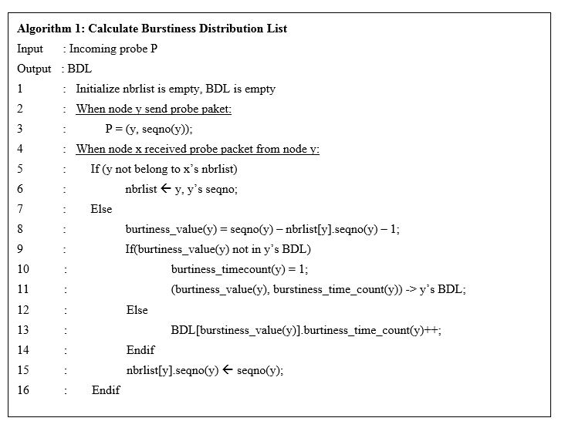
Calculate Burstiness Distribution List
1
P(2, 1)
2
Ex: Consider node 1 and node 2
Assume node 1 receives first probe packet P(2, 1)
Node 1 saves node 2 and seqno(2) to its neighbor list: nbrlist = {(2, 1)};
Node 2 generates P(2, 2), P(2, 3) assume that node 1 failed to receive these probe packet.
Then next received probe in node 1 is P(2, 4)
burstiness_value(2) = 4 – 1 – 1 = 2
burstiness_time_count(2) = 1;
Node 1 add pair (2, 1) to BDL refer to neighbor Node 2.
Node 1 update seqno(2) in neighbor list: nbrlist = {(2, 4)}

Slide 17
Calculate Burstiness Distribution List
1
P(2, 7)
2
Ex: Consider node 1 and node 2
Node 2 continue generates P(2, 5), P(2, 6) assume that node 1 failed to receive these probe packet.
Then next received probe in node 1 is P(2, 7)
burstiness_value(2) = 7 – 4 – 1 = 2
exists in BDL, only update BDL pair (2, 1) to (2, 2)

Slide 18
Calculate Burstiness Distribution List
1
P(2, n)
2
We repeat this process until finish measure link quality period.(reach the number of probe packets).
Finally, we have BDL for each neighbor as follows (with 1000 probe packets):
Burstiness value | 0 | 1 | 2 | 3 | 4
Burstiness time count | 634 | 129 | 31 | 2 | 1
Table 1. The example of Burstiness Distribution List.

Slide 19
Burstiness Distribution compare with link PRR
Good link: the burstiness value will be small while the burstiness time count will be large at the min burstiness value.
Bad link: the higher burstiness value and the burstiness time count will be low at the min burstiness value.
Fig 1. The distribution of Burstiness compare with link PRR

Slide 20
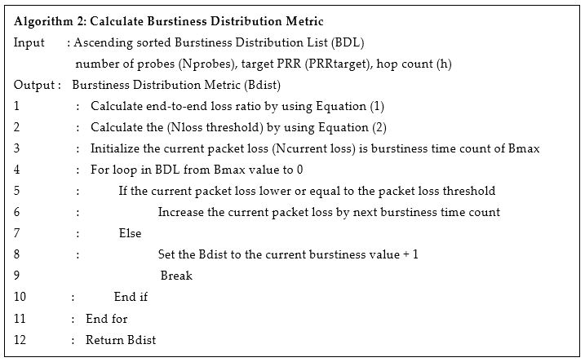
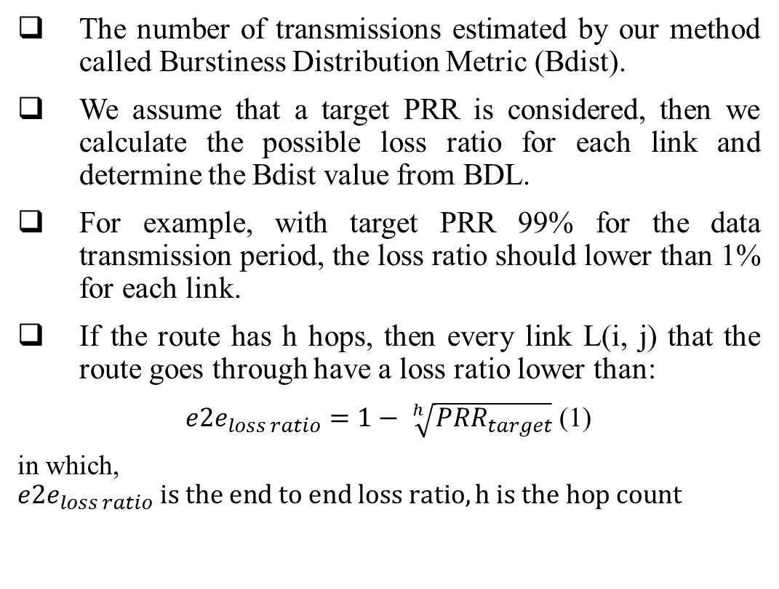
Calculate Burstiness Distribution Metric
The number of transmissions estimated by our method called Burstiness Distribution Metric (Bdist).
We assume that a target PRR is considered, then we calculate the possible loss ratio for each link and determine the Bdist value from BDL.
For example, with target PRR 99% for the data transmission period, the loss ratio should lower than 1% for each link.
If the route has h hops, then every link L(i, j) that the route goes through have a loss ratio lower than:
${e2e}_{loss ratio}=1− \sqrt[h]{{PRR}_{target}}$ (1)
in which, ${e2e}_{loss ratio} is the end to end loss ratio, h is the hop count$

Slide 21
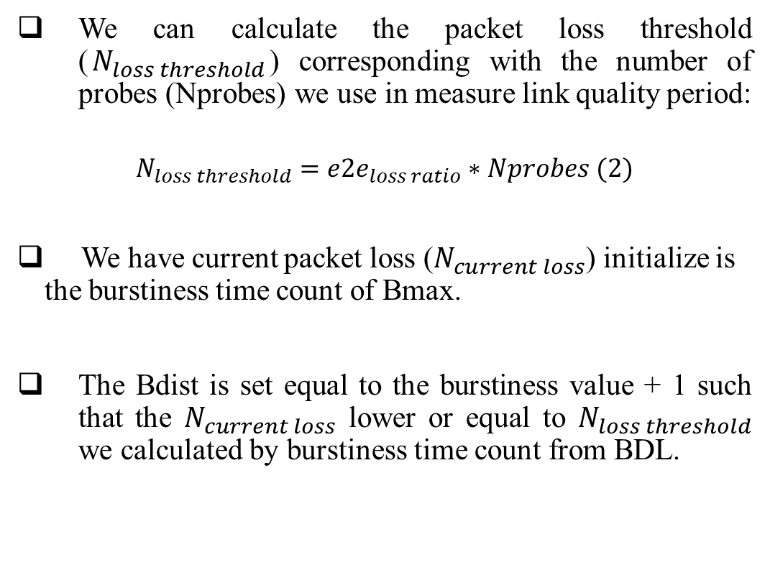
Calculate Burstiness Distribution Metric
We can calculate the packet loss threshold ($N_{loss threshold}$) corresponding with the number of probes (Nprobes) we use in measure link quality period:
$$N_{loss threshold}={e2e}_{loss ratio}∗Nprobes (2)$$
We have current packet loss ($N_{current loss}$) initialize is the burstiness time count of Bmax.
The Bdist is set equal to the burstiness value + 1 such that the $N_{current loss}$ lower or equal to $N_{loss threshold}$ we calculated by burstiness time count from BDL.

Slide 22
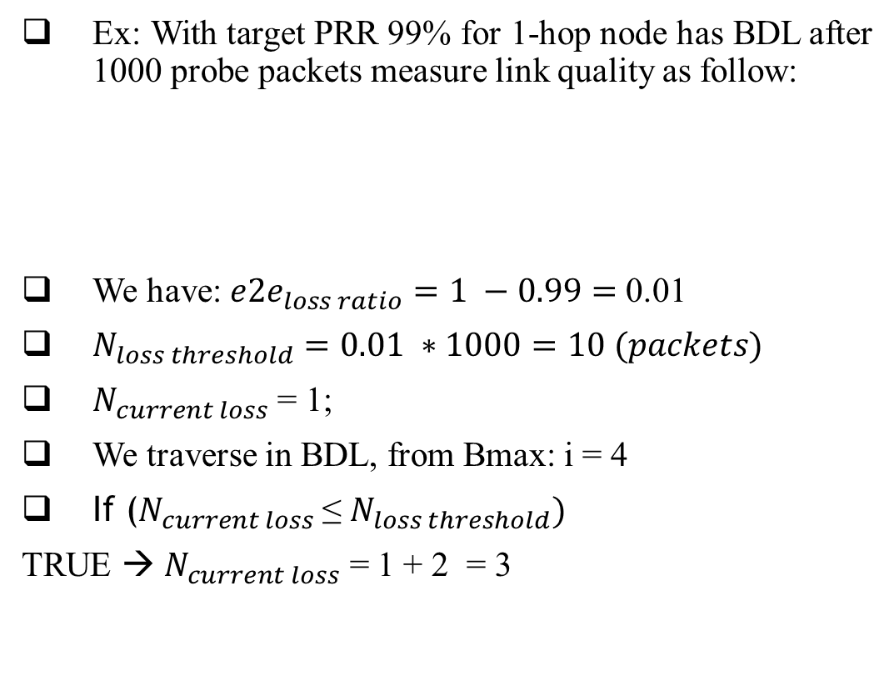
Calculate Burstiness Distribution Metric
Ex: With target PRR 99% for 1-hop node has BDL after 1000 probe packets measure link quality as follow:
We have: ${e2e}_{loss ratio}=1 −0.99=$0.01
$N_{loss threshold}=0.01 ∗1000=10 (packets)$
$N_{current loss}$ = 1;
We traverse in BDL, from Bmax: i = 4
If ($N_{current loss}$≤ $N_{loss threshold})$
TRUE → $N_{current loss}$ = 1 + 2 = 3
Burstiness value | 0 | 1 | 2 | 3 | 4
Burstiness time count | 634 | 129 | 31 | 2 | 1

Slide 23
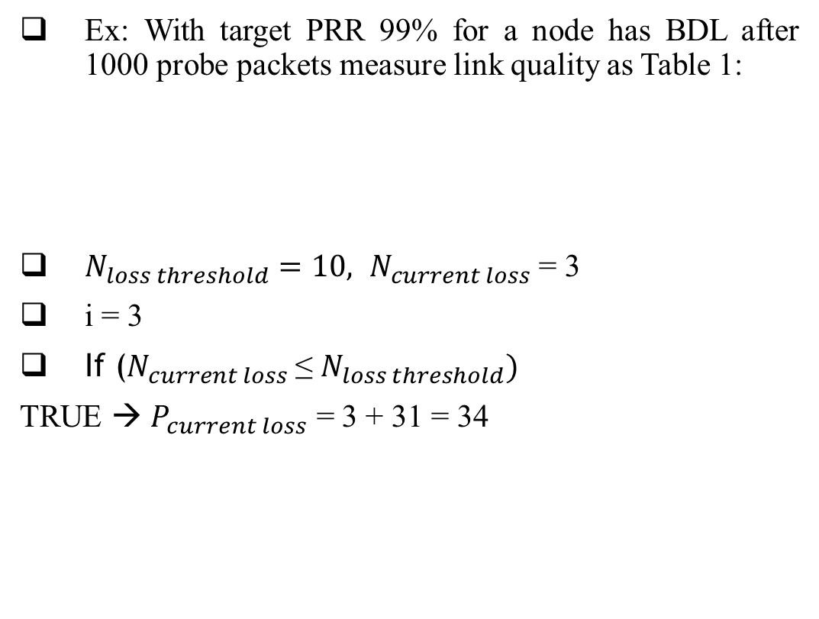
Calculate Burstiness Distribution Metric
Ex: With target PRR 99% for a node has BDL after 1000 probe packets measure link quality as Table 1:
${N_{loss threshold}=10, N}_{current loss}$ = 3
i = 3
If ($N_{current loss}$≤ $N_{loss threshold})$
TRUE → $P_{current loss}$ = 3 + 31 = 34
Burstiness value | 0 | 1 | 2 | 3 | 4
Burstiness time count | 634 | 129 | 31 | 2 | 1

Slide 24
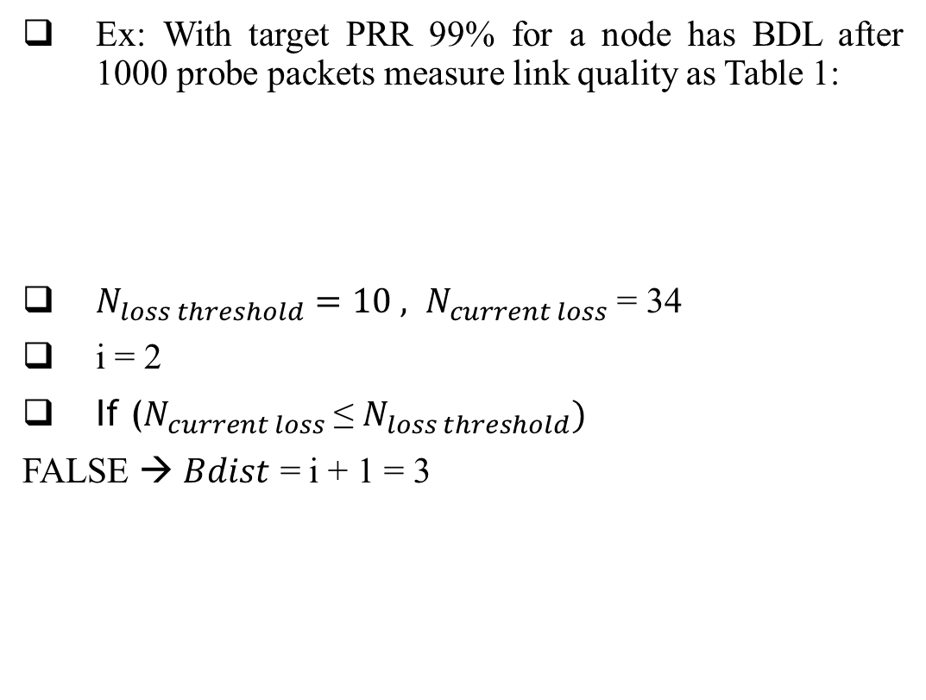
Calculate Burstiness Distribution Metric
Ex: With target PRR 99% for a node has BDL after 1000 probe packets measure link quality as Table 1:
$N_{loss threshold}=10 , N_{current loss}$ = 34
i = 2
If ($N_{current loss}$≤ $N_{loss threshold})$
FALSE → $Bdist$ = i + 1 = 3
Burstiness value | 0 | 1 | 2 | 3 | 4
Burstiness time count | 634 | 129 | 31 | 2 | 1

Slide 25
Presentation Outline
1. Introduction
2. Related Work
3. Our Proposal
4. Performance Evaluation
5. Conclusion

Slide 26
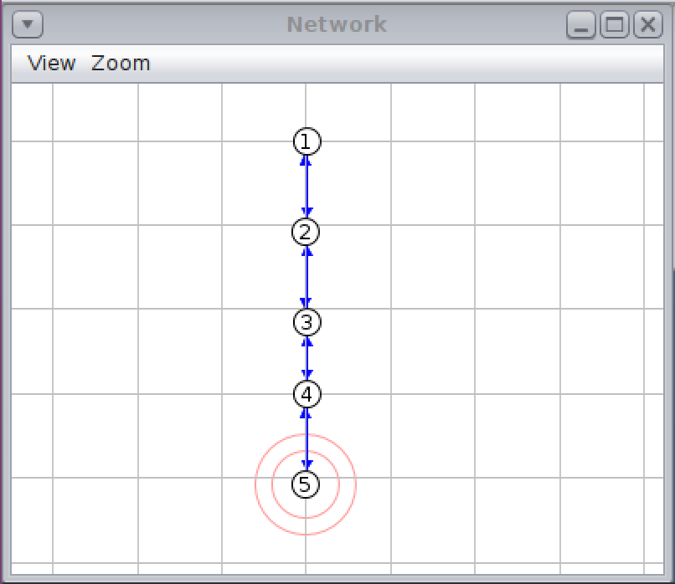
Effect of the hop count on network performance
A simple linear network with the hop count varying from 1 to 4 is considered.
The link quality of each between two nodes is set 90%.
In which we compare our proposed with some schemes such as ETX, PRR. Each scheme estimates the number of transmissions by itself.
We will examine the Data PRR at the sink with each value of the hop count.
90%
90%
90%
90%
Fig 2. Linear network.

Slide 27
Effect of the hop count on network performance
Scheme | ETX | PRR | Bdist
1 | 3 | 2 | 3
2 | 4 | 3 | 3
3 | 4 | 3 | 3
4 | 4 | 3 | 4
Hop count
Table 2. Number of transmissions estimate by each scheme.
Fig 3. Effect of the hop count on network performance.
From Fig 3, we can see that our proposed scheme and ETX scheme archive very high Data PRR even at the highest hop.
The PRR scheme shows the Data PRR decrease since the hop count increase → under estimate to reach target reliability.

Slide 28
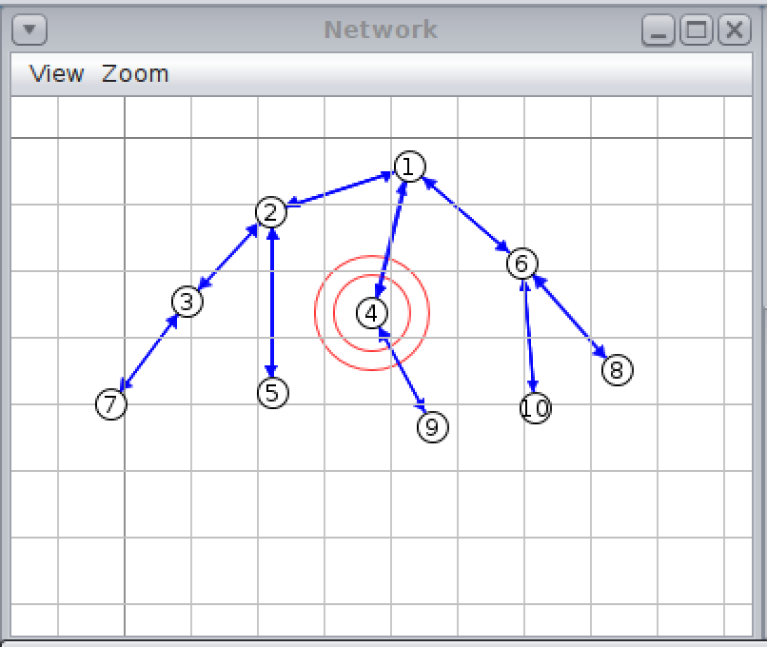
Evaluate the network with some estimation scheme
By using Cooja Simulator, the Bdist is compared with some schemes such as ETX, PRR. The key parameter is present in Table 2:
Number of nodes | 10
Number of probes | 1000
Target PRR | 99%
Link quality of the channel (is set) | 70% - 90%
Number of the data packets | 1000
Network area | 100m x 100m
Payload size | 26 bytes
Simulation time for each scenario | About 55 minutes
90%
70%
80%
80%
80%
90%
90%
90%
90%
Table 3. Summary of the simulation set up parameters.
Fig 3. Tree topology.

Slide 29
Evaluate the network with some estimation scheme
Each sensor node will generate 1000 packets periodically. The TSCH MAC protocol is used with the PCLLF [13] scheduling algorithm to guarantee that no collision in the network.
We collect the packet reception rate of each sensor node at the sink.
90%
70%
80%
80%
80%
90%
90%
90%
90%
Fig 3. Tree topology.

Slide 30
Evaluate the network with some estimation scheme
Scheme | ETX | PRR | Bdist
2 | 3 | 2 | 3
3 | 6 | 4 | 4
4 | 7 | 4 | 4
5 | 6 | 4 | 4
6 | 5 | 3 | 3
7 | 4 | 3 | 3
8 | 4 | 3 | 3
9 | 4 | 3 | 4
10 | 4 | 3 | 3
Node ID
Fig 4. The data PRR of each sensor node at the sink.
Table 4. Number of transmissions estimate by each scheme.
The Data PRR of the proposed scheme and ETX scheme archives targets PRR with the estimated times of transmission for each sensor node.
The PRR scheme archives much lower Data PRR since the estimation of the number of transmissions PRR is not very good. Because PRR did not consider the burstiness happen in the link.
ETX scheme also archives targets PRR but in term of energy consumption, the proposed scheme shows the better performances

Slide 31
Presentation Outline
1. Introduction
2. Related work
3. Our proposal
4. Performance Evaluation
5. Conclusion

Slide 32
Conclusion
In this study, we propose an LQE to apply to Industrial Wireless Sensor networks:
  With high reliability.
  Based on the burstiness link property of wireless, we estimate the number of transmissions required to reach the PRR target.
The simulation result shows that our proposed scheme has a good estimation compare with PRR and ETX in terms of reliability and energy consumption.
Future work
  We will apply and evaluate our approach to the real device for monitoring and control systems in industrial environments.

Slide 33
References
[1] T. T. Nguyen and H. Oh, “A Receiver for Resource-Constrained Wireless Sensor Devices to Remove the Effect of Multipath Fading,” IEEE Trans. Ind. Electron., vol. 65, no. 7, pp. 6009–6016, Jul. 2018, doi: 10.1109/TIE.2017.2779423.
[2] T. T. Nguyen and H. Oh, “SCSMA: A Smart CSMA/CA Using Blind Learning for Wireless Sensor Networks,” IEEE Trans. Ind. Electron., p. 1, 2019, doi: 10.1109/TIE.2019.2960753.
[3] T. Winter et al., “RPL: IPv6 Routing Protocol for Low-Power and Lossy Networks.,” rfc, vol. 6550, pp. 1–157, 2012.
[4] M. Mittal and C. Iwendi, “A survey on energy-aware wireless sensor routing protocols,” EAI Endorsed Trans. Energy Web, vol. 6, no. 24, 2019.
[5] T. Clausen, J. Yi, and U. Herberg, “Lightweight on-demand ad hoc distance-vector routing-next generation (LOADng): protocol, extension, and applicability,” Comput. Networks, vol. 126, pp. 125–140, 2017.
[6] T. T. Nguyen and H. Oh, “Constructing an optimally balanced tree to maximize data throughput with multiple channels,” Wirel. Networks, vol. 24, no. 3, pp. 993–1005, Apr. 2018, doi: 10.1007/s11276-017-1550-x.
[7] H.-J. Audéoud and M. Heusse, “Quick and efficient link quality estimation in wireless sensors networks,” in 2018 14th Annual Conference on Wireless On-demand Network Systems and Services (WONS), 2018, pp. 87–90.

Slide 34
References
[8] R. D. Gomes, D. V Queiroz, A. C. Lima Filho, I. E. Fonseca, and M. S. Alencar, “Real-time link quality estimation for industrial wireless sensor networks using dedicated nodes,” Ad Hoc Networks, vol. 59, pp. 116–133, 2017.
[9] D. S. J. De Couto, D. Aguayo, J. Bicket, and R. Morris, “A high-throughput path metric for multi-hop wireless routing,” in Proceedings of the 9th annual international conference on Mobile computing and networking, 2003, pp. 134–146.
[10] R. Fonseca, O. Gnawali, K. Jamieson, and P. Levis, “Four-bit wireless link estimation.,” in HotNets, 2007.
[11] K. Srinivasan, M. A. Kazandjieva, S. Agarwal, and P. Levis, “The β-factor: measuring wireless link burstiness,” in Proceedings of the 6th ACM conference on Embedded network sensor systems, 2008, pp. 29–42.
[12] S. Munir, S. Lin, E. Hoque, S. M. S. Nirjon, J. A. Stankovic, and K. Whitehouse, “Addressing burstiness for reliable communication and latency bound generation in wireless sensor networks,” in Proceedings of the 9th ACM/IEEE International Conference on Information Processing in Sensor Networks, 2010, pp. 303–314.
[13] A. Darbandi and M. K. Kim, “Path collision-aware real-time link scheduling for TSCH wireless networks,” KSII Trans. Internet Inf. Syst., vol. 13, no. 9, pp. 4429–4445, 2019, doi: 10.3837/tiis.2019.09.006.

Slide 35
Thank You

