Slide 2
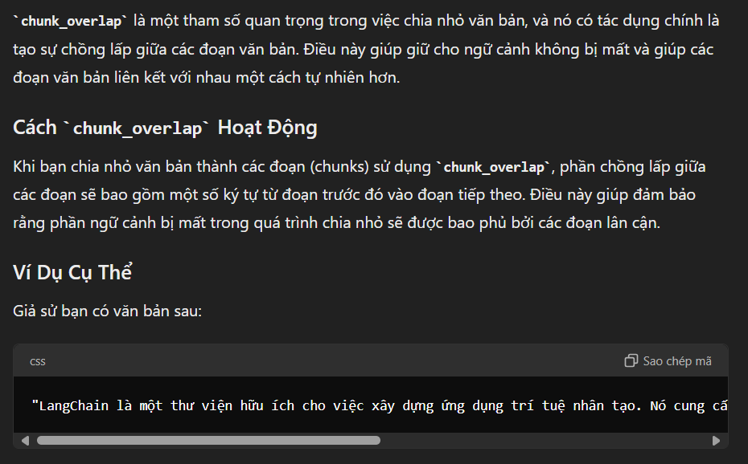
Tham số chunk_overlap

Slide 3
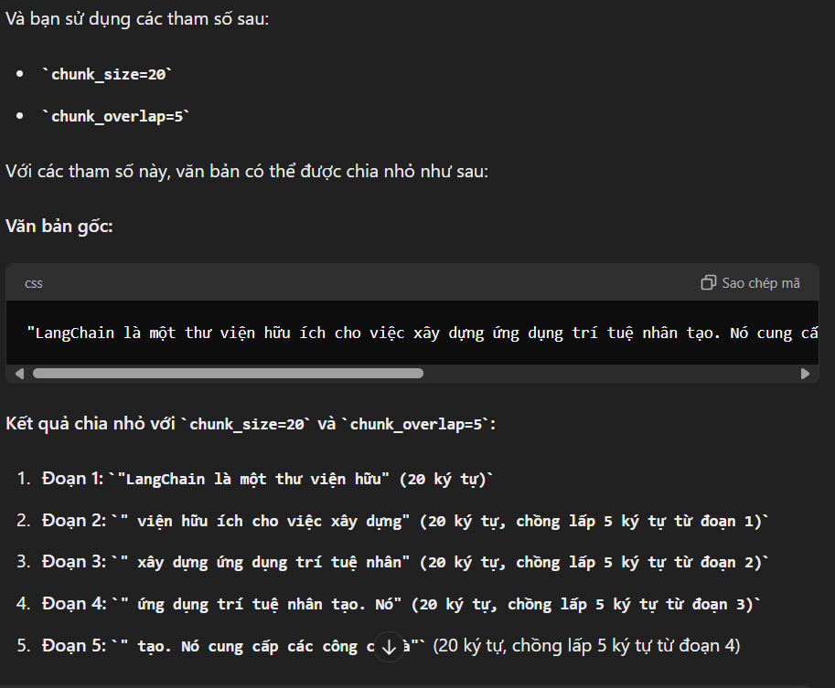

Slide 4
