Slide 1
3. Recursion
Data Structures and Algorithms in Java
<number>/25

Slide 2
Objectives
Recursive definition
Recursive program/algorithm
Recursion application
Method calls and recursion implementation
Anatomy of a recursive call
Classify recursions by number of recursive calls
Tail recursion
Non-tail recursion
Indirect recursion
Nested recursion
Excessive recursion
Data Structures and Algorithms in Java
<number>/25

Slide 3
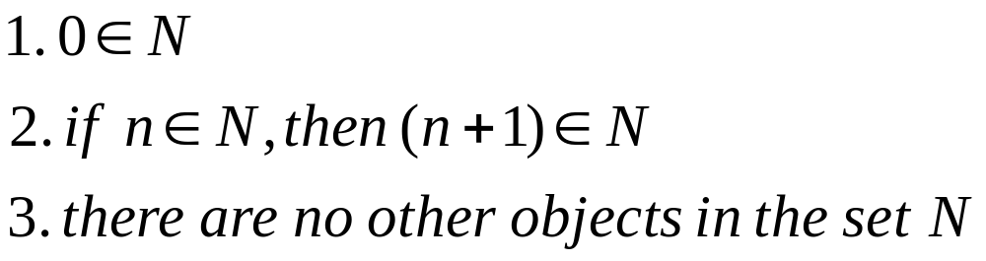
Recursive definition
Wikipedia: “A recursive definition or inductive definition is one that defines something in terms of itself (that is, recursively). For it to work, the definition in any given case must be well-founded, avoiding an infinite regress”.
A recursive definition consists of at least 2 parts:
  1) A base case (anchor or the ground case) that does not contain a reference to its own type.
  2) An inductive case that does contain a reference to its own type.
For example: Define the set of natural numbers
Data Structures and Algorithms in Java
<number>/25
Notes:
inductive : Quy nạpn cứ,
well-founded: Có căn cứ, điểm dừng
infinite regress: quay lui vô hạn

Slide 4
Some other examples for recursive definition
The Factorial of a natural number:
1 if n = 0 (anchor)
n*(n-1)! if n>0 (inductive step)
n! =
The Fibonacci sequence of natural numbers:
n if n<2
fibo(n-1) +fibo(n-2) otherwise
fibo(n) =
Data Structures and Algorithms in Java
<number>/25

Slide 5
Recursive program/algorithm - 1
One way to describe repetition within a computer program is the use of loops, such as Java’s while-loop and for-loop constructs. An entirely different way to achieve repetition is through a process known as recursion. Recursion is a technique by which a method makes one or more calls to itself during execution, or by which a data structure relies upon smaller instances of the very same type of structure in its representation. In computing, recursion provides an elegant and powerful alternative for performing repetitive tasks. Most modern programming languages support functional recursion using the identical mechanism that is used to support traditional forms of method calls. When one invocation of the method makes a recursive call, that invocation is suspended until the recursive call completes. Recursion is an important technique in the study of data structures and algorithms.
Data Structures and Algorithms in Java
<number>/27
Notes:
Repetition: lặp
Suspended: treo
Invocation: Lời gọi

Slide 6
Recursive program/algorithm - 2
A recursive program/algorithm is one that calls itself again.
There are three basic rules for developing recursive algorithms.
  • Know how to take one step.
  • Break each problem down into one step plus a smaller problem.
  • Know how and when to stop.
  Example for recursive program:
public static void DecToBin(int n)
{ int q = n/2; // One step
int r = n%2; // One step
if (q > 0)
{DecToBin(q); // smaller problem
}
System.out.print(r); // after all recursive calls have been
// made last remainder printed first
}
Data Structures and Algorithms in Java
<number>/27

Slide 7
Recursion application-(excep)
Recursive definitions are used in defining functions or sequences of elements
Purpose of recursive definition:
  Generating a new elements
  Testing whether an element belongs to a set (*)
(*) The problem is solved by reducing it to a simpler problem
Data Structures and Algorithms in Java
<number>/27

Slide 8
Method calls and recursion implementation – 1(excep)
Each time a method is called, an activation record (AR) is allocated for it. This record usually contains the following information:
Parameters and local variables used in the called method.
A dynamic link, which is a pointer to the caller's activation record.
Return address to resume control by the caller, the address of the caller’s instruction immediately following the call.
Return value for a method not declared as void. Because the size of the activation record may vary from one call to another, the returned value is placed right above the activation record of the caller.
Each new activation record is placed on the top of the run-time stack
When a method terminates, its activation record is removed from the top of the run-time stack
Thus, the first AR placed onto the stack is the last one removed
Data Structures and Algorithms in Java
<number>/27
Notes:
Activation: kích hoạt
Resume: chiếm lại
Terminates: chấm dứt

Slide 9
Method calls and recursion implementation - 2(excep)
Creating an activation record whenever a method is called allows the system to handle recursion properly. Recursion is calling a method that happens to have the same name as the caller. Therefore, a recursive call is not literally a method calling it-self, but rather an instantiation of a method calling another instantiation of the same original. These invocation are represented internally by different activation records and are thus differentiated by the system.
Data Structures and Algorithms in Java
<number>/27
Notes:
Handle: xử lý
Literally: Theo từng

Slide 10
Anatomy of a recursive Call
N = 1
N <= 1? YES
Return (1)
factorial(1)
1
N = 2
N <= 1? NO
return (2 * factorial (1)) =
1
factorial(2)
2
N = 3
N <= 1? NO
return (3 * factorial (2)) =
2
factorial(3)
6
N = 4
N <= 1? NO
return (4 * factorial (3)) =
6
factorial(4)
24
First call
24
Data Structures and Algorithms in Java
<number>/27
Notes:
Mổ xe

Slide 11
Classification of recursive functions by number of recursive calls
Considering the maximum number of recursive calls within the body of a single activation, there are 3 types of recursions.
• Linear recursion: Only 1 recursive call (to itself) in side the recursive function (e.g. binary search).
• Binary recursion: There exactly 2 recursive calls (to itself) in side the recursive function (e.g. Fibonacci number) .
• Multiple recursion: There are 3 or more recursive calls (to itself) in side the recursive function.
Data Structures and Algorithms in Java
<number>/27

Slide 12
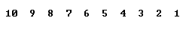
Tail recursion
Other classification of recursions
There is only one recursive call at the very end of a method implementation
class Main
{static void tail(int n)
{if(n >0)
{ System.out.print(n + " ");
tail(n-1);
}
}
public static void main(String [] args)
{tail(10);
System.out.println();
}
}
void nonTail (int i)
{ if (i > 0)
{tail(i-1);
System.out.print (i + "");
tail(i-1);
}
}
Data Structures and Algorithms in Java
<number>/27

Slide 13
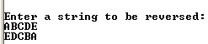
Non-tail recursion
The recursive call is not at the very end of a method implementation
public class Main
{public static void reverse() throws Exception
{char ch = (char) System.in.read();
if(ch != '\n')
{reverse();
System.out.print(ch);
}
}
public static void main(String [] args) throws Exception
{System.out.println("\nEnter a string to be reversed:");
reverse();
System.out.println("\n");
}
}
Data Structures and Algorithms in Java
<number>/27

Slide 14
Convert recursion implementation to iterative implementation using stack
{public static void nonRecursiveReverse() throws Exception
{MyStack t = new MyStack();
char ch;
while(true)
{ch = (char) System.in.read();
if(ch == '\n') break;
t.push(ch);
}
while(!t.isEmpty())
System.out.print(t.pop());
}
Data Structures and Algorithms in Java
<number>/27

Slide 15
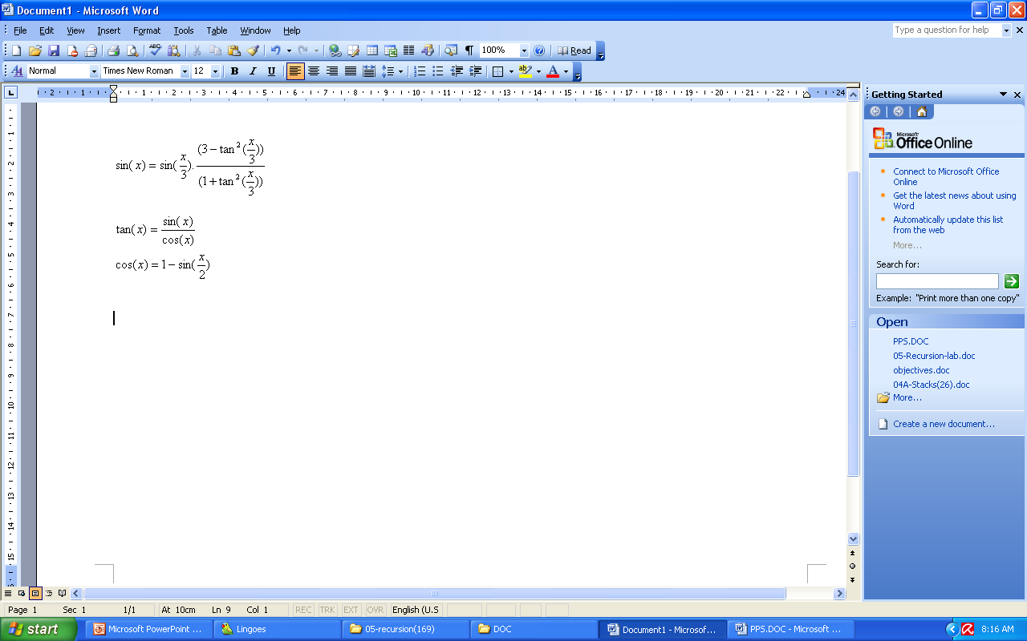
Indirect recursion
If f() calls itself, it is direct recursive
If f() calls g(), and g() calls f(). It is indirect recursion. The chain of intermediate calls can be of an arbitrary length, as in:
f() -> f1() -> f2() -> ... -> fn() -> f()
Example: sin(x) calculation
sin(x)
sin(x/3)
tan(x/3)
tan(x/3)
sin(x/3)
cos(x/3)
sin(x/3)
cos(x)
sin(x/6)
sin(x/6)
Recursive call tree for sin(x)
Data Structures and Algorithms in Java
<number>/27
Notes:
?

Slide 16
Nested recursion
A function is not only defined in terms of itself but also is used as one of the parameters
Consider the following examples:
0 if n=0
n if n>4
h(2 +h(2n)) if n<=4
h(n) =
Another example of nested recursive recursion is Ackermann’s function:
  A(0, y) = y + 1
  A(x, 0) = A(x - 1, 1)
  A(x, y) = A(x - 1, A(x, y - 1))
This function is interesting because of its remarkably rapid growth.
A(3,1) = 2⁴ - 3
A(4,1) = 2⁶⁵⁵³⁶ - 3
Data Structures and Algorithms in Java
<number>/27
Notes:
http://en.wikipedia.org/wiki/Fibonacci_numbers
Nested: Lồng

Slide 17
Excessive recursion - 1
Consider the Fibonacci sequence of numbers
This implementation looks very natural but extremely inefficient!
n if n<2
fibo(n-1) +fibo(n-2) otherwise
fibo(n) =
static long fibo(long n)
{if (n<2)
  return n;
  else
  return(fibo(n-1)+fibo(n-2));
}
Data Structures and Algorithms in Java
<number>/27
Notes:
http://en.wikipedia.org/wiki/Fibonacci_numbers
Excessive: đệ quy thừa

Slide 18
The tree of calls for fibo(4)
Excessive recursion - 2
Fib(4)
Fib(2)
Fib(3)
Fib(0)
Fib(1)
Fib(1)
Fib(2)
0
1
1
Fib(0)
Fib(1)
0
1
Data Structures and Algorithms in Java
<number>/27

Slide 19
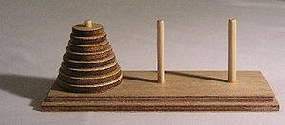
More Examples – The Tower of Hanoi
Rules:
  Only one disk may be moved at a time.
  Each move consists of taking the upper disk from one of the rods and sliding it onto another rod, on top of the other disks that may already be present on that rod.
  No disk may be placed on top of a smaller disk.
Source: http://en.wikipedia.org/wiki/Hanoi_tower
Data Structures and Algorithms in Java
<number>/27
Notes:
Reference: wikipedia
http://en.wikipedia.org/wiki/Hanoi_tower

Slide 20
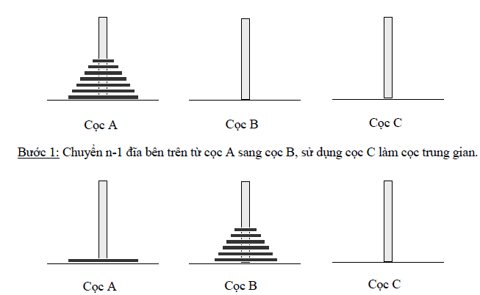
The Tower of Hanoi
Phan Thị Hà

Slide 21
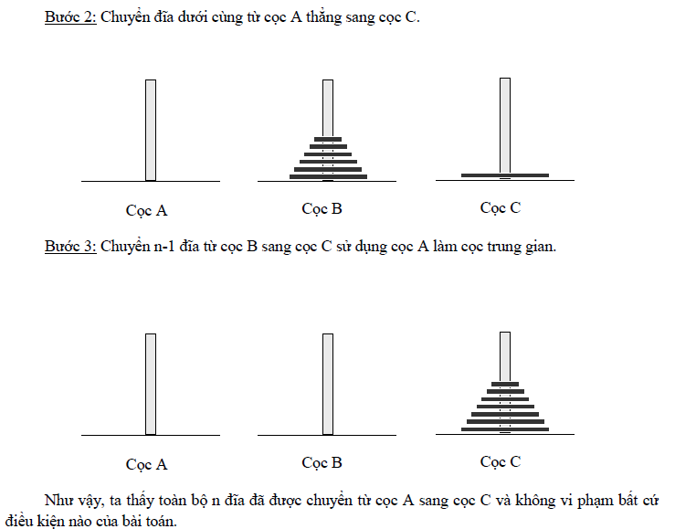
The Tower of Hanoi
Phan Thị Hà

Slide 22

More Examples – The Tower of Hanoi
Algorithm
void moveDisks(int n, char a, char c, char b)
{if (n == 1) // Stopping condition
  Move disk 1 from the a to c;
  else
  {moveDisks(n - 1, a, b, c);
  move disk n from a to c;
  moveDisks(n - 1, b, c, a);
  }
}
Data Structures and Algorithms in Java
<number>/27

Slide 23
Void Try ( int i ) {
for (int j =1; j<=N; j++){
if (chuaxet[j] ) {
X[i] = j;chuaxet[j] = 0;
if ( i ==N) Result();
else Try (i+1);
Chuaxet[j] = 1;
}
}
}
Data Structures and Algorithms in Java
<number>/25

Slide 24
  void DatHau(int i)
  {
  Khởi tạo danh sách các vị trí có thể đặt quân hậu tiếp theo;
  do{
  Lựa chọn vị trí đặt quân hậu tiếp theo;
  if Vị trí đặt là an toàn
  {
  Đặt hậu;
  if i<8
  {
  DatHau(i+1);
  if Không thành công
  Bỏ hậu đã đặt ra khỏi vị trí
  }
  }
  }while (Không thành công) && (Vẫn còn lựa chọn)
  }
Data Structures and Algorithms in Java
<number>/25

Slide 25
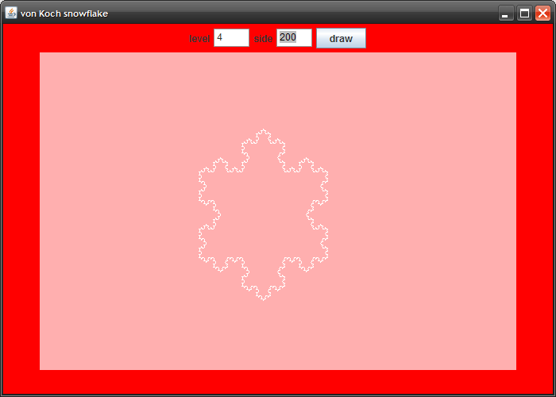




More Examples – Drawing fractals
Data Structures and Algorithms in Java
<number>/27
Notes:
Demo
Image source: http://www.javacoffeebreak.com/articles/fractal/index.html

Slide 26
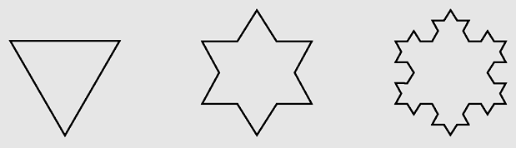
More Examples – Von Knoch snowflakes
Divide an interval side into three even parts
Move one-third of side in the direction specified by angle
Examples of von Koch snowflakes
Data Structures and Algorithms in Java
<number>/27

Slide 27
Recursion vs. Iteration
Some recursive algorithms can also be easily implemented with loops
  When possible, it is usually better to use iteration, since we don’t have the overhead of the run-time stack (that we just saw on the previous slide)
Other recursive algorithms are very difficult to do any other way
Data Structures and Algorithms in Java
<number>/27

Slide 28
Summary
Recursive definitions are programming concepts that define themselves
Recursive definitions serve two purposes:
  Generating new elements
  Testing whether an element belongs to a set
Recursive definitions are frequently used to define functions and sequences of numbers
Tail recursion is characterized by the use of only one recursive call at the very end of a method implementation.
Data Structures and Algorithms in Java
<number>/27

Slide 29
Reading at home
Text book: Data Structures and Algorithms in Java
5 Recursion 189
5.1 Illustrative Examples - 191
5.1.1 The Factorial Function -191
5.1.3 Binary Search - 196
5.1.4 File Systems - 198
5.2 Analyzing Recursive Algorithms - 202
5.3 Further Examples of Recursion - 206
5.3.1 Linear Recursion - 206
5.3.2 Binary Recursion - . 211
5.3.3 Multiple Recursion - 212
5.4 Designing Recursive Algorithms - 214
5.6 Eliminating Tail Recursion -. 219
Data Structures and Algorithms in Java
<number>/25

