Slide 1
Working with Prime Factors

Slide 2
Finding Prime Factors with Optimized Trial Divisions
A composite number N, i.e. the non-primes, can be written uniquely as a multiplication of its prime factors.
N = 1200 = 2 × 2 × 2 × 2 × 3 × 5 × 5 =2⁴ × 3 × 5²
Divide and Conquer spirit: N = P F × N’. We can keep doing this until eventually N’ = 1.
There is no divisor greater than √N, so we only repeat the process
of finding prime factors until P F ≤ √N
the worst case—when N is prime, O(π(√N)) =O(√N/ln√N) becasue of testing all smaller primes up to √N

Slide 3
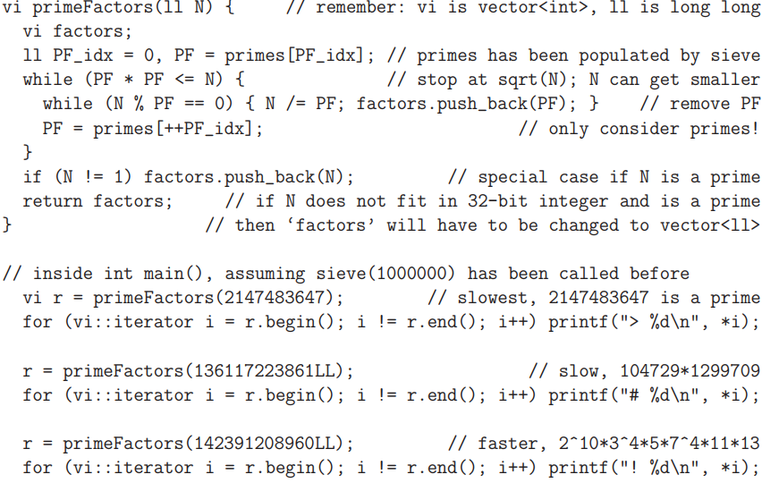

Slide 4
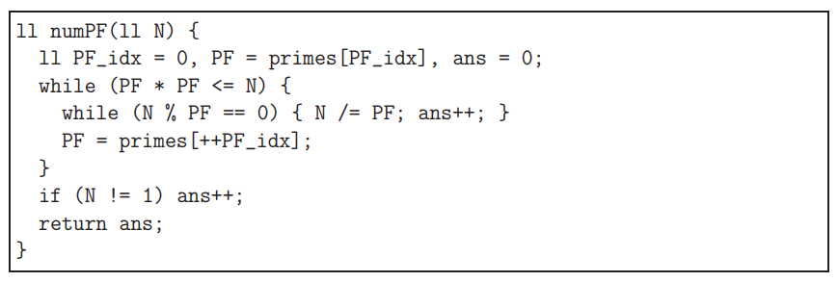
numPF(N): Count the number of prime factors of N

Slide 5
Working with Prime Factors
2. numDiffPF(N): Count the number of different prime factors of N
3. sumPF(N): Sum the prime factors of N
4. numDiv(N): Count the number of divisors of N
    N = a^{i} × b^{j} × . . . × c^{k},
    then N has (i + 1) × (j + 1) × . . . × (k + 1) divisors.
    Example: N = 60 = 2² × 3¹ × 5¹ has
    (2 + 1) × (1 + 1) × (1 + 1) = 3 × 2 × 2 = 12 divisors.

Slide 6
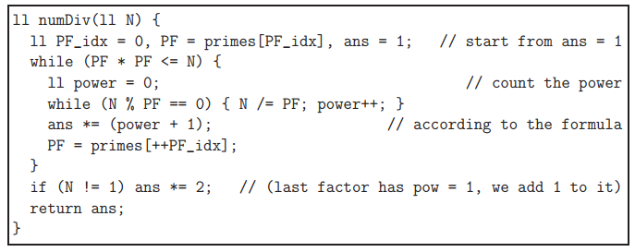
numDiv(N): Count the number of divisors of N

Slide 7
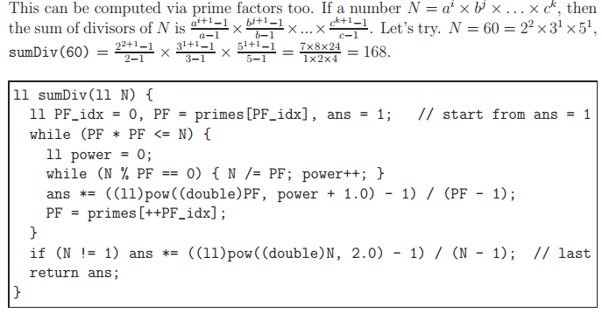
sumDiv(N): Sum the divisors of N
(1,2,3,4,5,6,10,12,15,20,30,60)

Slide 8
sumDiv(N): Sum the divisors of N
Let σ(n) be the sum of divisors of the natural number, n.
For any prime, p: σ(p) = p + 1, as the only divisors would be 1 and p.
Consider pª: σ(pª) = 1 + p + p² + ... + pª (1).
Multiplying by p: pσ(pª) = p + p² + p³ + ... + p^{a + 1} (2).
Subtracting (1) from (2): pσ(pª)−σ(pª) = (p−1)σ(pª) = p^{a+1} − 1.
Hence σ(pª) = (p^{a+1} − 1)/(p − 1).
For example, σ(3⁴)=(3⁵−1)/(3−1) = 242/2 = 121,
and checking: 1 + 3 + 9 + 27 + 81 = 121.

Slide 9
sumDiv(N): Sum the divisors of N
σ(a×b×...)=σ(a)×σ(b)×..., where a, b, ..., are relatively prime.
Returning to example, we use the fact that σ(72) = σ(2³×3²).
As 2³ and 3² are relatively prime, we can separately work out:
σ(2³) = 2⁴ − 1 = 15 and σ(3²) = (3³ − 1)/2 = 13.
Therefore, σ(72) = 15×13 = 195.

Slide 10
EulerPhi(N): Count the number of positive integers < N that are relatively prime to N
Two integers a and b are said to be relatively prime (or coprime) if
gcd(a, b) = 1
e.g. 25 and 42 are relatively prime
For example N = 36 = 2² × 3²
  Those 12 positive integers that are relatively prime to 36 are {1, 5, 7, 11, 13, 17, 19, 23, 25, 29, 31, 35}.
Notes:
https://en.wikipedia.org/wiki/Euler%27s_totient_function

Slide 11
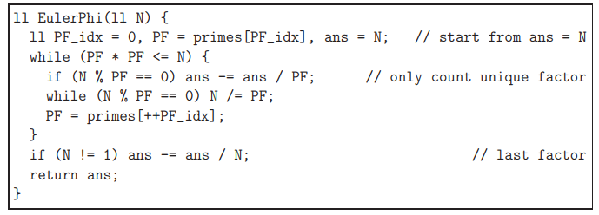
EulerPhi(N): Count the number of positive integers < N that are relatively prime to N

Slide 12
Exercise

Slide 13

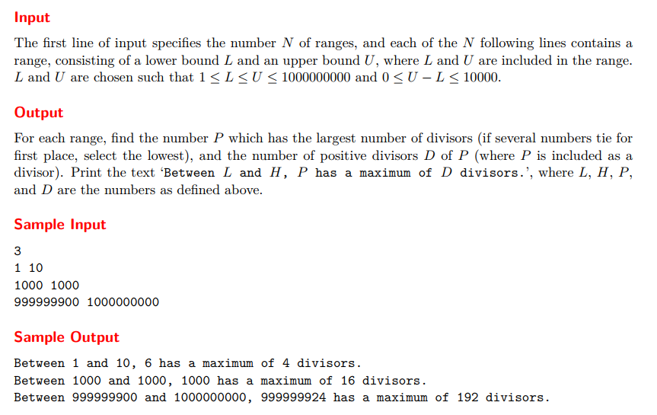

Slide 14

