Slide 1
Anaconda Installation
Anaconda is a package manager, an environment manager, and Python distribution that contains a collection of many open-source packages
Step1: www.anaconda.com
Step2: Click Get Started => Install Anaconda Individual Edition
Step3: Scroll to the bottom of page and Select your OS
Step4: Run .exe file
Step5: Follow the Instruction
Installation Tutorial:
https://www.datacamp.com/community/tutorials/installing-anaconda-windows

Slide 2
Github & Git
GitHub (Web Service) is a code hosting platform for version control and collaboration. It lets you and others work together on projects from anywhere
Sign up - https://github.com
Download Git Bash
https://git-scm.com/downloads
Linux (Debian) $ sudo apt-get install git
Linux (Fedora) $ sudo yum install git
Mac – http://git-scm.com/download/mac
Windows - http://git-scm.com/download/win
What is Github?
https://www.youtube.com/watch?v=w3jLJU7DT5E

Slide 3
Github
Remote
Pull
Git’s
Staging Area
Push
PC
Local

Slide 4
Git Initial Command
$ git init
$ git config --global user.name ‘your name’
$ git config --global user.email ‘your email’

Slide 5
Git Concepts
Version Control Software (VCS) for tracking changes in computer files
$ git init
$ git add <file>
$ git status
$ git commit
$ git push
$ git pull
$ git clone
Initialize Local Git Repository
Add File(s) to index (Staging Area)
Check Status of Staging Area
Commit changes index
Push to remote repository
Pull latest from remote repository
Clone a repository to your local directory

Slide 6
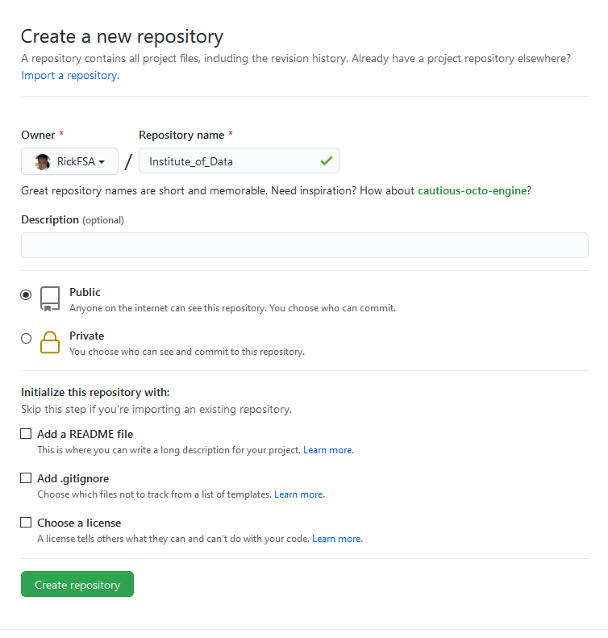
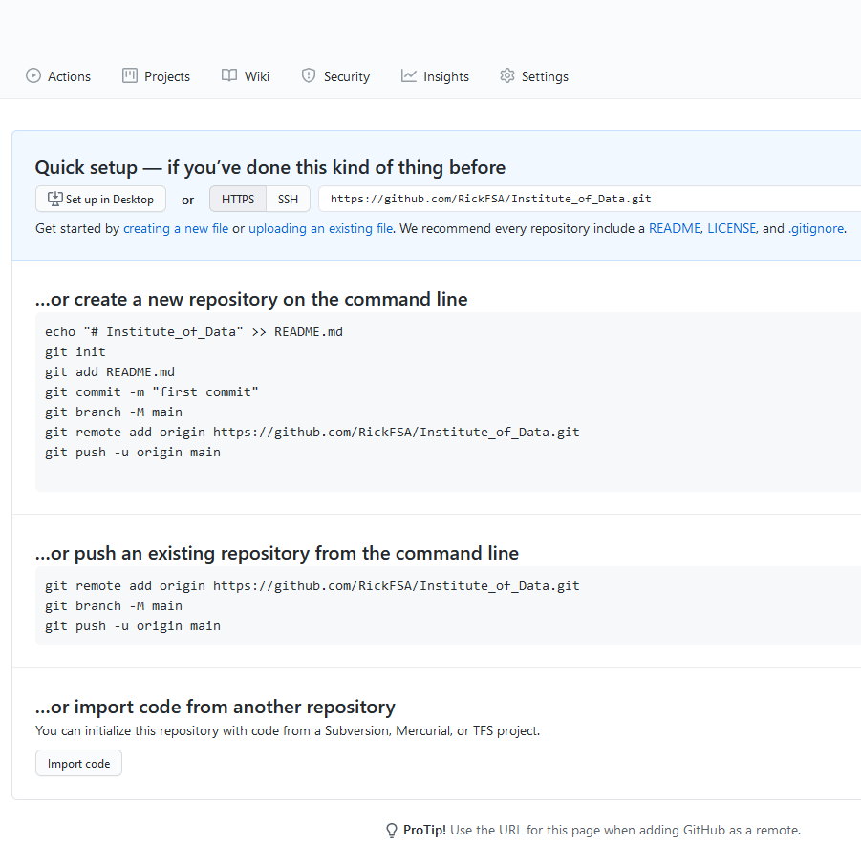
STEP1: Create Repository
STEP2: Copy https link
Copy this link

Slide 7
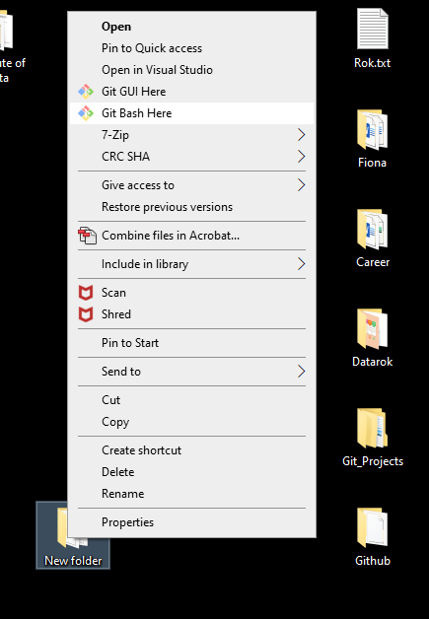
STEP3: Git bash on your directory
You can git bash on your Institute of Data Folder, or any preferred folder.
The main objective is to ensure you know the directory of your works(the location of your works).

Slide 8
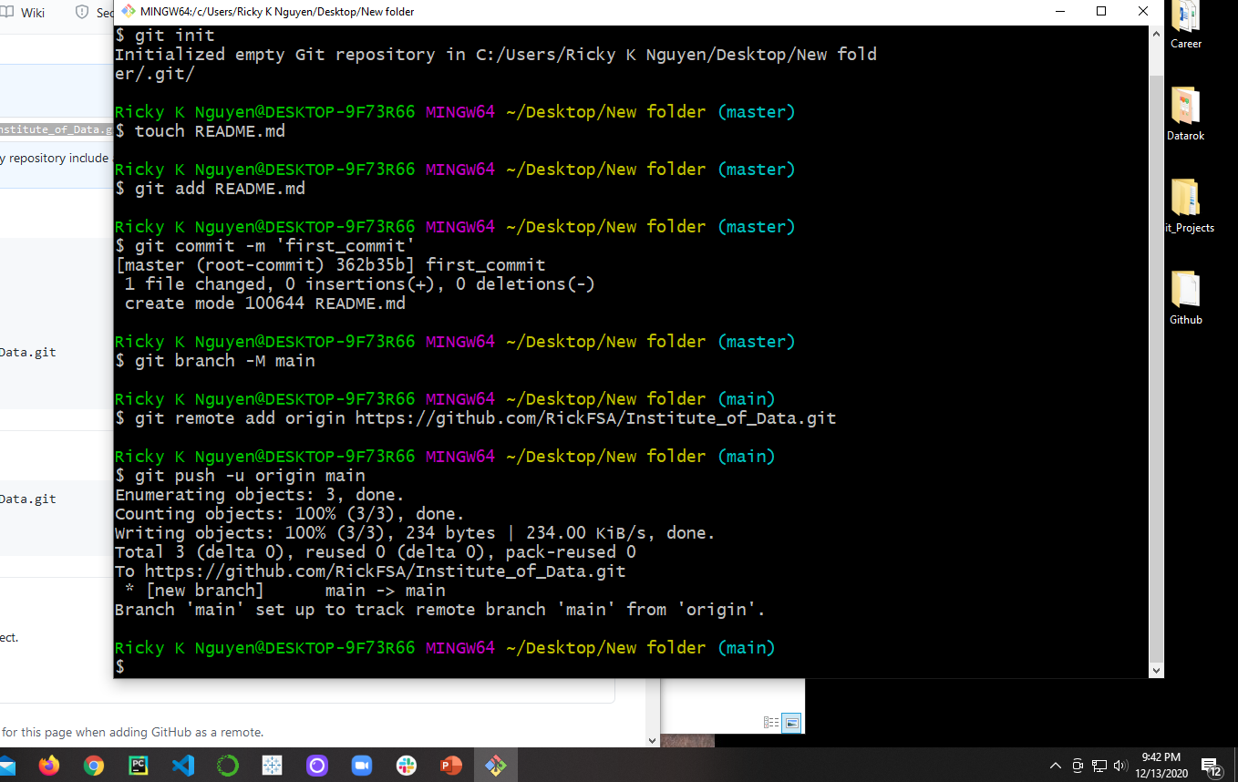
STEP4: Initialize linkage between PC & Github (please follow step-by-step instruction)
$ git init
$ touch README.md
This is a testing file we want to create to push to our repo. Feel free to change to your preferred file
$ git add README.md
Add file to staging area
$ git commit –m ‘first_commit’

Slide 9
$ git branch –M main
$ git remote add origin <enter your repository https links in here>
Paste link from step 2
$ git push –u origin main

Slide 10
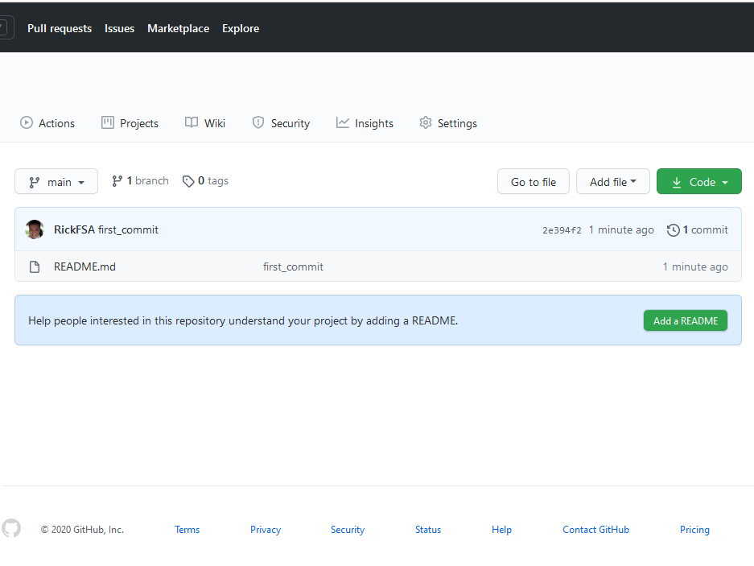
STEP5: Refresh your repository from web browser
README.md file has been pushed to your repository from your local PC

Slide 11
STEP6: Future pushes
We do not need to follow the above steps for future pushes. INSTEAD:
$git add filename that you want to add to staging area
git add . (the period will add all files)
$git commit –m ‘your preferred comment that will appear on your repo’
$git push

