Slide 1
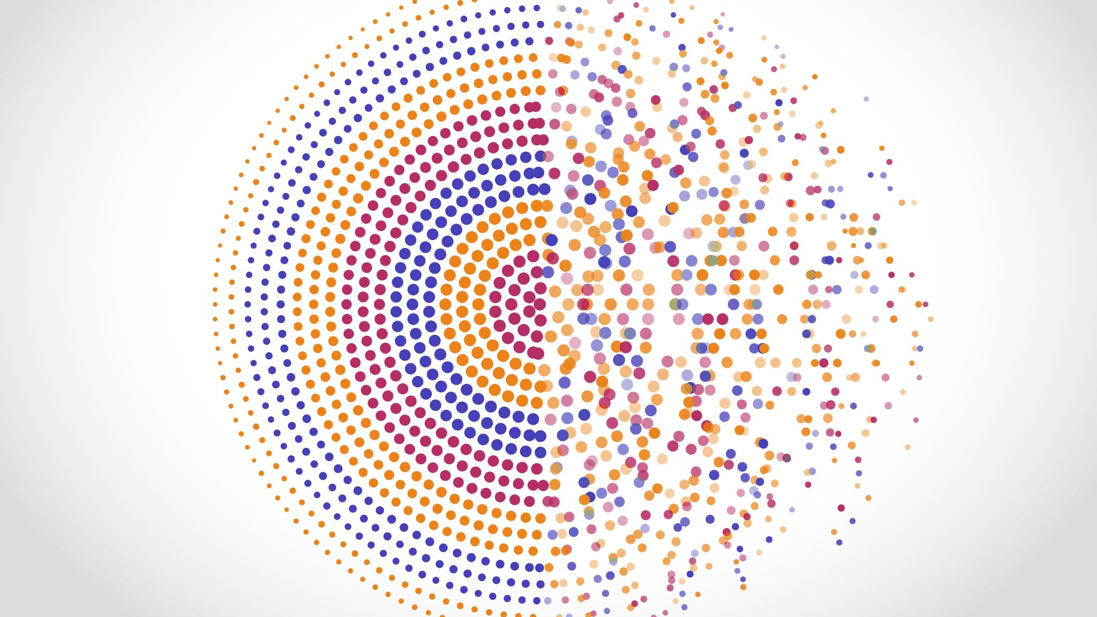
Bayesian parameter synthesis for Markov Population Models
Nhat-Huy Phung

Slide 2
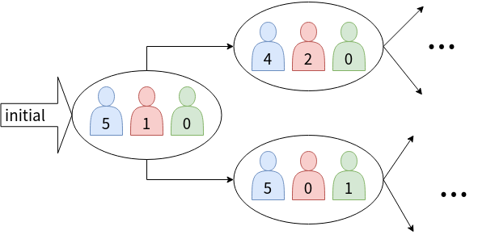
Motivation
We are interested in population dynamics of multiple species
E.g: number of surviving computer nodes, number of infected individuals
Notes:
In many fields of research and application, we interest in population of single or multiple species,
For example: how many surviving nodes are there in a distributed system
We also care about population dynamics, that is how does the population evolve
For example: Given a community, how many people get infected before the number of infections stabilized
In this thesis we study the population dynamics model the population with stochastic population process

Slide 3
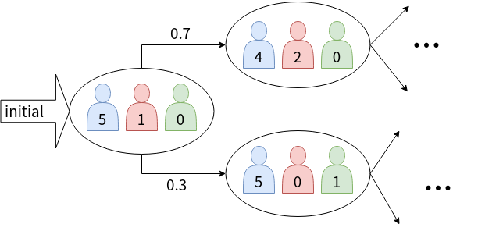
Motivation
Modeling populations of multiple species with a stochastic population process:
States track population size of each of the involved species
Transitions model the stochastic change of the population of each species
Time can be discrete or continuous; We focus on discrete-time Markov chains (DTMC)
Notes:
Specifically, we use stochastic population process study population dynamics which contains random evolution.
States tracks population sizes of involved species
Transitions model the random evolution of the population of each species
Which population process to use? In this thesis we use Markov population process.
To simplify the problem, we model the population with discrete-time model
Thus, the main object of research in this thesis is
DTMC with state labels represents population vector, I.e population of each involved species

Slide 4
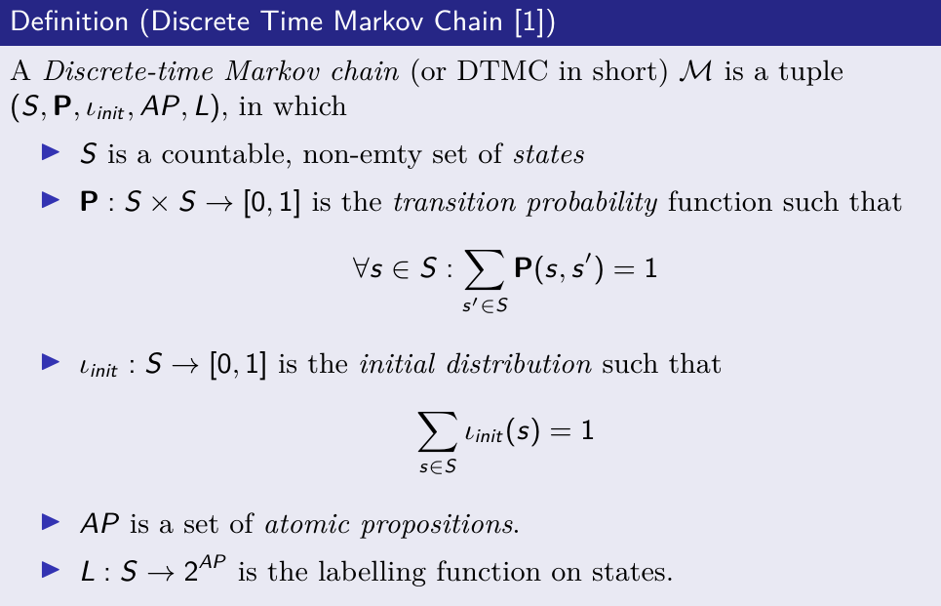
Motivation
DTMC (Baier, 2008 [1])
Notes:
As in all model checking problems, we first need to define a model
In this thesis we use Discrete-time markov chain as the model.

Slide 5
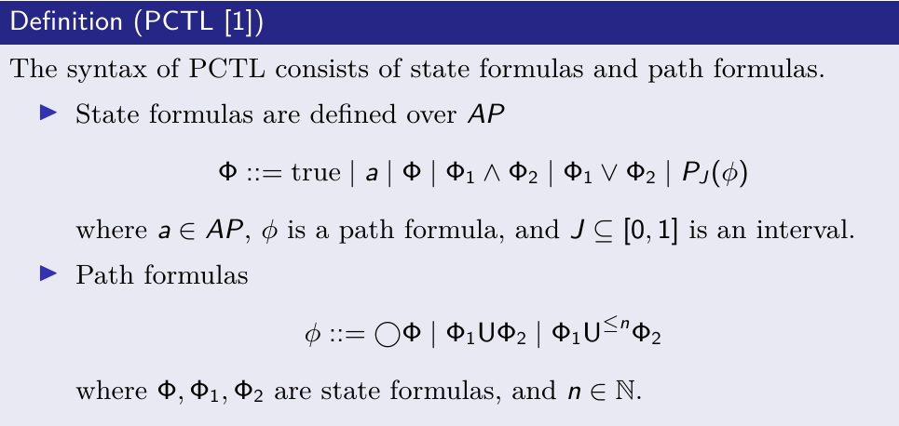
Motivation
Property specification: Probabilistic Computational Tree Logic (Baier, 2008 [1])
Notes:
We also needs to define a temporal logic to specify the property of interest
Here comes the definition of pctl

Slide 6
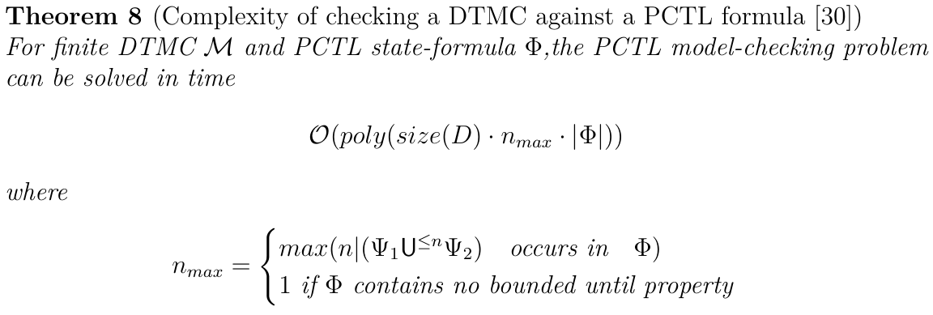
Motivation
Model checking: Complexity of PCTL model checking (Baier, 2008)
Notes:
Complexity

Slide 7

Motivation
Unknown features of the system
We know that DTMC with known transition matrix can be model-checked against PCTL formulae
What if transition matrix is unknown or only partially known?
Parameterized transitions: parametric models
Grey-box verification of the system
We have some observations of system executions
In this thesis, we observe a system at its steady state
Notes:
Unknown features of the system
In DTMC, transition matrix is known a priori.
However, the population dynamics is usually unknown, or assumed
=> We introduce parametric models.

Slide 8
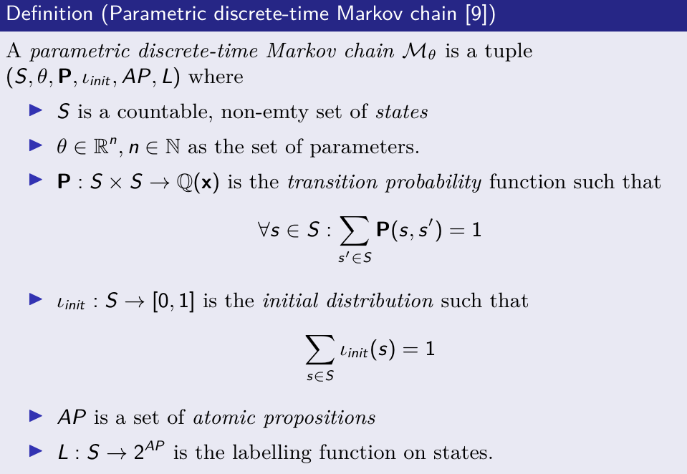
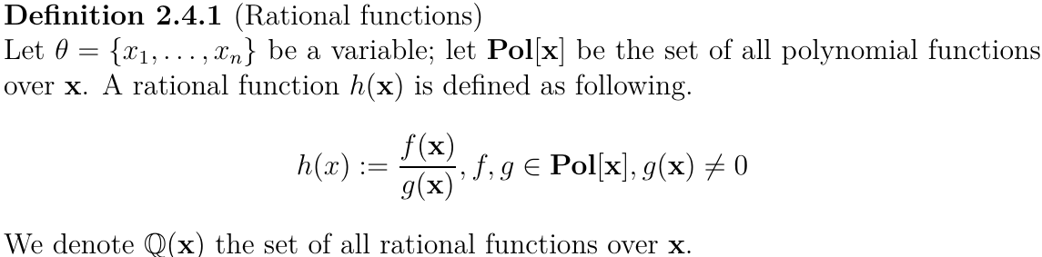
Motivation
PDTMC (Junges 2019 [3])
Notes:
Formal definition of pdtmc follow Phd thesis of Jnges at katoen group

Slide 9
Motivation
Parameter synthesis (Katoen 2016 [2])
Methods
Symbolic characterization of reachability property in form of rational function (Daws, 2004 [6])
Parameter region sampling and partitioning (Kwiatkowska, 2006 [7])
Parameter lifting (Quatmann, 2016 [8])
Tools
PROPHESY (Dehnert, 2015 [5])
PRISM-PSY (Ceska, 2016 [4])
Notes:
There are different definitions of parameter synthesis, here we stick to the definition by Katoen, 2011 in his paper probabilistic model checking landscape that (def..)
In the paper, Katoen also summarized the following method for parameter synthesis. These methods based on parameter space partitioning
In this thesis, we use sampling-based method.

Slide 10
Research questions
Parameter inference
01
Given experimental data, how can we estimate model parameters?
Parameter synthesis
02
Given a property of interest, how do we find a space of parameter values satisfying the property?
Notes:
As we have parameterized transitions, the following questions emerge:
Parameter inference
How to estimate model parameters given experiment data?
Parameter synthesis
How to find a set of parameters satisfying a temporal property of interest?

Slide 11
Challenges
State space explosion problem
The number of model states grows exponentially as the number of state variables increases.
Example:
- Given a population of people belonging to 3 groups: susceptible (S), infected (I), recovered (R), how many possible population vectors are there?
- Population size = 5 => 3⁵ = 243
Population size = 10 => 3¹⁰ = 59049
……
Notes:
Number of model states grows exponentially as the number of involved state variable increase
The exponential growing of state space leads to high computational cost
Of course during the model construction, some states can be lumped
However, lumping is not always possible
=> need another method to mitigate
…. (Tanja: this is before the population abstraction – leave it like this, but be aware that it may be asked.. Population abstraction is not exponential, but is combinatorial

Slide 12
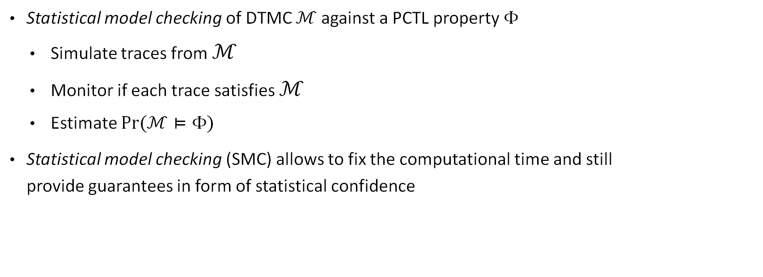
Approach
Statistical model checking of DTMC $ℳ$against a PCTL property $Φ$
Simulate traces from $ℳ$
Monitor if each trace satisfies $ℳ$
Estimate $Pr⁡(ℳ⊨Φ)$
Statistical model checking (SMC) allows to fix the computational time and still provide guarantees in form of statistical confidence
Notes:
Statistical model checking is a simulation-based approach to model checking
Statistical model checking reduces computational cost by

Slide 13
Challenges
There are different sources of uncertainties: in the model, finite sample size, and parameter search
Uncertainties from the system
The system is stochastic
Uncertainties from data
Not enough samples/noisy data
Uncertainties from algorithm
Monte Carlo sampling algorithm (Sequential Monte Carlo) is randomized
There are hyperparameters: perturbation kernels, ABC threshold....
Notes:
1. The system itself behaves randomly; thus we model with stochastic process
2. We use data informed methods, thus low quality/noisy data deteriorates inference results. We later show how to deal with this situation.
3. Randomized algorithm, each execution of algorithm gives different results. Furthermore, how do we select hyperparameters? Just try...

Slide 14
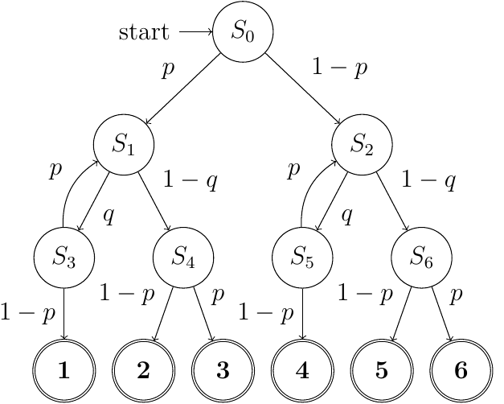

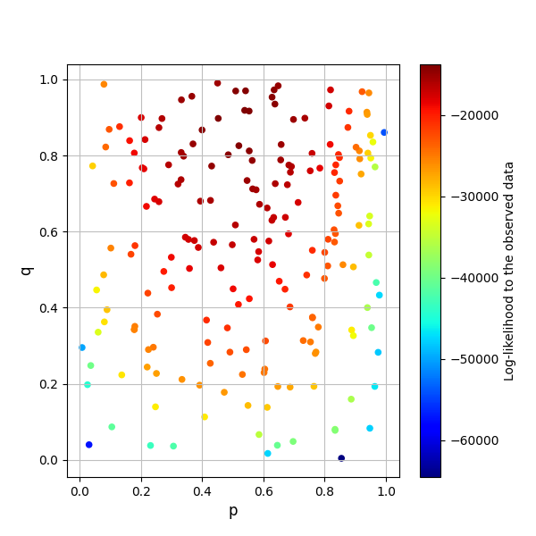
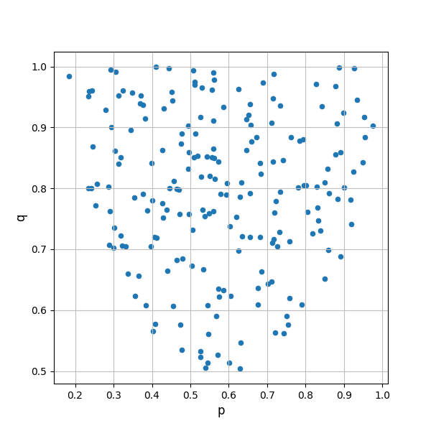

Challenges
Given a parametric DTMC, for example Knuth-Yao die,
Parameter inference is data-based and does not include the satisfaction wrt. property of interest
Parameter synthesis is property-based and does not include the likelihood wrt. data
$Dobs$= [4386, 442, 392, 2418, 2177, 185]
((p,q) = (0.527, 0.917))
Notes:
Leftside: we see the shape (trend) but not the color
Right side: we see the color but not the shape

Slide 15
Approach
How to combine parameter inference and parameter synthesis?
Data-informed, Bayesian parameter synthesis
Parameter synthesis: Find a set of satisfying parameter instantiations
Bayesian inference: Approximate the posterior distribution of parameters by Monte Carlo sampling
Input
Model $ℳ$
Model ℳ
Experiment data $D_{obs}$
Experiment data 𝐷_𝑜𝑏𝑠
Bayesian parameter synthesis
Likelihood-free method
Output
Property $Φ$
Property Φ
Satisfying parameter values
Method with likelihood
Corresponding likelihood or its approximation
Parameter estimation
Notes:
Data-informed parameter synthesis, this is the main contribution of this thesis
Find a set of satisfying parameters values
Approximate or exact their corresponding likelihood to generate experiment data
From the set of parameter and likelihood values, estimate model parameters, validate its satisfaction to the property of interest

Slide 16
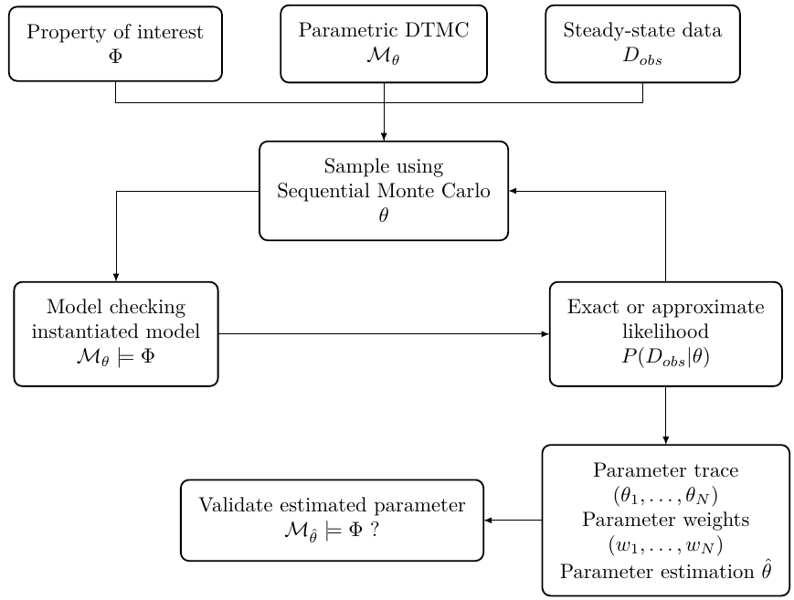
Framework
Bayesian parameter synthesis framework
Sampling parameter space
Accept a sampled parameter value if it is satisfying (SMC or RF)
Exact computation of likelihood (RF) or approximation by a measure (ABC)
Validate estimated value

Slide 17
RF-SMC
Framework
ABC-SMC-ABC
Bayesian parameter synthesis framework RF-SMC
Sampling parameter space
Accept a sampled parameter value if it is satisfying
Rational function evaluation
Exact computation of likelihood
Validate estimated value
Bayesian parameter synthesis framework SMC-ABC-SMC
Sampling parameter space
Accept a sampled parameter value if it is satisfying
Statistical model checking
Estimate distance by simulating instantiated model
Validate estimated value

Slide 18
Framework
Input
Sampling algorithm:
Approximate Bayesian Computation (ABC)
Exact evaluation of likelihood
Model checking module:
Statistical model checking
Rational function evaluation
Output

Slide 19
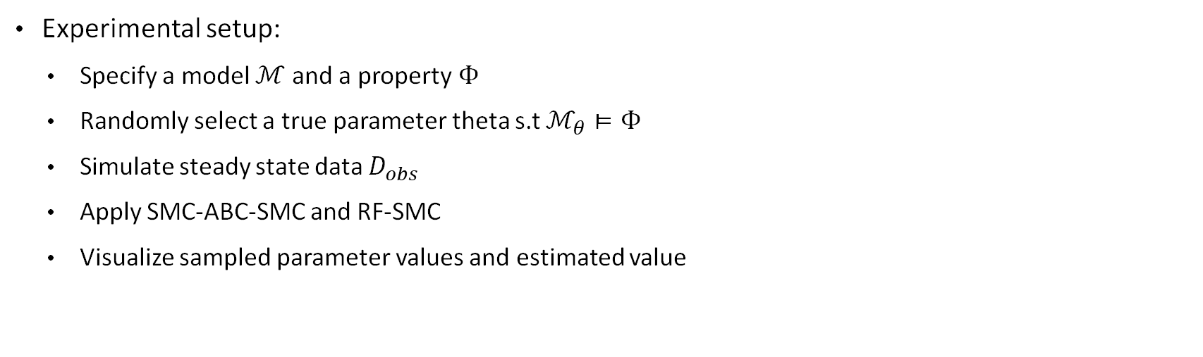
Case study
Experimental setup:
Specify a model $ℳ$ and a property$Φ$
Randomly select a true parameter theta s.t $ℳ_{θ}⊨Φ$
Simulate steady state data $D_{obs}$
Apply SMC-ABC-SMC and RF-SMC
Visualize sampled parameter values and estimated value

Slide 20
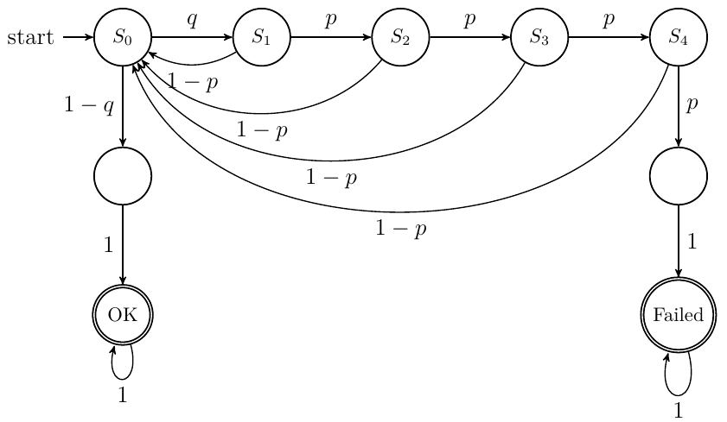
Case study
Zeroconf 4
Property P_{≥0.75} (true U_{≤4} "OK")
True parameter (p,q) = (0.105547, 0.449658)
Synthetic data ("Failed", "OK") = (41, 9959)

Slide 21
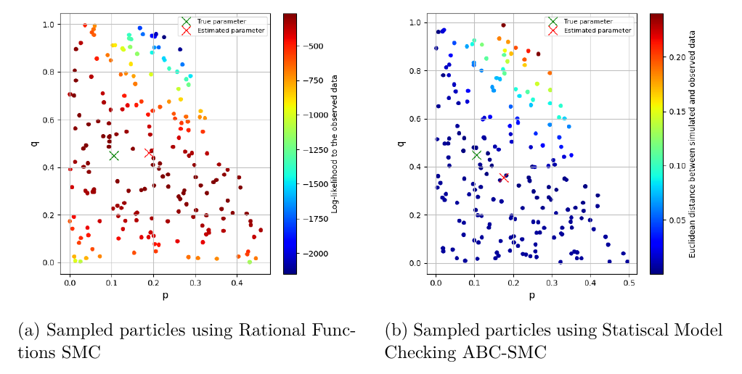
Case study: Zeroconf 4

Slide 22
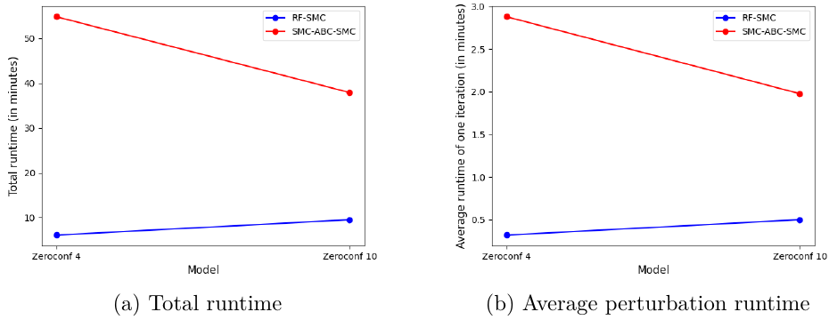
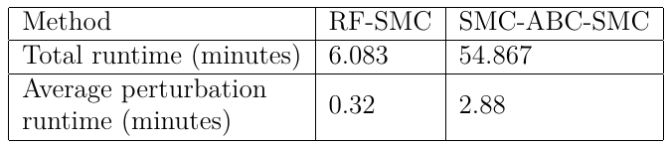
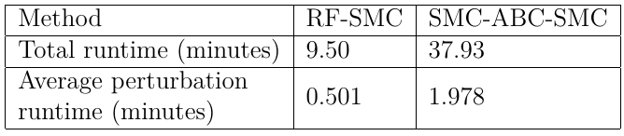
Case study: Zeroconf 4
Run time for Zeroconf 4
Run time for Zeroconf 10
Notes:
- This experiment shows that the SMC-ABC-SMC is more expensive than RF-SMC
-

Slide 23
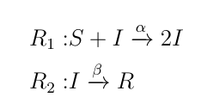
Case study: SIR(15,1,0)
SIR: an epidemic model
Population of 3 species: S (suspected), I (infected), R (recovered)
Initially population S₀, I₀, R₀
Population dynamics defined by 2 reactions:

Slide 24
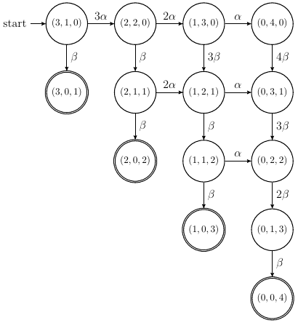
Case study: SIR(15,1,0)
SIR, CTMC model construction
State space exploration:
Apply R₁ and R₂ where applicable, mark a state as visited
If neither R₁ or R₂ applicable: mark as BSCC
If state is already visited: backtrack
Example: SIR(3,1,0) CTMC

Slide 25
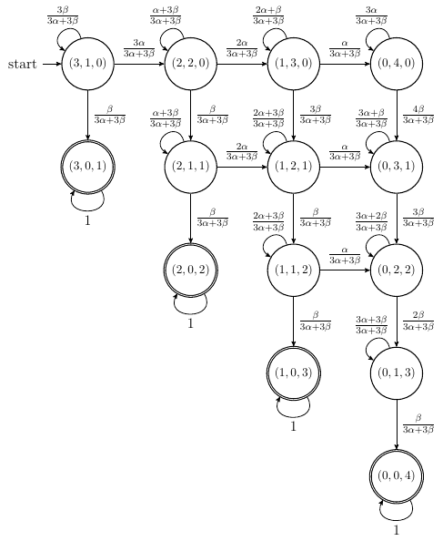
Case study: SIR(15,1,0)
SIR, DTMC model construction
From reactions R1 and R2, construct a CTMC
Uniformize CTMC to DTMC
Uniformization preserves transient probabilities
Example: SIR(3,1,0) DTMC
Notes:
As uniformization preserves reachability properties, we transform CTMC to DTMC through uniformization.

Slide 26
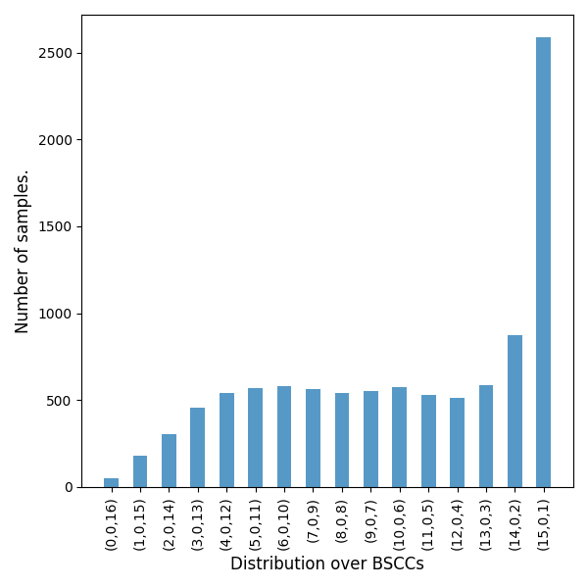
Case study: SIR(15, 1, 0)
Property: P_{≥0.25} (i ≤ 8 U_{≤16} i = 0)
Number of infected (i) does not exceed half of the population until the pandemic stabilized
True parameter (α, β) = (0.011499, 0.062111)
Synthetic data D_{obs} = (50, 181, 302, 455, 539, 567, 582, 566, 541,553, 574, 528, 512, 586, 875, 2589)

Slide 27
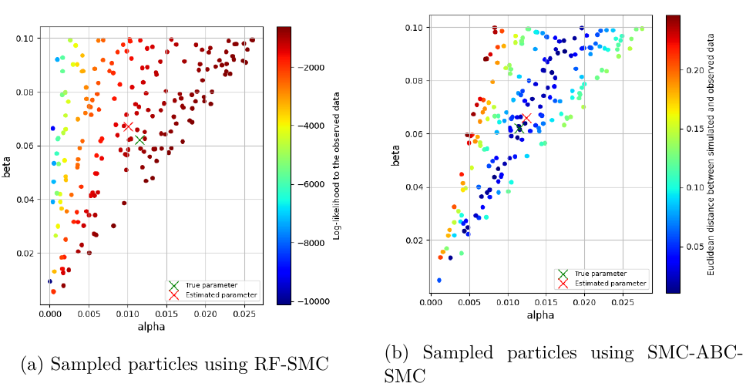
Case study: SIR(15, 1, 0) with high quality data

Slide 28
Case study: SIR(15, 1, 0) with low quality data
Property: P_{≥0.25} (i ≤ 8 U_{≤16} i = 0)
True parameter (α, β) = (0.011499, 0.062111)
Merged BSCCs: (S ≤ 8), (S>8)
Synthetic data: [54, 146]
Notes:
Merging BSCC lowers data quality by introducing uncertainty;

Slide 29
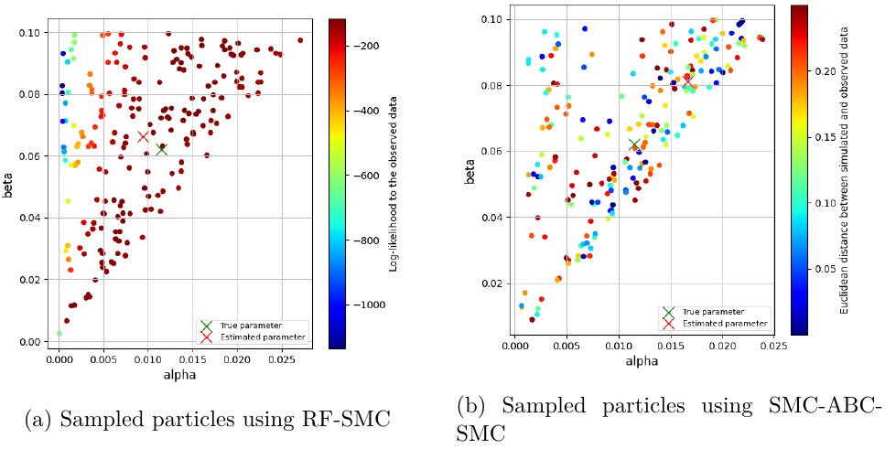
Case study: SIR(15, 1, 0) with low quality data
SMC-ABC-SMC seems to have no trend on likelihood

Slide 30
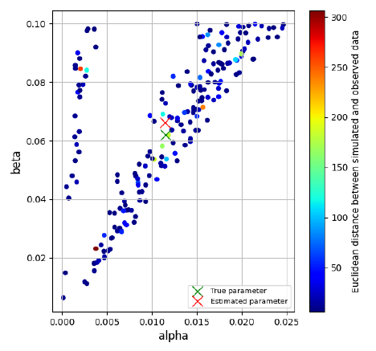
Case study: SIR(15, 1, 0) with low quality data
Apply decreasing factor 0.95 to ABC threshold
After each perturbation kernel, multiply threshold by 0.95
Decreasing distance threshold makes SMC-ABC-SMC shows a comparable accuracy to RF-SMC

Slide 31
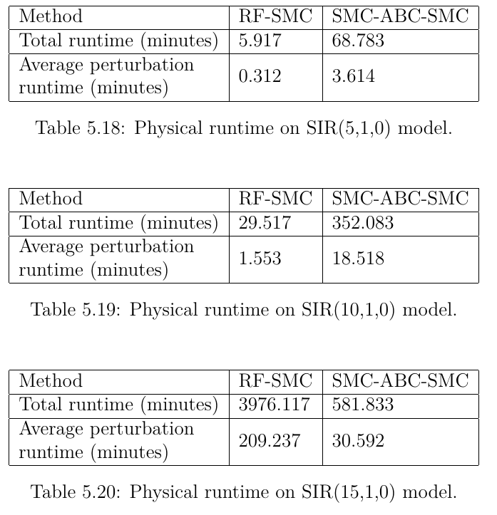
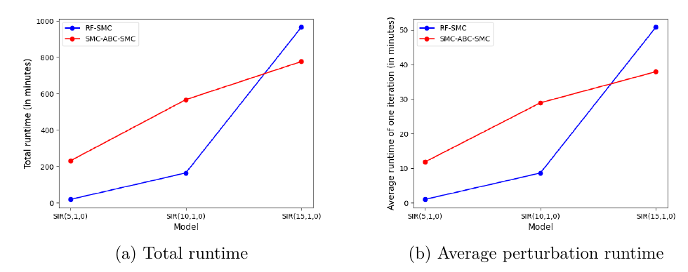
Case study: SIR(15, 1, 0)

Slide 32
Conclusion
In the thesis, we designed, implemented, and tested two data-informed Bayesian parameter synthesis frameworks RF-SMC and SMC-ABC-SMC
In terms of accuracy, SMC-ABC-SMC is comparable to RF-SMC
In terms of scalability, SMC-ABC-SMC shows slower increasing computational cost as the model state space size increases
Base on our findings, we suggest that the simulation-based method SMC-ABC-SMC should be preferred over rational-function-based RF-SMC

Slide 33
Future works
Bayesian Model Checking: reduce computational cost and improve accuracy of statistical model checking with less simulation by employing prior knowledge about the model.
Sampling algorithm: Optimization, hyperparameter selection
Implementation improvement: overcome limitations of Python wrapper StormPy (parallelization, performance) by porting the code base to C++

Slide 34
References
Baier, Christel, and Joost-Pieter Katoen. Principles of model checking. MIT press, 2008.
Katoen, Joost-Pieter. "The probabilistic model checking landscape." Proceedings of the 31st Annual ACM/IEEE Symposium on Logic in Computer Science. 2016.
Junges, Sebastian, et al. "Parameter synthesis for markov models." arXiv preprint arXiv:1903.07993 (2019).
Češka, Milan, et al. "PRISM-PSY: precise GPU-accelerated parameter synthesis for stochastic systems." International Conference on Tools and Algorithms for the Construction and Analysis of Systems. Springer, Berlin, Heidelberg, 2016.
Dehnert, Christian, et al. "Prophesy: A probabilistic parameter synthesis tool." International Conference on Computer Aided Verification. Springer, Cham, 2015.

Slide 35
References
6. Daws, Conrado. "Symbolic and parametric model checking of discrete-time Markov chains." International Colloquium on Theoretical Aspects of Computing. Springer, Berlin, Heidelberg, 2004.
7. Kwiatkowska, Marta, Gethin Norman, and David Parker. "Symmetry reduction for probabilistic model checking." International Conference on Computer Aided Verification. Springer, Berlin, Heidelberg, 2006.
8. Quatmann, Tim, et al. "Parameter synthesis for Markov models: Faster than ever." International Symposium on Automated Technology for Verification and Analysis. Springer, Cham, 2016.

