Slide 1
Basic introduction

Slide 2
Programming
What is programming?
Programming is the process of writing instructions that tell a computer what to do.
It’s how humans create software, apps, and systems.
Example of programming
When you press a button in a phone app → that’s the result of programming.
When your car’s dashboard shows fuel level → that’s programming in embedded systems.
When you play a video game → everything you see is the result of programming.

Slide 3
Programming language
What is programming language
A programming language is a set of instructions and rules that allows humans to communicate with computers and tell them what to do.
Example
If you want a computer to add two numbers and display the result, you can write this command in python:
print( 2 + 3 )

Slide 4
Some famous programming language
Type | Examples | Used For
High-level | Python, C++, Java, C# | Apps, software, AI, games
Web | JavaScript, HTML, CSS | Websites and web apps
System | C, C++, Assembly | Operating systems, hardware control
Embedded | C, C++ | Microcontrollers (like ESP32, Arduino)

Slide 5
C++ programming language
W hat is C++ Programming language?
C++ is a powerful and versatile programming language used to create software, games, operating systems, and even embedded systems.
Why is C++?
Fast and efficient
Object-Oriented
Rich library support
Compatible with C
Low-level control

Slide 6
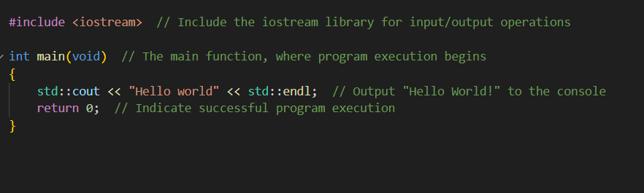
Example of C++

Slide 7
Necessary knowlegde

Slide 8
Programming environment
What is programming environment?
A programming environment is the workspace and toolset you use to develop software
For example, when you open VS Code, write C++ code, and run it using a compiler — that’s your C++ programming environment.
Why you need a programming environment?
A programming environment makes coding faster, easier, and less error-prone

Slide 9
Main components of programming environment
Component | Description | Example
Text Editor / IDE | Where you write and edit code | VS Code, CLion, Visual Studio
Compiler / Interpreter | Translates your code into machine language | g++, clang, Python interpreter
Debugger | Helps find and fix errors | GDB (for C++), LLDB
Terminal / Console | Runs your program or commands | Command Prompt, Bash
Libraries & Dependencies | Extra tools or code your program uses | STL (C++), NumPy (Python)
Version Control | Tracks changes in your code | Git, GitHub

Slide 10
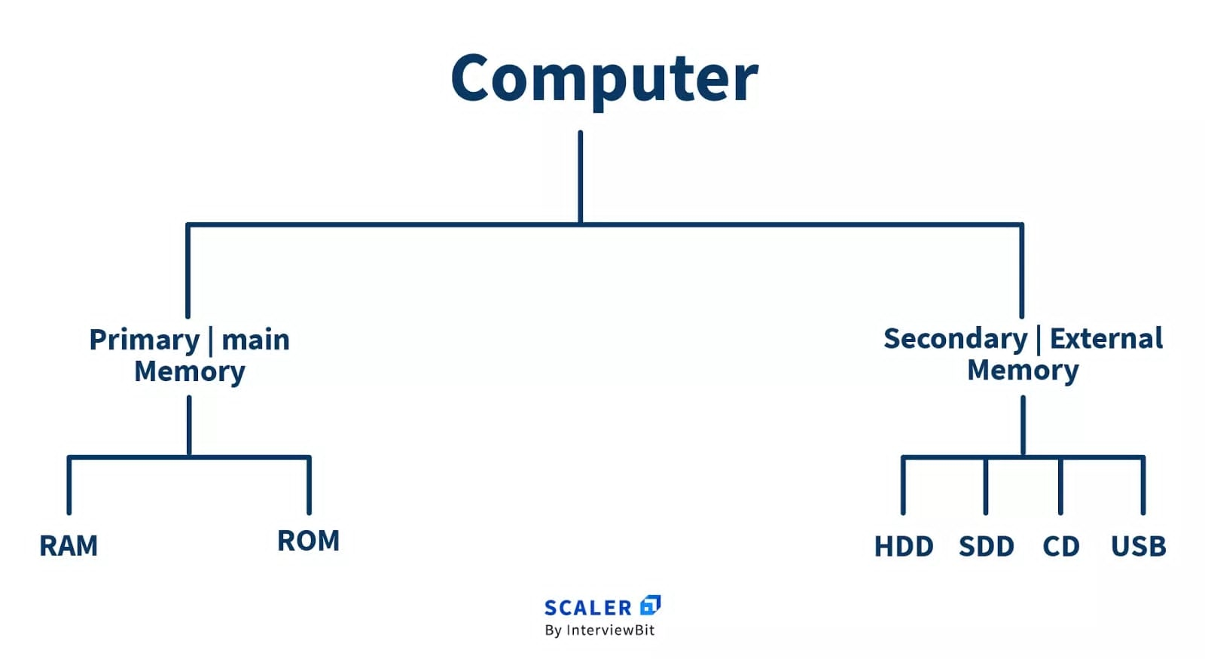
Computer architecture

Slide 11
Windows Subsystem for Linux (WSL)
What is WSL?
WSL is a feature in Windows 10 and Windows 11 that allows you to run a real Linux environment directly inside Windows, without needing a virtual machine or dual-boot setup.
Why you need WSL?
WSL helps developers use Linux tools, environments, and workflows directly inside Windows, without needing to install a separate Linux system.
Why you need Linux tools?
Most servers and systems run on Linux
Linux tools are powerful for automation and system control
Development frameworks are Linux-friendly

