Slide 1
Visual Studio Code introduction
(VS Code)

Slide 2
Overview of VS Code
What is VS Code?
VS Code (Visual Studio Code) is a free, lightweight, open-source code editor made by Microsoft. It supports many programming languages and includes features.
Why you need VS Code?
Smart editing
Built-in debugger
Git integration
Extensions
Lightweight & fast

Slide 3
How to open VS Code
Feature | Open Manually | “code .” Command
Ease of use | Very easy | Needs terminal knowledge
Speed | Slower | Faster
Folder context | Must browse manually | Opens current terminal folder automatically
Integration with Git/build tools | Limited | Excellent
Best for | Beginners, small edits | Developers, automation, workflow efficiency

Slide 4
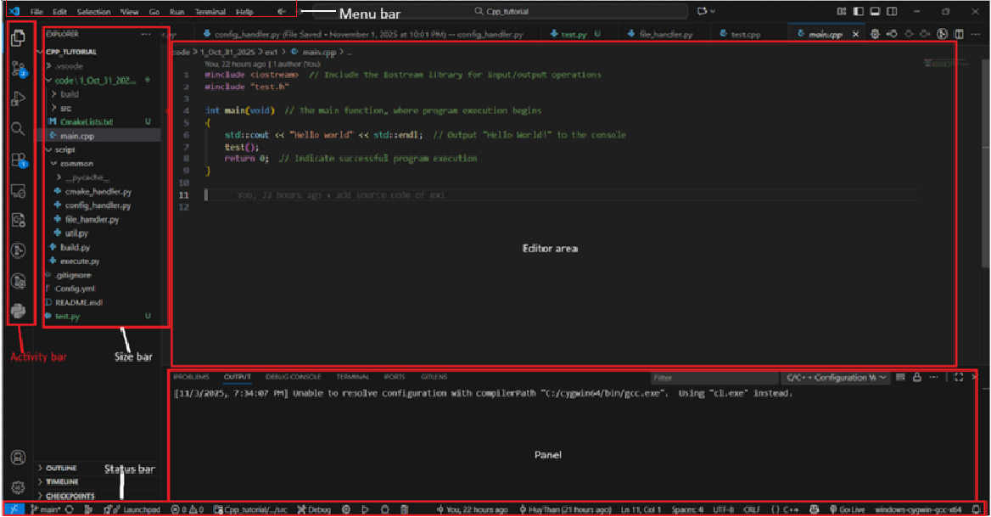
VS Code interface

Slide 5
Menu bar in VS Code
File → open, save, close files/folders
Edit → undo, redo, find, replace
Selection → select all, copy line, etc.
View → toggle panels, zoom, layout
Go → navigate between files, definitions
Run → debug and run code
Terminal → open or manage integrated terminals
Help → access documentation, about info

Slide 6

Activity bar in VS Code
Icon | Name | Description
📁 | Explorer | View and manage your files/folders
🔍 | Search | Find and replace text in your workspace
 | Source Control (Git) | Manage Git changes (commit, push, pull)
🐞 | Run & Debug | Start and manage debugging sessions
🧠 | Extensions | Install or disable VS Code extensions

Slide 7
Panel
Tab | Description
Problems | Shows compiler/linker errors
Output | Displays output from extensions or build tools
Debug Console | Shows print/debug messages while debugging
Terminal | Built-in command line (bash, PowerShell, etc.)

Slide 8
Side bar
Changes depending on which icon you selected in the Activity Bar.
Examples:
If you select Explorer, it shows your folder structure and files.
If you select Source Control, it shows Git changes.
If you select Extensions, it lists installed and available extensions.

Slide 9
Command promt introduction

Slide 10
Command Prompt
What is Command Prompt?
The Command Prompt (often called CMD) is a built-in program in Windows that lets you type text commands to control your computer — instead of clicking with a mouse.
Why you need Command Prompt?
Command Prompt gives us direct control over the operating system using text commands, which can be faster and more powerful than using a graphical interface.
What the Command Promt used for?
Run programs and scripts
Navigate files and folders
Manage system settings
Perform troubleshooting or administrative tasks

Slide 11
Some common commands in WSL
Command | Meaning | Example
wsl | Opens the default Linux distribution inside Windows | wsl → Opens your default Linux shell
ls | List files and folders | ls -l → show details (permissions, size, date)
cd | Change directory | cd /home/huy/Cpp_project
pwd | Print current directory | pwd
mkdir | Create a new folder | mkdir build
rm | Remove files | rm main.cpp
rm -r | Remove a folder and its contents | rm -r build
cp | Copy files | cp main.cpp backup.cpp
mv | Move or rename files | mv main.cpp src/main.cpp

Slide 12
Methods for opening Command Prompt
Method | Steps | Note
1. Search in Start Menu | Press Windows key → type “cmd” → Enter | Easiest and fastest method.
2. Run dialog | Press Win + R → type “cmd” → Enter | Quick way to open it.
3. Power User Menu | Press Win + X → choose “Command Prompt” or “Windows Terminal” | On newer Windows, it may show Windows Terminal instead of Command Prompt.
4. File Explorer address bar | In any folder, click on the address bar → type cmd → Enter | Opens Command Prompt directly in that folder’s path.
5. Task Manager | Press Ctrl + Shift + Esc → File → Run new task → type “cmd” → Enter | You can also check “Create this task with administrative privileges” to open as admin.

Slide 13
Git introduction

Slide 14
Git
What is git?
Git is a version control system — a tool that helps developers track changes in their code over time.
What git does?
Git records every change you make to files (like source code) and lets you easily go back to previous versions if needed.
Why git is useful?
It helps teams work together on the same project without overwriting each other’s work.

Slide 15
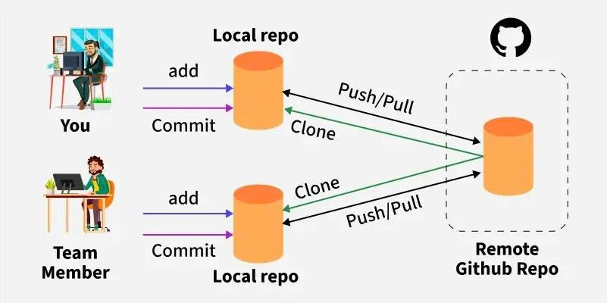
Git repository

Slide 16
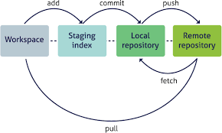
Git lifecycle

Slide 17
Git lifecycle
Stage | Location | Description (Meaning) | Purpose / Use Case
1. Workspace | On your local filesystem | The place where you edit, add, or delete real files in your project. Changes here are not yet tracked by Git until you add them. | Work directly on your source code — the starting point of all changes.
2. Staging Index (Staging Area) | Inside the hidden .git/index | A temporary area where you select which changes will be included in the next commit. | Prepare commits — choose exactly what you want to record in history.
3. Local Repository | Stored locally (inside .git/) | Stores the commit history of your project — each commit is a snapshot of your code. | Keep a complete version history on your computer; you can work offline.
4. Remote Repository | On a remote server | A shared copy of your local repository used to collaborate with others. | Sync, back up, and share your project with teammates.

Slide 18
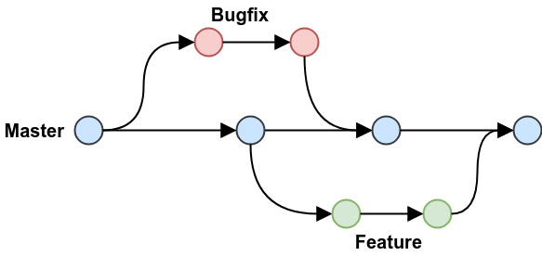
Git branch

Slide 19
Git command
Category | Command | Description
Repository Management | git init | Initialize a new Git repository
 | git clone <url> | Clone a remote repository to your local machine
Staging & Committing | git status | Check the status of files (staged, modified, untracked)
 | git add <file> | Add a specific file to the staging area
 | git add . | Add all changes to the staging area
 | git commit -m "message" | Commit changes with a message
Undoing Changes | git restore <file> | Restore a modified file to last commit
 | git reset --hard <commit-id> | Reset repository to a specific commit (dangerous)
 | git reset --soft <commit-id> | Reset repository to a specific commit , but keeps all changes in the staging area (index).

Slide 20
Git command
Category | Command | Description
Branching | git branch <branch-name> | Create a new branch
 | git checkout <branch-name> | Switch to another branch
 | git checkout -b <branch-name> | Create and switch to a new branch
 | git branch -d <branch-name> | Delete a branch
 | git branch | List all branches
 | git merge <branch-name> | Merge a branch into the current one
Viewing History | git log | Show commit history
 | git diff | Show unstaged changes between working directory and index
Remote Repositories | git remote -v | List remote repositories
 | git remote add origin <url> | Add a remote repository
 | git fetch | Fetch updates from remote (without merging)
 | git pull | Fetch and merge updates from remote
 | git push | Push commits to remote repository

