Slide 1
Structure of a C++ Program

Slide 2
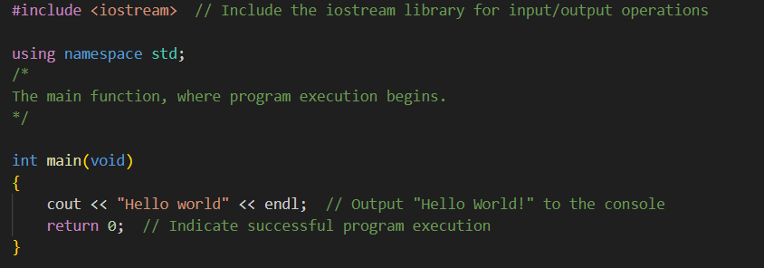
The structure of C++ program
1. Libraries inclusion ( #include <iostream> ): When referring specifically to including libraries
2. Namespace Declaration ( using namespace std; ): A namespace declaration tells the compiler which group of names (like cout, cin, etc.) the program is using.
3. Comment Section ( // or /* ... */ ): Used to describe code and make it easier to understand. They are ignored by the compiler.
4. Main Function Declaration ( int main(void) ): The entry point of every C++ program. Execution starts from here.
5. Function Body (Statements) (cout << "Hello world" << endl; ): Contains the actual instructions to be executed
6. Return Statement (return 0; ): Ends the program and returns 0 to indicate successful execution to the operating system.

Slide 3
Data type and variable in C++

Slide 4

Concept of data type and variable
What is variable?
Variables are containers for storing data values.
What is data type?
A data type (variable type) defines what kind of data a variable can store and how much memory it needs.
What is variable name?
A variable name is a label used in programming to identify and refer to a storage location that holds a value.
Syntax
Example
type variableName = value;

Slide 5
Data type
Data Type | Size (Bytes) | <cstdint> Format | Range of Values | Description | Example
bool | 1 | — | true or false | Stores Boolean logic values. | bool isReady = true;
char | 1 | int8_t / uint8_t | -128 to 127 (signed), 0 to 255 (unsigned) | Stores a single character (ASCII). | char grade = 'A';
short | 2 | int16_t | -32,768 to 32,767 | Short integer type (signed). | short s = -123;
unsigned short | 2 | uint16_t | 0 to 65,535 | Short integer (unsigned). | unsigned short us = 60000;
int | 4 | int32_t | -2,147,483,648 to 2,147,483,647 | Standard integer type. | int count = 100;
unsigned int | 4 | uint32_t | 0 to 4,294,967,295 | Unsigned integer (no negatives). | unsigned int n = 5000;
long long | 8 | int64_t | -9,223,372,036,854,775,808 to 9,223,372,036,854,775,807 | Very large integer. | long long big = 9000000000LL;
unsigned long long | 8 | uint64_t | 0 to 18,446,744,073,709,551,615 | Very large unsigned integer. | unsigned long long ubig = 18000000000ULL;
float | 4 | — | ~±3.4 × 10^38 (9-10 digits precision) | Single-precision floating-point. | float temp = 36.6f;
double | 8 | — | ~±1.7 × 10^308 (17-18 digits precision) | Double-precision floating-point. | double pi = 3.1415926535;

Slide 6
Rule on naming variable
Rule | Description | Example
1. Must start with a letter or underscore (_) | A variable name cannot start with a number. | ✅ age, _count ❌ 1value
2. Can contain letters, digits, and underscores | Only these characters are allowed. | ✅ total_marks, number2
3. No spaces or special characters | You cannot use spaces or symbols like @, #, $, etc. | ❌ total marks, price$
4. Case-sensitive | Uppercase and lowercase letters are treated differently. | Age ≠ age
5. Cannot be a C++ keyword | You cannot use reserved words like int, float, if, etc. | ❌ int;
6. Should be meaningful | Use names that describe the variable’s purpose. | ✅ studentScore
7. No limit on length (but keep it readable) | Long names are allowed but not recommended. | ✅ totalNumberOfStudents

