Slide 1


Project: Certificate Generation System
Group 2 – Batch 97A
www.themegallery.com

Slide 2
Contents
Introduction
Goals
So how do we do it ?
Database analysis
Demo the software
Team members responsibilities

Slide 3
Introduction
Team members introduction
Project theme presentation
Client organization
Requirements
Student management system
Including 10 modules :
Admin
Manage student Module
Manage account Module
Manage course Module
Manage class Module
Manage subject Module
Manage tuition Module
Manage candidate Module
Generation Certificate Module
Student
View info
Update info

Slide 4
Goals
Programming aspect
Build a program easy to maintain & extend
End product aspect
Build a distribute system
Working efficiently
Handy to use, user friendly
Security strengthen
Database backup & restore in case of crash
Easy to deploy & install

Slide 5
So how do we do it ?
Programming aspect
Using OOP techniques: inheritance & polymorphism
Using the same coding standard method, variable have meaningful names, using camel case standard
System configs in property files
End product aspect
Using RMI architecture
Using JDBC

Slide 6

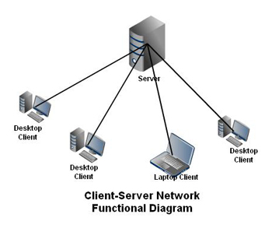
So how do we do it ? (2)
Database
RMI architecture

Slide 7
List of tools use
Eclipse for Java 3.7.2
Lucidchart (https://www.lucidchart.com)
iReport 4.7.1
MySQL Workbench 5.2 CE
GitHub (https://github.com/)
Paint, PhotoShop

Slide 8
Database analysis

Slide 9
Demo the software

Slide 10
Team members responsibility
Huy Thang + Cong Huu:
Application analysis
Database Design
Diagram

Slide 11
Acknowledgement
To instructor
To team members

Slide 12
Thank You !
Group 2 – Batch 97A

