Slide 1

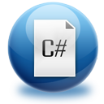

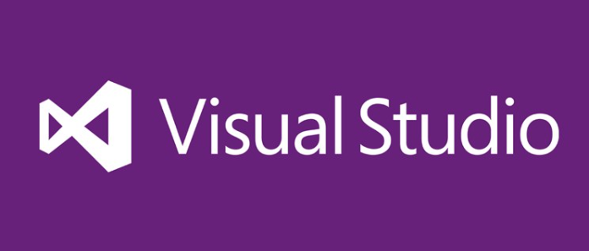


C# Fundamentals
What you need to know

Slide 2
Programming Phases
Define a task/problem
Plan your solution
Find suitable algorithm to solve it
Find suitable data structures to use
Write code
Fix program error (bugs)
Make your customer happy
= Specification
= Design
= Implementation
= Testing & Debugging
= Deployment

Slide 3

Why C# and .NET Framework?
Microsoft is very strong industry leader
.NET Framework and C# are the primary development technologies in the MS ecosystem
The C# language
Modern object-oriented language
Multi-paradigm programming language
Widespread and very popular
Easy to learn
Easy to switch to other languages

Slide 4
Inside .NET Framework
Building blocks of .NET Framework
C#
C++
VB.NET
J#
F#
PHP
Perl
Delphi
…
ASP.NET
Web Forms, MVC, Web API, SignalR
Windows
Forms
WPF / XAML
WinJS / Win8
FCL
WCF and WWF (Communication and Workflow Tier)
ADO.NET, EF, LINQ and XML (Data Tier)
Base Class Library (BCL)
CLR
Common Language Runtime (CLR)
Operating System (OS)

Slide 5

Benefits of Visual Studio
Single tool for:
Writing code in many languages (C#, VB, …)
Using different technologies (Web, WPF, …)
For different platforms (.NET CF, Silverlight, …)
Full integration of most development activities (coding, compiling, testing, debugging, deployment, version control, ...)
Very easy to use!

Slide 6
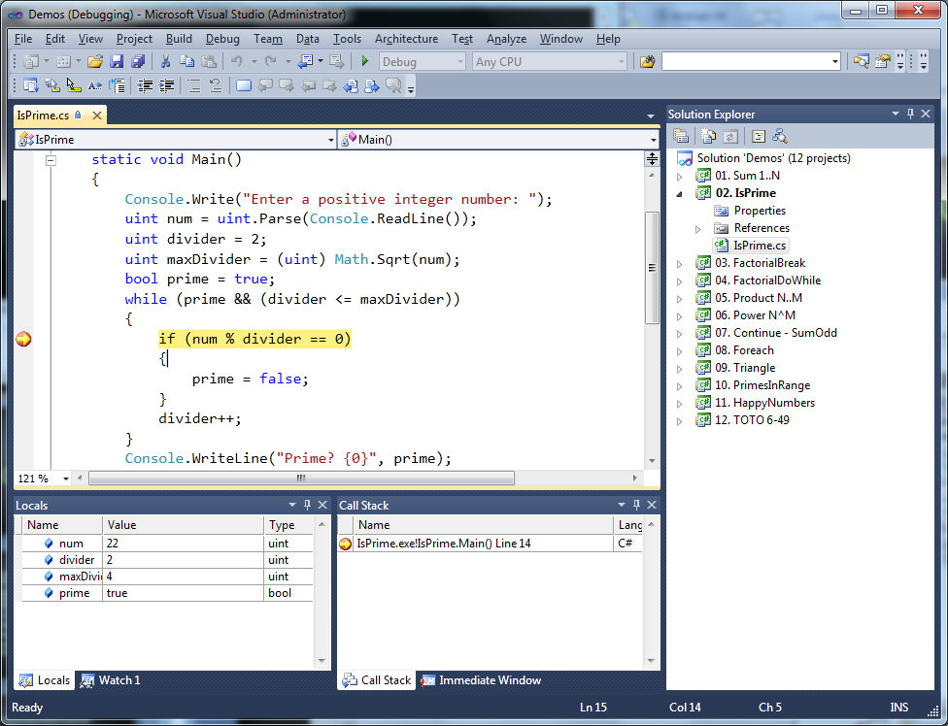
Visual Studio – Example

Slide 7
How Computing Works?
Computers are machines that process data
Data is stored in the computer memory in variables
Variables have name, data type and value
Example of variable definition and assignment in C#
Variable name
Data type
int count = 5;
Variable value

Slide 8
Nullable Types
Nullable types are instances of the System.Nullable struct
Wrapper over the primitive types
E.g. int?, double?, etc.
Nullabe type can represent the normal range of values for its underlying value type, plus an additional null value
Useful when dealing with Databases or other structures that have default value null

Slide 9
Dynamic Types
Dynamic types in C# (keyword dynamic)
Can hold anything (string, number, object, function / method reference)
Operations evaluated at runtime
Behave like types in JavaScript / PHP
dynamic a = 5;
dynamic b = 3;
Console.WriteLine(a + b); // 8 (sum of integers)
a = "5";
b = 3;
Console.WriteLine(a + b); // 53 (string concatenation)

Slide 10
Categories of Operators in C#
Category | Operators
Arithmetic | + - * / % ++ --
Logical | && || ^ !
Binary | & | ^ ~ << >>
Comparison | == != < > <= >=
Assignment | = += -= *= /= %= &= |= ^= <<= >>=
String concatenation | +
Type conversion | is as typeof
Other | . [] () ?: new

Slide 11
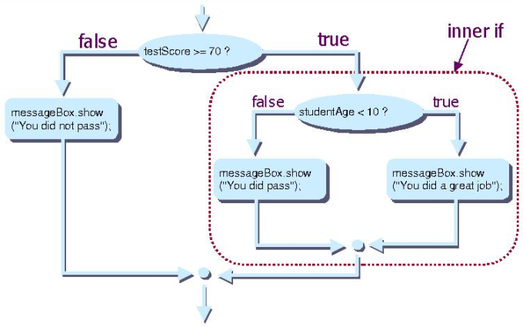
Conditional statements
If-else statement
Note: else is not required
Conditions can be nested
else can be else if
if (expression)
{
statement1;
}
else
{
statement2;
}

Slide 12
Simple for Loop – Example
A simple for-loop to print the numbers 0…9:
for (int number = 0; number < 10; number++)
{
Console.Write(number + " ");
}
A simple for-loop to calculate n!:
decimal factorial = 1;
for (int i = 1; i <= n; i++)
{
factorial *= i;
}

Slide 13

What are Arrays?
An array is a sequence of elements
All elements are of the same type
The order of the elements is fixed
Has fixed size (Array.Length)
Element of an array
0 1 2 3 4
Element index
Array of 5 elements
… | … | … | … | …

Slide 14
Processing Arrays: for Statement
Use for loop to process an array when
Need to keep track of the index
Processing is not strictly sequential from the first to the last element
In the loop body use the element at the loop index (array[index]):
for (int index = 0; index < array.Length; index++)
{
squares[index] = array[index] * array[index];
}

Slide 15

Processing Arrays: foreach
How foreach loop works?
type – the type of the element
value – local name of variable
array – processing array
Used when no indexing is needed
All elements are accessed one by one
Elements can not be modified (read only)
foreach (type value in array)

Slide 16
Lists (Resizable Arrays)
List<T> – array that can resize dynamically
When adding or removing elements
Also have indexers [] (like arrays)
T is the type that the list will hold
E.g. List<int> will hold integers
List<object> will hold objects
Basic methods and properties
Add(T element) – adds new element to the end
Remove(element) – removes the element
Count – returns the current size of the list

Slide 17
List Example
List<int> intList = new List<int>();
for( int i=0; i<5; i++)
{
intList.Add(i);
}
Is the same as:
int[] intArray = new int[5];
for( int i=0; i<5; i++)
{
intArray[i] = i;
}
The main difference
When using lists we don't have to know the exact number of elements

Slide 18

What is a Method?
A method is a kind of building block that solves a small problem
A piece of code that has a name and can be called from the other code
Can take parameters and return a value
Methods allow programmers to construct large programs from simple pieces
Methods are also known as functions, procedures, and subroutines

Slide 19
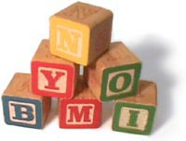
Why to Use Methods?
More manageable programming
Split large problems into small pieces
Better organization of the program
Improve code readability
Improve code understandability
Avoiding repeating code
Improve code maintainability
Code reusability
Using existing methods several times

Slide 20
Overloading Methods
What means "to overload a method name"?
Use the same method name for multiple methods with different signature (parameters)
static void Print(string text)
{
Console.WriteLine(text);
}
static void Print(int number)
{
Console.WriteLine(number);
}
static void Print(string text, int number)
{
Console.WriteLine(text + ' ' + number);
}

Slide 21
Variable Number of Parameters
A method in C# can take variable number of parameters by specifying the params keyword
static long CalcSum(params int[] elements)
{
long sum = 0;
foreach (int element in elements)
sum += element;
return sum;
}
static void Main()
{
Console.WriteLine(CalcSum(2, 5));
Console.WriteLine(CalcSum(4, 0, -2, 12));
Console.WriteLine(CalcSum());
}

Slide 22
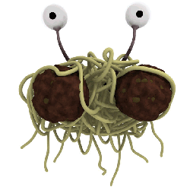
What Is String?
Strings are sequences of characters
Each character is a Unicode symbol
Represented by the string data type in C# (System.String)
Example:
string s = "Hello, C#";
s
H | e | l | l | o | , |  | C | #

Slide 23
The System.String Class
Strings are represented by System.String objects in .NET Framework
String objects contain an immutable (read-only) sequence of characters
Strings use Unicode to support multiple languages and alphabets
Strings are stored in the dynamic memory (managed heap)
System.String is reference type

Slide 24

The System.String Class (2)
String objects are like arrays of characters (char[])
Have fixed length (String.Length)
Elements can be accessed directly by index
The index is in the range [0...Length-1]
string s = "Hello!";
int len = s.Length; // len = 6 char ch = s[1]; // ch = 'e'
index =
0 | 1 | 2 | 3 | 4 | 5
H | e | l | l | o | !
s[index] =

Slide 25

Handling Exceptions
In C# the exceptions can be handled by the try-catch-finally construction
catch blocks can be used multiple times to process different exception types
try
{
// Do some work that can raise an exception
}
catch (SomeException)
{
// Handle the caught exception
}

Slide 26
The System.Exception Class
Exceptions in .NET are objects
The System.Exception class is base for all exceptions in CLR
Contains information for the cause of the error / unusual situation
Message – text description of the exception
StackTrace – the snapshot of the stack at the moment of exception throwing
InnerException – exception caused the current exception (if any)

Slide 27
Exception Hierarchy
Exceptions in .NET Framework are organized in a hierarchy

Slide 28
Using throw Keyword
Throwing an exception with an error message:
Exceptions can accept message and cause:
Note: if the original exception is not passed the initial cause of the exception is lost
throw new ArgumentException("Invalid amount!");
try
{
Int32.Parse(str);
}
catch (FormatException fe)
{
throw new ArgumentException("Invalid number", fe);
}

Slide 29
Classes in OOP
Classes model real-world objects and define
Attributes (state, properties, fields)
Behavior (methods, operations)
Classes describe the structure of objects
Objects describe particular instance of a class
Properties hold information about the modeled object relevant to the problem
Operations implement object behavior

Slide 30
Classes in C#
Classes in C# can have members:
Fields, constants, methods, properties, indexers, events, operators, constructors, destructors, …
Inner types (inner classes, structures, interfaces, delegates, ...)
Members can have access modifiers (scope)
public, private, protected, internal
Members can be
static (common) or specific for a given object

Slide 31
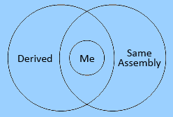
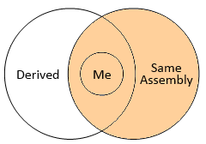
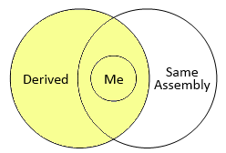
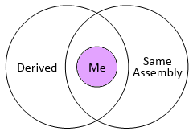
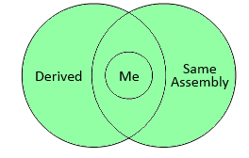
Access Modifiers Explained
public
internal
protected
private
protected internal

Slide 32

Chaining Constructors Calls
Reusing constructors (chaining)
public class Point
{
private int xCoord;
private int yCoord;
public Point() : this(0, 0) // Reuse the constructor
{
}
public Point(int xCoord, int yCoord)
{
this.xCoord = xCoord;
this.yCoord = yCoord;
}
// More code …
}

Slide 33
Enumerations in C#
Enumerations are types that hold a value from a fixed set of named constants
Declared by enum keyword in C#
public enum DayOfWeek
{
Mon, Tue, Wed, Thu, Fri, Sat, Sun
}
class EnumExample
{
static void Main()
{
DayOfWeek day = DayOfWeek.Wed;
Console.WriteLine(day); // Wed
}
}

Slide 34
C# Structures
What is a structure in C#?
A value data type (behaves like a primitive type)
Examples of structures: int, double, DateTime
Classes are reference types
Declared by the keyword struct
Structures, like classes, have properties, methods, fields, constructors, events, …
Always have a parameterless constructor
It cannot be removed
Mostly used to store data (bunch of fields)

Slide 35
What are Generics?
Generics allow defining parameterized classes that process data of unknown (generic) type
The class can be instantiated (specialized) with different particular types
Example: List<T> → List<int> / List<string> / List<Student>
Generics are also known as "parameterized types" or "template types"
Similar to the templates in C++
Similar to the generics in Java

Slide 36
Namespaces
Namespaces logically group type definitions
May contain classes, structures, interfaces, enumerators and other types and namespaces
Can not contain methods and data directly
Can be allocated in one or several files
Namespaces in .NET are similar to namespaces in C++ and packages in Java
Allows definition of types with duplicated names
E.g. a type named Button is found in Windows Forms, in WPF and in ASP.NET Web Forms

Slide 37
Overloading Operators
In C# some operators can be overloaded (redefined) by developers
The priority of operators can not be changed
Not all operators can be overloaded
Overloading an operator in C#
Looks like a static method with 2 operands:
public static Matrix operator *(Matrix m1, Matrix m2)
{
return new m1.Multiply(m2);
}

Slide 38
What are Attributes?
.NET attributes are:
Declarative tags for attaching descriptive information in the declarations in the code
Saved in the assembly at compile time
Objects derived from System.Attribute
Can be accessed at runtime (through reflection) and manipulated by many tools
Developers can define custom attributes

Slide 39
Fundamental Principles of OOP
Inheritance
Inherit members from parent class
Abstraction
Define and execute abstract actions
Encapsulation
Hide the internals of a class
Polymorphism
Access a class through its parent interface
39

Slide 40


How to Define Inheritance?
Specify the name of the base class after the name of the derived (with colon)
Use the keyword base to invoke the parent constructor
public class Shape
{ … }
public class Circle : Shape
{ … }
public Circle (int x, int y) : base(x)
{ … }

Slide 41
Inheritance: Important Aspects
Structures cannot be inherited
In C# there is no multiple inheritance
Only multiple interfaces can be implemented
Static members are also inherited
Constructors are not inherited
Inheritance is transitive relation
If C is derived from B, and B is derived from A, then C inherits A as well

Slide 42
Inheritance: Important Features
When a derived class extends its base class
It can freely add new members
Cannot remove derived ones
Declaring new members with the same name or signature hides the inherited ones
A class can declare virtual methods and properties
Derived classes can override the implementation of these members
E.g. Object.ToString() is virtual method

Slide 43

Abstraction in .NET
In .NET object-oriented programming abstraction is achieved in several ways:
Abstract classes
Interfaces
Inheritance
Control
+click()
ButtonBase
+Color : long
Button
RadioButton
CheckBox
43

Slide 44
Interfaces vs. Abstract Classes
C# interfaces are like abstract classes, but in contrast interfaces:
Can not contain methods with implementation
All interface methods are abstract
Members do not have scope modifiers
Their scope is assumed public
But this is not specified explicitly
Can not define fields, constants, inner types and constructors

Slide 45
Encapsulation in .NET
Fields are always declared private
Accessed through properties in read-only or read-write mode
Constructors are almost always declared public
Interface methods are always public
Not explicitly declared with public
Non-interface methods are declared private / protected
45

Slide 46
Polymorphism
Polymorphism = ability to take more than one form (objects have more than one type)
A class can be used through its parent interface
A child class may override some of the behaviors of the parent class
Polymorphism allows abstract operations to be defined and invoked
Abstract operations are defined in the base class' interface and implemented in the child classes
Declared as abstract or virtual
46

Slide 47
Virtual Methods
Virtual method is
Defined in a base class and can be changed (overridden) in the descendant classes
Can be called through the base class' interface
Virtual methods are declared through the keyword virtual
Methods declared as virtual in a base class can be overridden using the keyword override
public virtual void Draw() { … }
public override void Draw() { … }

Slide 48
Cohesion
Cohesion describes
How closely the routines in a class or the code in a routine support a central purpose
Cohesion must be strong
Well-defined abstractions keep cohesion strong
Classes must contain strongly related functionality and aim for single purpose
Cohesion is a powerful tool for managing complexity

Slide 49

Strong Cohesion
Strong cohesion (good cohesion) example
Class Math that has methods:
Sin(), Cos(), Asin()
Sqrt(), Pow(), Exp()
Math.PI, Math.E
double sideA = 40, sideB = 69;
double angleAB = Math.PI / 3;
double sideC =
Math.Pow(sideA, 2) + Math.Pow(sideB, 2)
- 2 * sideA * sideB * Math.Cos(angleAB);
double sidesSqrtSum = Math.Sqrt(sideA) + Math.Sqrt(sideB) + Math.Sqrt(sideC);

Slide 50
Coupling
Coupling describes how tightly a class or routine is related to other classes or routines
Coupling must be kept loose
Modules must depend little on each other
Or be entirely independent (loosely coupled)
All classes / routines must have small, direct, visible, and flexible relationships to other classes / routines
One module must be easily used by other modules

Slide 51
Loose Coupling – Example
class Report
{
public bool LoadFromFile(string fileName) {…}
public bool SaveToFile(string fileName) {…}
}
class Printer
{
public static int Print(Report report) {…}
}
class Program
{
static void Main()
{
Report myReport = new Report();
myReport.LoadFromFile("C:\\DailyReport.rep");
Printer.Print(myReport);
}
}

