Slide 1


High-Quality Classes and Class Hierarchies
Best Practices in the Object-Oriented Design

Slide 2
Why We Need Methods?
Methods (functions, routines) are important in software development
Reduce complexity
Divide and conquer: complex problems are split into composition of several simple
Improve code readability
Small methods with good method names make the code self-documenting
Avoid duplicating code
Duplicating code is hard to maintain

Slide 3
Why We Need Methods? (2)
Methods simplify software development
Hide implementation details
Complex logic is encapsulated and hidden behind a simple interface
Algorithms and data structures are hidden and can be transparently replaced later
Increase the level of abstraction
Methods address the business problem, not the technical implementation:
Bank.accounts[customer].deposit(500);

Slide 4
Symptoms of Wrong Methods
Method that does something different than its name is wrong for at least one of these reasons:
The method sometimes returns incorrect result → bug
The method returns incorrect output when its input is incorrect or unusual → low quality
Could be acceptable for private methods only
The method does too many things → bad cohesion
The method has side effects → spaghetti code
Method returns strange value when an error condition happens → it should indicate the error

Slide 5
How Much Parameters Methods Should Have?
Limit the number of parameters to 7 (+/-2)
7 is a "magic" number in psychology
Human brain cannot process more than 7 (+/-2) things in the same time
If the parameters need to be too many, reconsider the method's intent
Does it have a clear intent?
Consider extracting few of the parameters in a new class

Slide 6
Methods Length
How long should a method be?
There is no specific restriction
Avoid methods longer than one screen (30 lines)
Long methods are not always bad
Be sure you have a good reason for their length
Cohesion and coupling are more important than the method length!
Long methods often contain portions that could be extracted as separate methods with good name and clear intent → check this!

Slide 7

Basic Principles
Cohesion, Coupling, Inheritance and Polymorphism

Slide 8
Strong Cohesion
Methods should have strong cohesion
Should address single task and address it well
Should have clear intent
Methods that address several tasks in the same time are hard to be named
Strong cohesion is used in engineering
In computer hardware any PC component solves a single task
E.g. hard disk performs a single task – storage

Slide 9
Cohesion Problems in Real Code
Say, we have an application consisting of two layers:
Do not use a method for both top-down and bottom-up updates!
Both updates are essentially different, e.g. a RemoveCustomer() method in the DataLayer
Presentation Layer
Data Layer

Slide 10
Loose Coupling
What is loose coupling?
Minimal dependences of the method on the other parts of the source code
Minimal dependences on the class members or external classes and their members
No side effects
If the coupling is loose, we can easily reuse a method or group of methods in a new project
Tight coupling → spaghetti code

Slide 11
Loose Coupling and OOP
Reducing coupling with OOP techniques
Abstraction
Define a public interface and hide the implementation details
Encapsulation
Make methods and fields private unless they are definitely needed
Define new members as private
Increase visibility as soon as this is needed

Slide 12
Inheritance in C# and JS
In C# all class members are inherited
Fields, methods, properties, etc.
Structures cannot be inherited, only classes
No multiple inheritance is supported
Only multiple interface implementations
In JS inheritance is supported indirectly
Several ways to implement inheritance
Multiple inheritance is not supported
There are no interfaces (JS is typeless language)

Slide 13
Polymorphism in C# and JS
In C# polymorphism is implemented through:
Virtual methods (virtual)
Abstract methods (abstract)
Interfaces methods (interface)
In C# override overrides a virtual method
In JavaScript all methods are virtual
The child class can just "override" any method from any object
There are no interfaces (JS is typeless language)

Slide 14
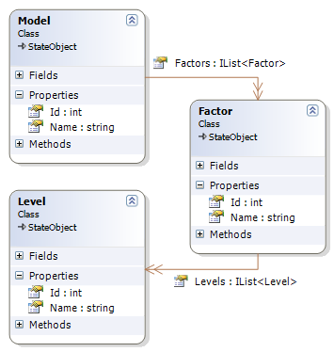
High-Quality Classes
How to Design High-Quality Classes? Abstraction, Cohesion and Coupling

Slide 15

Good Abstraction – Example
public class Font
{
public string Name { get; set; }
public float SizeInPoints { get; set; }
public FontStyle Style { get; set; }
public Font(
string name, float sizeInPoints, FontStyle style)
{
this.Name = name;
this.SizeInPoints = sizeInPoints;
this.Style = style;
}
public void DrawString(DrawingSurface surface,
string str, int x, int y) { … }
public Size MeasureString(string str) { … }
}

Slide 16

Bad Abstraction – Example
public class Program
{
public string title;
public int size;
public Color color;
public void InitializeCommandStack();
public void PushCommand(Command command);
public Command PopCommand();
public void ShutdownCommandStack();
public void InitializeReportFormatting();
public void FormatReport(Report report);
public void PrintReport(Report report);
public void InitializeGlobalData();
public void ShutdownGlobalData();
}
Does this class really represents a "program"? Is this name good?
Does this class really have a single purpose?

Slide 17
Encapsulation
Minimize visibility of classes and members
In C# start from private and move to internal, protected and public if required
Classes should hide their implementation details
A principle called encapsulation in OOP
Anything which is not part of the class interface should be declared private
Classes with good encapsulated classes are: less complex, easier to maintain, more loosely coupled
Classes should keep their state clean → throw an exception if invalid data is being assigned

Slide 18
Class Methods and Data
Keep the number of methods in a class as small as possible → reduce complexity
Minimize direct methods calls to other classes
Minimize indirect methods calls to other classes
Less external method calls == less coupling
Also known as "fan-out"
Minimize the extent to which a class collaborates with other classes
Reduce the coupling between classes

Slide 19
Class Constructors
Initialize all member data in all constructors, if possible
Uninitialized data is error prone
Partially initialized data is even more evil
Incorrect example: assign FirstName in class Person but leave LastName empty
Initialize data members in the same order in which they are declared
Prefer deep copies to shallow copies (ICloneable should make deep copy)

Slide 20
Use Design Patterns
Use private constructor to prohibit direct class instantiation
Use design patterns for common design situations
Creational patterns like Singleton, Factory Method, Abstract Factory
Structural patterns like Adapter, Bridge, Composite, Decorator, Façade
Behavioral patterns like Command, Iterator, Observer, Strategy, Template Method

Slide 21
Namespaces
Group related classes together in namespaces
Follow consistent naming convention
namespace Utils {
class MathUtils { … }
class StringUtils { … }
}
namespace DataAccessLayer {
class GenericDAO<Key, Entity> { … }
class EmployeeDAO<int, Employee> { … }
class AddressDAO<int, Address> { … }
}

Slide 22

Exceptions
Best Practices for Exception Handling

Slide 23
Exceptions
Exceptions provide a way to inform the caller about an error or exceptional events
Can be caught and processed by the callers
Methods can throw exceptions:
public void ReadInput(string input)
{
if (input == null)
{
throw new ArgumentNullException("input"); }
…
}

Slide 24
Exceptions (2)
Use try-catch statement to handle exceptions:
You can use multiple catch blocks to specify handlers for different exceptions
Not handled exceptions propagate to the caller
void PlayNextTurn()
{
try
{
readInput(input);
…
}
catch (ArgumentException e)
{
Console.WriteLine("Invalid argument!");
}
}
Exception thrown here
The code here will not be executed

Slide 25
Exceptions (3)
Use finally block to execute code even if exception occurs (not supported in C++):
Perfect place to perform cleanup for any resources allocated in the try block
void PlayNextTurn()
{
try
{
… }
finally
{
Console.WriteLine("Hello from finally!");
}
}
Exceptions can be eventually thrown here
The code here is always executed

Slide 26

Computer Performance

Slide 27
Good Computer Performance
Good computer performance:
Short response time for a given piece of work
High throughput (rate of processing work)
Low utilization of computing resource(s)
High availability of the computing system or application
Fast (or highly compact) data compression and decompression
High bandwidth / short data transmission time

Slide 28
Is Performance Really a Priority?
Performance improvements can reduce readability and complexity
“Premature optimization is the root of all evil.”
Donald Knuth
“More computing sins are committed in the name of efficiency (without necessarily achieving it) than for any other single reason – including blind stupidity.”
W. A. Wulf

Slide 29
How to Improve Performance?
Software requirements
Software cost vs. performance
System design
Performance-oriented architecture
Resource-reducing goals for individual subsystems, features, and classes
Class and method design
Data structures and algorithms

Slide 30
How to Improve Performance? (2)
External Interactions
Operating system
External devices – storage, network, Internet
Code Compilation / Code Execution
Compiler optimizations
Hardware
Very often the cheapest way
Code Tuning

Slide 31
Introduction to Code Tuning
What is code tuning / performance tuning?
Modifying the code to make it run more efficiently (faster)
Not the most effective / cheapest way to improve performance
Often the code quality is decreased to increase the performance
The 80 / 20 principle
20% of a program’s methods consume 80% of its execution time

Slide 32

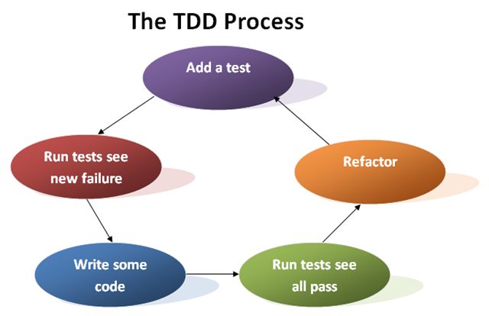
Code and Test vs. Test Driven Development

Slide 33
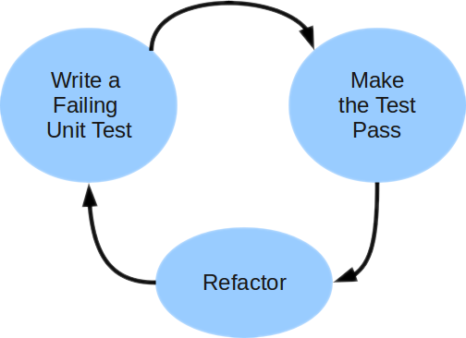
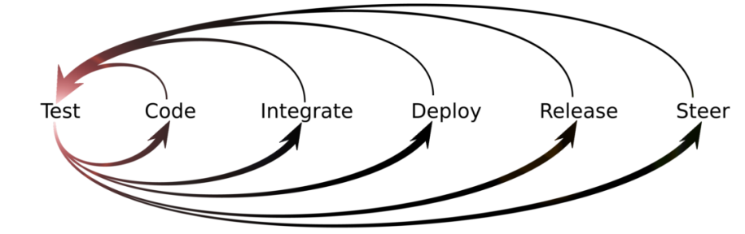
Unit Testing Approaches
"Code First" (code and test) approach
Classical approach
"Test First" approach
Test-driven development (TDD)

Slide 34
Test-Driven Development (TDD)
Create a test list
Pick а test
Write test
Compile and fail
Write enough code to compile
Run test and fail
Write code to pass test
Time flow
Remove duplication

Slide 35
Code Refactoring
What is refactoring of the source code?
Improving the design and quality of existing source code without changing its behavior
Step by step process that turns the bad code into good code (if possible)
Why we need refactoring?
Code constantly changes and its quality constantly degrades (unless refactored)
Requirements often change and code needs to be changed to follow them

Slide 36

When to Refactor?
Bad smells in the code indicate need of refactoring
Refactor:
To make adding a new function easier
As part of the process of fixing bugs
When reviewing someone else’s code
Have technical debt (or any problematic code)
When doing test-driven development
Unit tests guarantee that refactoring does not change the behavior
If there are no unit tests, write them

Slide 37
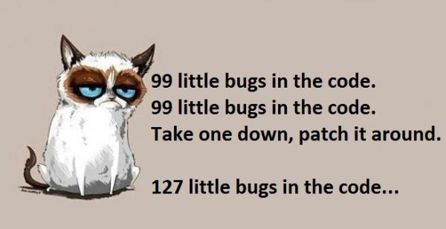
Good Code Main Principles
Avoid duplication (DRY)
Simplicity – Keep it simple stupid (KISS)
Make it expressive (self-documenting, comments)
Reduce overall code (YAGNI)
More code = more bugs
Avoid premature optimization
Appropriate level of abstraction
Hide implementation details
Boy scout rule
Leave your code better than you found it

Slide 38
Good Code Main Principles (2)
Don’t make me think
Code should surprise the reader as little as possible (principle of least astonishment)
Consistency!
Write code for the maintainer
Unit test
SOLID
Single responsibility principle
Open/closed principle
Liskov substitution principle
Interface segregation principle
Dependency inversion principle

Slide 39
Refactoring Process
Save the code you start with
Check-in or backup the current code
Make sure you have tests to assure the behavior after the code is refactored
Unit tests / characterization tests
Do refactorings one at a time
Keep refactorings small
Don’t underestimate small changes
Run the tests and they should pass / else revert
Check-in

Slide 40
Refactoring Tips
Keep refactorings small
One at a time
Make a checklist
Make a "later"/TODO list
Check-in/commit frequently
Add tests cases
Review the results
Pair programming
Use tools (Visual Studio + Add-ins)

Slide 41

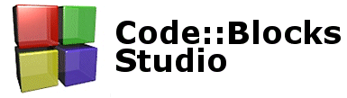

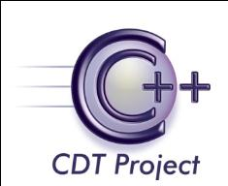



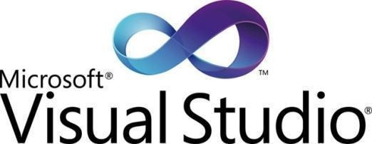


Integrated Development Environments (IDEs)
Visual Studio, Eclipse, IntelliJ IDEA, Netbeans, JDeveloper, Code::Blocks, Bloodshed Dev-C++

Slide 42
Visual Studio
Visual Studio is official .NET development tool from Microsoft
Multiple languages: C#, VB.NET, F#, C++, …
Multiple technologies and platforms: ASP.NET, WPF, WiForms, Silverlight, WWF, WCF, iOS, Windows Mobile, Android, NodeJS, Xamarin…
Very powerful and feature rich
Write, compile, model, design GUI, forms, data, build, execute, debug, test, deploy, refactor, …
Commercial product, has free editions

Slide 43


Other IDEs
JavaScript IDEs
WebStorm, Sublime Text, VS, Atom, Notepad++
Java IDEs
Eclipse, Android Studio, NetBeans, IntelliJ IDEA, Jdeveloper
C++ IDEs
Code::Blocks, Bloodshed Dev-C++, VS
PHP IDEs – PHPStorm, Zend Studio, phpDesigner
Ruby – RubyMine
Objective C (iOS) – Xcode, AppCode

Slide 44

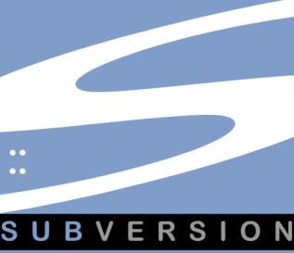



Source Control Systems
Subversion (SVN), Team Foundation Server (TFS), CVS, Git, Mercurial, Perforce, …

Slide 45
What is Source Control System?
Source control systems (version control systems, source control repositories)
Hold the source code and project assets during the development process
Allow simultaneous changes in the source code and conflict resolution
Keep version history of the project assets
Some of the most popular source control systems: Git, SVN, TFS, CVS

Slide 46
Git
Distributed revision control system
Support for distributed, non-linear workflows
Very efficient and secure
Initially designed and developed by Linus Torvalds for Linux kernel development in 2005
Become one of the most widely adopted version control system for software development
Independent full-fledged working directories
Used by GitHub
Allows variety of workflows to be used

Slide 47


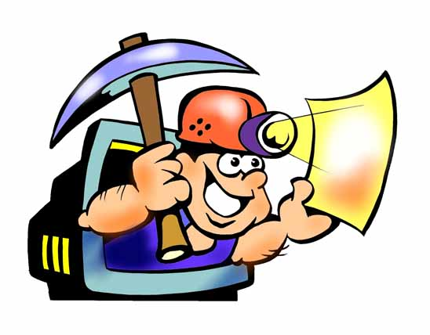


Logging Tools
Log4J, Log4Net

Slide 48
Logging
Logging is chronological and systematic record of data processing events in a program
E.g. the Windows Event Log
Logs can be saved to a persistent medium to be studied at a later time
Use logging in the development phase:
Logging can help you debug the code
Use logging in the production environment:
Helps you troubleshoot problems

Slide 49
Log4J / Log4Net
Log4J / Log4Net are a popular logging frameworks for Java / .NET
Designed to be reliable, fast and extensible
Simple to understand and to use API
Allows the developer to control which log statements are output with arbitrary granularity
Fully configurable at runtime using external configuration files

Slide 50
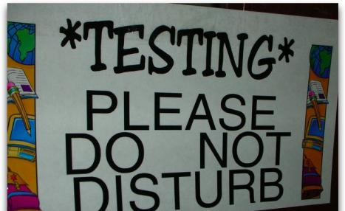



Unit Testing Tools
JUnit, NUnit, CppUnit, TestNG, JsUnit, …

Slide 51
Unit Testing Frameworks / Tools
Unit testing frameworks
Simplify design, implementation and execution of unit tests
Popular unit testing frameworks
JUnit, TestNG – classical unit testing frameworks for Java
Visual Studio Team Test (VSTT), NUnit, MbUnit – for .NET development
cppUnit, UnitTest++ – for C++ developers
jsUnit – for JavaScript

Slide 52
Code Coverage & Mocking Tools
Code coverage tools
Code coverage tools check what portion of the source code is covered by the unit tests
CodeCover for Eclipse – for Java
Visual Studio Team Suite – for C#
CoverageMeter – for C++
Mocking tools
Allow testing functionality that is still not implemented9, e.g. through its interface
Moq, TypeMock, Rhino Mock, JustMock

Slide 53
Test Automation
Test automation
Replaces manual tests (performed by people) with automated tests (performed by script)
Automatically run test scenarios and compare the actual outcomes to predicted outcomes
Automated testing tools
Record and replay test scenarios
Automated testing frameworks
Allow programmatically simulate user activity

Slide 54


Bug Tracking / Issue Tracking Systems
TRAC, Bugzilla, JIRA, TFS, SourceForge, CodePlex, Project Locker, GitHub, TeamPulse

Slide 55
Bug Tracking Systems
Bug tracking / issue tracking systems
Track bugs / issues related to software development, called tickets
Tickets consist of:
Category: bug / feature request / task
State: new → assigned → fixed → closed
Priority: critical / high / low / etc.
Owner / responsible person
Summary, description, attachments

Slide 56
SCM and ALM Systems
Software Configuration Management (SCM systems (e.g. Rational ClearCase, StarTeam)
Change management for requirements, documents, source code, etc.
Tools, policies, workflow, etc.
Application Lifecycle Management (ALM) systems (e.g. VSTS + TFS, StarTeam, Polarion)
Covers the entire development process
Requirements, planning, project management, architecture, build, QA, test, integration, etc.

